Slide 1

Exploratory Data Analysis
Name : Afshan Hashmi Location: Saudi Arabia Team: Data and Analytics Date: 15-March-2021

Slide 2

Agenda
Executive Summary
Problem Statement
Approach
EDA
EDA Summary
Recommendations

Slide 3
Executive summary–G2M(cab industry) case study
XYZ is a private equity firm in US. Due to remarkable growth in the Cab Industry in last few years and multiple key players in the market, it is planning for an investment in Cab industry.
Objective : Provide actionable insights to help XYZ firm in identifying the right company for making investment.
The analysis has been divided into four parts:
Data Understanding
Analysing profit and features affecting it.
Finding the most profitable Cab company
Recommendations for investment

Slide 4

Data Exploration
20 Features( including 5 derived features)
Timeframe of the data: 2016-01-31 to 2018-12-31
Total data points :359392
Assumptions:
Outliers are present in Price_Charged feature but due to
unavailability of trip duration details ,we are not treating this as outlier.
Profit of rides are calculated keeping other factors constant and only
Price_Charged and Cost_of_Trip features used to calculate profit.
Age has been divided into 4 age group
Income has been divided into 6 level of income
Cab_Data.csv
Customer_ID.csv
Transaction_ID.csv
City.csv
cab data
US Holiday
Final Data

Slide 5
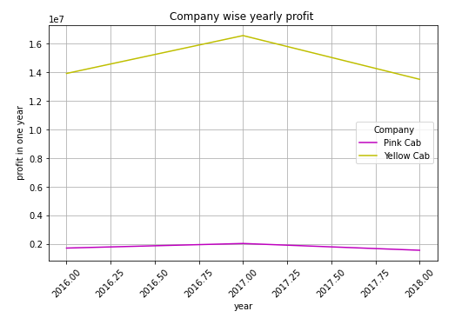
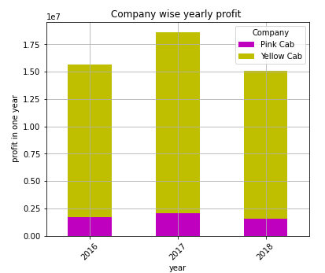
Profit Analysis
Profit Analysis Yearly
It is clearly visible that profit for both company increase in the year 2017 and decreases in 2018

Slide 6
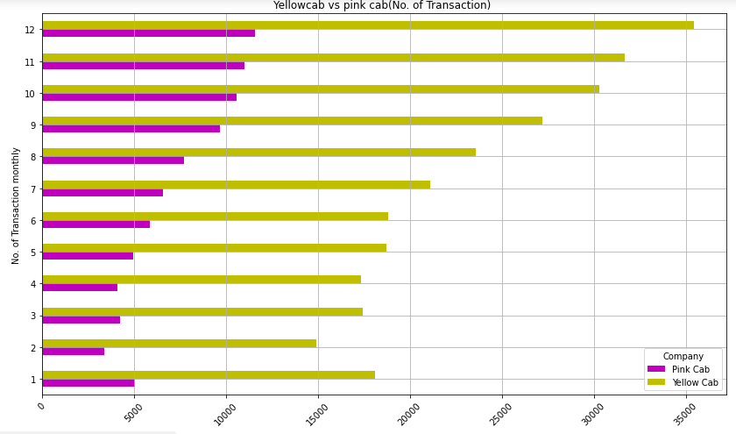
Profit Analysis
Profit Analysis Monthly
we can see a significant increase in travelling from July to December
The trend is similar in both the cab but yellow cab has major impact

Slide 7
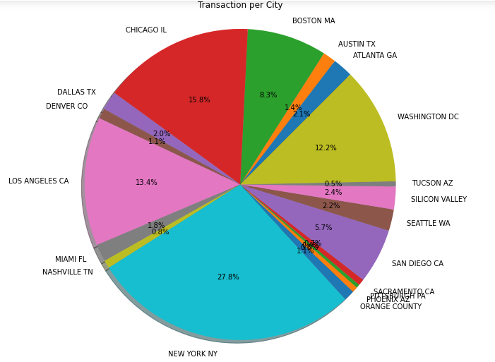
City wise transaction Analysis
New York followed by Chicago and LA has maximum no. of cab users
While Pittsburg and Tucson has minimum no. of cab users

Slide 8
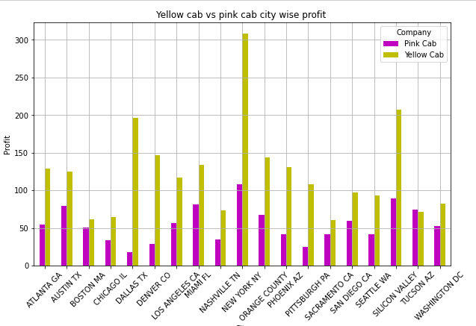
City wise Profit Analysis
New York followed by Chicago and LA has maximum no. of cab users
While Pittsburg and Tucson has minimum no. of cab users

Slide 9
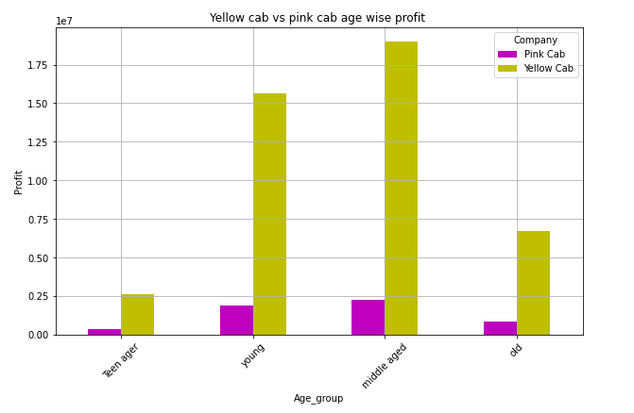
Age wise Profit Analysis
It is clearly visible that middle aged followed by young are the most profitable customer
old customer is half of the young customer and very few customers are teenagers
This trend is similar for both the cab but profit of pink cab is much lesser than the yellow cab

Slide 10
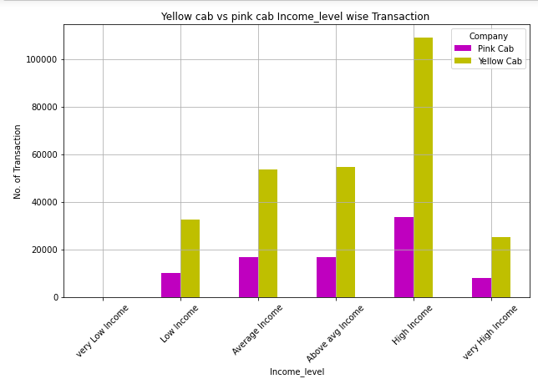
Income wise Transaction Analysis
Very low income group has negligible no. of customer for both the cab
High Income group are the major customer for cab industry (particularly yellow cab)

Slide 11
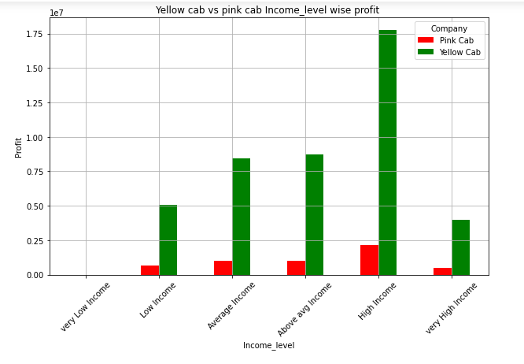
Income wise profit Analysis
The trend is similar in both the cab but pink cab is far less profitable than yellow cab

Slide 12
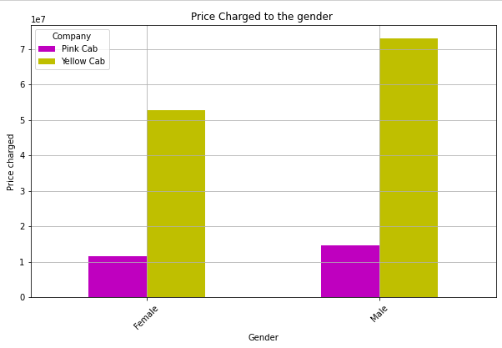
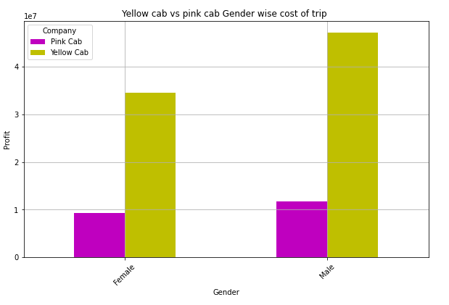
Profit Analysis
Gender based Analysis

Slide 13
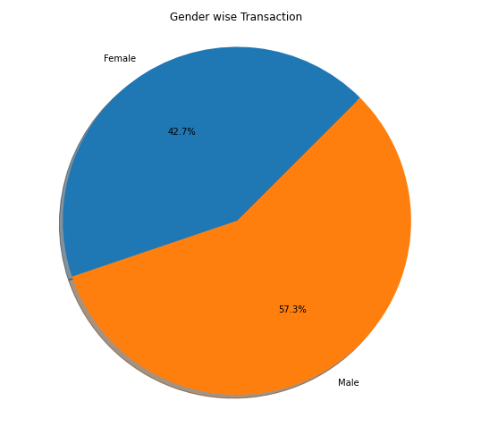
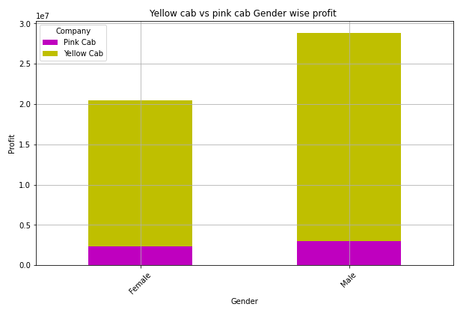
Profit Analysis
Gender based Analysis
Female share is less in both the company but pink cab has not much difference in no. of male and female customer

Slide 14
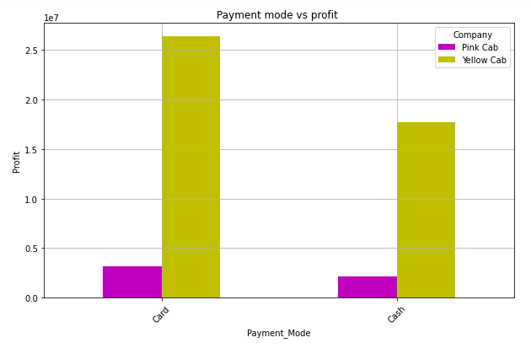
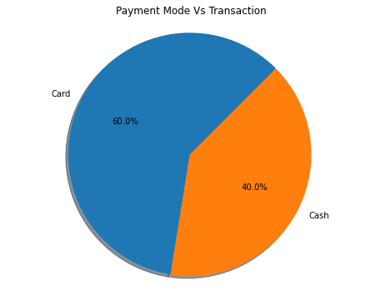
Profit Analysis
Payment mode based Analysis
60% customer prefer to pay by card and the trend is similar in both yellow and pink cab

Slide 15
Profit Analysis
Payment mode based Analysis
60% customer prefer to pay by card and the trend is similar in both yellow and pink cab

Slide 16
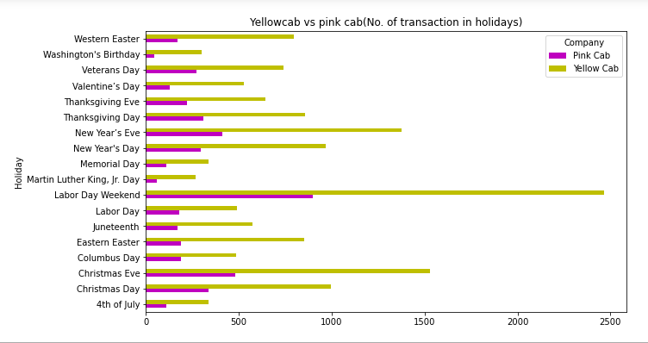
Holiday Transaction Analysis

Slide 17
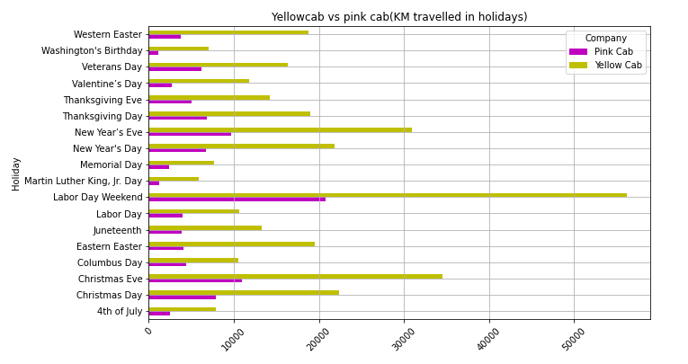
Holiday Distance Travelled Analysis

Slide 18
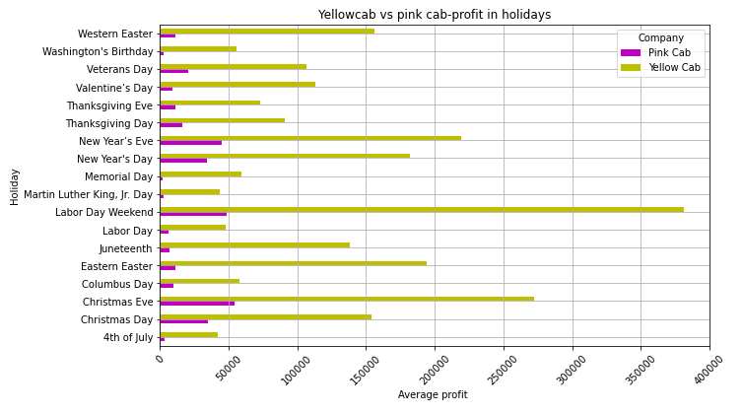
Company wise Profit Analysis on Holidays

Slide 19
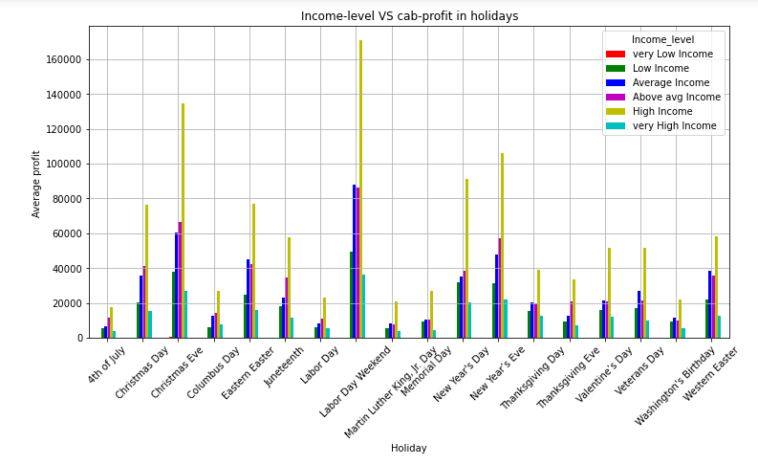
Income VS Profit Analysis on Holidays
High Income group of people are the most frequent travelers whereas very high income are not so frequent
It seems they prefer their own car

Slide 20
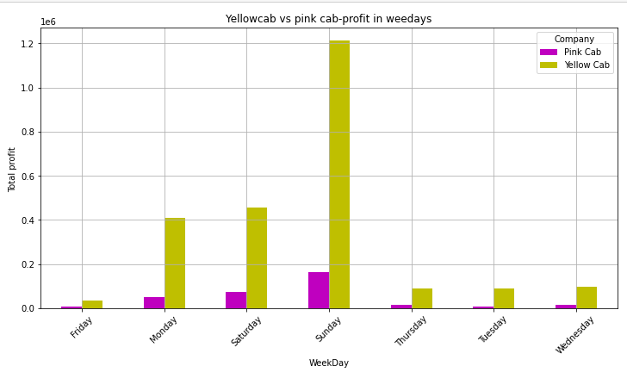
Profit earn on each day of the week
Most of the travelling is done on Sundays
Followed by Saturday and
Monday
The trend is similar for both the countries

Slide 21
Recommendations
We have evaluated both the cab companies on following points and found Yellow cab better than Pink cab:
Yearly ,monthly and daily Business: The cab’s business flourished in 2017 and declined in 2018.Most of the travelling is done during August to December. And people prefer to travel on Saturdays and Sundays . The trend is alike in Pink and Yellow cab but yellow cab has higher share of business and profit.
Gender Impact :There are less female customer in both the companies but the difference between No. Of male and female customer is very high in yellow cab , which indicates pink cab is doing good business with the female customer.
Income impact on business: Mostly High income(15000-25000)US $ customer contribute a major share in the cab business of both the companies . They have almost negligible customer from very low income group .Here also yellow cab is the favourite for all income group.
Age Group Impact: Most of the customers are of Middle age and young age and very few teenagers. Here also Yellow cab is favourite among all age group.
Payment mode: 60% user pay by card but there is no impact on the business of any company because pink cab is far behind the yellow cab
City wise analysis: Both the cab has highest no. of transaction in New York but in Chicago and Denver Pink Cab has lowest business whereas Yellow Cab has very high business share in these cities
US Holiday Impact: Yellow cab earn highest profit on labor day while Pink cab earn most of its profit on Christmas
On the basis of above point , we will recommend Yellow cab for investment and also suggest to give extra facilities to female customer and add special rate plan for Christmas to further enhance the business of Yellow cab.

Slide 22
Thank You

