Slide 1
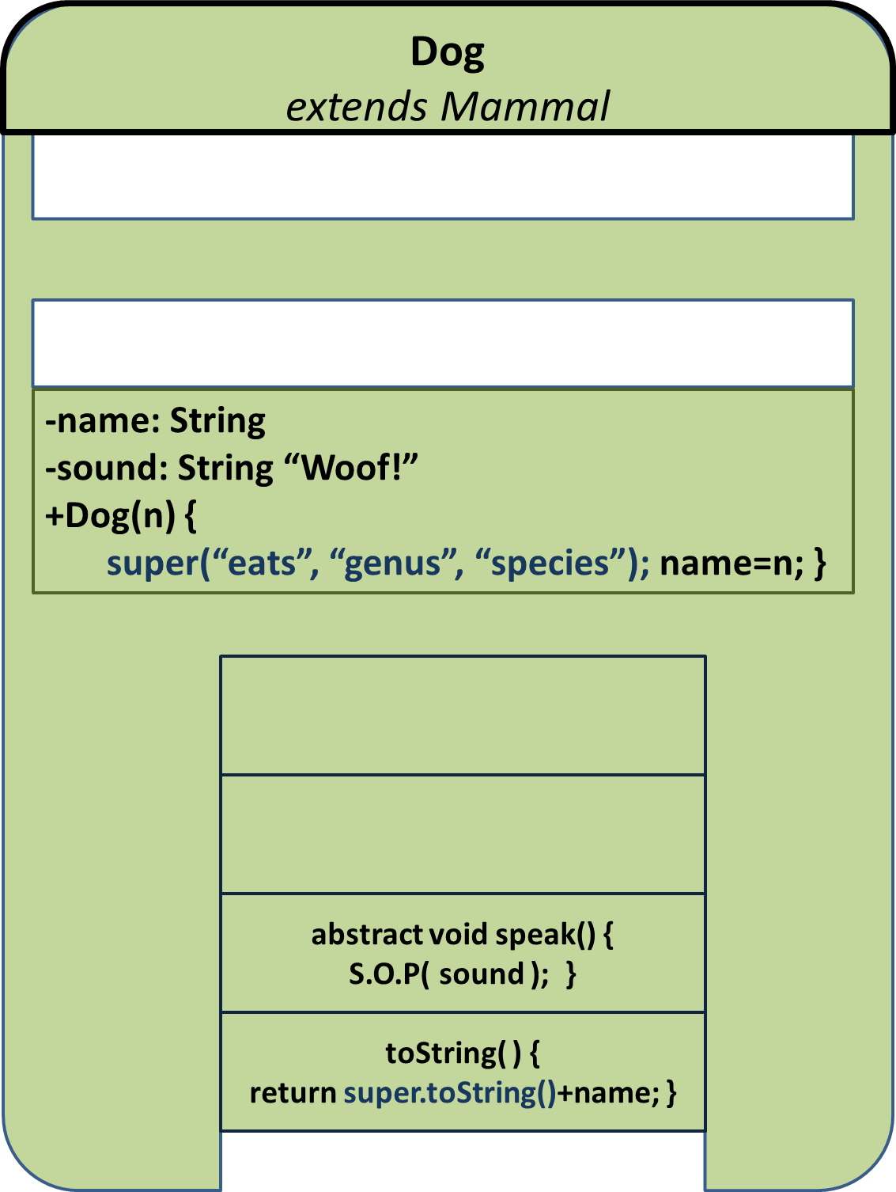


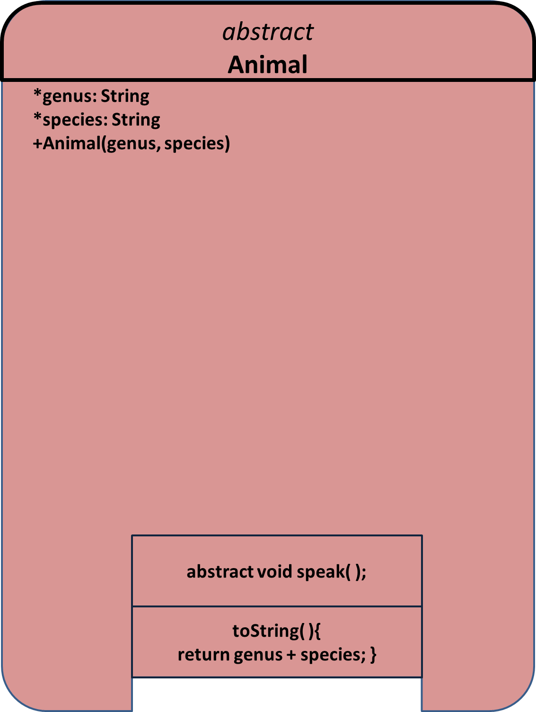
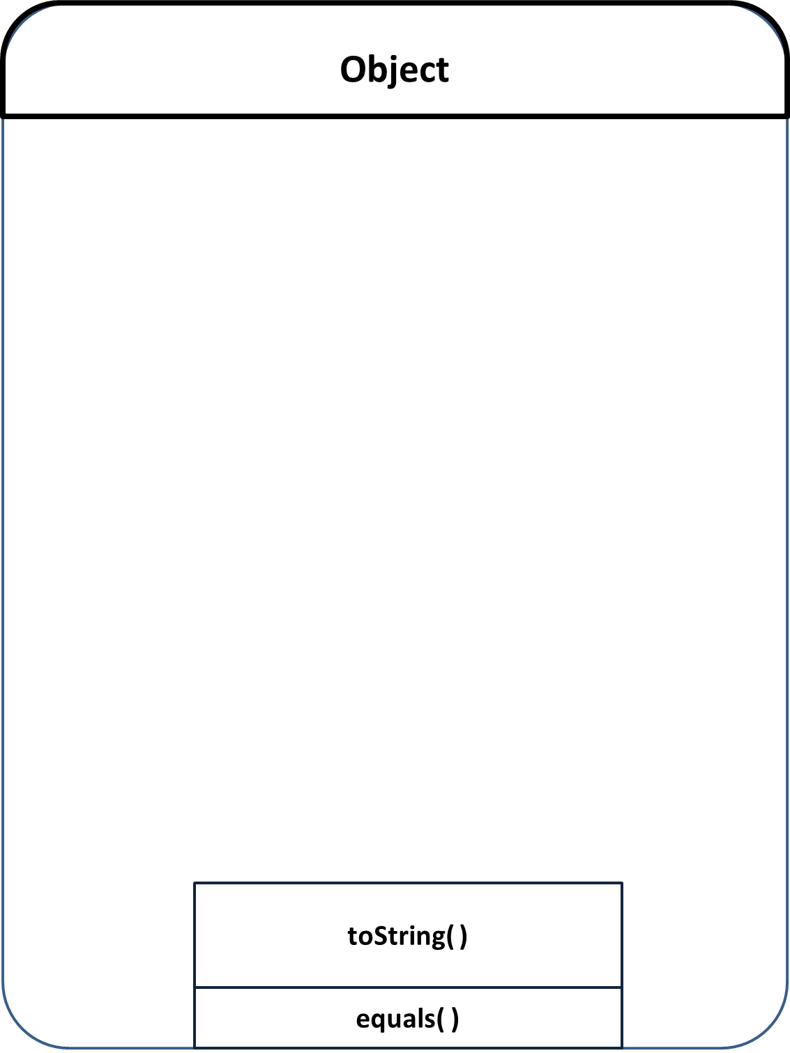
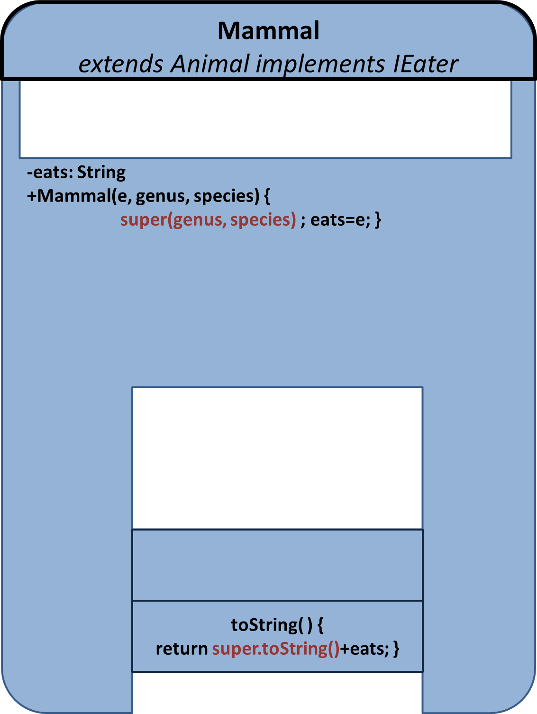
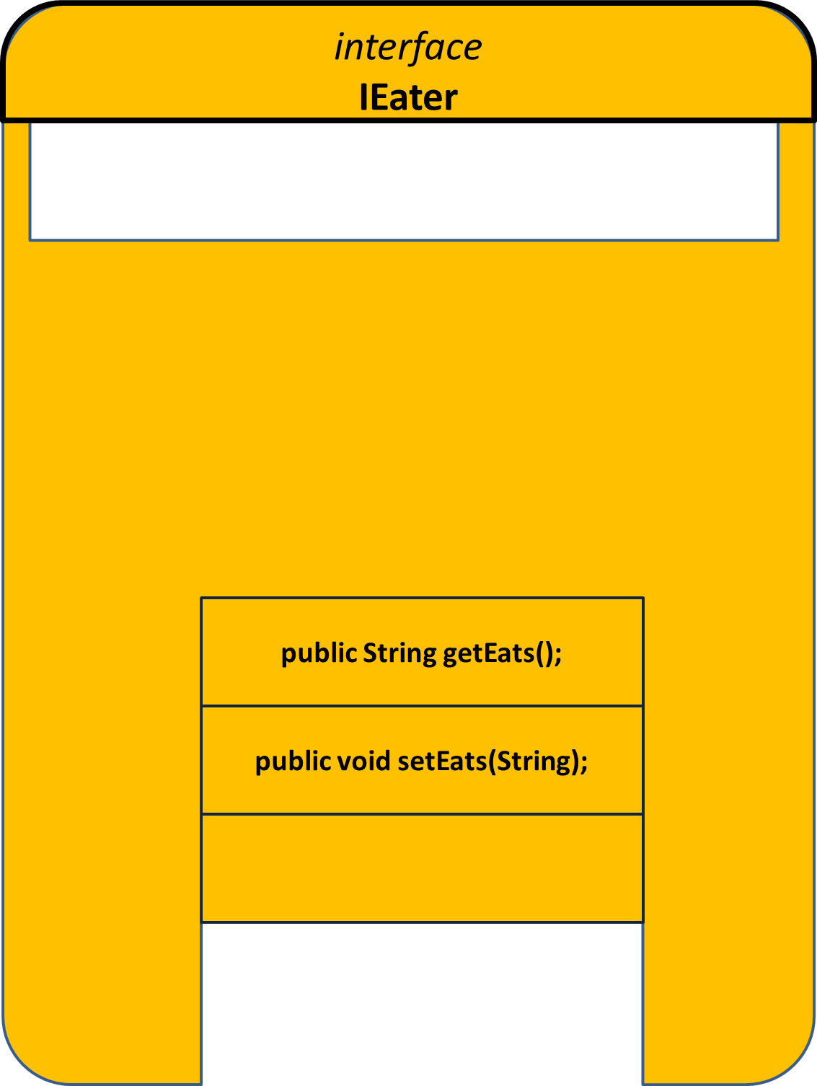

Slide 2
Object
toString( )
equals( )

Slide 3
abstract
Animal
*genus: String
*species: String
+Animal(genus, species)
abstract void speak( );
toString( ){
return genus + species; }

Slide 4
interface
IEater
public String getEats();
public void setEats(String);

Slide 5
Mammal
extends Animal implements IEater
-eats: String
+Mammal(e, genus, species) {
super(genus, species) ; eats=e; }
toString( ) {
return super.toString()+eats; }

Slide 6
Dog
extends Mammal
-name: String
-sound: String “Woof!”
+Dog(n) {
super(“eats”, “genus”, “species”); name=n; }
abstract void speak() {
S.O.P( sound ); }
toString( ) {
return super.toString()+name; }

Slide 7
Cow
extends Mammal
-name: String
-sound: String “Moo!”
+Cow(n) {
super(“eats”, “genus”, “species”); name=n; }
abstract void speak() {
S.O.P( sound ); }
toString( ) {
return super.toString()+name; }

Slide 8
Cat
extends Mammal
-name: String
-sound: String “Meow!”
+Cat(n) {
super(“eats”, “genus”, “species”); name=n; }
abstract void speak() {
S.O.P( sound ); }
toString( ) {
return super.toString()+name; }

