Slide 1
Cloud Computing

Slide 2
Topics
6th Major Cloud Services Providers
5th Cloud Security
6th Major Cloud Services Providers
7th IoT in Cloud Computing and everyday use
8th How companies use and benefit from Cloud Services
1st What is Cloud Computing
2nd Types of Cloud Computing
3rd Advantages and Disadvantages
4th Cloud vs local servers

Slide 3
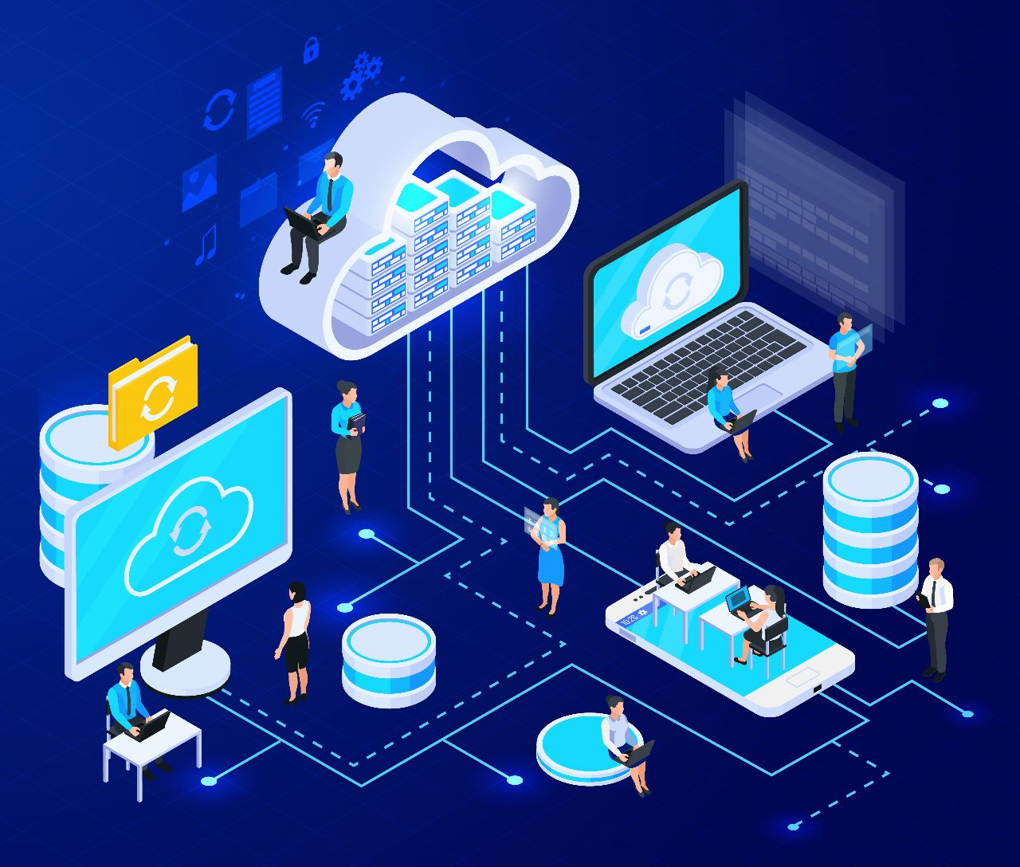
01
What is Cloud Computing?

Slide 4
What is Cloud Computing?
The on-demand availability of computing resources (such as storage and infrastructure), as services over the internet,
instead of using your own local computer or physical servers.

Slide 5
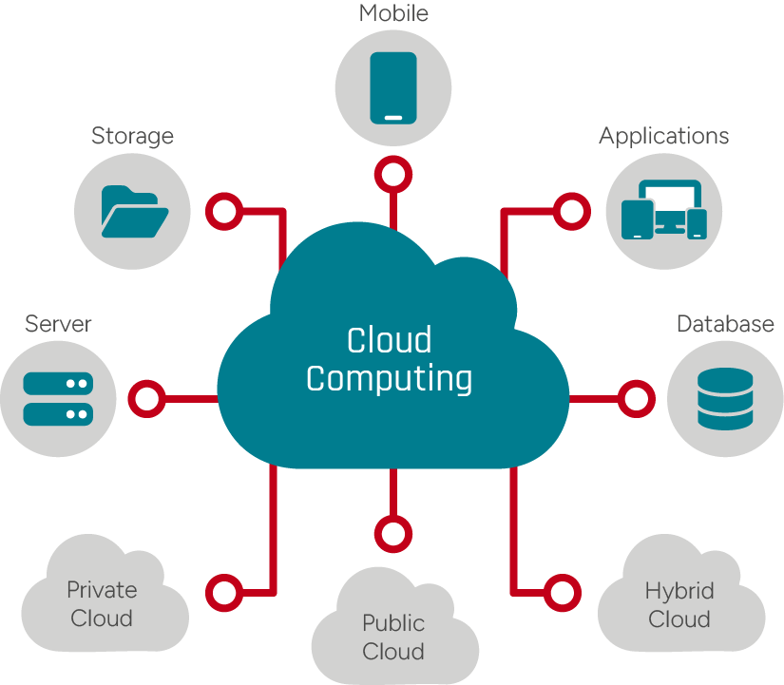
Examples:
Using Google Drive to store files online;
Saving photos to iCloud;
Running websites without owning physical servers.

Slide 6
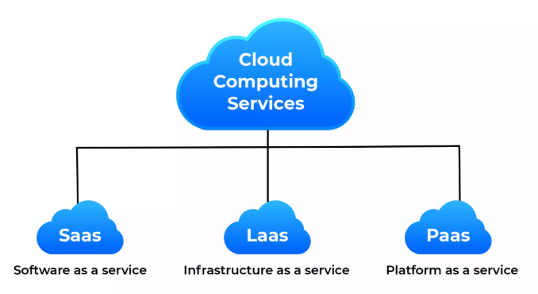
02
Types of Cloud Computing

Slide 7
Main types of cloud services
Infrastructure as a Service (IaaS)
You rent virtual machines, storage, and networks
Software as a Service (SaaS)
You use software through a browser or app
Platform as a Service (PaaS)
You deploy apps without managing hardware

Slide 8
Types of Cloud Environments
Notes:
describes where the cloud infrastructure is located and who uses it

Slide 9

Public Cloud
Infrastructure is owned by a cloud provider and shared among many customers.
lower cost
Private Cloud
Infrastructure is used only by one organization.
more control and security
Hybrid Cloud
A combination of the public and private clouds.
Notes:
Example public: using servers from Amazon Web Services or Google.

Slide 10
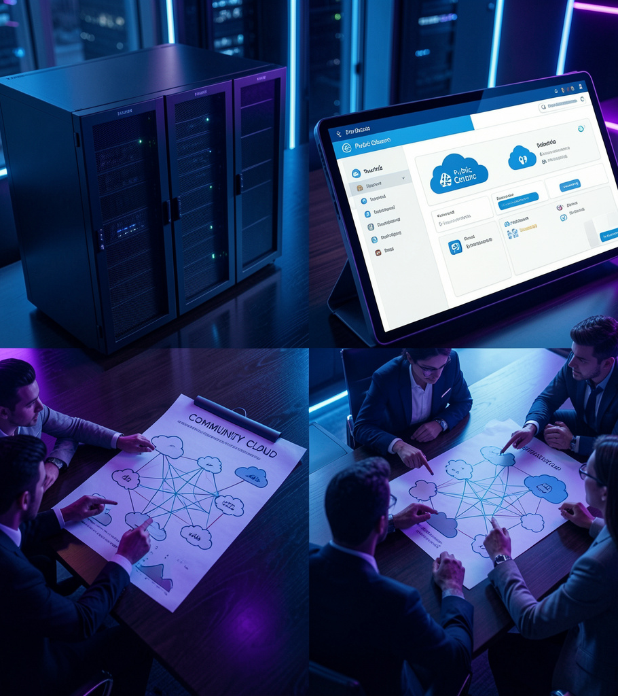

03
Advantages and Disadvantages of Cloud Computing
Notes:
Next, i'm going to speak on the advantages and disadvantages of Cloud Computing.

Slide 11

Key Benefits of Cloud Computing
Cost Efficiency
Scalability and Flexibility
Accessibility and Remote collaboration
Security and compliance
Disaster Recovery
Business Continuity
Cloud services advantages are significant, it can be a way for companies to reduce their carbon footprint by as much as 30%
Notes:
Some of the key benefits of Cloud Computing consist of:
Cost Efficiency: Reduced Hardware and Software Expenses, Lower Energy Consumption, Minimal Maintenance Costs, Pay-As-You-Go Pricing Model
Scalability and Flexibility: Easy Resource Allocation and Management, Rapid Deployment of Applications and Services
Accessibility and Mobility: Access to Data and Applications From Anywhere, Improved Collaboration and Productivity, Support for Remote Work and Distributed Teams
Enhanced Security (Security and compliance (when managed correctly)): Centralized Data Storage and Protection, Regular Security Updates and Patches, Advanced Encryption and Authentication Methods, Disaster Recovery and Business Continuity, Automated Data Backup and Recovery, Reduced Downtime and Data Loss, Simplified Disaster Recovery Planning
Sustainability of cloud environment - Companies using cloud computing utilize only the computing power they need, which, in turn, reduces their carbon footprint.

Slide 12

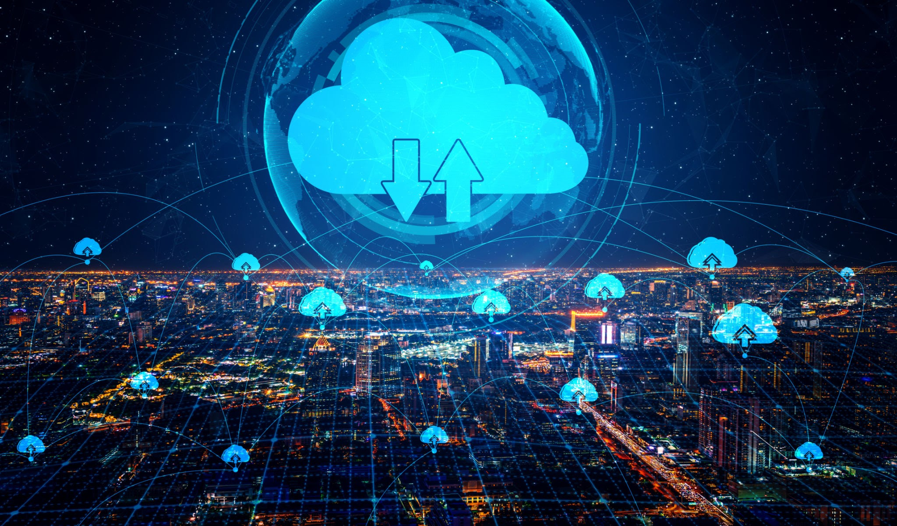
Disadvantages of Cloud Computing
Ongoing operational costs
Security risks and Data Privacy concerns
Reliability issues (performance issues, dependent on network connection)
Limited control over infrastructure
Notes:
Even though the advantages may be significant, there are still a few drawbacks to using Cloud Computing Services: Data Privacy and Security Concerns: Potential for Data Breaches and Unauthorized Access, Compliance With Data Protection Regulations, Trusting Third-Party Providers With Sensitive Information
Limited Control and Customization: Dependence on Cloud Service Providers, Restrictions on Software and Hardware Customization, Network Dependency and Connectivity Issues, Reliance on Stable Internet Connection, Performance Issues Due to Network Latency, Vulnerability to Distributed Denial-of-Service (DDoS) Attacks Downtime and Service Reliability issues: Risk of Outages and Service Disruptions, Shared Resources and Potential for Performance Degradation Ongoing operational costs Security risks and data privacy concerns Downtime and reliability issues Limited control over infrastructure
Limited portability

Slide 13
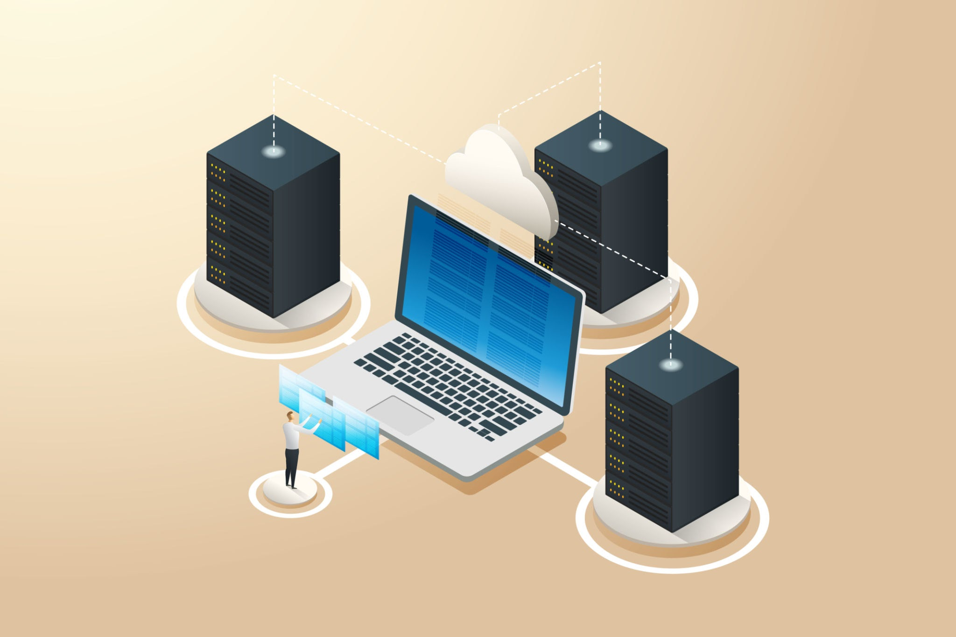
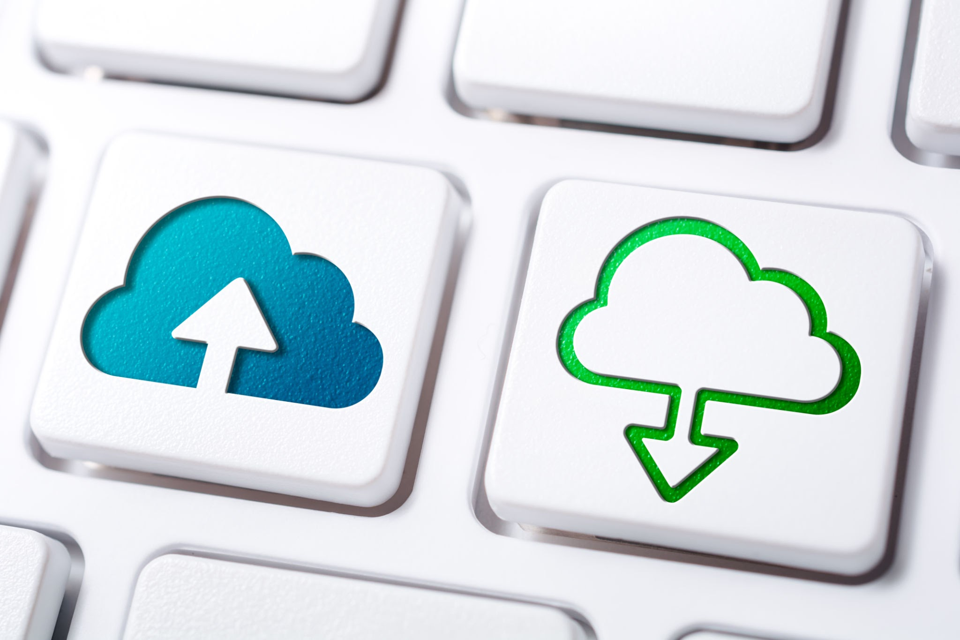
04
Cloud vs Local servers

Slide 14

Local (or on-premise) Servers
Enhanced Control over infrastructure and company data.
Performance not all-relying on Internet connection.
Require a significant upfront investment. Lower ongoing subscription costs.
Personalized Security measures, maintenance is of the company’s responsibility.
Notes:
Key features of Local Server Solutions: Control (Businesses have full control over their infrastructure and data, including customization and security protocols.) Performance ( For companies that prioritize speed and reliability in environments with limited or no internet access, on-premise servers can offer consistent performance.) Cost Structure ( Server solutions require a significant upfront investment in hardware, licenses, and IT personnel, but they may have lower ongoing subscription costs.) Security ( With dedicated control, businesses can implement stringent security measures to protect sensitive data.)

Slide 15
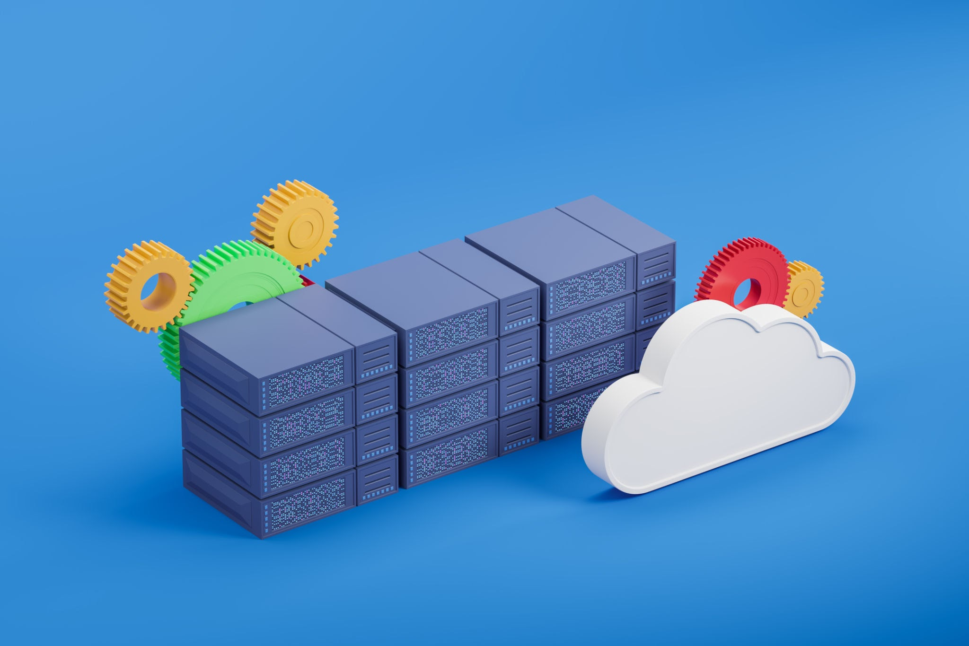
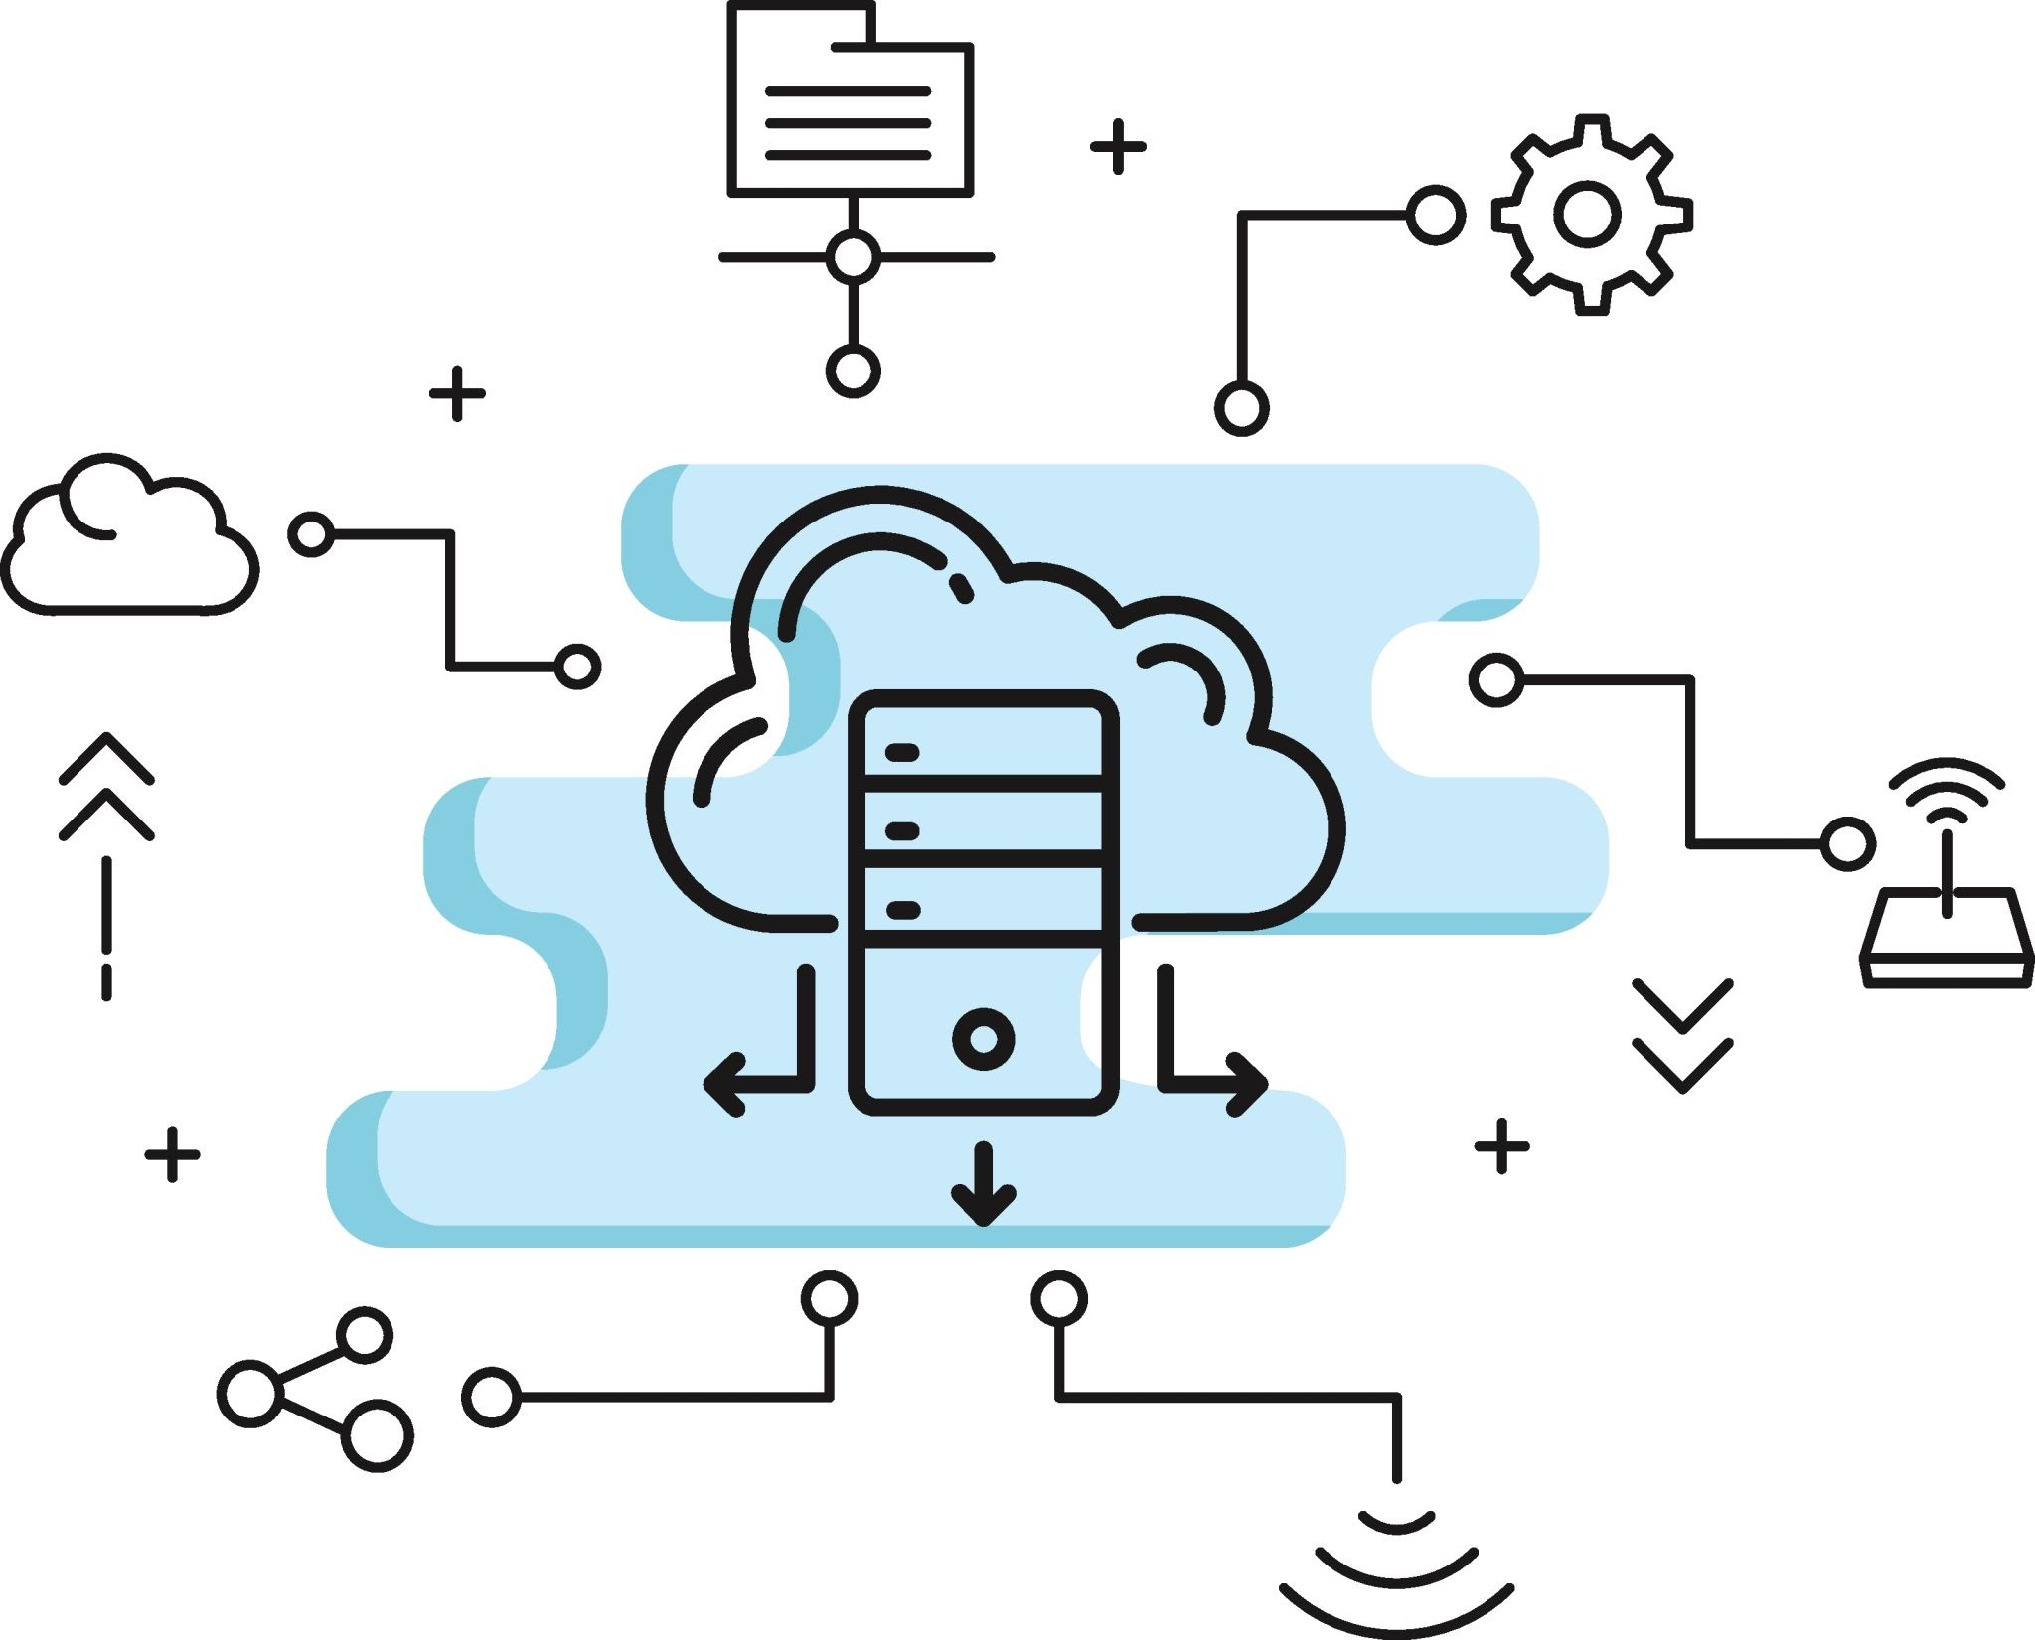
Cloud Servers, and a Hybrid approach
Remote access to the software from anywhere (with Internet connection)
Can easily scale up, more adaptable
Cloud provider is responsible for server maintenance
Subscription based model
Critical workloads can stay local, but still needs scalability – better to go for a
Hybrid Approach
Notes:
Key features of Cloud-Based Solutions: Accessibility (Users can access the software or data from anywhere with an internet connection.) Scalability (Cloud systems can easily scale up or down depending on the needs of your business.) Maintenance (The cloud provider is responsible for server maintenance, updates, and security, reducing the burden on in-house IT teams.) Cost Structure (Most cloud services operate on a subscription-based model, which can reduce upfront costs)

Slide 16

How to choose?
There is no right answer, and the answer can change over time.
It depends on funds available and the compromises each company is willing to make.
Most importantly: make and informed decision, weigh the pros and cons, and plan for future changes and the business evolution.
Notes:
Personal opinion: In my personal opinion, there is no right answer for the choice of using or not using Cloud Services, and to choose Cloud Servers or On-Premise servers, it will depend on the compromises (and of course the amount of funds available for IT services and staff) each company is willing to make to protect their data, or if they want more flexibility and scalability of the business in the future. The most important thing is to make an informed decision, considering the pros and cons of every approach, and a plan for if changes arise in the future of each specific company.

Slide 17
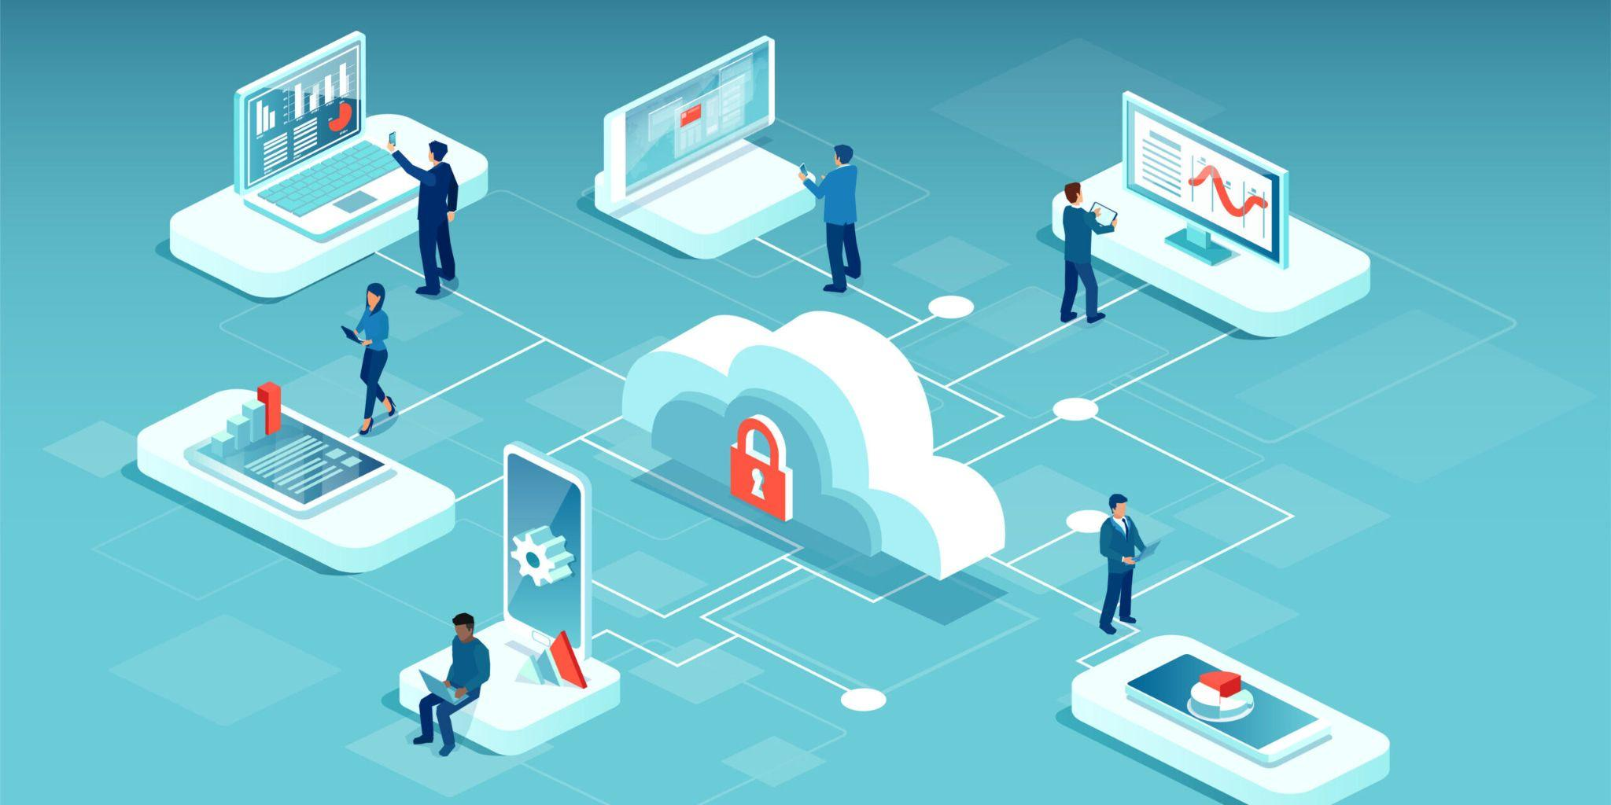
05
Cloud Security
What is it?
Is it important?

Slide 18

Main Security Threats
Data Breaches
Malware Attacks
Insider Threats
DDos Attacks

Slide 19
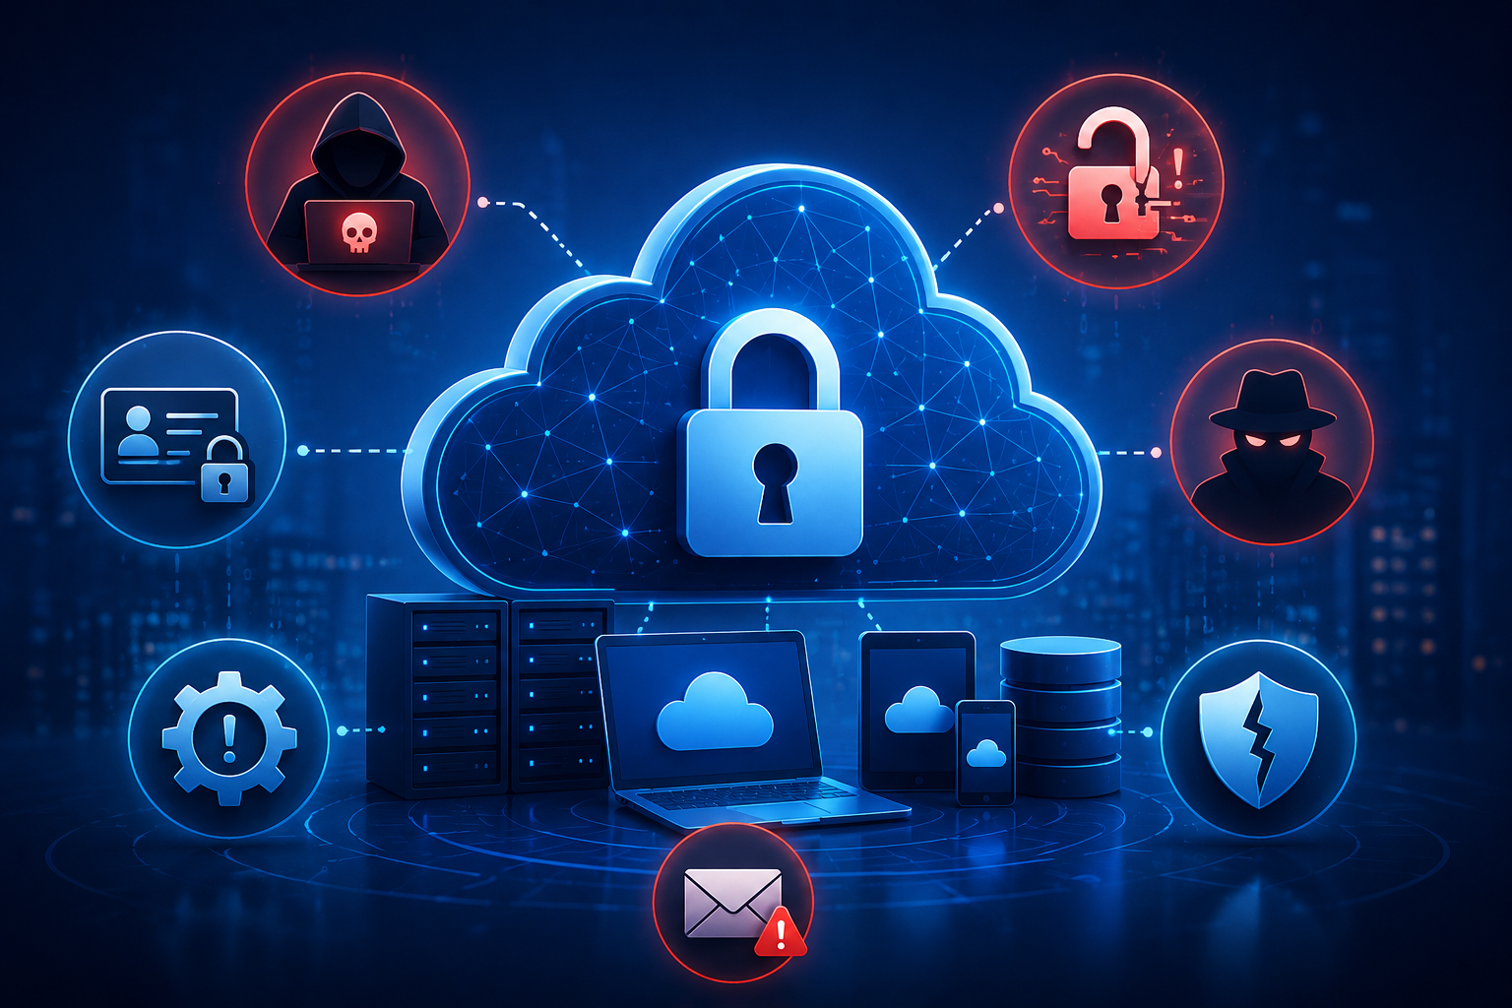
Security Solutions
Encryption
Multi-Factor Authentication
Firewalls
Identity and Access Management
Regular Backups

Slide 20
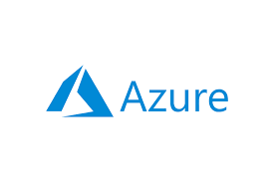

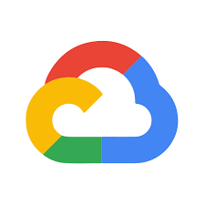
06
Major Cloud Services Providers

Slide 21

Cloud Services
Infrastructure as a Service (Iaas)
Platform as a Service (Paas)
Software as a Service (Saas)

Slide 22
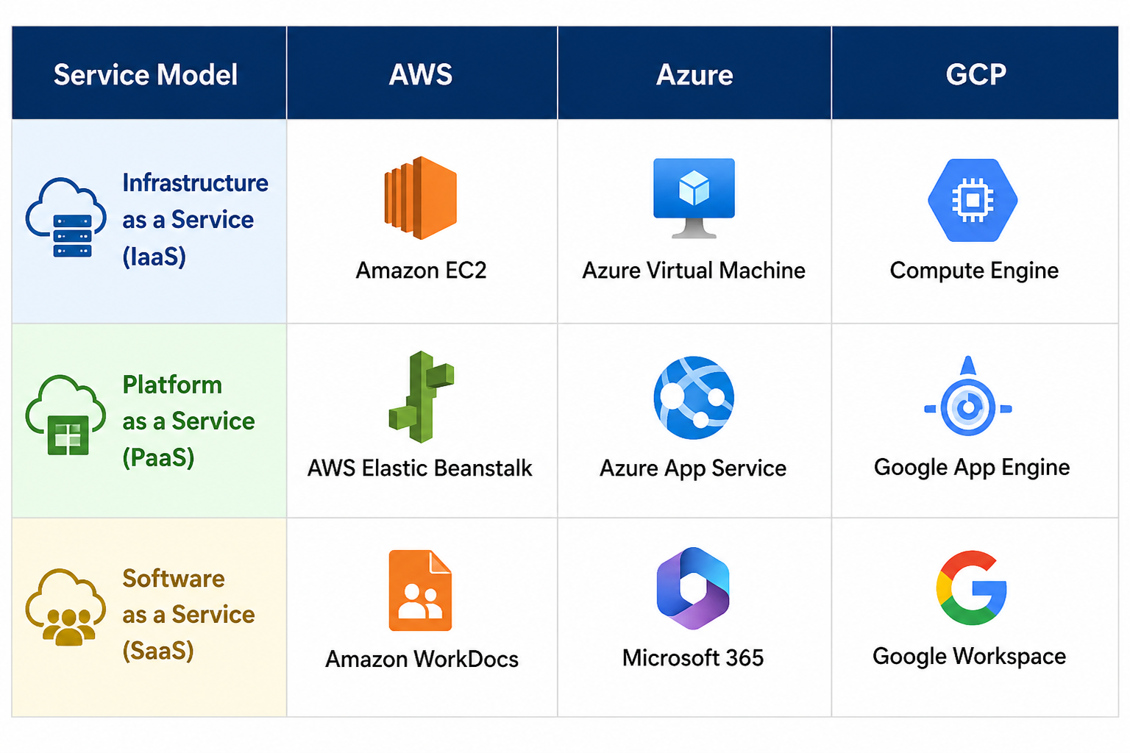
Titulo
Texto

Slide 23
07
Iot in Cloud Computing and everyday use

Slide 24
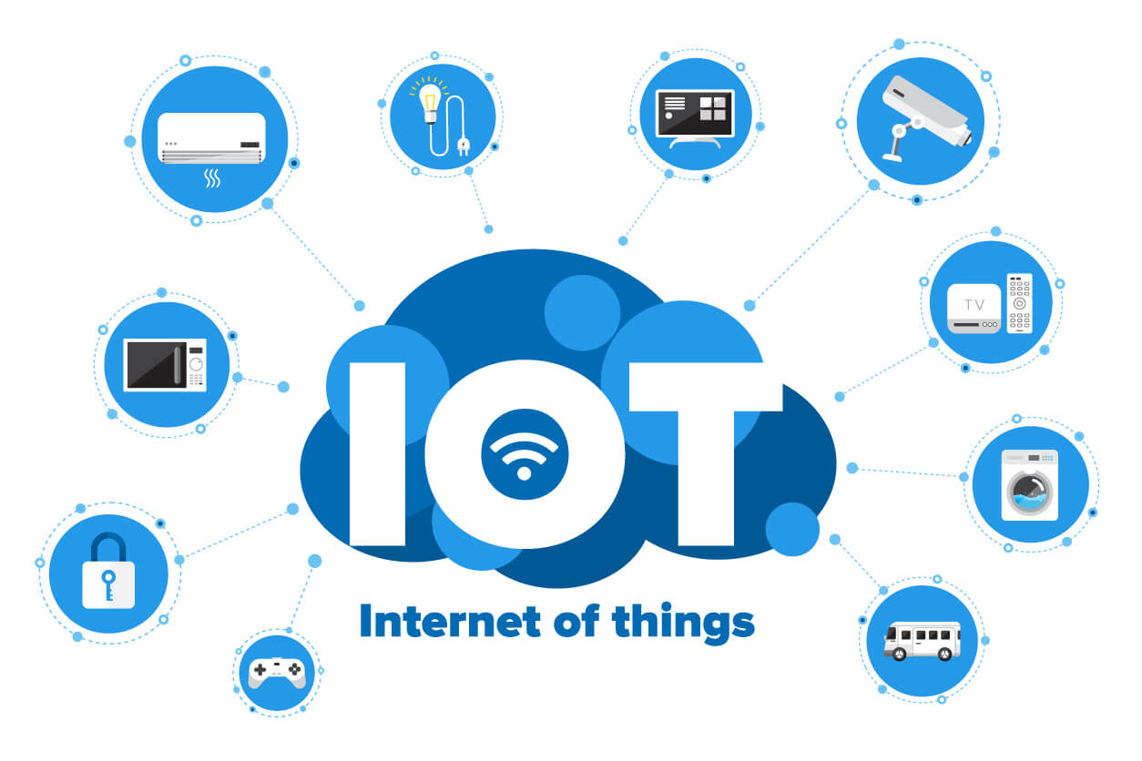
What is IoT?
Internet of things:
receive
collect
send

Slide 25
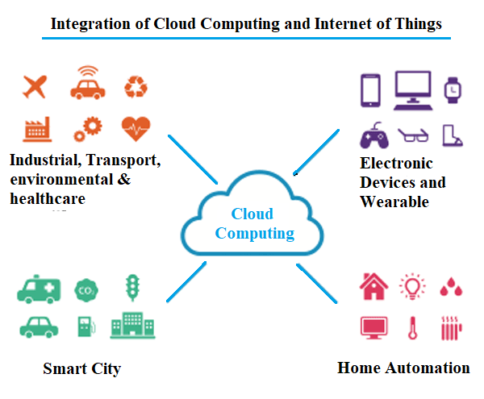
Iot and Cloud Computing and everyday use
Cloud Services
Cloud store
Analyze data
Allow remote control
Monitoring in real time

Slide 26
08
How companies use and benefit from Cloud Services

Slide 27
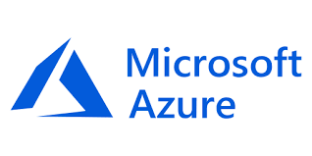
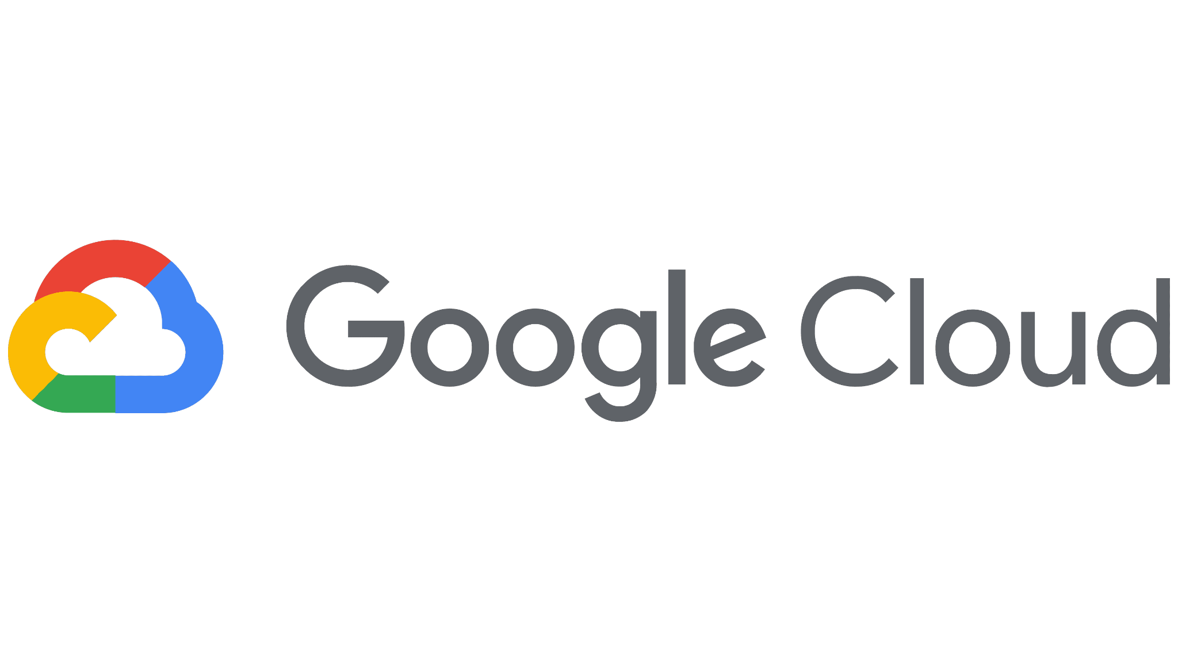

Cloud Services in companies
Benefits from Cloud services
Stock online
Remote work
Communication
Backup and security
Cost reduction
Scalability
Greater productivity
Remote access

Slide 28
References
https://cloud.google.com/learn/what-is-cloud-computing
https://www.oracle.com/europe/cloud/what-is-cloud-computing/
https://www.opit.com/magazine/advantages-of-cloud-computing/
https://devot.team/blog/advantages-and-disadvantages-of-cloud-computing
https://www.future-processing.com/blog/the-advantages-and-disadvantages-of-cloud-computing/
https://www.youtube.com/watch?v=sLN1KNOX68M
https://www.ainfosys.com/tutorials/cloud-vs-local-server/
https://www.youtube.com/watch?v=uhcV9Uo_N0c
https://www.youtube.com/watch?v=qQGUttofN0w
https://www.youtube.com/watch?v=-zJ4yrD5jKw
https://www.cloudflare.com/learning/?utm_source=chatgpt.com
https://tryhackme.com/?utm_source=chatgpt.com

