Slide 1
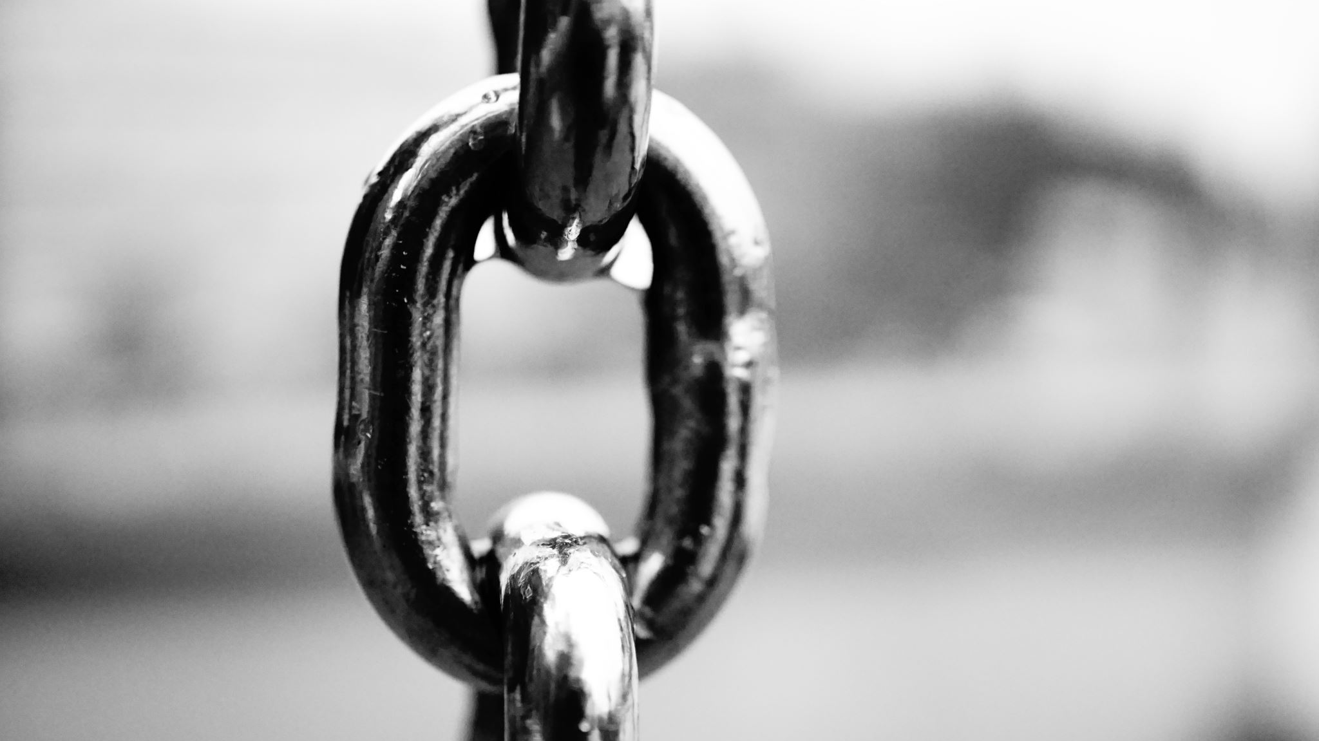
Blockchain
Ahmed Altouqi

Slide 2


What is Blockchain?
Virtual database
Stores information electronically
Most common use
Personal use

Slide 3
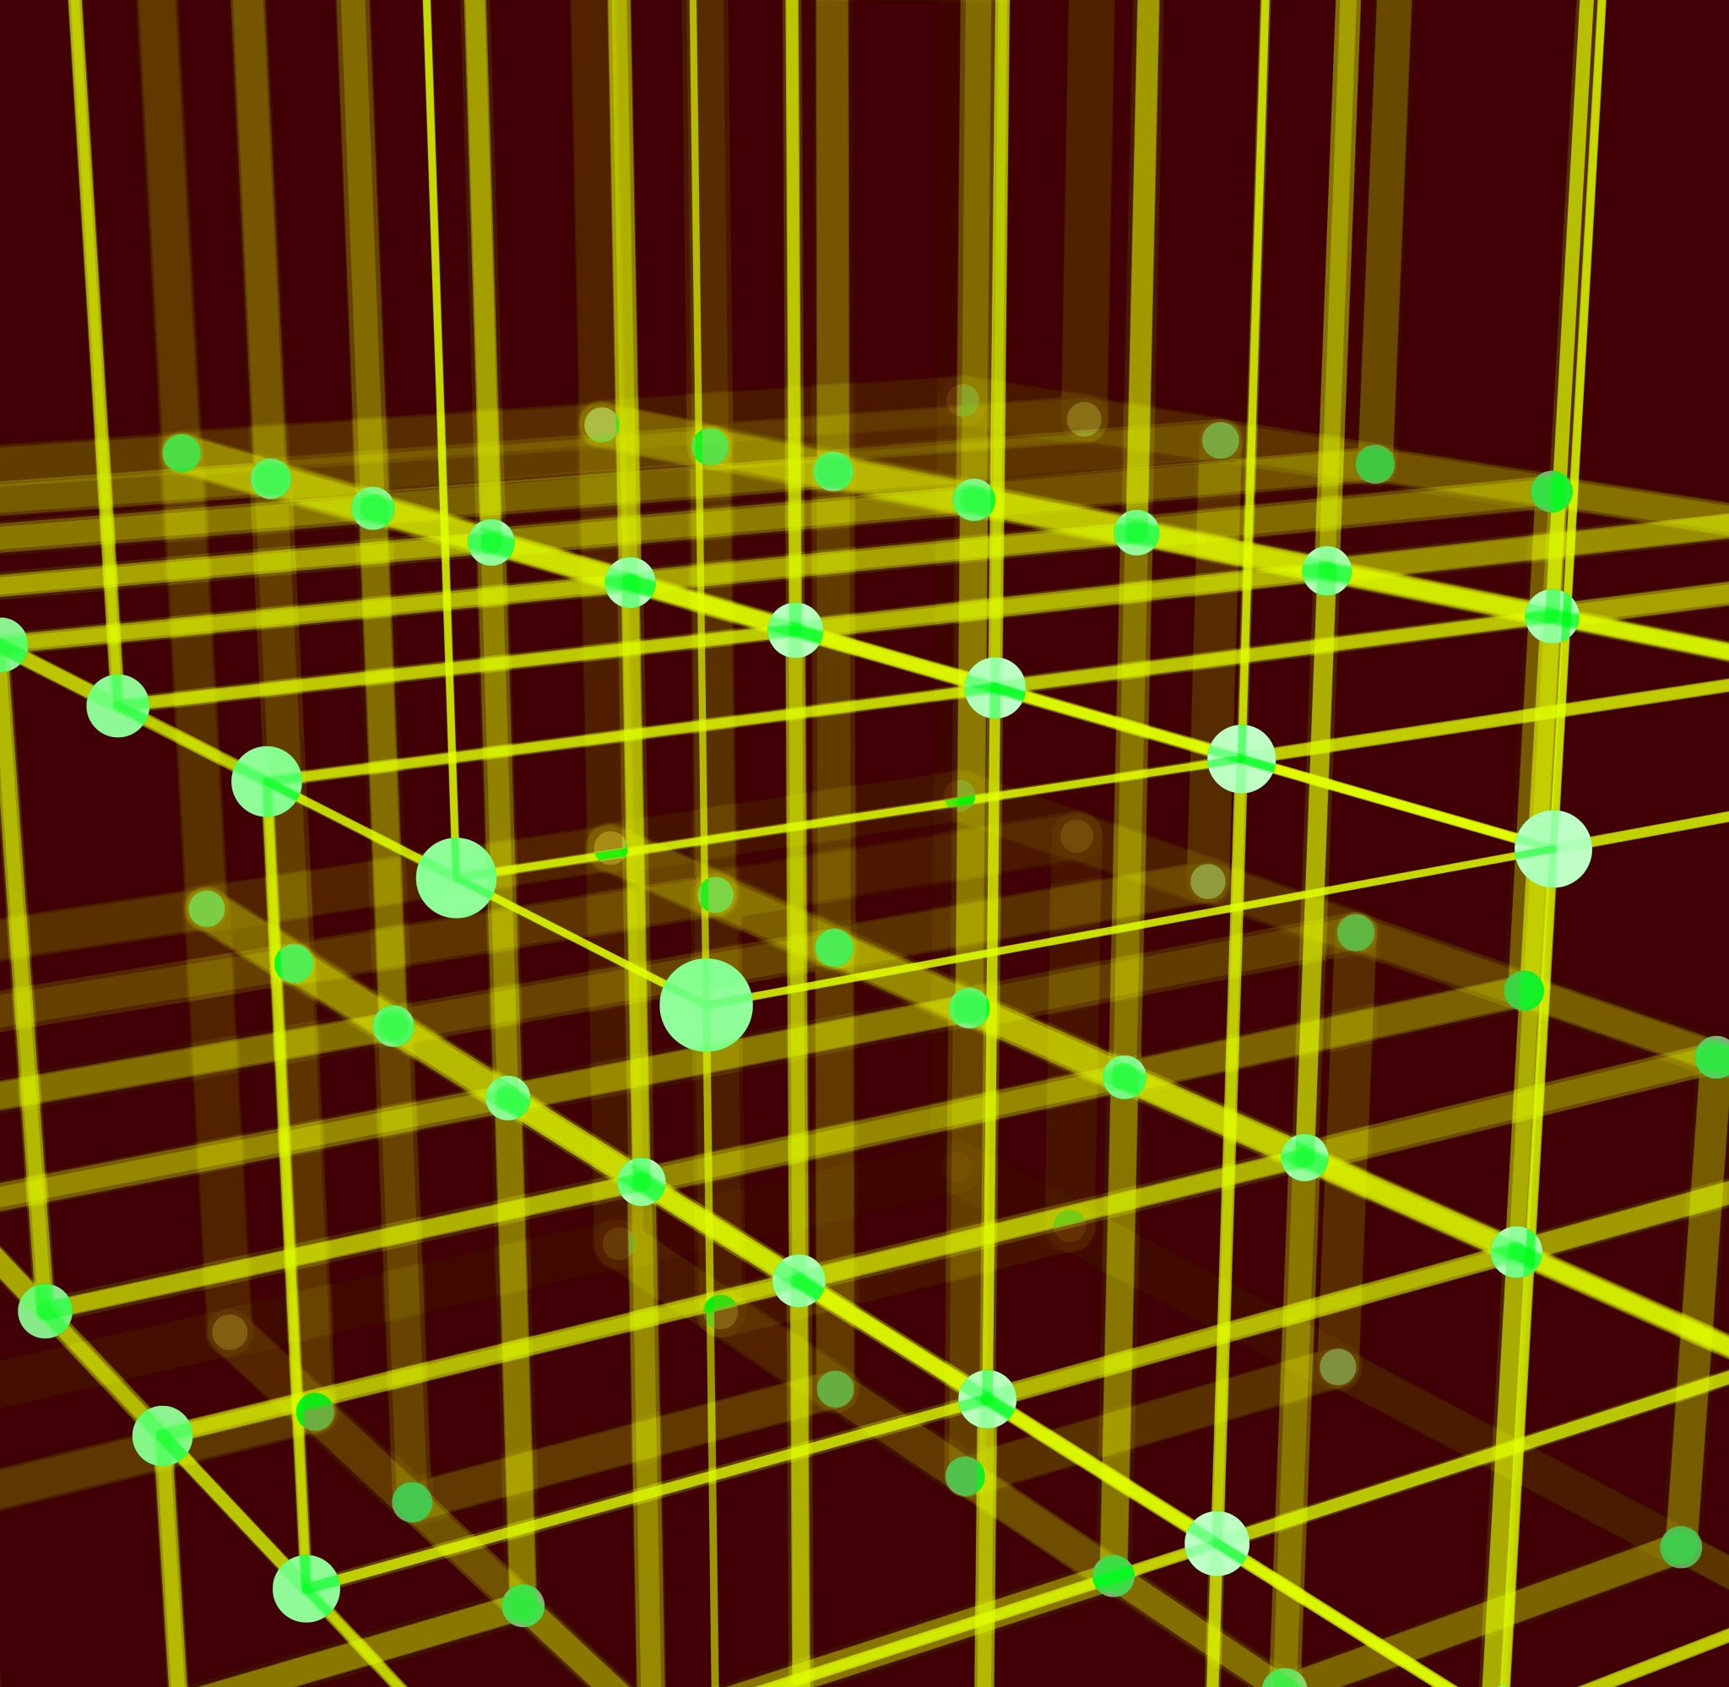
Elements of Blockchain
Blocks
Nodes
Hash

Slide 4
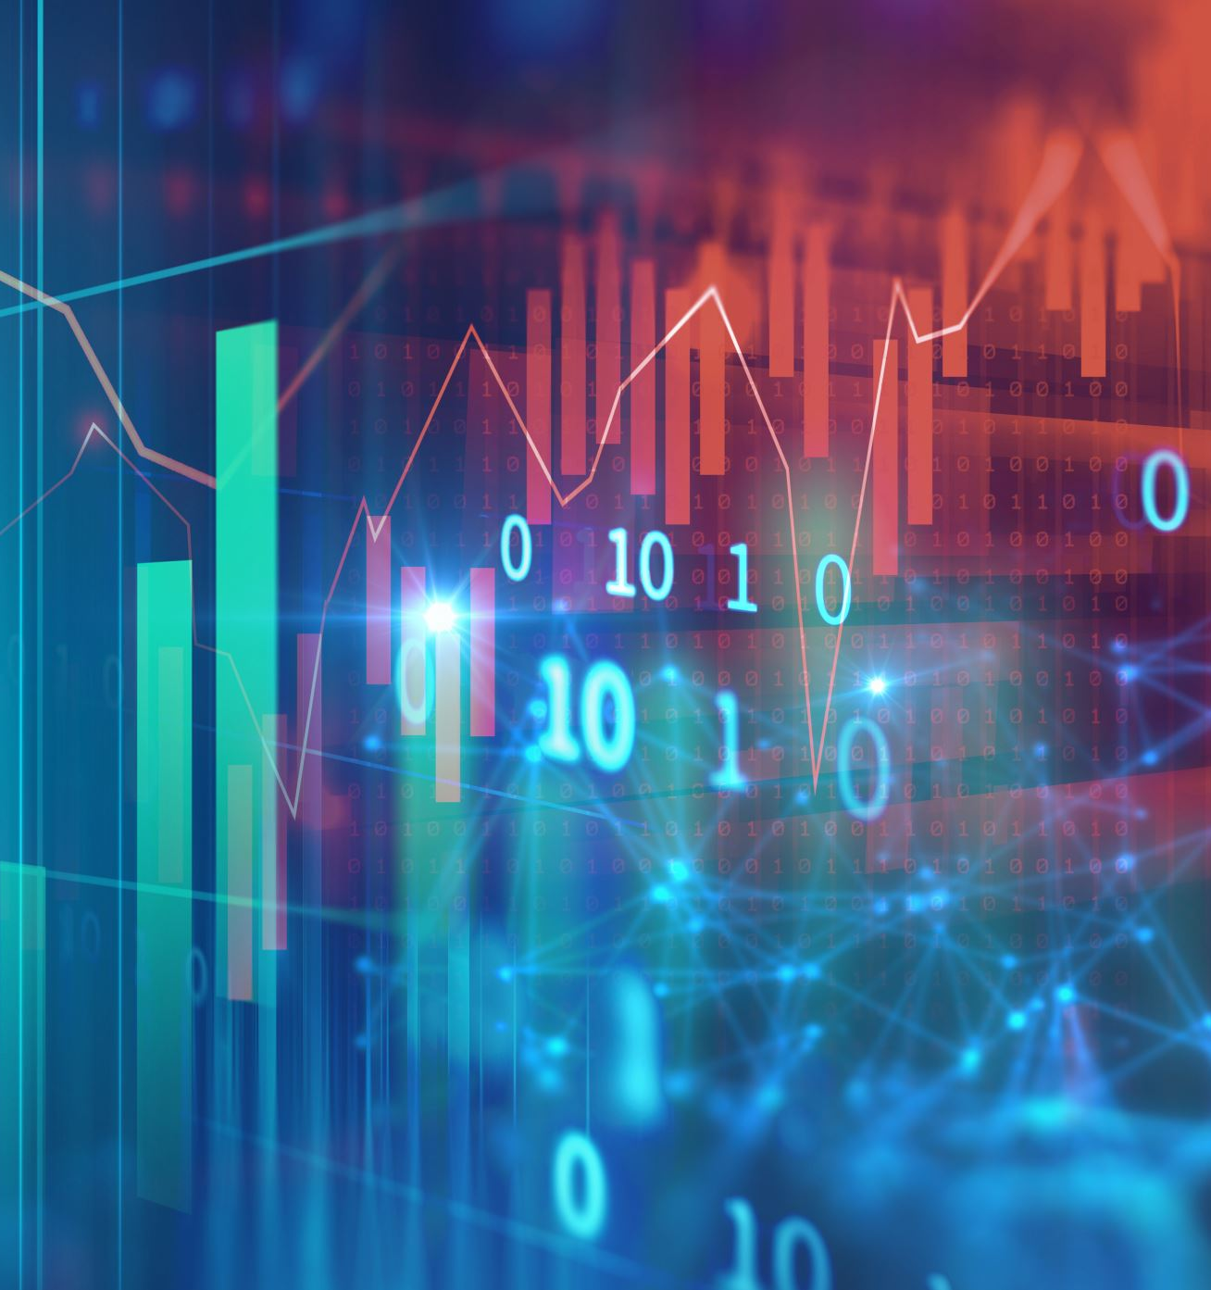
Uses of Blockchain
Transactions
Monitor supply chain
Create digital identities
Easy and fast data share

Slide 5
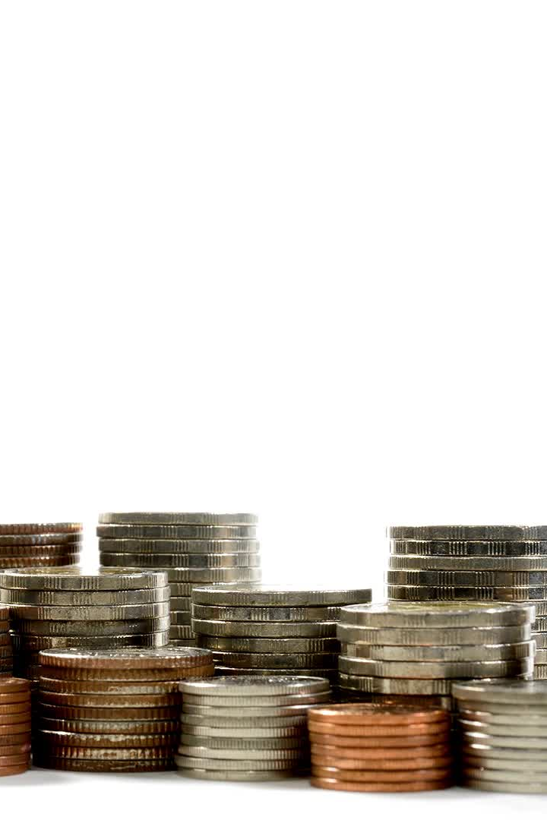
Benefits of Blockchain
Lower costs
High security
Saving time

Slide 6

Citations
https://www.investopedia.com/terms/b/blockchain.asp
https://www.synopsys.com/glossary/what-is-blockchain.html
https://learn.bybit.com/blockchain/what-is-hashing-in-blockchain/

