Slide 1

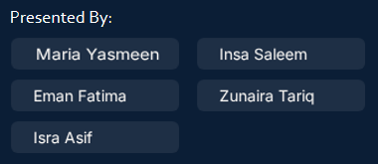
FJWU · Research Presntation
Beyond GPA:
Are FJWU Students Truly
Job-Ready?
An Analytical Framework Combining Research · NLP · Data Analytics · Professional Ethics
Capstone Project Presentation
Department of Computer Science
Fatima Jinnah Women University
Batch 2023-27
Applied AI & Data Science · Mixed-Method Research · NLP Analysis · Professional Practices

Slide 2
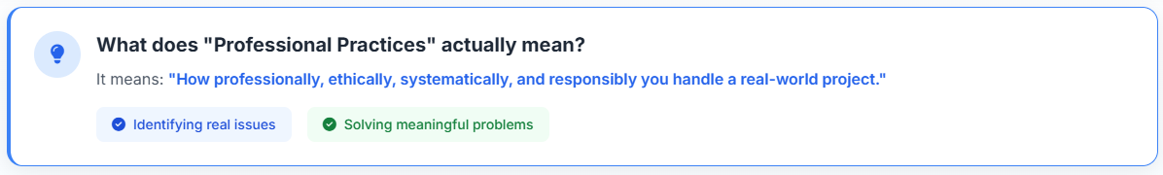




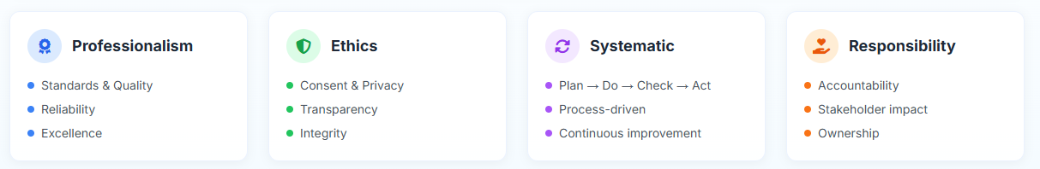
Understanding Professional Practices
"Professional Practices means how professionally, ethically, systematically, and responsibly you handle a real-world project."
Professional
Ethical
Systematic
Responsible
High standards & quality
Integrity & responsibility
Structured & methodical
Accountable outcomes

Slide 3

Problem Identification
THE REAL-WORLD GAP
WHY THIS IS PROFESSIONAL
HIGH GPA
≠
JOB READY?
Identified a meaningful, real-world educational problem
3.5 – 4.0
?
Questioned existing assumptions about academic success metrics
Academic Score
Industry Ready
Focused on student employability — a genuine societal challenge
Key Finding: Students may achieve high GPA yet still feel fundamentally unprepared for real-world employment challenges.
Applied analytical thinking before beginning any data collection
Professional Practice Applied: Evidence-Based Problem Definition

Slide 4


Research Problem
THE CENTRAL QUESTION
"Does academic performance alone determine job readiness, or do practical skills and industry exposure play a greater role?"
Target Investigation Areas
Comparison of high CGPA versus practical application confidence
Influence of industry internships & standard certifications
Disconnect between academic curricula & modern market demands

Slide 5



Requirements Gathering
Students
University
Context
Industry
Standards
Primary data source
Institutional background
Job-readiness benchmarks
Surveyed student perception of job readiness, skill gaps, and academic experience
FJWU academic environment, curriculum structure, and student demographics considered
Industry expectations for skills, communication, and professional competencies examined
Professional Practice Applied:
Questionnaire designed to avoid bias · Gather authentic insights · Capture real student behavior · Cover all stakeholder perspectives

Slide 6
Ethical Data Collection
Consent
Privacy
Students voluntarily filled out forms. No coercion or pressure applied at any stage.
No sensitive personal information was collected. Participant anonymity fully maintained.
Confidentiality
Transparency
All responses used exclusively for academic research purposes only.
Participants were fully informed about the purpose and scope of the research.
Professional Practice Applied: Ethical research framework — making this project credible, trustworthy, and academically sound

Slide 7
05 · Data Management
1
2
3
4
5
›
›
›
›
Raw
Data
Structured
Dataset
Data
Cleaning
Qualitative
Conversion
Ready for
Analysis
Survey responses collected
Organized into columns & rows
Inconsistencies removed
Text → analyzable format
Clean, reliable dataset
Data Integrity
Reliability
Accuracy
Accurate, complete records
Consistent, reproducible data
Verified, bias-reduced inputs
Professional Practice Applied: Structured data pipeline ensuring integrity, accuracy, and reliability throughout

Slide 8






Data Preprocessing
Cleaning Tasks
Technology Tools Used
Removed partial and incomplete records.
The entire pipeline leverages standard open-source data science tools to guarantee absolute auditability and replication.
Standardized qualitative and categorical data.
Addressed and input minor missing values.
Eradicated unexpected duplicate response rows.
Formatted structural layout for advanced analytic runs.

Slide 9
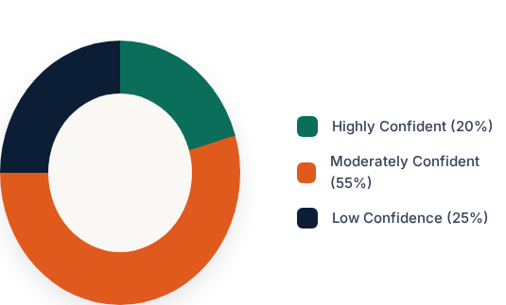
Exploratory Data Analysis
Student Job Readiness Self-Ratings
Key Observations
Most FJWU CS students exhibit CGPA ranges between 3.0 and 3.5.
A significant portion of respondents have no internship exposure.
Standard programming rated much higher than advanced DevOps or Project Management.

Slide 10






Statistical Analysis
CGPA vs Skills Gap
Exposure Lift
Identified Gaps
Correlation tests show a weak link between pure CGPA and practical technical execution. Top grades don't guarantee project capability.
Internship and certified training experiences mathematically produce a direct positive shift in confidence and perceived work readiness.
Severe gaps exist in Cloud, DevOps, Agile Methodologies, and corporate business communication compared to standard requirements.

Slide 11
Data Collection
Dataset Overview
Primary data was gathered through carefully designed student response surveys to evaluate ground reality directly.
108 Responses: Exhaustive target representation.
Google Forms: Highly standardized virtual execution.
Key Variables: Student CGPA, core technical skills, certificates, previous internships, and self-reported readiness.

Slide 12

Research Methodology
Mixed-Method Research Approach
QUANTITATIVE
QUALITATIVE
Likert-scale survey responses
Open-ended student response text
Numerical GPA correlation data
Thematic pattern extraction via NLP
+
Statistical frequency analysis
Sentiment and opinion analysis
Percentage-based skill gap mapping
Narrative coding of student concerns
Rating-scale self-assessment data
Emergent theme identification
Professional Practice Applied: Real-world research demands multiple data types — we didn't rely on just one method

Slide 13

NLP & Responsible AI Usage
NLP ANALYSIS PIPELINE
Responsible AI
Text Collection
Applied NLP ethically without invasive profiling or data misuse
1
Raw open-ended responses gathered from students
2
Preprocessing
Tokenization, stopword removal, normalization
Explainable Analysis
3
Pattern Analysis
All AI-assisted findings can be traced back to source responses
Frequency analysis and keyword extraction
4
Theme Extraction
Thematic clustering of recurring concerns
Data-Driven Decisions
5
Insight Generation
Data-driven findings for decision making
Conclusions drawn from evidence, not assumptions or intuition
Professional Practice Applied: Responsible, explainable AI usage with data-driven decision making

Slide 14

Critical Thinking
Core Question We Dared to Ask:
"Does GPA Actually Reflect Job Readiness?"
Analytical Thinking
Evidence-Based Questioning
Questioned conventional wisdom about GPA
Designed a study to test, not just assume
Challenged assumed correlation between grades & skills
Let data shape the conclusions, not the other way
Used evidence to examine a widely-held belief
Maintained objectivity throughout the process
Professional Practice Applied: Analytical thinking and evidence-based inquiry — the core of all professional research

Slide 15

Visual Communication & Key Findings
Student Skill Gap Ratings (% feeling unprepared)
Research Response Distribution
Professional Practice Applied: Clear visual communication simplifies complex findings for all stakeholders

Slide 16

Interactive Dashboard
Key Features
We designed and implemented a custom real-time data analytical dashboard for instant data exploration.
Utilizes fully modular interactive components for fast metric tracking across subsets.
Tech Stack

Slide 17

Reporting & Documentation
🎯
🔬
📊
Objectives
Methodology
Findings
Clearly defined research goals and scope from the outset
Step-by-step documentation of research and analysis approach
Data-driven insights presented with supporting visualizations
⚠️ Limitations
💡 Recommendations
Honest acknowledgment of research boundaries and constraints
Actionable suggestions for universities, students, and industry
Professional Practice Applied: Structured reporting with full traceability from objective to recommendation

Slide 18

Industry Impact Thinking
This project creates measurable impact across three key stakeholders
Students
University
Industry
Identify personal skill gaps before graduation
Data to support curriculum reform decisions
Access to better-prepared skilled graduates
Better preparation and planning for careers
Evidence for adding practical skill development
Reduced onboarding and training costs
Shift focus from GPA-only to holistic readiness
Bridge the gap between academia and industry
Closer collaboration with universities
Gain self-awareness about employability
Improve graduate employment outcomes
Input into shaping relevant curricula
Professional Practice Applied: Thinking beyond the classroom to real societal and industry impact

Slide 19

04 · Team Management
Member
Role
Responsibility
Skills Applied
Member 1
Data Lead
Data Collection & Survey Distribution
Communication, Field Research
Member 2
Data Analyst
Data Cleaning & Preprocessing
Accuracy, Attention to Detail
Member 3
NLP Engineer
NLP Analysis & Pattern Extraction
AI Tools, Text Mining
Member 4
Visualizer
Charts, Graphs & Dashboard Design
Visual Communication
Member 5
Reporter
Documentation & Presentation
Technical Writing, Delivery
✔ Collaboration
✔ Accountability
✔ Project Coordination
✔ Structured Roles
Professional Practice Applied: Clear role division, defined timelines, and collaborative accountability

Slide 20
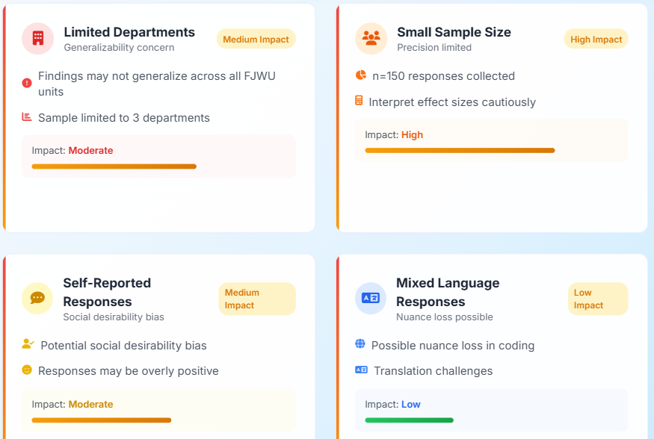

Most students hide limitations. We don't. Acknowledging limitations is a mark of true professionalism.
12. Limitations & Research Honesty

Slide 21

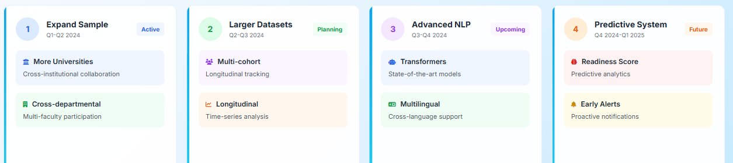
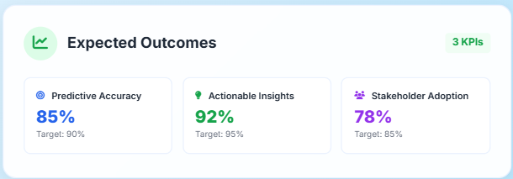
13 · Future Improvements & Roadmap

Slide 22
Why This Project Is Genuinely Strong
Research
Psychology
NLP & AI
Education
Industry
Relevance
Professional
Ethics
Data
Analytics
"Very few student projects combine all these disciplines properly — this one does."

Slide 23
FJWU · Final Conclusion
Our Project Statement:
"This project is not just a research study — it is an analytical framework to understand the disconnect between academic achievement and real-world readiness."
✔ Research
✔ Ethics
✔ NLP
✔ Teamwork
✔ Documentation
✔ Visual Communication
✔ Critical Thinking

Slide 24


Questions & Discussion
Thank you for your valuable time and attention.
FJWU CS Capstone Project - Batch 2023

