Slide 1














Protein secondary structure assignment
Presented by : Insaf ElEbri

Slide 2
01
02
03
04
Secondary Structure
DSSP Program
Implemented Program
Results

Slide 3
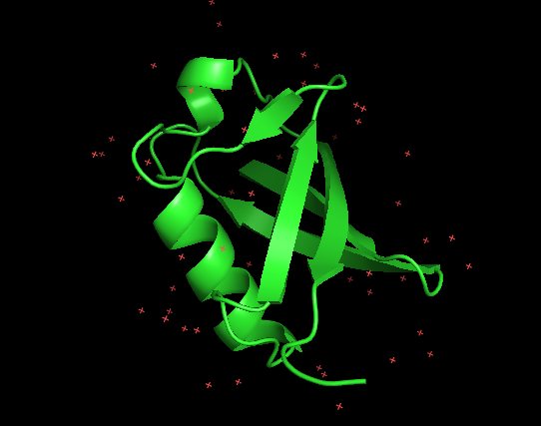
Definition
Secondary structure refers to regular, recurring arrangements in space of adjacent amino acid residues in a polypeptide chain. It is maintained by hydrogen bonds between amide hydrogens and carbonyl oxygens of the peptide backbone. The major secondary structures are α-helices and β-structures.

Slide 4


DSSP Program
Is a program designed by Wolfgang Kabsch and Chris Sander to standardize secondary structure assignment.
Is not designed to predict secondary structure.

Slide 5
PDB FILE
1)Turn
2)Helix
3)Bridge
4)Ladder
5)Sheet
HBPlus
.hb2
Of the protein we want to test
To extract the H-Bonds

Slide 6
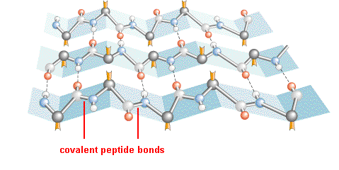
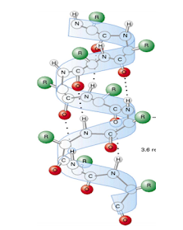
The 5 main sections of the program
Turn
Helix
Bridge
Ladder
Sheet
A loop for will browse these to lists to calculate the distance between both involved residues. If it is equal to FOUR then a list called TURN will append the two of them.
If there’s a set of one or more consecutive bridges of identical type, the program will identify it as a Ladder.
Parallel
Antiparalle
01
02
03
04
05

Slide 7
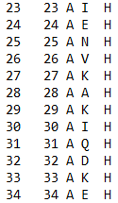
Results

