Slide 1




NEXT GEN EMPLOYABILITY PROGRAM
Creating a future-ready workforce
Team Members
College Name
Student Name : Sriram Aravindh S R
Student ID : 311121104056
Loyola-ICAM College of Engineering and Technology

Slide 2

CAPSTONE PROJECT SHOWCASE
Project Title
Music Player Web Application using Django Framework
Abstract | Problem Statement | Project Overview | Proposed Solution | Technology Used | Pages | Conclusion

Slide 3
Abstract
The Music Player Web Application built using the Django Framework is designed to provide users with a platform for streaming and managing their music collection online. The application offers a user-friendly interface where users can register, log in, and upload their music tracks to create personalized playlists.

Slide 4
Problem Statement
In today's digital age, music enthusiasts often face challenges in managing and accessing their music collection across multiple devices. Traditional methods of storing music locally on devices limit accessibility and organization. There is a need for a comprehensive solution that allows users to securely store, organize, and stream their music collection from any device with an internet connection.

Slide 5
Project Overview
The Music Player Web Application is a platform developed using the Django Framework to provide users with a comprehensive solution for managing and streaming their music collection online. The application aims to address the challenges faced by music enthusiasts in organizing and accessing their music across various devices.

Slide 6
Proposed Solution
.
The proposed solution is to develop a Music Player Web Application using the Django Framework, which will offer users a seamless and intuitive platform for managing and streaming their music collection online, Which eliminates the need of regular storage devices to store the users favorite music and the user can listen to these song that they uploaded to the site from anywhere they want.

Slide 7


Technology Used
Front-end
Back-end

Slide 8
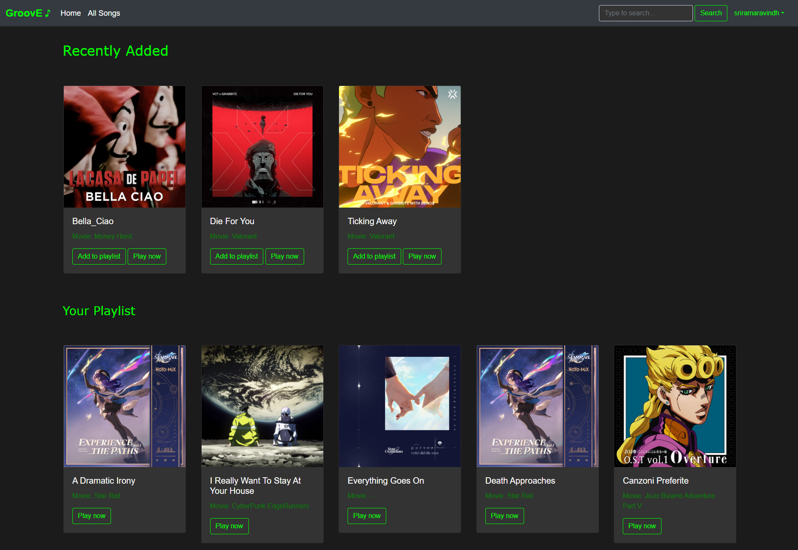
Homepage

Slide 9
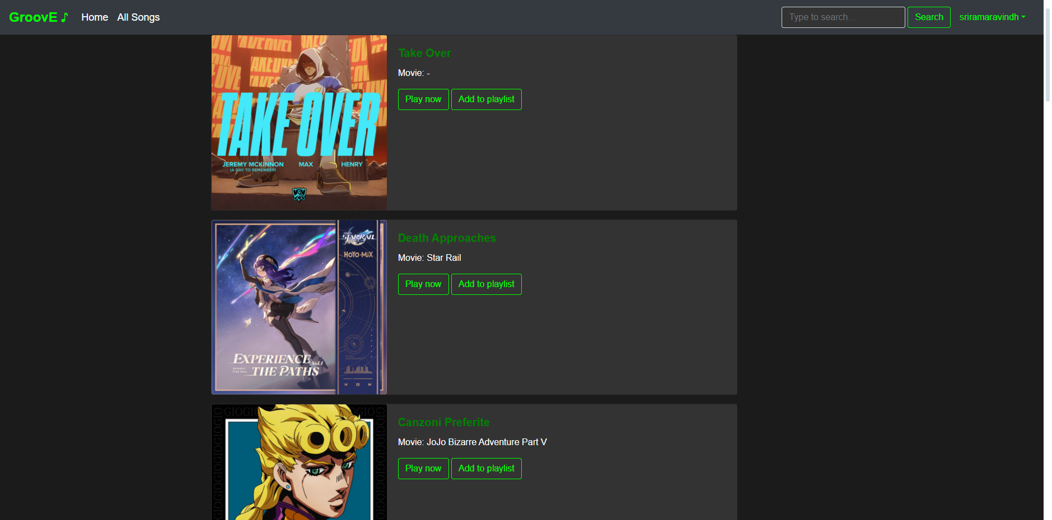
All Songs Page

Slide 10
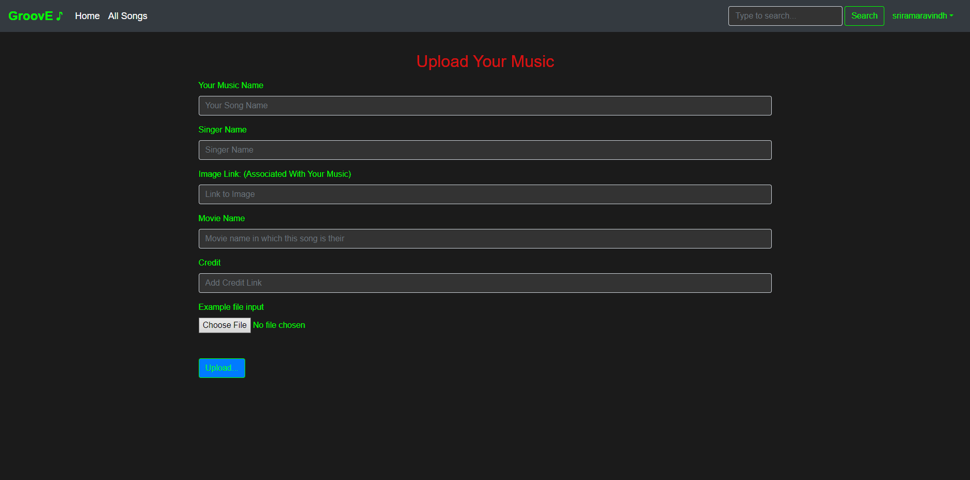
Upload Page

Slide 11
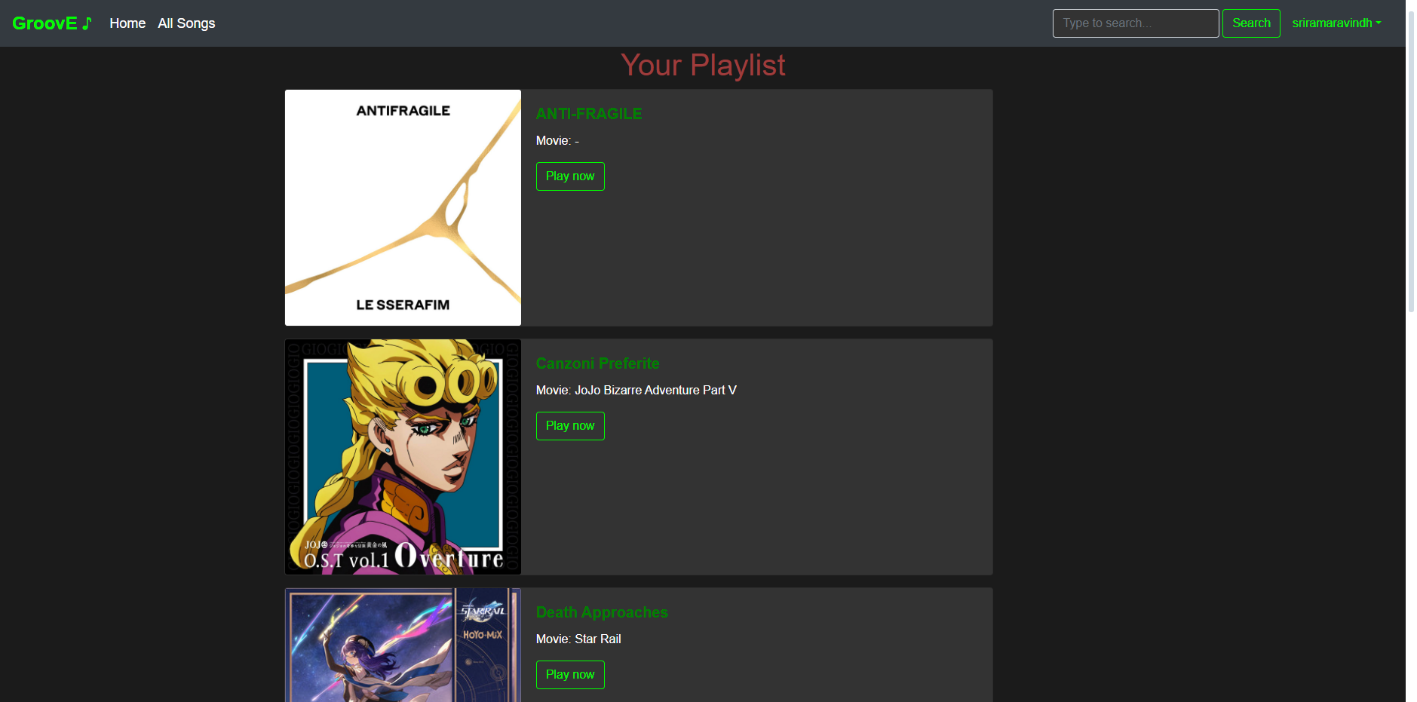
Playlist Page

Slide 12
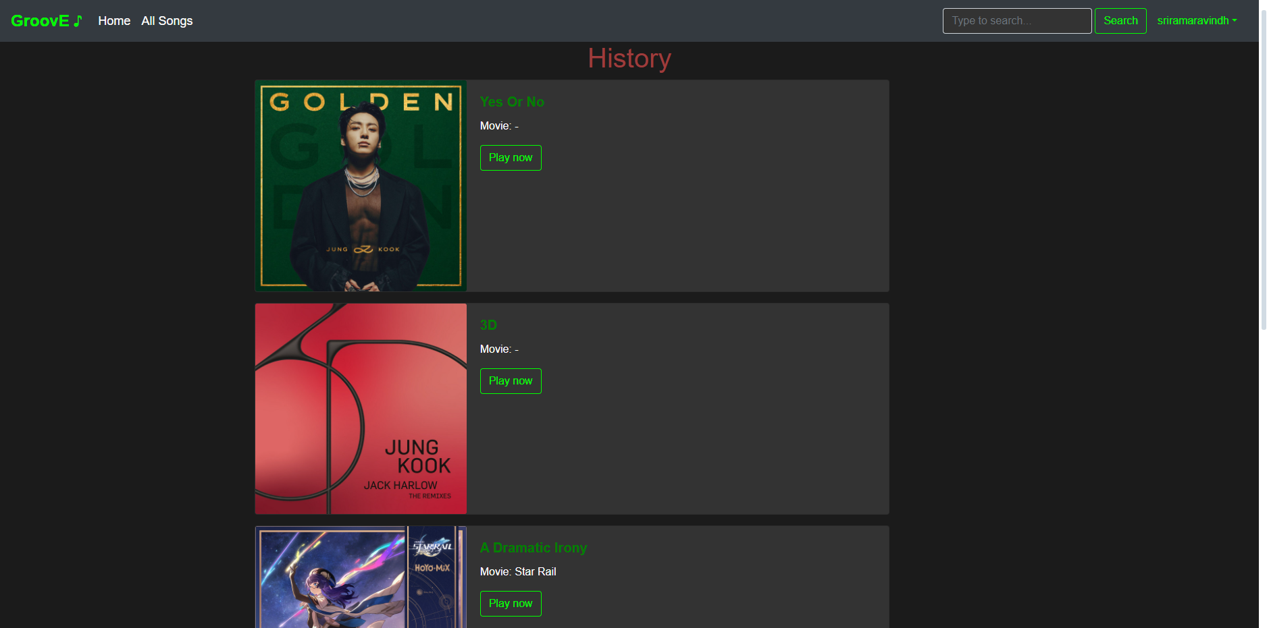
History Page

Slide 13
Future Enhancements:
1. Social Integration for sharing and collaboration.
2. Customizable Themes and UI for user preferences.
3. Enhanced Offline Support for downloading tracks.
4. Collaborative Playlists with friends and families.
5. Live Streaming Podcasts and Music.

Slide 14
Conclusion
In conclusion, the Music Player Web Application developed using the Django Framework offers a robust platform for users to manage, organize, and enjoy their music collection online. With its user-friendly interface, secure authentication, and seamless streaming capabilities, the application enhances the music listening experience. Future enhancements such as social integration, advanced recommendation systems, and customizable themes will further enrich the user experience, making it a comprehensive solution for music enthusiasts.

Slide 15
Thank You!
Notes:
Thank You !!

