Slide 1
Group 3
Yubo Feng
Wei Yang
Zi Wang
Recommend
System
Recommendation System for JD.com

Slide 2


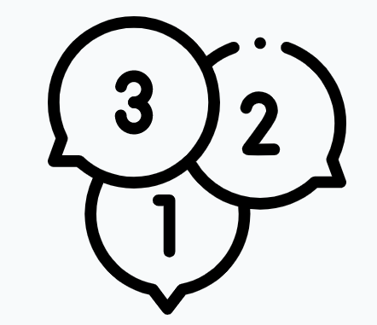


Framework
Sequence of SKUS to vector
Extract embedding from NN
EDA
Method
Preprocess
NN Model
Conclusion
Determine hyper parameter
Generate n-gram samples
Evaluation of model

Slide 3
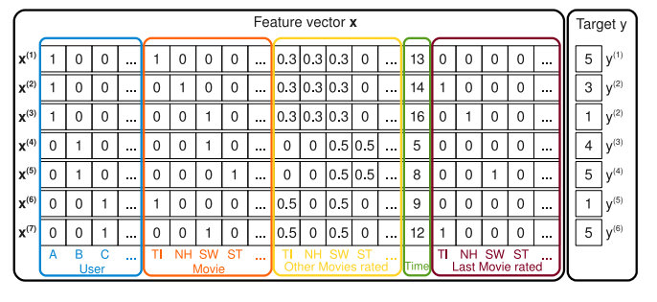
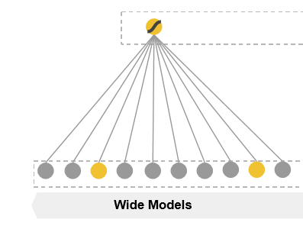
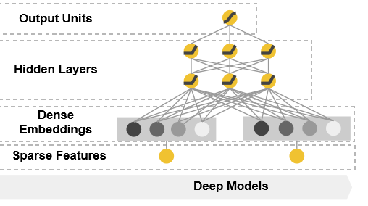
Introduction
Memorization versus Generalization
Interpretable versus Robustness
Wide Memorization Model
Embedding Based Model
Figure from [https://arxiv.org/pdf/1606.07792.pdf] & [https://cseweb.ucsd.edu/classes/fa17/cse291-b/reading/Rendle2010FM.pdf]

Slide 4

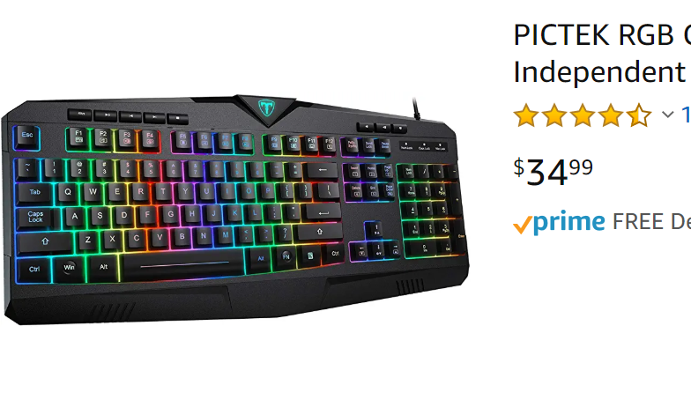


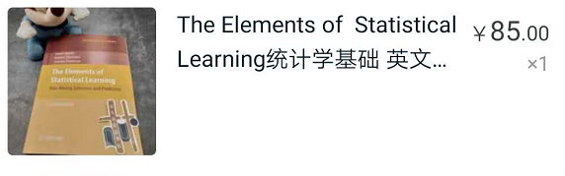

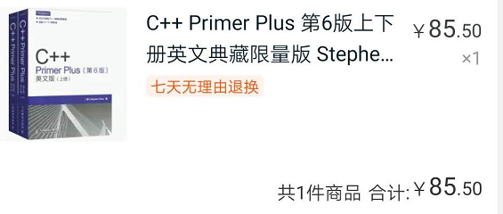
Introduction

Slide 5
Assumption
Short sequence of clicks are correlated
Recent historical purchase can reflect recent taste
Word 2 Vector !!!
How should we deal with sparse input?
How short the sequence should be?
Can we also embed User?
How can User embedding reflect taste?
Can we parallel computation?

Slide 6
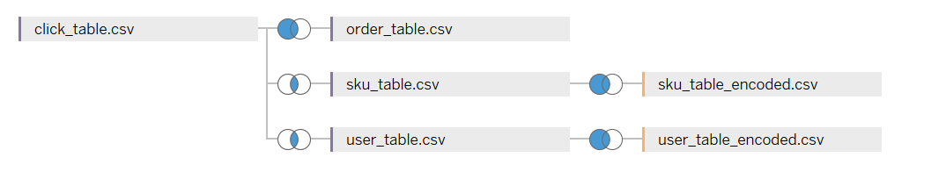
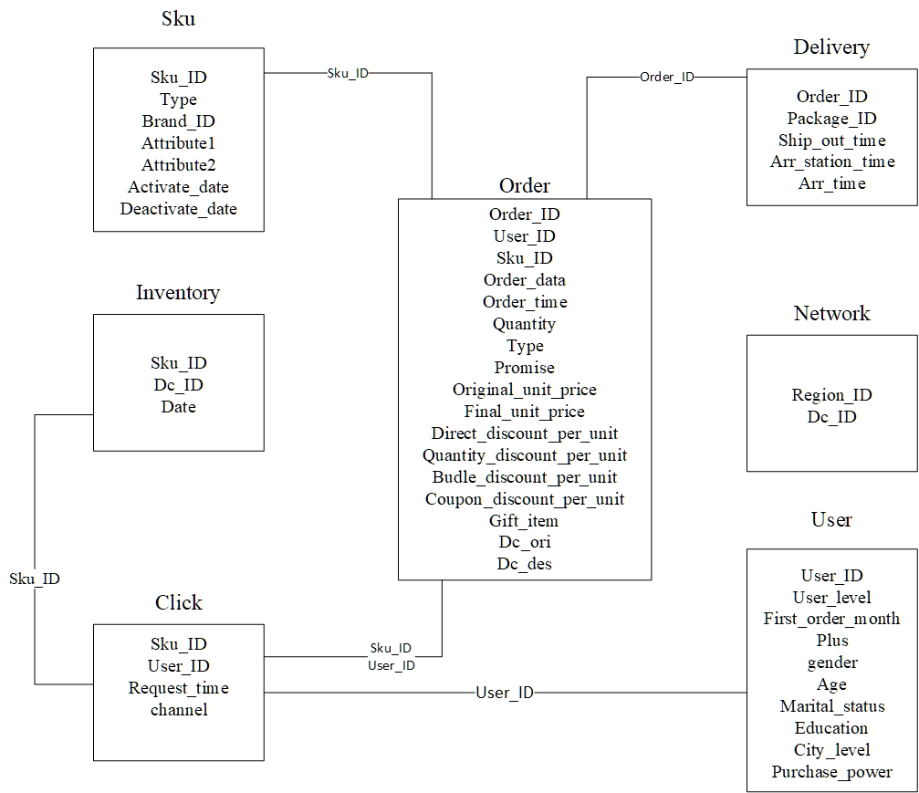
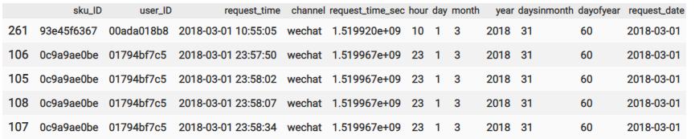
Dataset Structure and Pipeline
Goods
N-gram sequence
Embedding model
word2vec pretraining
Layer Initialization

Slide 7
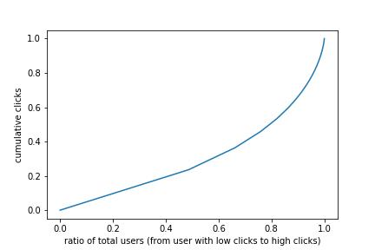
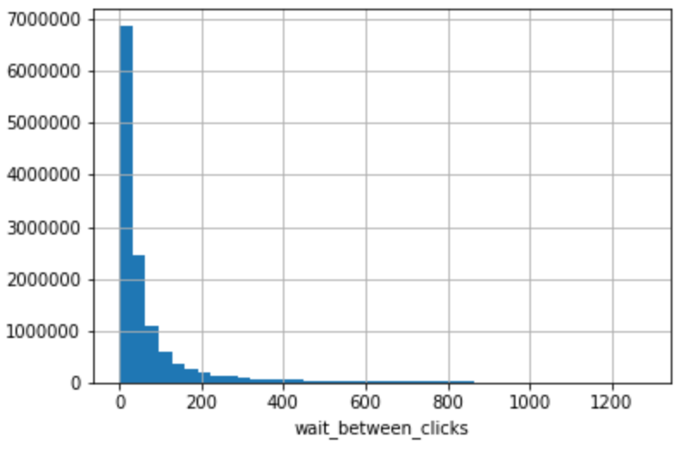
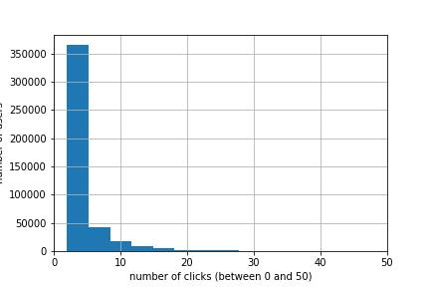
Exploratory Data Analysis (EDA)
Click interval
Cumulative click ratio
Click count
Notes:
带观众简单了解下数据集

Slide 8
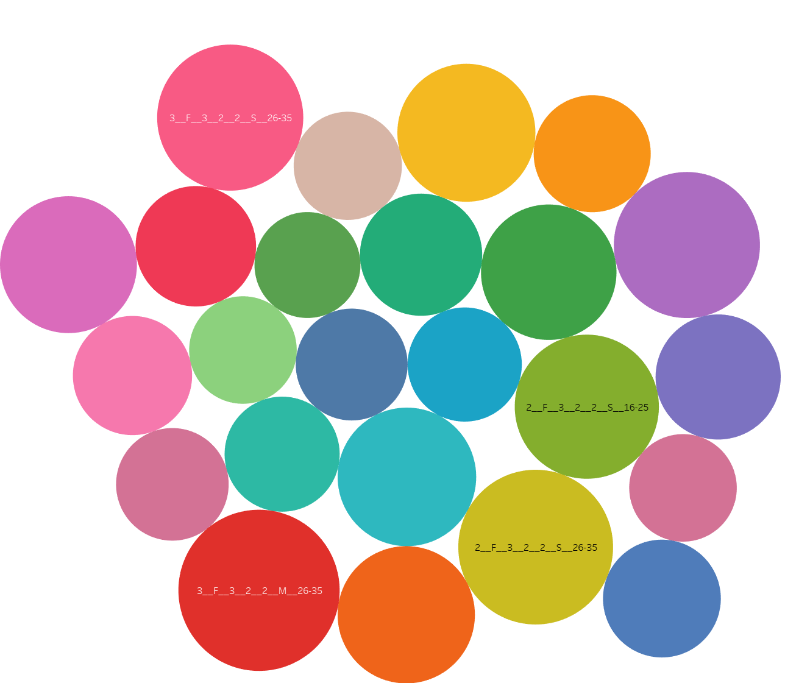
Data Transformation
Concatenate features
to make new User_ID
User level
Gender
Education
City level
Purchase power
Martial status
Age
[Size represents number of clicks]
Notes:
带观众简单了解下数据集

Slide 9
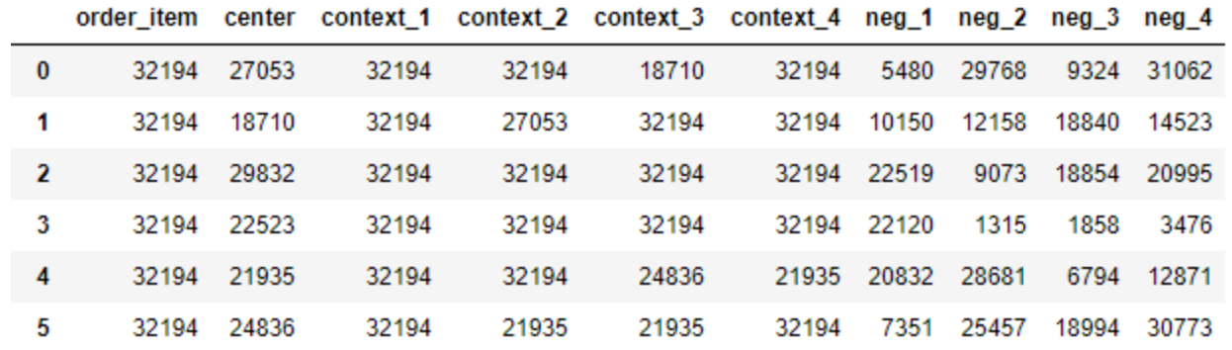
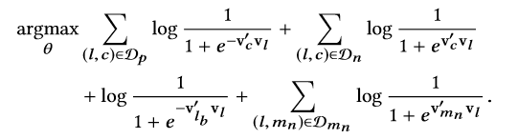


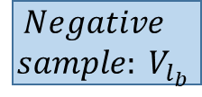







Word2vector pretraining
More weight!!
$$Center: V_{l}$$
$$Context: V_{c}$$
$$Context: V_{c}$$
$$Negative$$
$$sample: V_{l_{b}}$$
$$V_{m_{n}}$$
Ordered
Not Order
Not Order
Not Order
Not Order
[0]: $V_{m_{0}}$
[3]: $V_{l_{3}}$
[1 2]: $V_{c_{1}} V_{c_{2}}$
[4 5]: $V_{c_{4}} V_{c_{5}}$
[7 8]: $V_{b_{7}} V_{b_{8}}$
Notes:
带观众简单了解下数据集

Slide 10
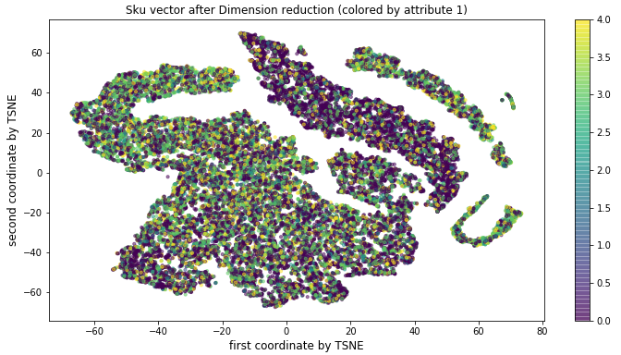
Word2vector pretraining

Slide 11
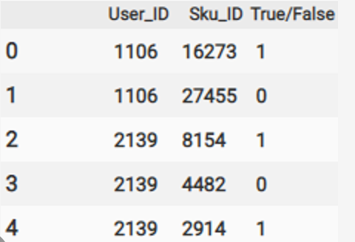
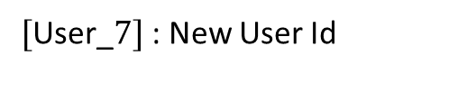





Neural Network Model
Preference of User
Preference
Difference
$[1.1, 1.3…]$: User vector 1
Diff1
$[1.1, −1.3…]$: User vector 2
Diff2
$[−1.1, 1.3…]$: User vector 3
Diff3
$[\text{User}\text{_}7]$: New User Id
$[\text{SKU}\text{_6}]$: SKU Id
$[1.1, 1.3…]$: SKU vector

Slide 12
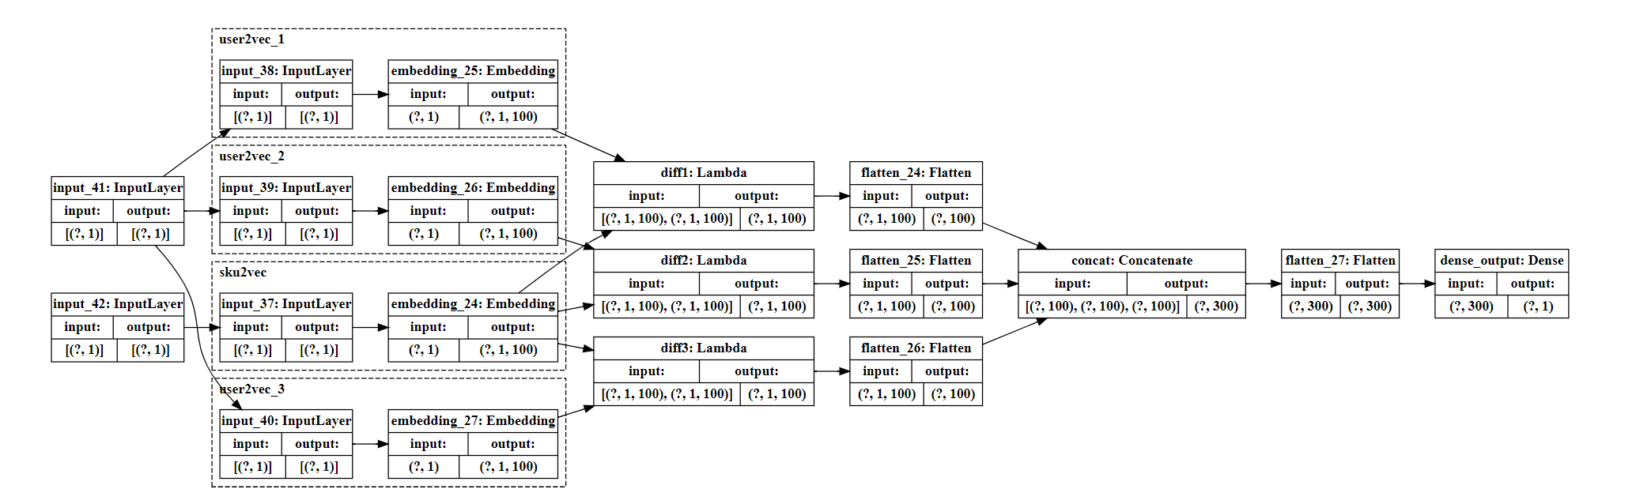
Neural Network Model
Dense Output
Difference
Densely connected layer to output probability
Embedding
Subtract each
User vector with
SKU vector
Preprocess
User ID to User vector
SKU ID to SKU vector
User ID and SKU ID are preprocessed to vector

Slide 13
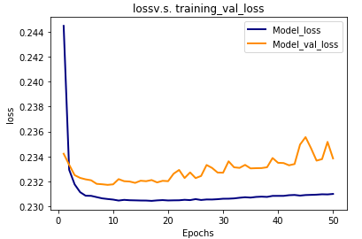
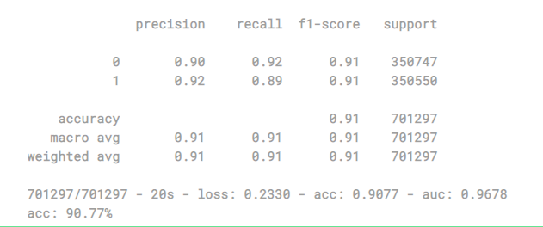
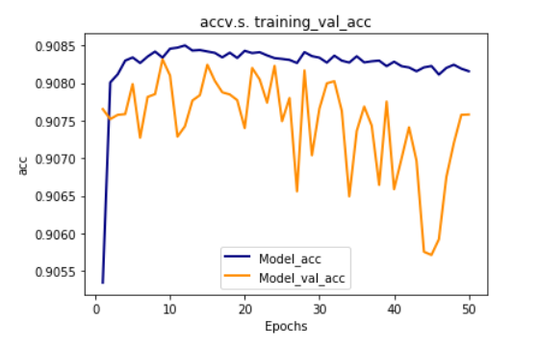
Neural Network Model
Conclusion
The best model we obtained get higher accuracy than RNN based model.

Slide 14
Conclusion
Strength
Weakness
Scalable
Interpretable
Memorization
Can utilize parallelization to speed up: Faster than RNN-based model
Less generalizable: model recommends popular SKU, instead of novel SKU
Unable to interpret SKU embedding & Unable to do case study, because variables are anonymous.
Performance lower than CNN-based model
Future Work
Make output layer deeper
Use embedding layer to initialize deep-wide network

Slide 15
Thank You
Group 3 Yubo Feng/Wei Yang/Zi Wang
Reference
https://dl.acm.org/doi/abs/10.1145/3219819.3219885 Real-time personalization using embeddings for search ranking at airbnb-kdd axiog
https://arxiv.org/pdf/1606.07792.pdf Wide & Deep Learning for Recommender Systems

