Slide 1
Recommendation System
Focus on the implementation of System Architecture
Wei Yang
Notes:
This project focus on the scenario that a start up company with available thirty days data on their database, who want to improve their customer satisfaction by implemented a new recommendation in their website.
So, this project is also kind of exploration from zero to one. It focus more on engineering aspect, focus on how to embed some traditional algorithms like CF in this system, how to combine all the tools to build the system, rather than diving into algorithms or model’s part like neural network.

Slide 2
Outline
Data description
System framework
Offline part
Online part
Improved case
Difficulties and future plan
Notes:
This is the brief outline in this presentation.

Slide 3
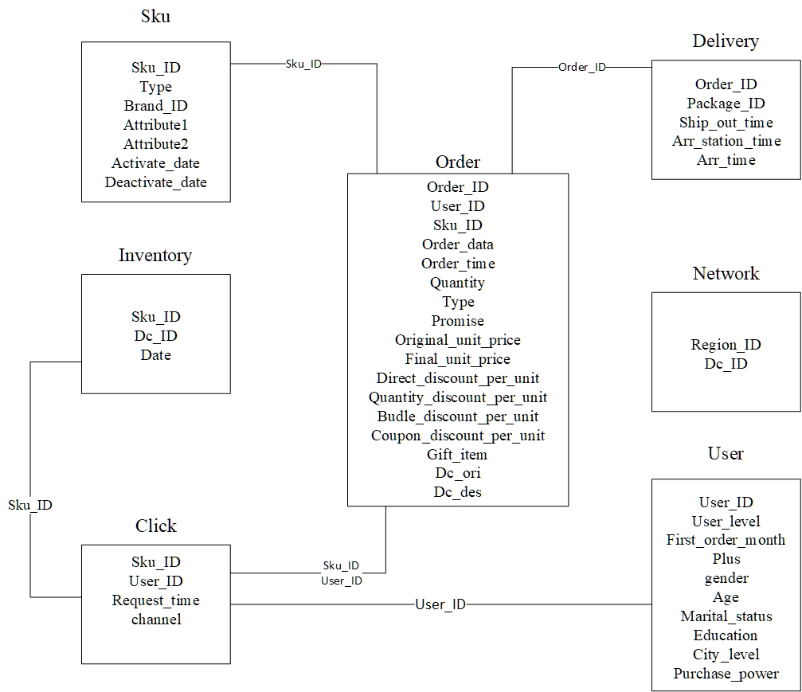
Data description
ER graph
Notes:
This is a dataset from jingdong. This Entity-Relation graph shows the data fields and connection between tables. This project primarily use the sku table (which is the item table), along with the user table and the interaction click table.

Slide 4
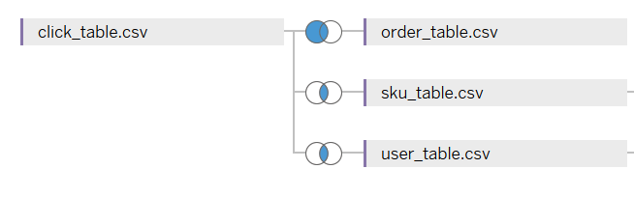
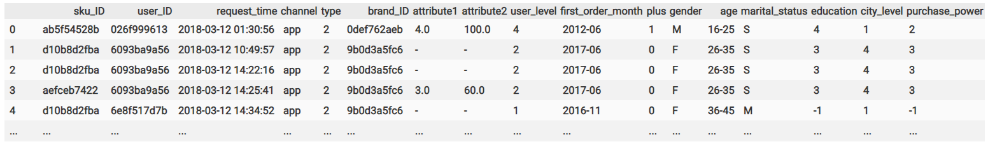
Data description
Integration and cleaning
Summary
30 successive days
31868 SKU (items)
457298 users
20214515 click records
Cleaning
Remove click records with the same user_ID and request_time
Notes:
I use click interaction as primary target to extract information. Joined the tables to get the desired table as show in the bottom, which contains sku_ID, user_ID. Each row is a click by the user.
It remove click records with the same user_ID and request_time. Sometime, we may click several times on our screen, but the effective records in there are only once.
But for privacy protection, the sku_ID and user_ID are encoded, which means I don’t know what kind of item that it truly is. That make the result of the system not that intuitive, because we only have the encoded ID. (隐私加密介绍)
On this click table, it contains 30 successive days records. As you can see the large size of the user and sku, to get the response faster, I randomly choosing about 10% users and items as target first. (选择数据集)

Slide 5
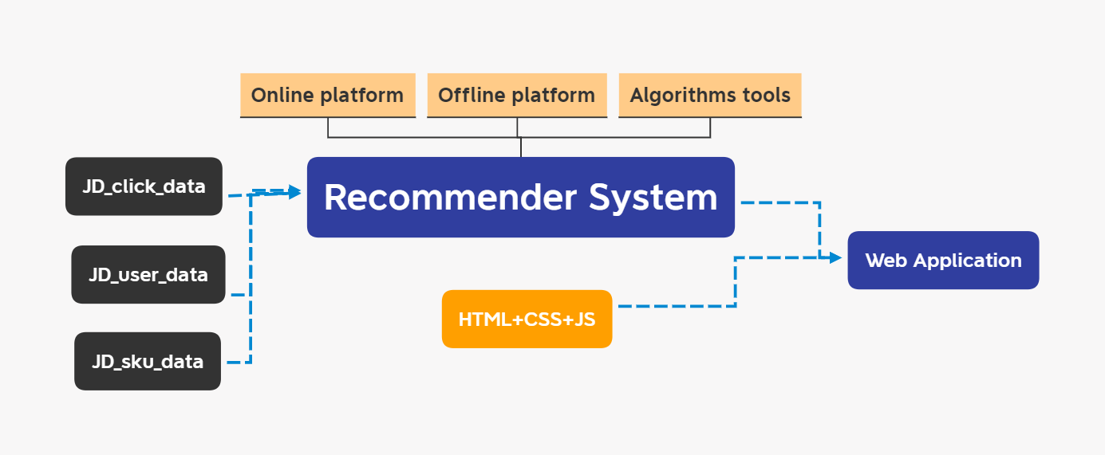
System Framework
Notes:
This is the basic outline. I mainly focus on figuring out how to separate the online and offline part on this recommender system.

Slide 6
Offline - Initialization
Processed data : effective span ; methods used
User-Item matrix from accumulated click counts for each user by SKU ( from beginning )
User Based CF
Item Based CF
Item attributes grouping table (rolling windows 7 days)
Contents based filtering
User attributes grouping table (rolling windows 7 days)
Demographic based filtering
Item embedding from user click sequence (rolling windows 30 days)
Word embedding
Notes:
This slides summarize the information that I retrieve.
For simulation the true environment, consider that we only have 15 days data, and the system will update day by day with the time moving forward. Until the end of this dataset.
I retrieve accumulated click counts for each user by sku_ID to get a User item matrix, It is kind of panel data for user_ID and sku_ID.
After I got it, it is convenient to apply the collobrative filtering algorithms In there.
So, the reason why I choose to accumulate the click from beginning is because I think we probably have more inclination to buy the item if we click more times of that item. This information may not that useful for book recommendation or film recommendation, which I will probably not click twice.
To incremental the value of this matrix, we need to save it into database, and updated by the new record in next day. (更新逻辑)
For Item attributes grouping table, find the 10 highest click frequency items in each group, and then join the table back with item attributes. In other words, we group items based on their attributes first, and find what is the most popular ten items in each group. If a user click a item within one group, we just recommend the most popular items in that group, on the recent week. Obviously, the more attributes the items had, the more accuracy this method will be. In my case, the dataset only has two attributes for each item. This method may be not that effective, but I think it still provides us a pool to make further selection, right?(解释 item attributes )
There are lots of different contents-based filtering methods, the classical one will extract TF-IDF matrix from reviews, and then grouping the reviews for item OR just directly map the features to user profile. I think they are almost the same, it is kind of grouping or clustering.
For user attributes grouping table, I use almost the same method to deliver demographic based filtering in there.
Last, for item embedding, I first generate user click sequence, and treat these SKU_ID sequence as vocabulary in NLP concept, then get the embedding for each sku_ID by training a skip-gram model.

Slide 7
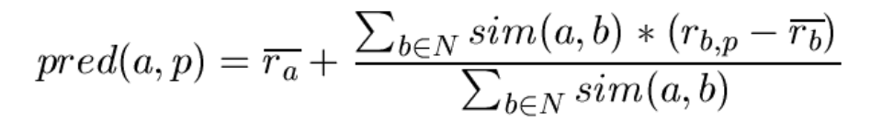
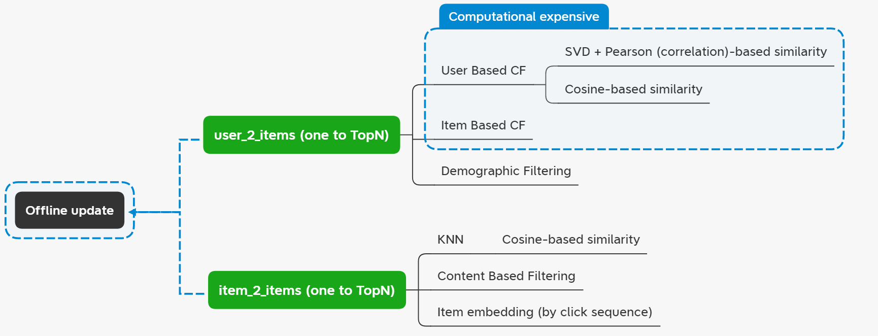
Offline – Way to use
Calculate mapping table once a day offline
Update the mapping table in the server database
Online Dynamic = fusion these mapping tables
Notes:
With the pre-processed data, each method generate a score, and I can get the rank in their score matrix.
There are two categories, one is user to items mapping table, another is the item to items mapping table. For the first one, we get give a user, and the function will return the highest topN items as its recommendation, which is the items that user probably tend to click from the method aspect.(解释怎么看图),
It is similar for the item to items case, I only need provide an item_ID to the table, and it will return the topN items as its recommendation.
There are questions to consider.
First, why this is the offline computed. Well, the computation in there are expensive, especially in the collaborative filtering that we need to calculate the Pearson correlation and the similarity weighted sum prediction. The dimension reduction technique, truncate SVD used in there to improve the efficiency of calculate high dimension correlation. (计算很慢) Therefore, we can pre-calculate such mapping table and saved in the server database. User only need to load this mapping on their browser. (结论)
And,
as I mention before, the pre-processed data calculate once a day on the maintanance time, it can also be calculated several times in a day. It depends on the cost and benefit that the startup company have.
For this project, I choose to update only once a day.
Then, there is another question, in user aspect, this setting means the system is not making dynamic recommendation. Which means the recommend list will not change in a day.
So, with limit computational resource, we can try integrate these mapping table to make the system dynamic.
For examples, we can initialize the recommend list of a user with user 2 items table as the beginning of the day. The system only need the user_ID to get the recommend list on that mapping table.
Then, after user clicking some of items, the system will have other lists from item 2 items mapping table. We can concatenate the list of them in some special way. Then, the recommend list will be more dynamic for users to some extents.
There are a bunch to fusion methods to integrate them, like majority vote.
The fusion part is normally be deployed on the Online platform.

Slide 8
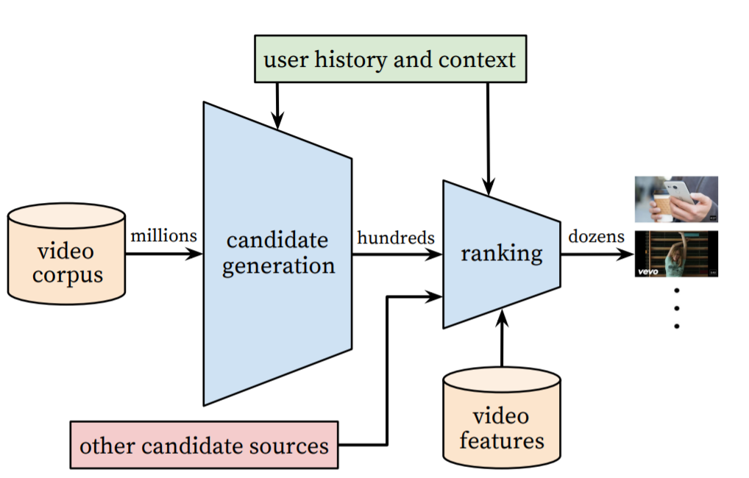
Framework – improved case
YouTube Recommendations Architecture (five years ago)
Pre-calculated mapping table => candidate generator
Fusing by tricks or Neural networks => ranking and detail selection
Notes:
As the mature architecture on Youtube, we can treat the pre calculated mapping table as the candidate generator, or as an initial filter, we can get a pool to do the further selection.
To better improve the accuracy, we can further utilize some neural network models to help user make better fusion, or detail selection.
To implement that, we need extra features and label data to train a ranking model in there. In this dataset, we can also do it, because we have the item orders information. But this part is a little bit time consuming, I will leave it in the future.

Slide 9
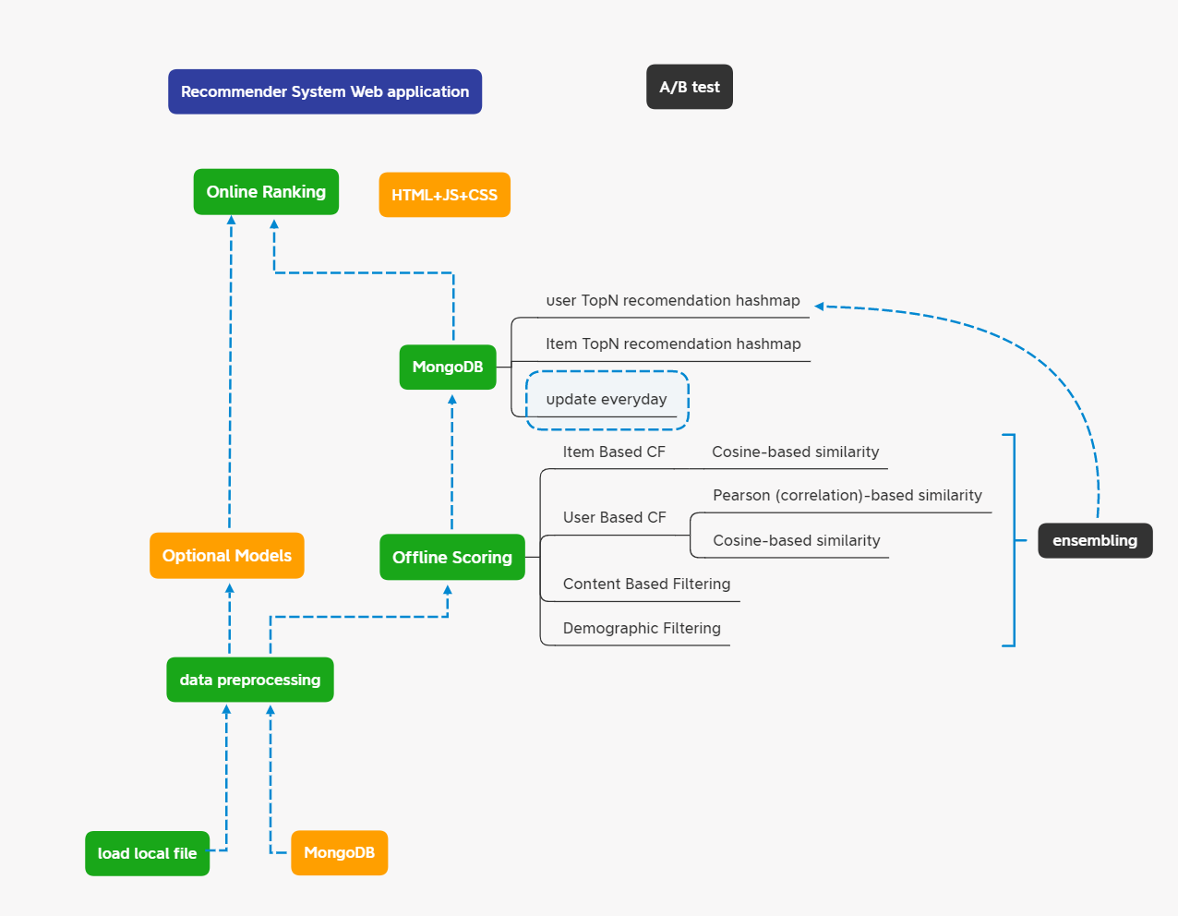
Difficulties and future plan
Difficulties
Efficient storage
Evaluation
Future plan
Test on other data source
Try NN models
Test the response speed
Notes:
Till now, I am not able to show the demo. I finished the whole blue pipeline in a 10% target dataset, and make simulation the calculation by retrieving dataset with time moving forward.
but I am still working on the connection with frontend, website rendering part.
On the engineering aspect, I think the most difficult one is the data storing and loading part, since the offline result is really large in recommendation system, and it is also timeseries. I am still trying to figure it out on mongoDB.
For the evaluation, A/B test is obviously not available in this dataset on this period since there is no influenced user-item interaction generated by the system build there. The precision and recall can be tried in this case, but I think it is just a kind of measurement that calculate how much similar that the models in this system as the original existed system in JingDong at that time. So, to evaluate such system, I think the dataset from online testing may be needed.
In the future, I may try different dataset that without encoding the item and user id, which may have more intuitive recommendation result. Or probably try to incorporate some neural network models in there. Off course the speed of the response will need to be considered.
And that’s all my project. I will finish the rest of the frontend part, And try to make the system more complete in the final report.

Slide 10
Thanks for listening
Wei Yang

