Slide 1
InSecurity
Cybersecurity association

Slide 2
Cybersecurity ?
OSINT
System
Reverse engineering
Password cracking
Privelege exploitation
Forensic
Network
Steganography
Web server
Web client

Slide 3
01
02
TABLE OF CONTENTS
03
04
RECOGNITION
Dorks, Wireshark, Whois, ...
SCAN
Nmap, Gobuster, Nessus, BurpSuit, ...
EXPLOIT
John, Hydra, Metasploit, peass, SQLmap,...
POST-EXPLOIT
Netcat, nc, Meterpreter, ...

Slide 4
Dorks
Searching method using special command, ex :
bases du hacking filetype:pdf
site:tryhackme nmap
inurl:login linkedin
GHDB

Slide 5
Wireshark
Sniffing tool to get everything that is pass through a network.
Need some basis of the OSI model and some understanding of protocols

Slide 6
Whois
Get IP address, DNS an some other informations of a target

Slide 7
Nmap
Get openned ports.
Usefull to know what do the machine and what protocol it use
nmap -sS -p- {ip}
nmap -A {hostname}

Slide 8
Gobuster
Get openned ports.
Usefull to know what do the machine and what protocol it use
nmap -sS -p- {ip}
nmap -A {hostname}

Slide 9
Nessus
Get openned ports.
Usefull to know what do the machine and what protocol it use
nmap -sS -p- {ip}
nmap -A {hostname}

Slide 10
BurpSuit
Get openned ports.
Usefull to know what do the machine and what protocol it use
nmap -sS -p- {ip}
nmap -A {hostname}

Slide 11
John
Crack passwords.

Slide 12
Hydra
Crack password online

Slide 13
Metasploit
Get openned ports.
Usefull to know what do the machine and what protocol it use
nmap -sS -p- {ip}
nmap -A {hostname}

Slide 14
Peass
Script to run on the target to know weaknesses

Slide 15
SQLmap
Get openned ports.
Usefull to know what do the machine and what protocol it use
nmap -sS -p- {ip}
nmap -A {hostname}

Slide 16
GTFOBins
Usefull site to gain root access with an app badly configured.
if python have the SUID set :
sudo install -m =xs $(which python)
./python -c ‘import os; os.execl(“/bin/sh”,”sh”,”-p”)’

Slide 17
NetCat & nc
Listen a given port.
Usefull to ask the target to connect to you instead of connecting to the target

Slide 18
Meterpreter
Get openned ports.
Usefull to know what do the machine and what protocol it use
nmap -sS -p- {ip}
nmap -A {hostname}

Slide 19
“This is a quote. Words full of wisdom that someone important said and can make the reader get inspired.”
—SOMEONE FAMOUS

Slide 20
01
THE COMPANY
This is the subtitle that makes it comprehensible

Slide 21
THE SLIDE TITLE GOES HERE!
Do you know what helps you make your point clear? Lists like this one:
  Because they’re simple
  You can organize your ideas clearly
  And because you’ll never forget to buy milk!
And the most important thing: the audience won’t miss the point of your presentation

Slide 22
MAYBE YOU NEED TO DIVIDE THE CONTENT
VENUS
MERCURY
Venus has a beautiful name and is the second planet from the Sun.
It’s terribly hot—even hotter than Mercury—and its atmosphere is extremely poisonous.
Mercury is the closest planet to the Sun and the smallest one in the Solar System.
The planet’s name has nothing to do with the liquid metal since it was named after the Roman messenger god, Mercury

Slide 23
YOU COULD USE THREE COLUMNS, WHY NOT?
MARS
VENUS
JUPITER
Despite being red, Mars is a cold place, not hot. It’s full of iron oxide dust, giving the planet its reddish cast
Venus has a beautiful name and is the second planet from the Sun. It’s terribly hot, even hotter than Mercury
It’s a gas giant and the biggest planet in our Solar System. Jupiter is the fourth-brightest object in the sky

Slide 24

A PICTURE ALWAYS REINFORCES THE CONCEPT
Images reveal large amounts of data, so remember: use an image instead of long texts. Your audience will appreciate that

Slide 25

A PICTURE IS WORTH A THOUSAND WORDS

Slide 26
AWESOME WORDS
Because key words are great for catching your audience’s attention

Slide 27
02
DATA ANALYTICS
This is the subtitle that makes it comprehensible

Slide 28

IF YOU WANT TO MODIFY THIS GRAPH, CLICK ON IT, FOLLOW THE LINK, CHANGE THE DATA AND REPLACE IT

Slide 29
SOMETIMES, REVIEWING CONCEPTS IS A GOOD IDEA
MERCURY
VENUS
MARS
Mercury is the closest planet to the Sun
Venus has a beautiful name, but it’s terribly hot
Despite being red, Mars is a cold place, not hot
SATURN
JUPITER
NEPTUNE
Yes, this is the ringed one. It’s a gas giant
It’s the biggest planet in our Solar System
Neptune is the farthest planet from the Sun

Slide 30
HOW ABOUT THE PERCENTAGES?
MERCURY
VENUS
Mercury is the closest planet to the Sun
Venus has a beautiful name, but it’s terribly hot
SATURN
JUPITER
Yes, this is the ringed one. It’s a gas giant
It’s a gas giant and the biggest planet in our Solar System

Slide 31
INFOGRAPHICS MAKE YOUR IDEA UNDERSTANDABLE…
VENUS
Venus has a beautiful name, but it’s terribly hot, even hotter than Mercury
NEPTUNE
Neptune is the farthest planet from the Sun
MERCURY
Mercury is the closest planet to the Sun
JUPITER
It’s a gas giant and the biggest planet in our Solar System
MARS
Despite being red, Mars is a cold place, not hot

Slide 32
…AND THE SAME GOES FOR TABLES
 | MASS (earths) | DIAMETER (earths) | SURFACE GRAVITY (earths)
MERCURY | 0,06 | 0,38 | 0,38
MARS | 0,11 | 0,53 | 0,38
SATURN | 95,2 | 9,4 | 1,16

Slide 33
THIS IS A MAP
NEPTUNE
Neptune is the farthest planet from the Sun
VENUS
Venus has a beautiful name, but it’s terribly hot, even hotter than Mercury
MARS
Despite being red, Mars is a cold place, not hot
JUPITER
It’s a gas giant and the biggest planet in our Solar System

Slide 34
A TIMELINE ALWAYS WORKS FINE
DAY 1
DAY 2
DAY 3
DAY 4
Mercury is the smallest planet in our Solar System and the closest to the Sun
Despite being red, Mars is a cold place, not hot. The planet is full of iron oxide dust
The Sun is the star at the center of the Solar System
Venus has a beautiful name, but it’s terribly hot

Slide 35
03
BUSINESS OBJECTIVES
03
This is the subtitle that makes it comprehensible

Slide 36
4,498,300,000
Big numbers catch your audience’s attention

Slide 37
333,000.00
24h 37m 23s
386,000 km
earths is the Sun’s mass
is Jupiter’s rotation period
is the distance between the Earth and the Moon

Slide 38
COMPANY SERVICES
MERCURY
MARS
VENUS
Mercury is the closest planet to the Sun and is only a bit larger than our Moon
Despite being red, Mars is a cold place, not hot. It’s full of iron oxide dust
Venus has a beautiful name and is the second planet from the Sun

Slide 39
04
SOCIAL MEDIA
This is the subtitle that makes it comprehensible

Slide 40
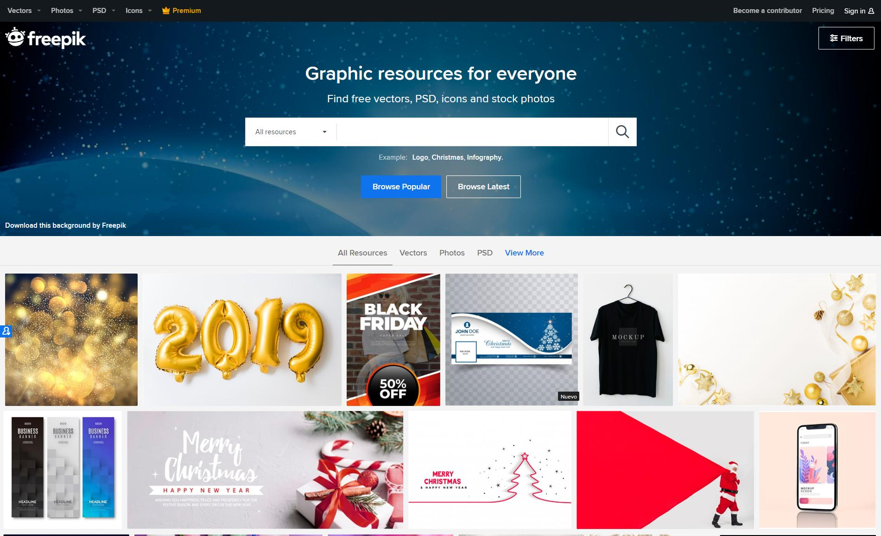
DESKTOP SOFTWARE
You can replace the image on the screen with your own work. Just delete this one, add yours and send it to the back

Slide 41
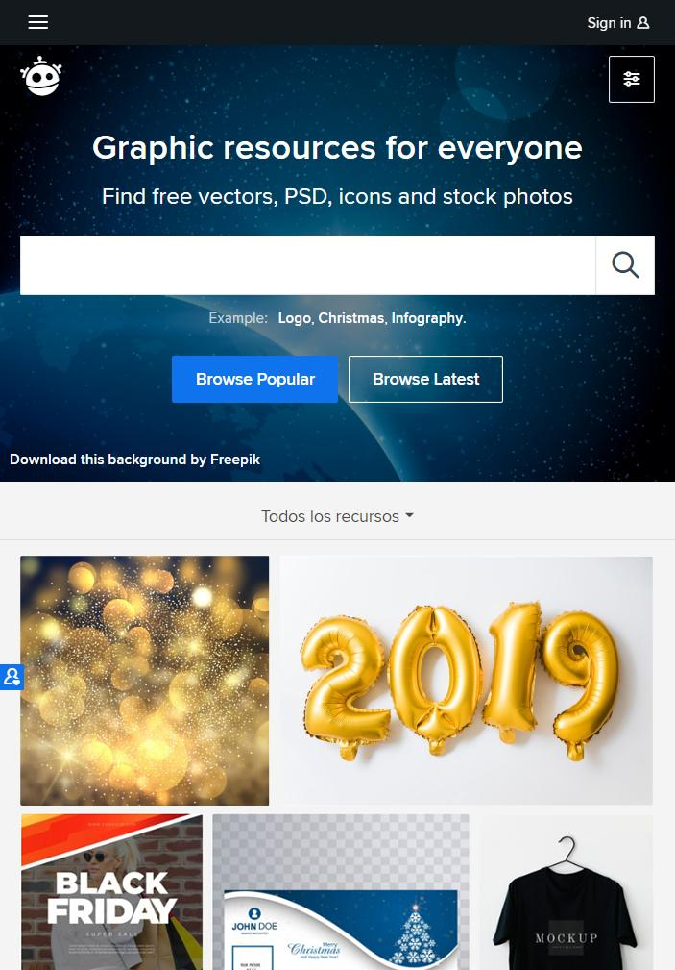
TABLET APP
You can replace the image on the screen with your own work. Just delete this one, add yours and send it to the back

Slide 42
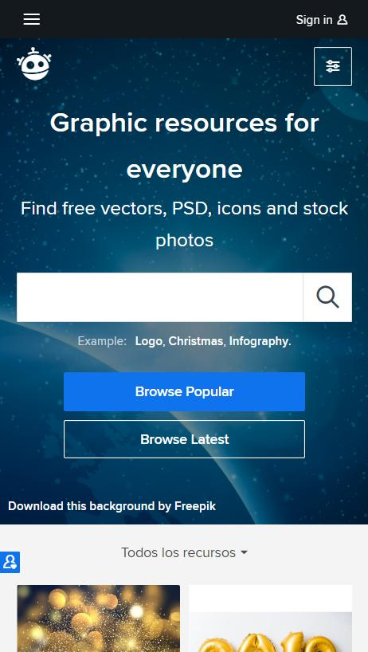
MOBILE WEB
You can replace the image on the screen with your own work. Just delete this one, add yours and send it to the back

Slide 43
OUR TEAM
JOHN DOE
HELENA JAMES
JAMES PATTERSON
You can replace the image on the screen with your own
You can replace the image on the screen with your own
You can replace the image on the screen with your own

Slide 44
THANKS!
Does anyone have any questions?
addyouremail@freepik.com
+91 620 421 838
yourcompany.com

Slide 45
CREDITS
This is where you give credit to the ones who are part of this project.
Did you like the resources on this template? Get them for free at our other websites.
Presentation template by Slidesgo
Icons by Flaticon
Infographics by Freepik
Images created by Freepik and rawpixel -Freepik
Author introduction slide photo created by Freepik
Text & Image slide photo created by Freepik.com

Slide 46
Instructions for use (free users)
In order to use this template, you must credit Slidesgo by keeping the Thanks slide.
You are allowed to:
Modify this template.
Use it for both personal and commercial purposes.
You are not allowed to:
Sublicense, sell or rent any of Slidesgo Content (or a modified version of Slidesgo Content).
Distribute this Slidesgo Template (or a modified version of this Slidesgo Template) or include it in a database or in any other product or service that offers downloadable images, icons or presentations that may be subject to distribution or resale.
Use any of the elements that are part of this Slidesgo Template in an isolated and separated way from this Template.
Delete the “Thanks” or “Credits” slide.
Register any of the elements that are part of this template as a trademark or logo, or register it as a work in an intellectual property registry or similar.
For more information about editing slides, please read our FAQs or visit Slidesgo School:
https://slidesgo.com/faqs and https://slidesgo.com/slidesgo-school

Slide 47
Instructions for use (premium users)
In order to use this template, you must be a Premium user on Slidesgo.
You are allowed to:
Modify this template.
Use it for both personal and commercial purposes.
Hide or delete the “Thanks” slide and the mention to Slidesgo in the credits.
Share this template in an editable format with people who are not part of your team.
You are not allowed to:
Sublicense, sell or rent this Slidesgo Template (or a modified version of this Slidesgo Template).
Distribute this Slidesgo Template (or a modified version of this Slidesgo Template) or include it in a database or in any other product or service that offers downloadable images, icons or presentations that may be subject to distribution or resale.
Use any of the elements that are part of this Slidesgo Template in an isolated and separated way from this Template.
Register any of the elements that are part of this template as a trademark or logo, or register it as a work in an intellectual property registry or similar.
For more information about editing slides, please read our FAQs or visit Slidesgo School:
https://slidesgo.com/faqs and https://slidesgo.com/slidesgo-school

Slide 48
Fonts & colors used
This presentation has been made using the following fonts:
Squada One
(https://fonts.google.com/specimen/Squada+One)
Roboto Slab
(https://fonts.google.com/specimen/Roboto+Slab)
#0c2e3a
#110f16
#ffffff

Slide 49
Use our editable graphic resources...
You can easily resize these resources keeping the quality. To change the color just ungroup the resource and click on the object you want to change. Then click on the paint bucket and select the color you want. Don’t forget to group the resource again when you’re done.

Slide 51
...and our set of editable icons
You can resize these icons keeping the quality.
You can change the stroke and fill color; just select the icon and click on the paint bucket/pen tool.

Slide 52
Business Icons

Slide 53
Avatar Icons

Slide 54
Creative Process Icons

Slide 55
Educational Process Icons

Slide 56
Help & Support Icons

Slide 57
Medical Icons

Slide 58
Nature Icons

Slide 59
Performing Arts Icons

Slide 60
SEO & Marketing Icons

Slide 61
Teamwork Icons

Slide 62


