Slide 1
E-Maintenance V7
How to add an Equipment when a Job is in
In Progress status?

Slide 2
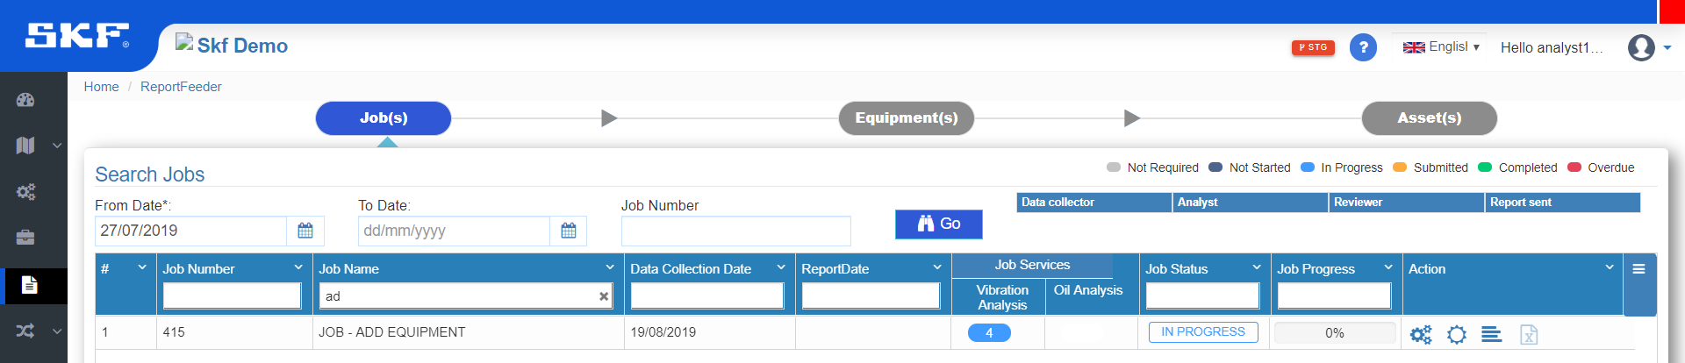
Job – In Progress
To add an Equipment when a Job is in In Progress status, contact reviewer of the Job.
Reviewer must update the status of job as Not Started (Page 2)

Slide 3
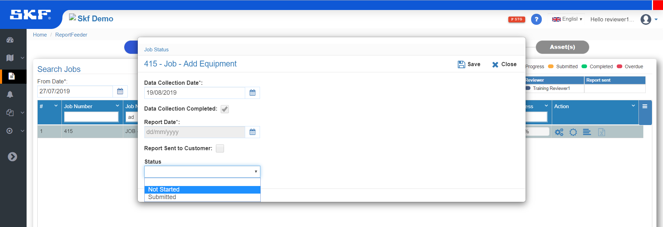
Reviewer
1
Update Job Status as NOT STARTED and Save.

Slide 4
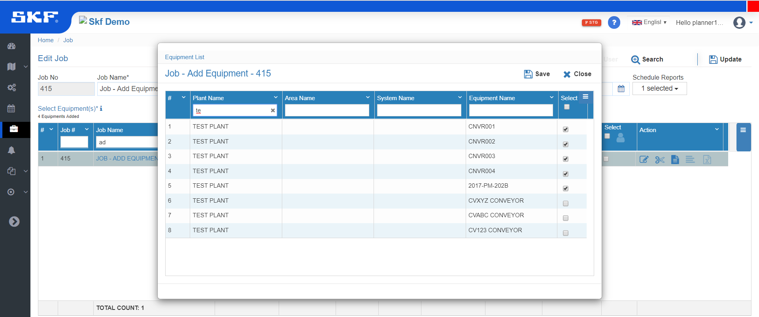
Planner
Update Job
6
Select Equipments
5
Edit Job
3
1
2
Go to “Jobs”
4
Choose Equipment and Save

Slide 5
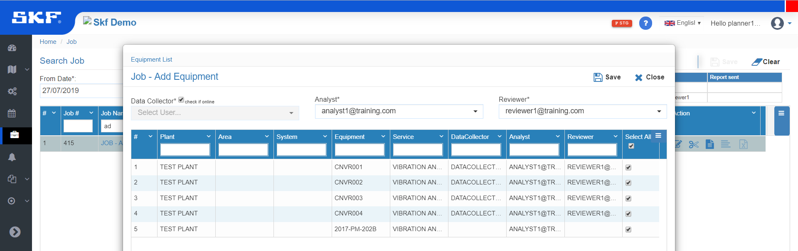
Re-assign Job using Split Job
Check “Online Data Collection”, assign Analyst & Reviewer
4
Click “Split Job”
2
1
3
Select all Equipments
Since, the Data Collection has already been done, we are now checking it as Online Data Collection and assign only the Analyst & Reviewer. (Kindly follow this step as instructed)

Slide 6
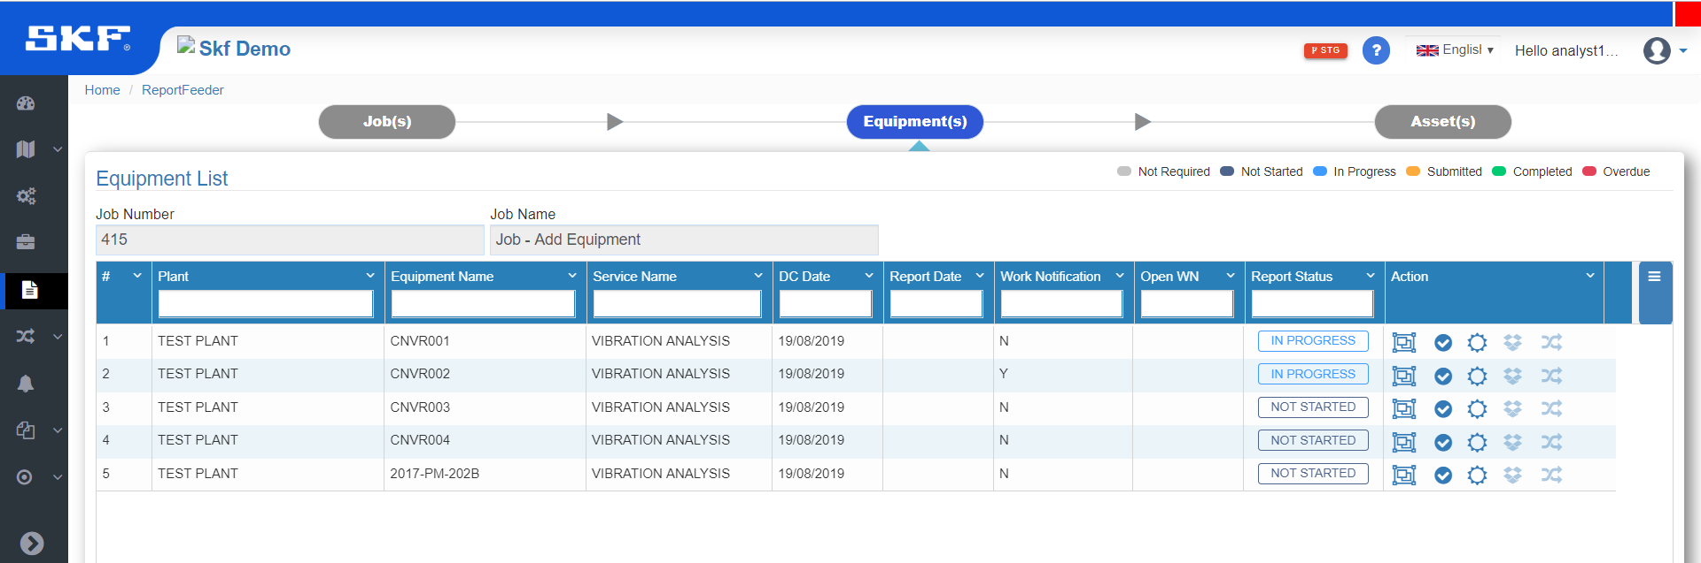
Analyst
Now, the 5th Equipment is available for Analyst to feed data.

