Slide 1
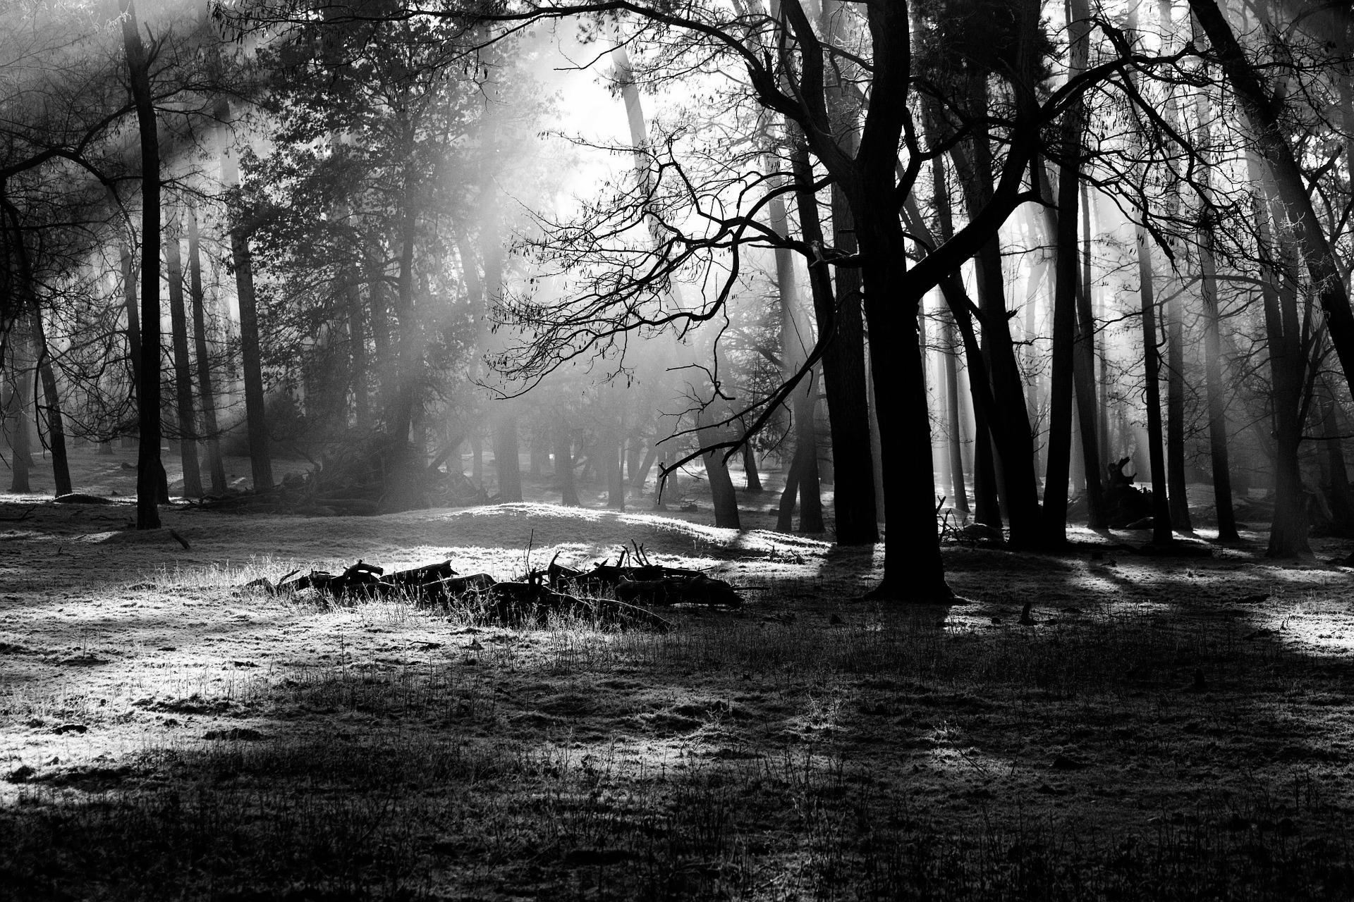

BATALOG
Progress
Report
#2.2
I
Group Members:
Hadi S. ( h_soufi) | David M. (dlmassey)
Rahim I. (r_iqbal) | Kevin K. (knkeomal)
Thien L. (t_le)

Slide 2
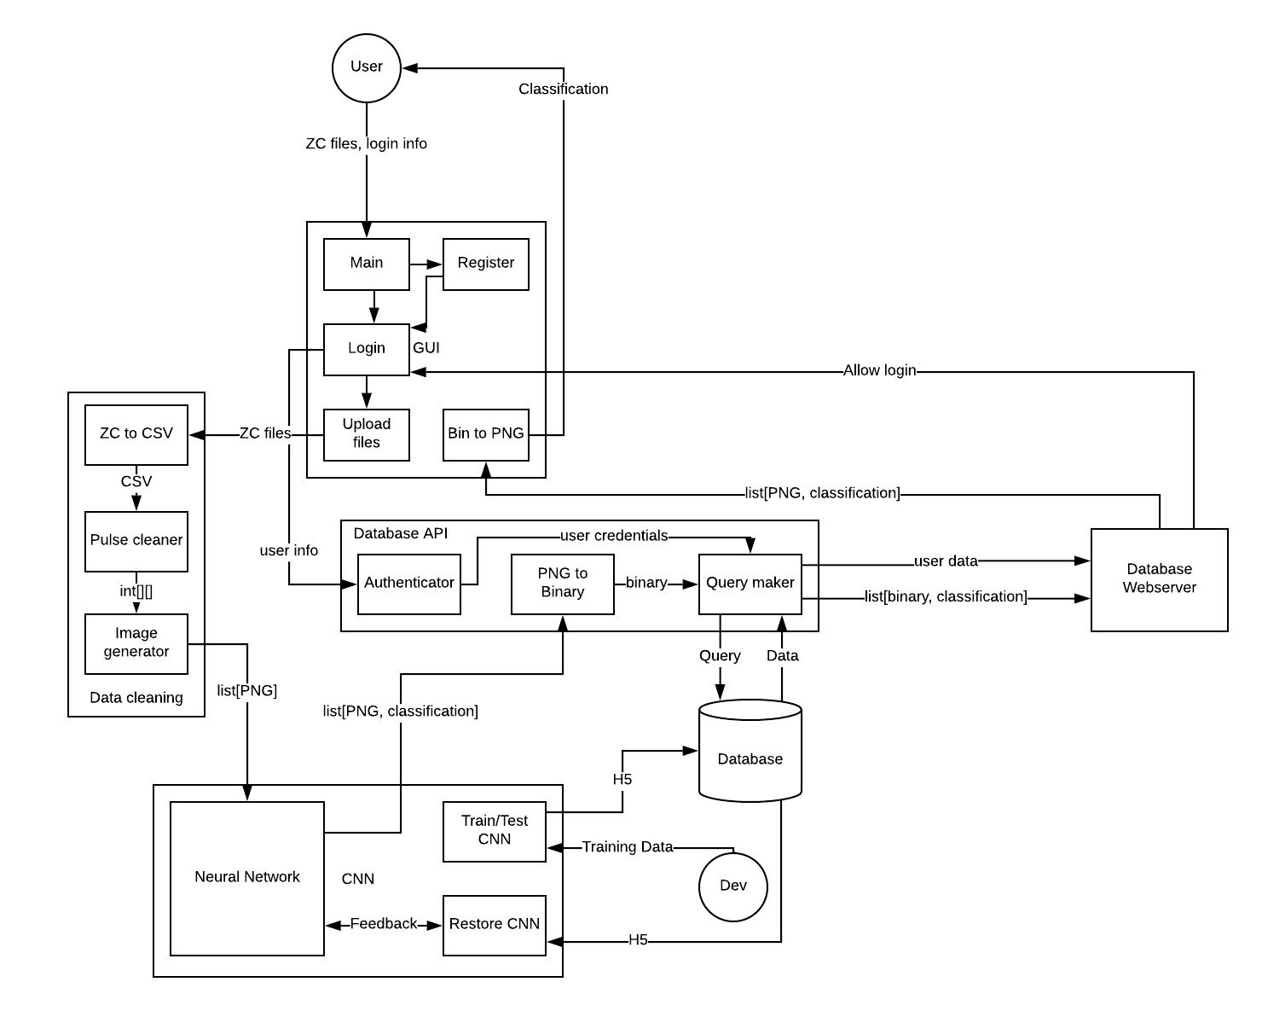
Overall System Model

Slide 3
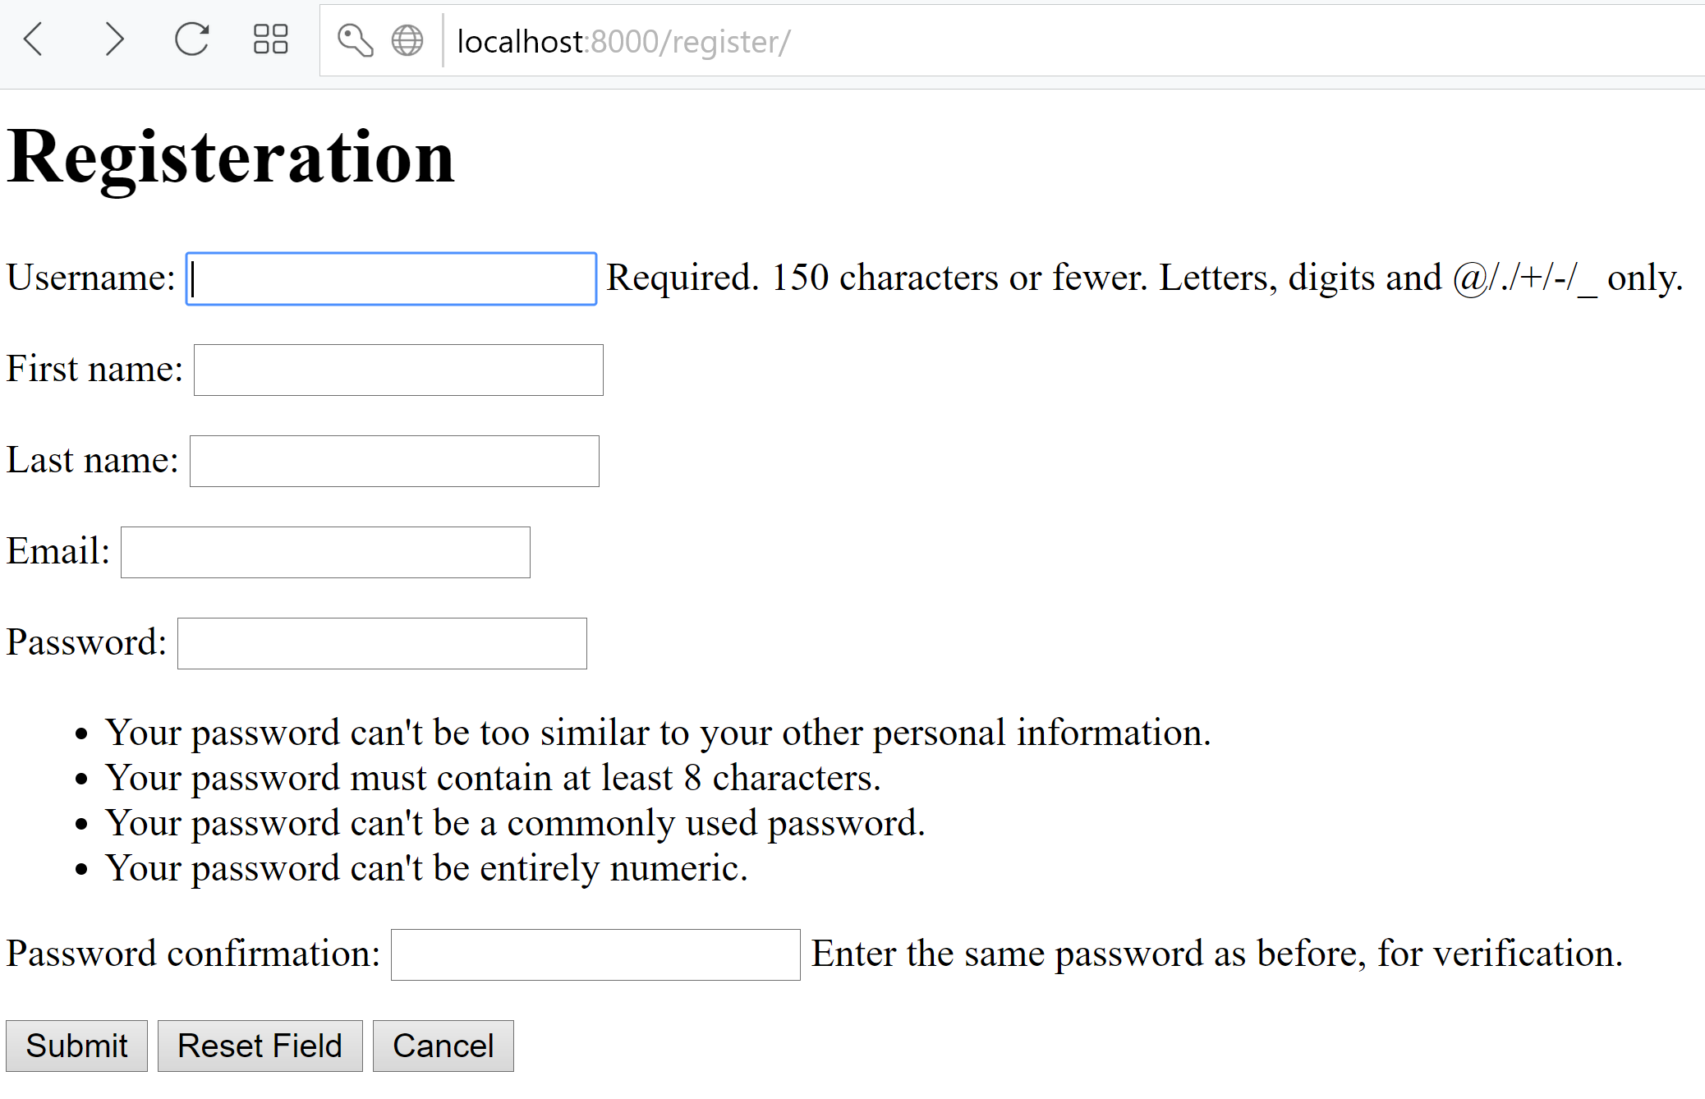
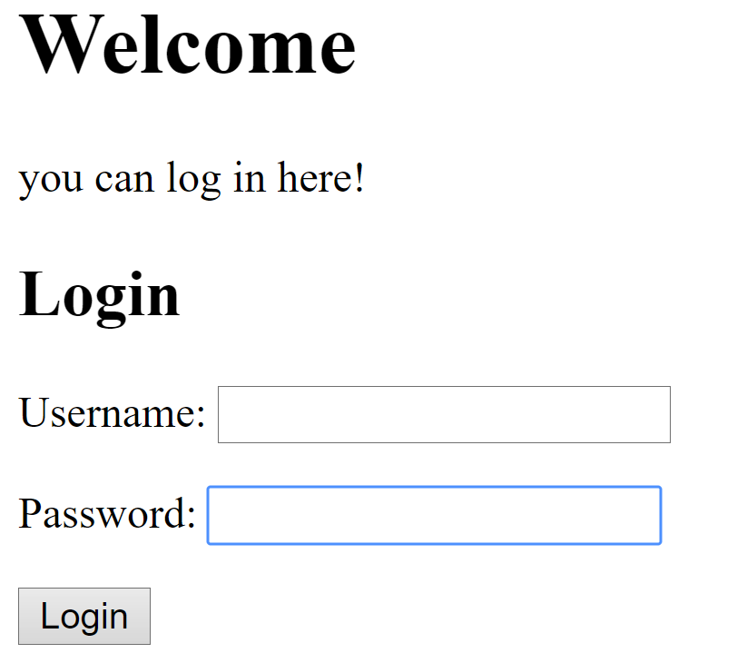
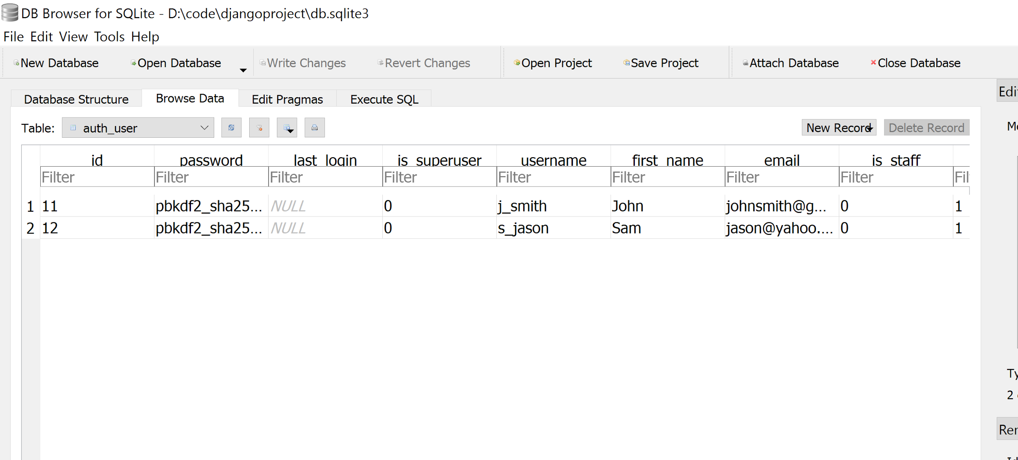
Registration & User database
Notes:
Rahim

Slide 4
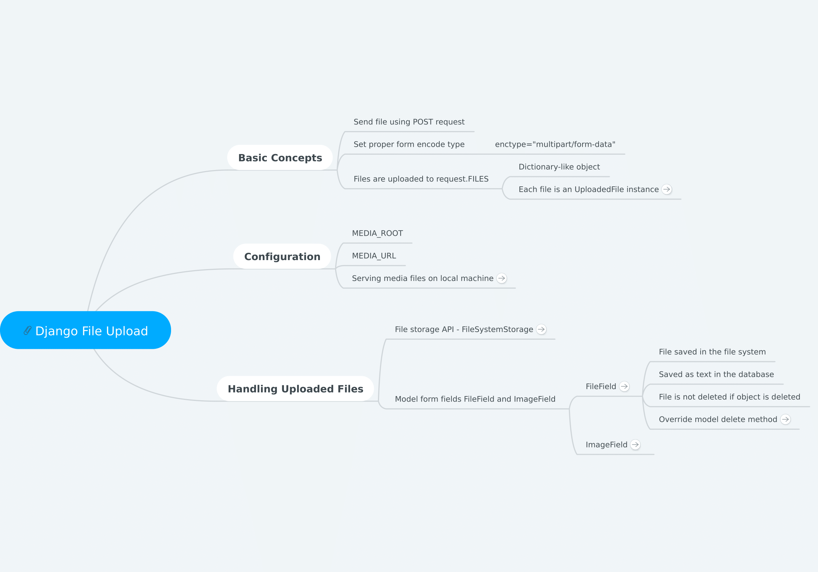
Zero-crossing file analysis

Slide 5
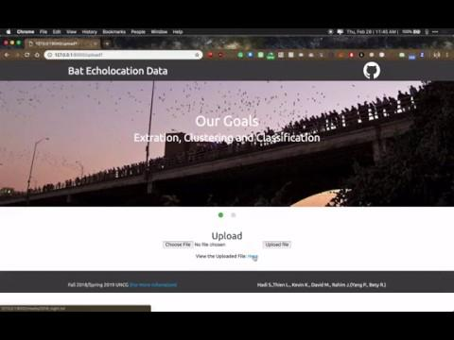
Zero-crossing file analysis

Slide 6
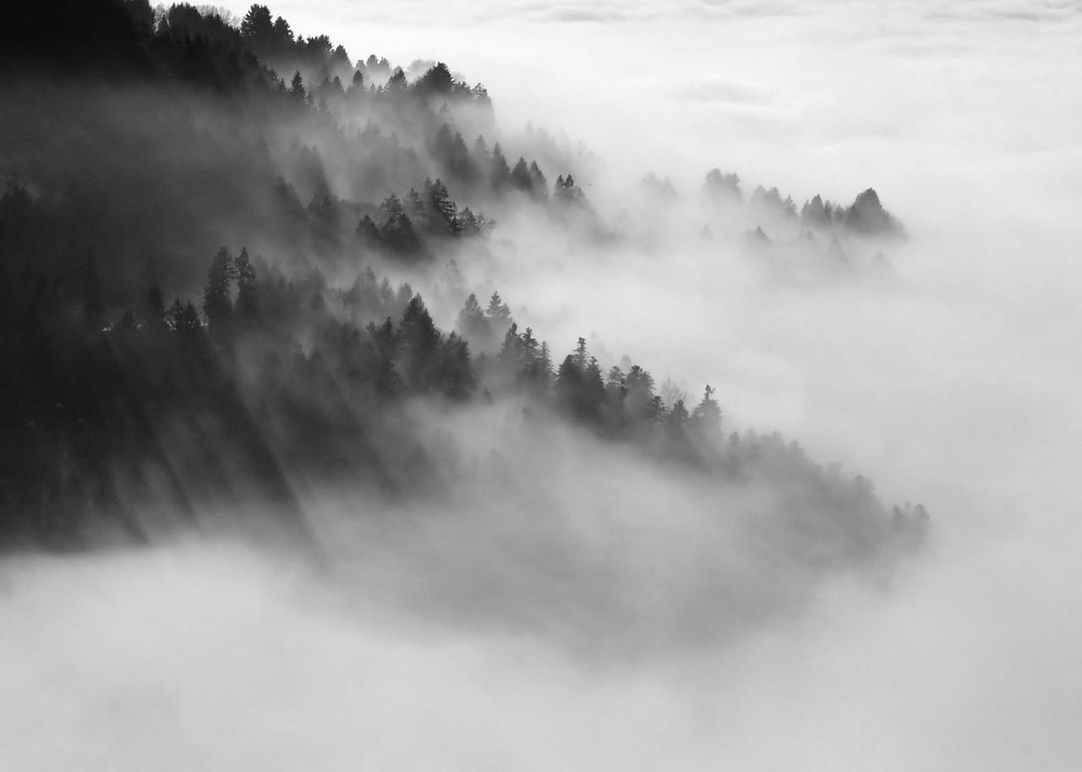
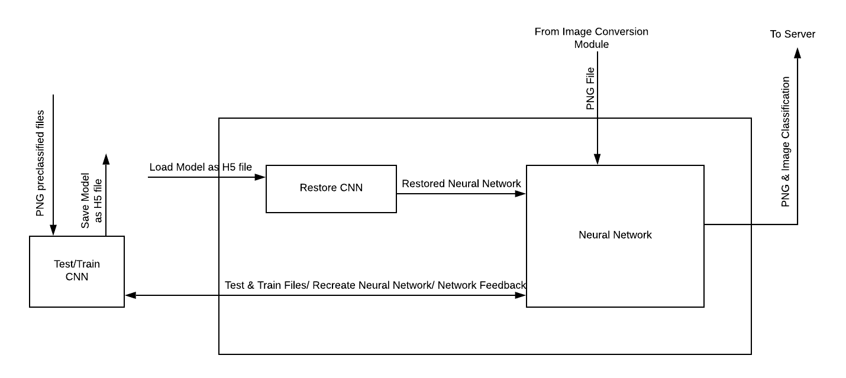
CNN
I
Notes:
David

Slide 7
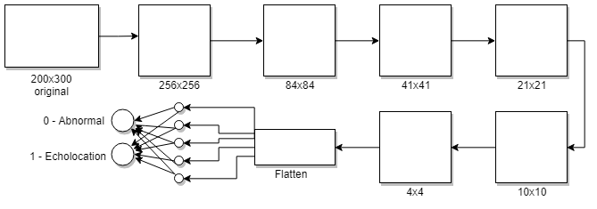
CNN
Preliminary models showed high accuracy but bad predictions
Researched information about other models
Decided to make the convolutional and pooling layers by hand using their math formulas
Resulting model showed higher accuracy with greatly improved predictions.
Continued to test other image augmentations and setting changes to acquire better results
I
Notes:
David (again)

Slide 8
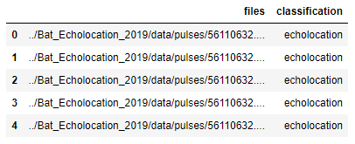
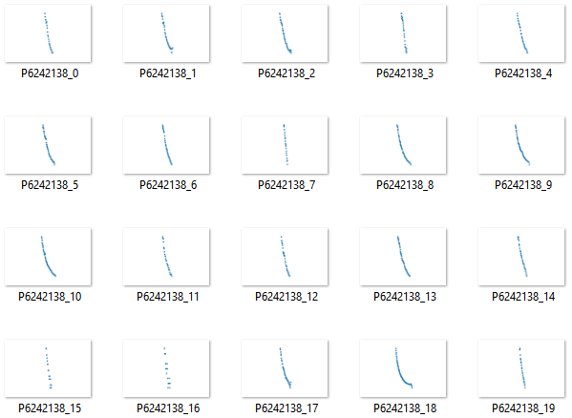

Manual Data Classification
Echolocation
Abnormal
Notes:
Kevin

Slide 9
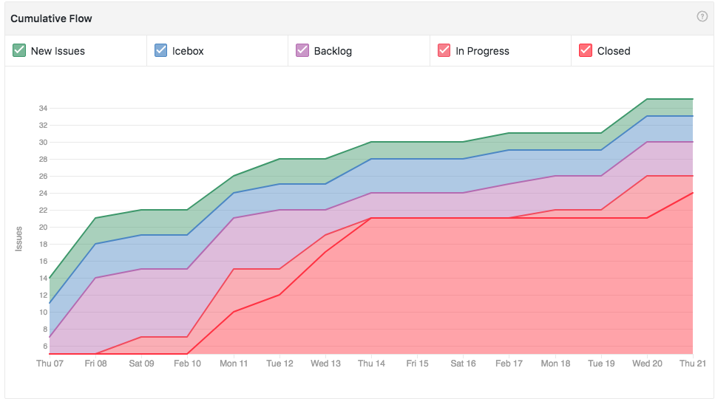
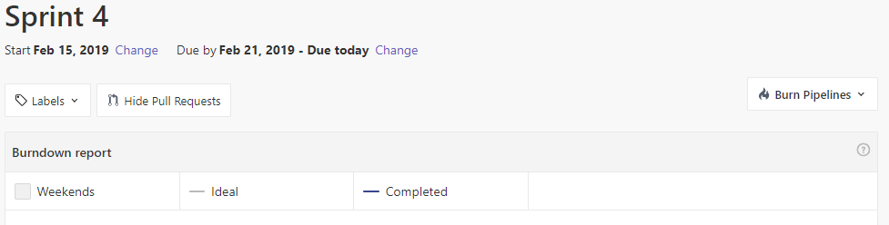
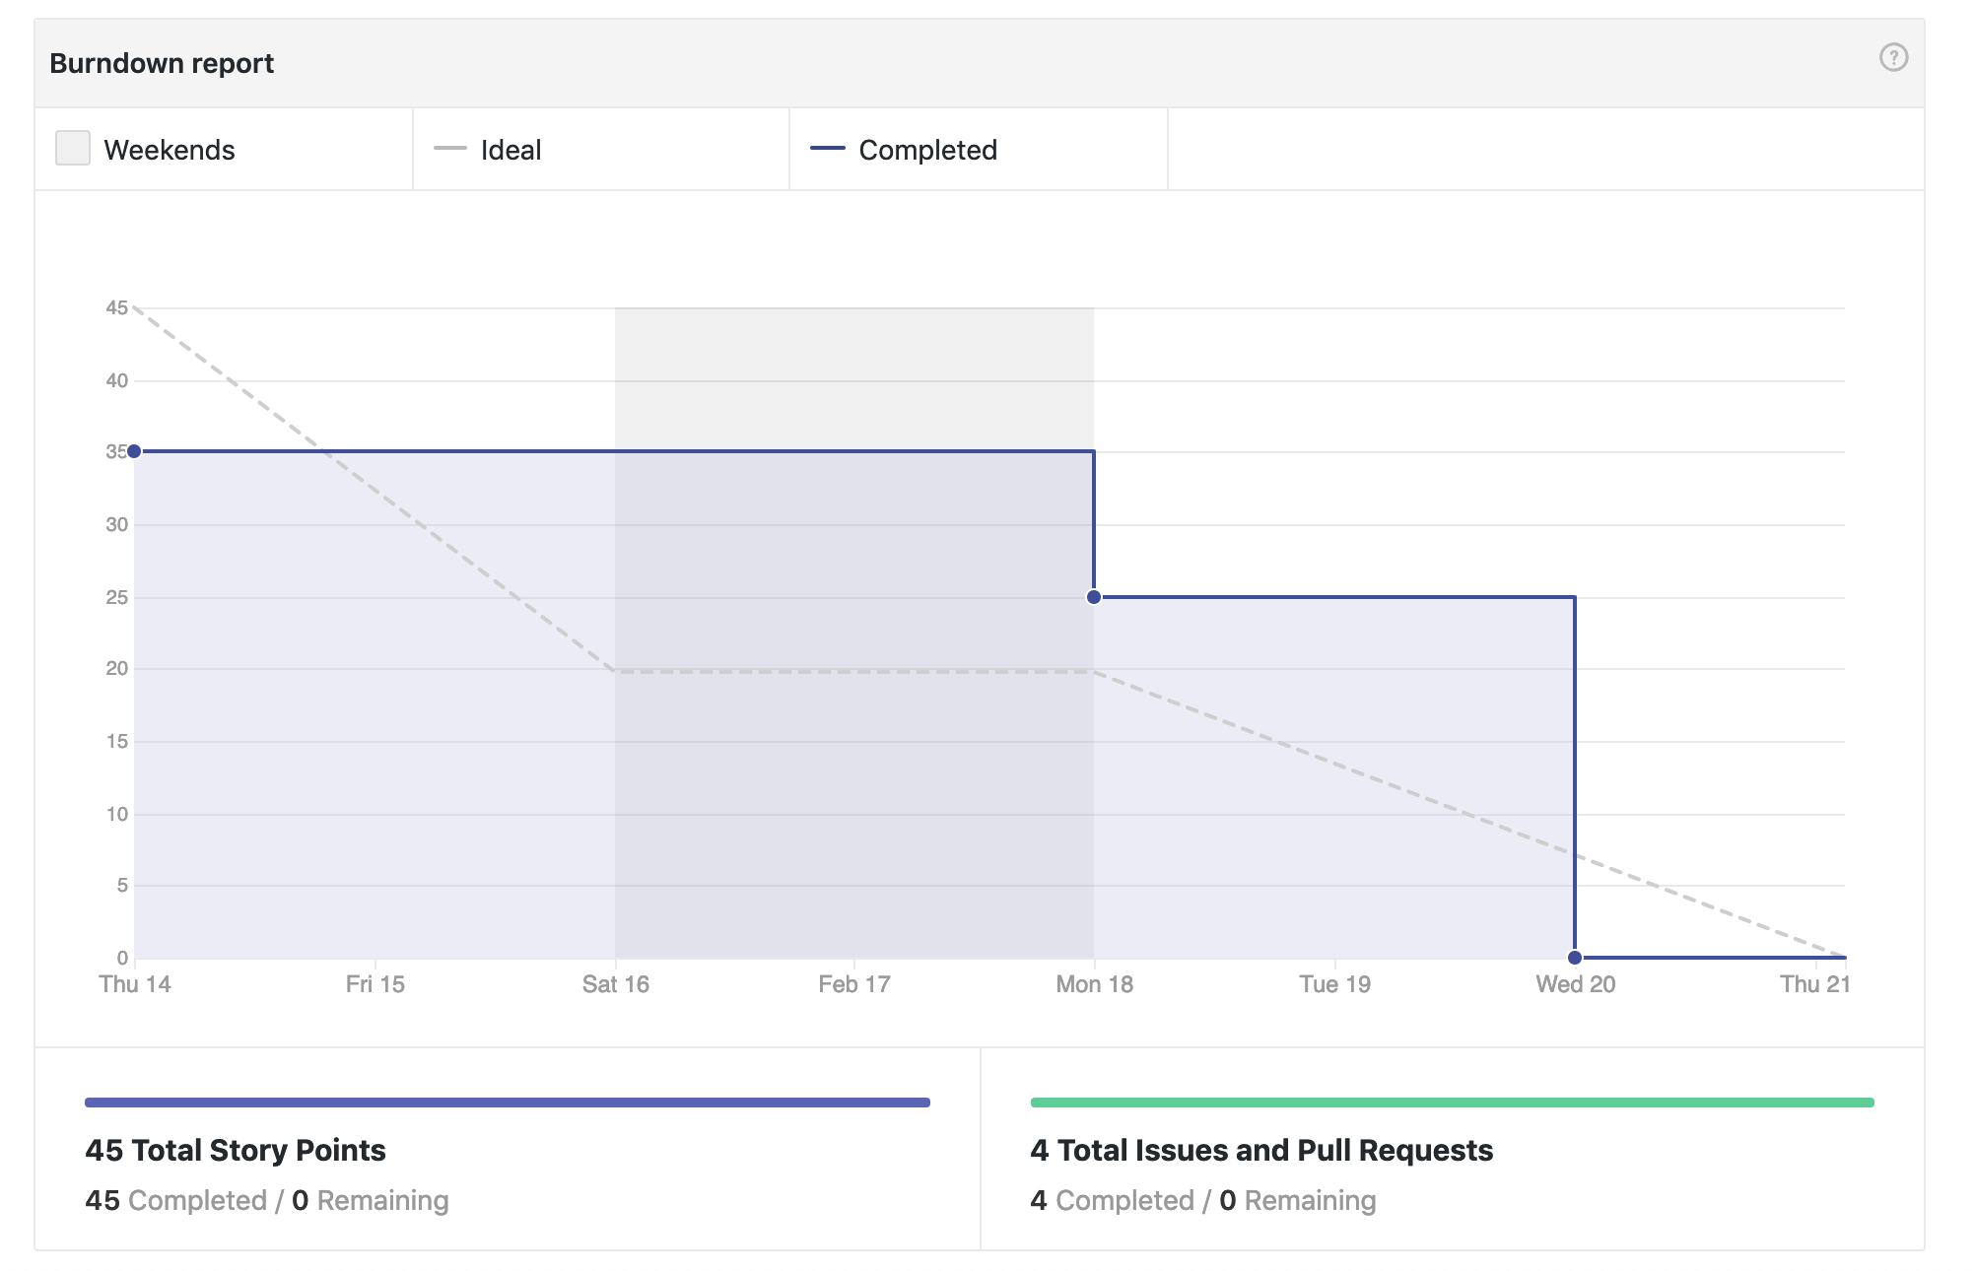
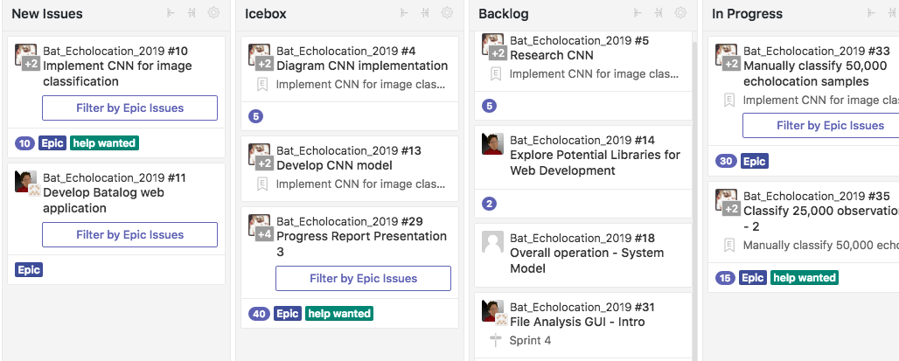
Scrum Sprint 4
Notes:
https://pixabay.com/en/office-sitting-room-executive-730681/
https://pixabay.com/en/imac-ipad-computer-tablet-mobile-605421/

Slide 10
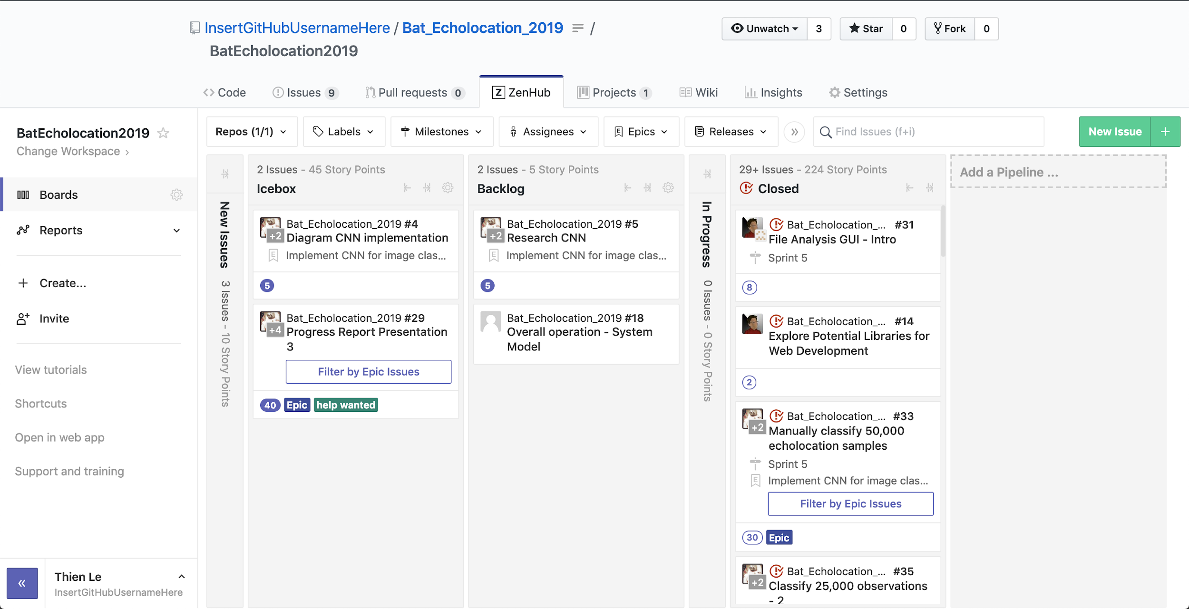
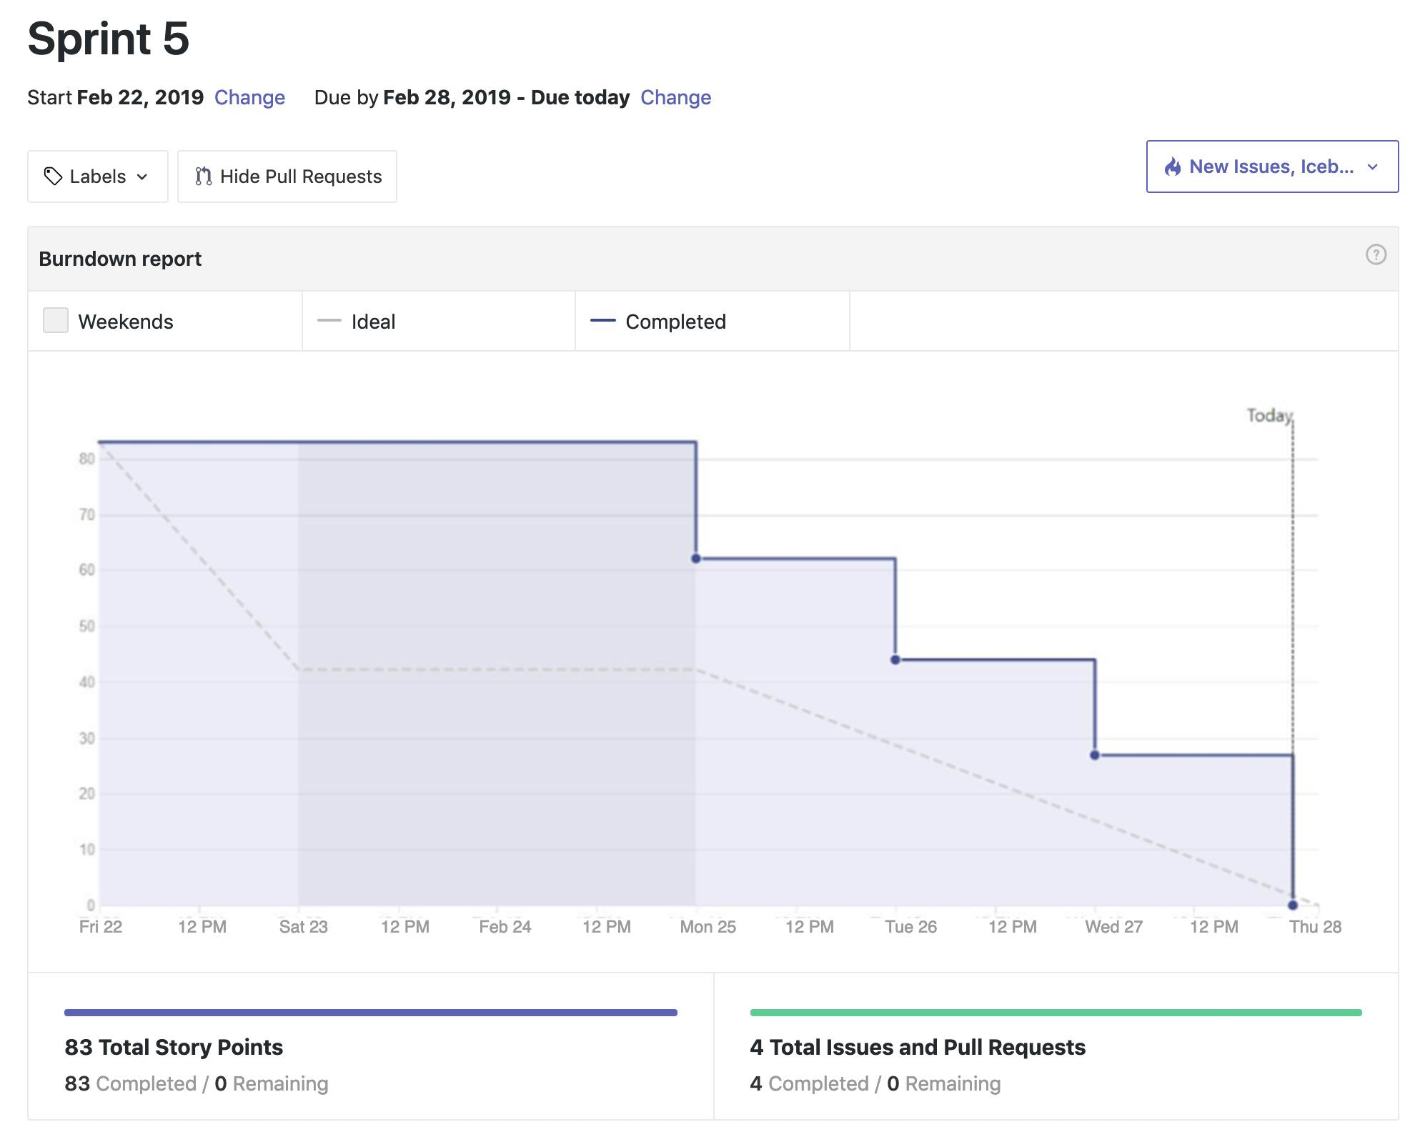
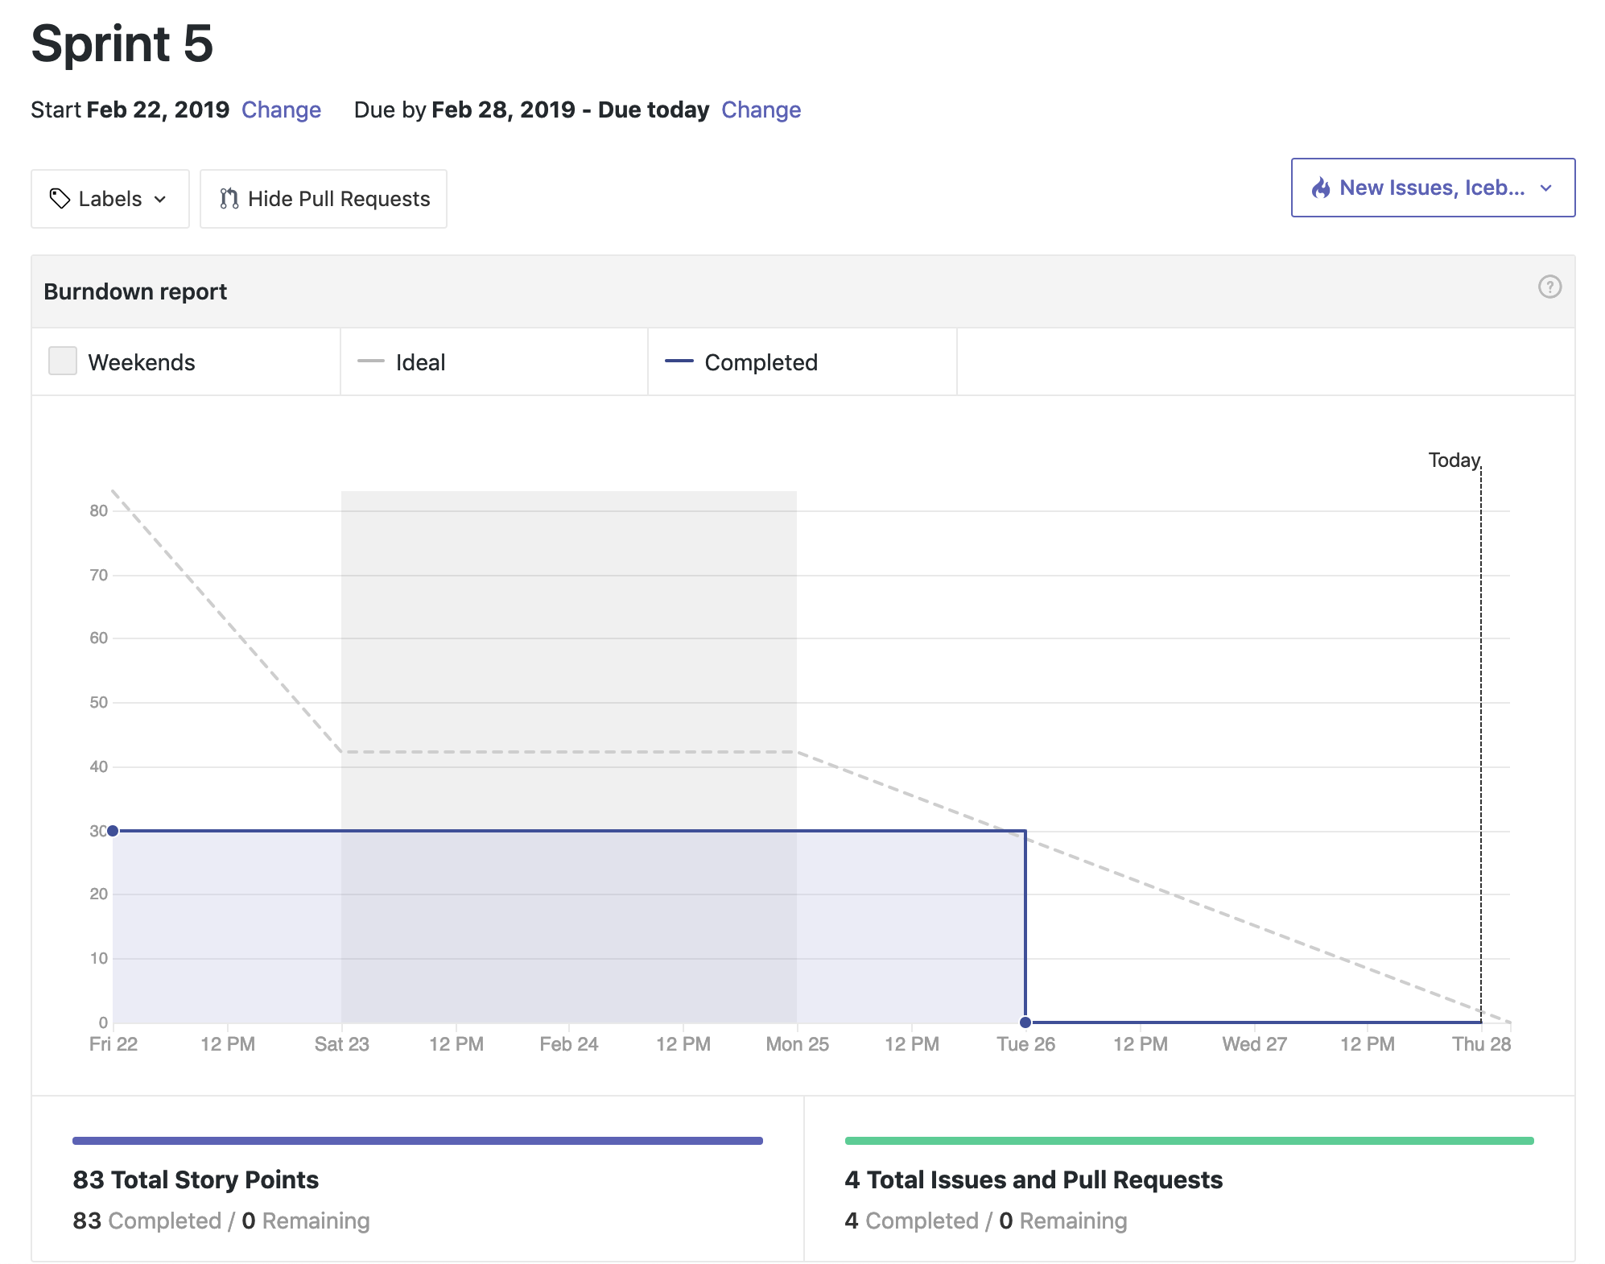
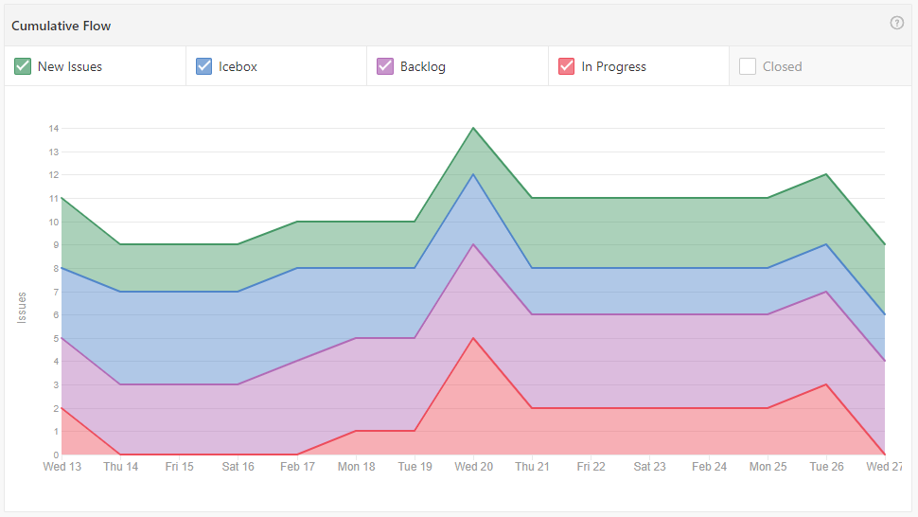
Scrum Sprint 5

Slide 11
Thank you!
BATALOG
Progress
Report
#2.2
I
Group Members:
Hadi S. ( h_soufi) | David M. (dlmassey)
Rahim I. (r_iqbal) | Kevin K. (knkeomal)
Thien L. (t_le)

