Slide 1
Insheights Integrated Value Creation System (IIVCS)
Organization Strategy Model (OSM) | Product Transformation System (PTS) | Customer Value Delivery Model (CVDM)
How organizations define, build, and deliver value – from strategic intent to realized customer outcome
© 2026 Insheights LLC. All rights reserved. Proprietary.

Slide 2
THE PROBLEM
Organizations don’t lack frameworks — they lack coherence.
The gap isn’t more practice — it’s a system that makes existing practices work as one.
1
2
3
Siloed systems
Disconnected flow
Framework sprawl
Strategy lives in one system, product in another, delivery in a third.
Customer journey, value-stream delivery, outcome measurement, and upstream feedback are rarely connected.
New frameworks pile on top of existing ones — multiplying overhead instead of clarity.
Insheights LLC · Integrated Value Creation System

Slide 3
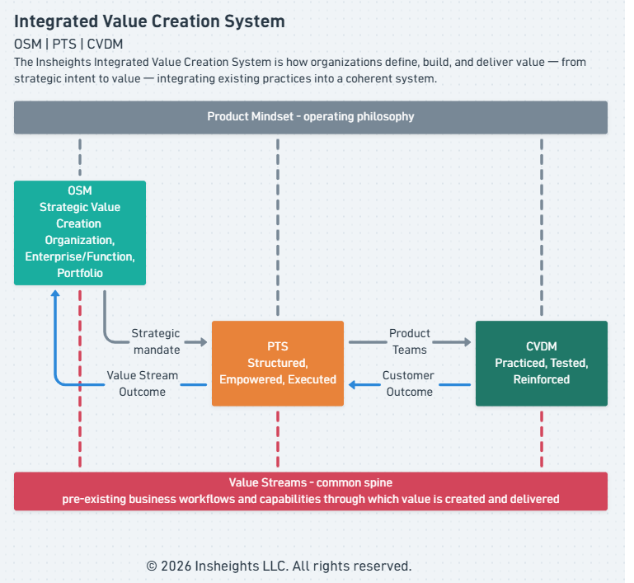
THE IDEA
An integrated system
IIVCS integrates existing practices into a coherent system rather than replacing them.
Integrated
Purposefully unified across strategy, operating model, and value delivery.
Value Creation
The single purpose the whole system serves.
System
Interdependent parts that work as one.
Insheights LLC · Integrated Value Creation System

Slide 4
THE VALUE PROPOSITION
One system to define, build, and deliver value.
From strategic intent to realized customer outcome — by integrating existing practices rather than replacing them.
1
2
3
Integrate, don’t replace
Cover what others split
Prove the value
SAFe, Scrum, OKRs, ITIL, ERM, Design Thinking, VSM, and JTBD get a coherent home — not another framework on the pile.
Journey, value-stream delivery, outcome measurement, and upstream feedback — connected at once, not in silos.
3E, AER, and the 8 Values make value visible, measurable, and continuously improvable – with AER measuring two tracks: the organization and the customer.
Insheights LLC · Integrated Value Creation System

Slide 5
PRODUCT MINDSET
The operating philosophy
The IIVCS runs on Product Mindset philosophy that shapes how strategy is formed, how teams are built, and how value is delivered.
Principle | What it means
Customer Obsession | Every decision starts with the customer
Outcome over output | Measured by value delivered, not features shipped
Continuous discovery | Stay in constant contact with reality
Hypothesis-driven thinking | Every initiative is a testable assumption
Cross-functional ownership | Teams own the full value chain end-to-end
Insheights LLC · Integrated Value Creation System

Slide 6
THE FRAMEWORKS
Three frameworks, one spine
Value Streams — the pre-existing workflows and capabilities through which value is created — are the common spine of the system.
Framework | Role | One word
OSM | Organization Strategy Model | Governs
PTS | Product Transformation System | Operationalizes
CVDM | Customer Value Delivery Model | Realizes
OSM governs the value streams, PTS operationalizes them, and CVDM realizes value through them.
Insheights LLC · Integrated Value Creation System

Slide 7
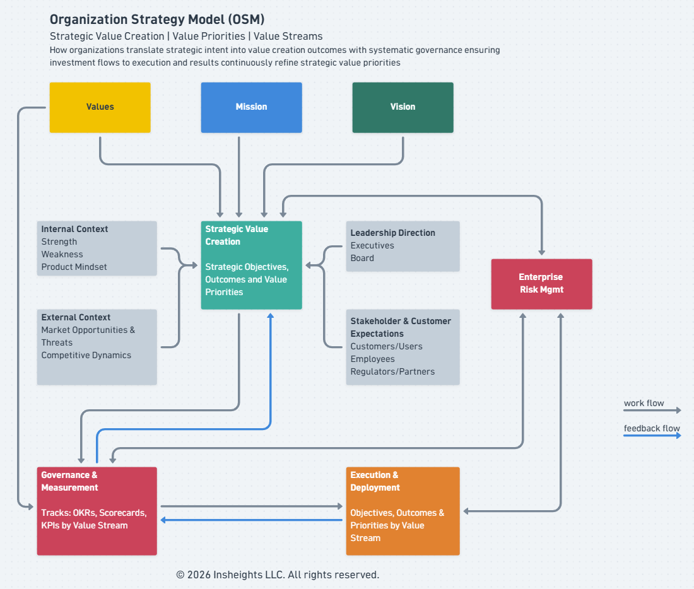
OSM
Organization strategy
How organizations translate strategic intent into prioritized value-creation outcomes.
Strategic Value Creation
Value Priorities
Value Streams
Insheights LLC · Integrated Value Creation System

Slide 8
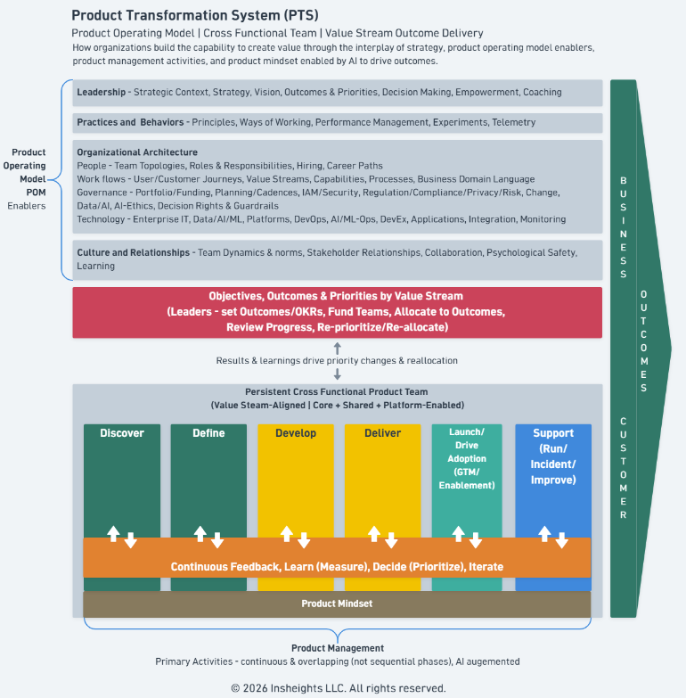
PTS
Turns strategy into capability
OSM’s strategic intent, value priorities, and value streams are:
Structured
Empowered
Executed
Insheights LLC · Integrated Value Creation System

Slide 9
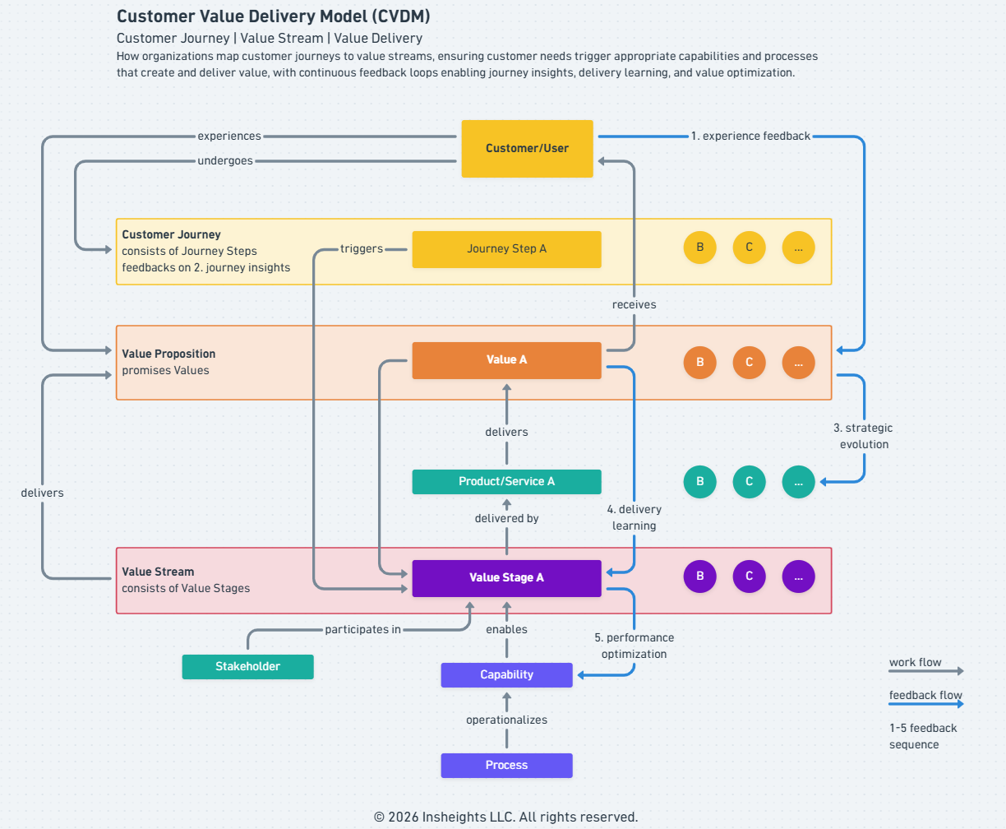
CVDM
Anchored on the customer
The Product Mindset is here:
Practiced
Tested
Reinforced
Insheights LLC · Integrated Value Creation System

Slide 10
VALUE FLOW
How value flows and feeds back
DOWNSTREAM
Strategic intent → Operating model → Realized customer outcome
UPSTREAM FEEDBACK
CVDM → PTS → OSM
Customer signals become delivery learning, delivery learning becomes strategic evolution, continuously refining where the organization creates value.
The feedback is what makes it a system — not a stack of frameworks.
Insheights LLC · Integrated Value Creation System

Slide 11
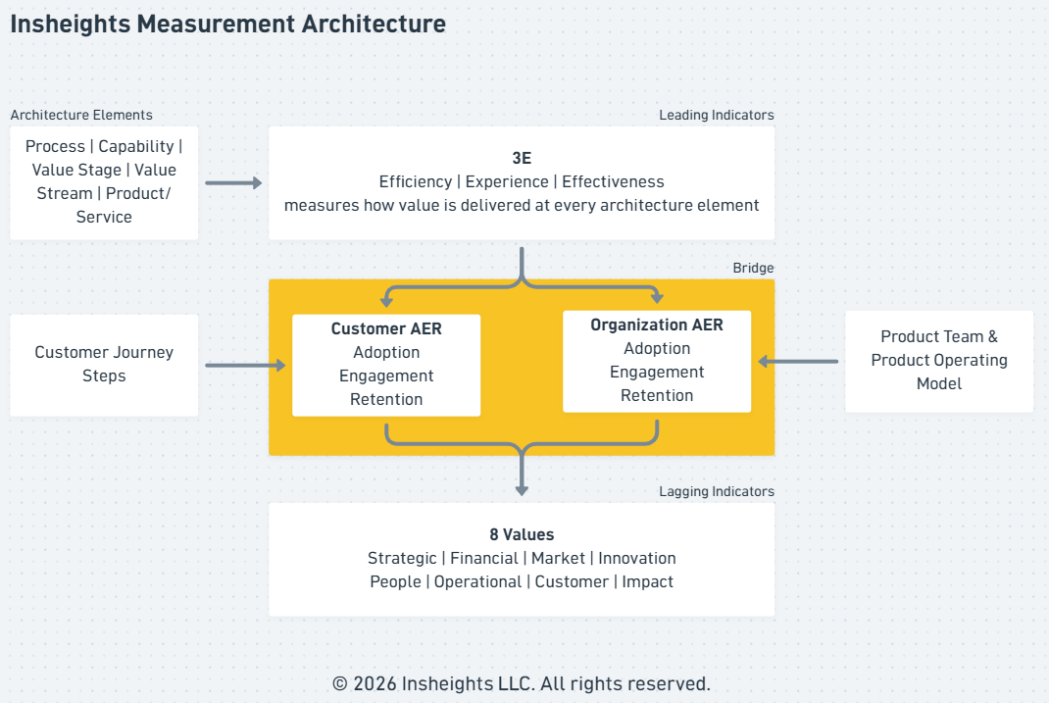
MEASUREMENT
The measurement architecture
One connected system spans every framework — from how value is delivered to what the organization generates.
3E — Efficiency, Experience, Effectiveness
AER — Adoption, Engagement, Retention – measured on two parallel tracks: organization and customer
8 Values — Strategic, Financial, Market, Innovation, People, Operational, Customer, Impact
Insheights LLC · Integrated Value Creation System

Slide 12
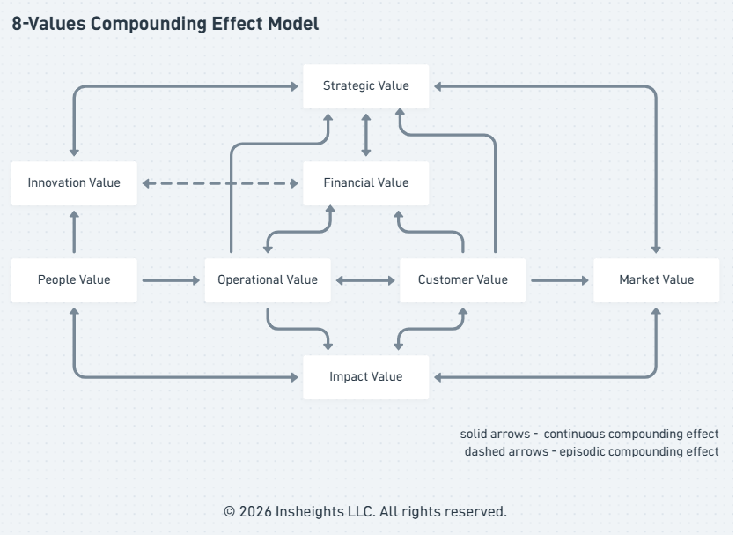
THE 8 VALUES
What the organization generates
Eight dimensions that compound into sustained impact — People Value is the source; every other a convergence node.
Customer · Financial — the visible proof
People · Operational — the engine
Market · Strategic · Innovation · Impact
Insheights LLC · Integrated Value Creation System

Slide 13
Thank you
IIVCS — a coherent system for how organizations define, build, and deliver value — from strategic intent to realized customer outcome — by integrating existing practices rather than replacing them.
Explore the full system – README.md
Measurement models – 3e.md, aer.md, 8-values.md
Framework positioning – positioning.md
For more details, visit
https://github.com/Insheights/in-frameworks

