Slide 1
Time Series Analysis “Tadawul Stock market”
Brought to you by :
Hanan Al shehri
Inshirah Almutairi
Supervised by:
Mejdal alqahtani

Slide 2
ROADMAP
Data Selection
Data Description
Model Validation
1
3
5
2
4
6
Data Extracting
Models Selection
Conclusion

Slide 3

Data Collection :
Subscribed to eReference by month(paid data).
Collected huge a daily data to 202 companies.
Selected 2 datasets.
Web scraped it.
Data Description :
From Jan 2012 till Nov 2021(Up to date)
AlRajhi contains 2477 enteris and 13 feature.
STC contains 2269 and 13 feature.

Slide 4
Data Cleaning:
No null values.
Check Types.
Drop columns.
Date Type is important (Since it’s the X).
No Duplicate Dates .

Slide 5

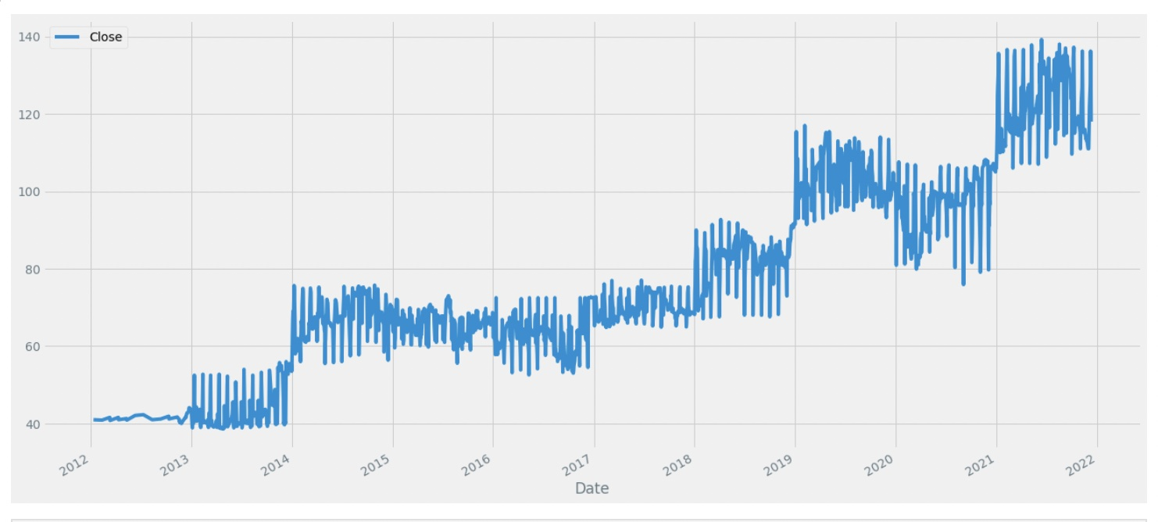
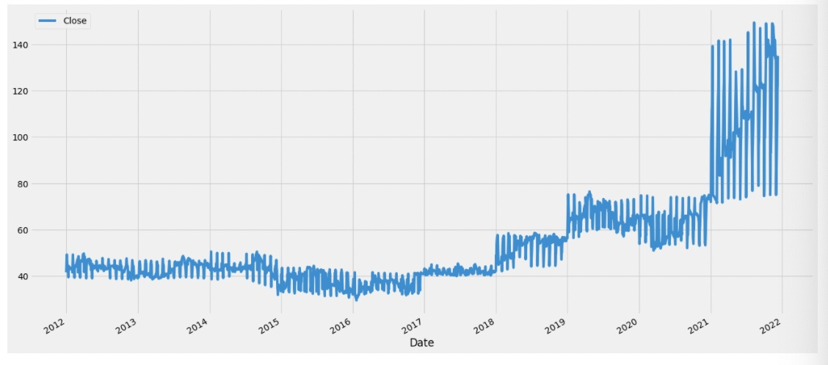
Data Visualization :

Slide 6
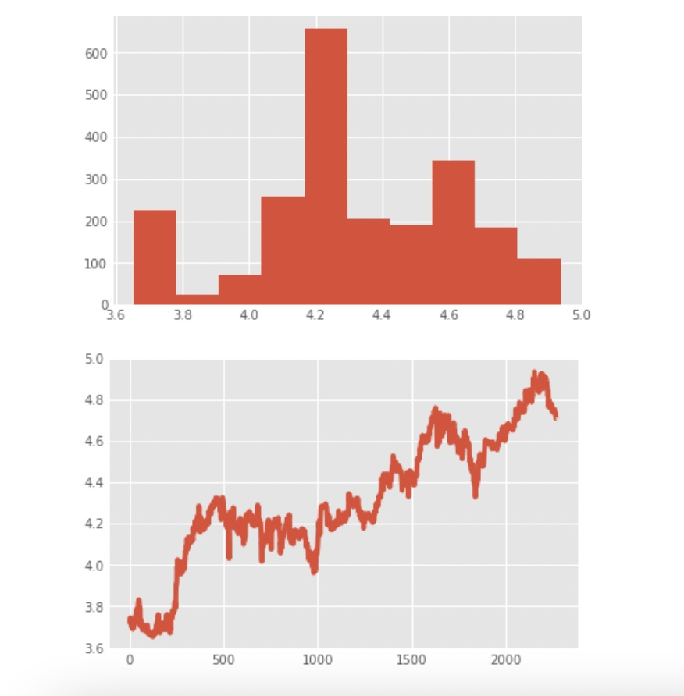
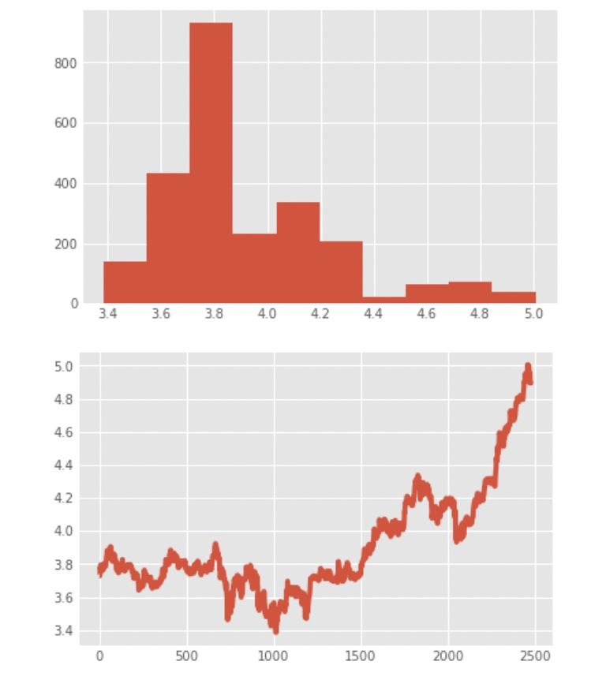
Stationary test:

Slide 7


Models difference :
ARIMA
Facebook Prophet
Explained by dr.patrick
growthg(t), seasonality s(t), holidays h(t) , and error e_t

Slide 8
Model Selection
The 8 models were measured by the Validation Squared error
 | STC | AlRajhi
ARIMA(5,1,1) | 15.45 | 16.05
ARIMA(0,1,0) | 15.42 | 16.12
ARIMA(0,1,1) | 15.42 | 16.15

Slide 9
Model Selection
The 2 best models were measured by the least test Squared error
 | STC | AlRajhi
ARIMA(1,1,2) | 10.18 | 11.07
ARIMA(3,1,2) | 10.00 | 11.00

Slide 10
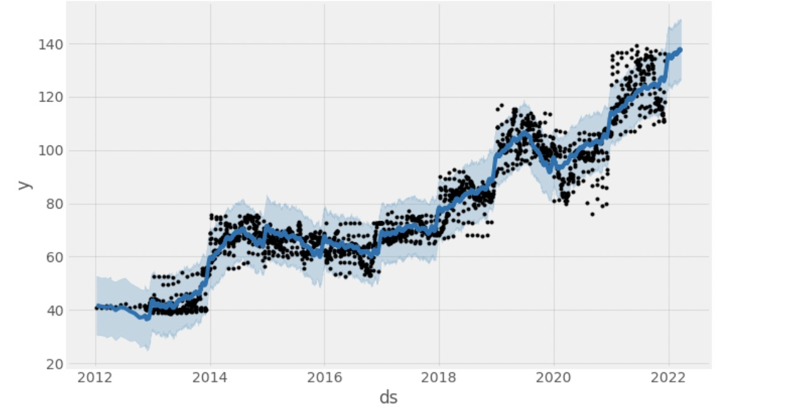
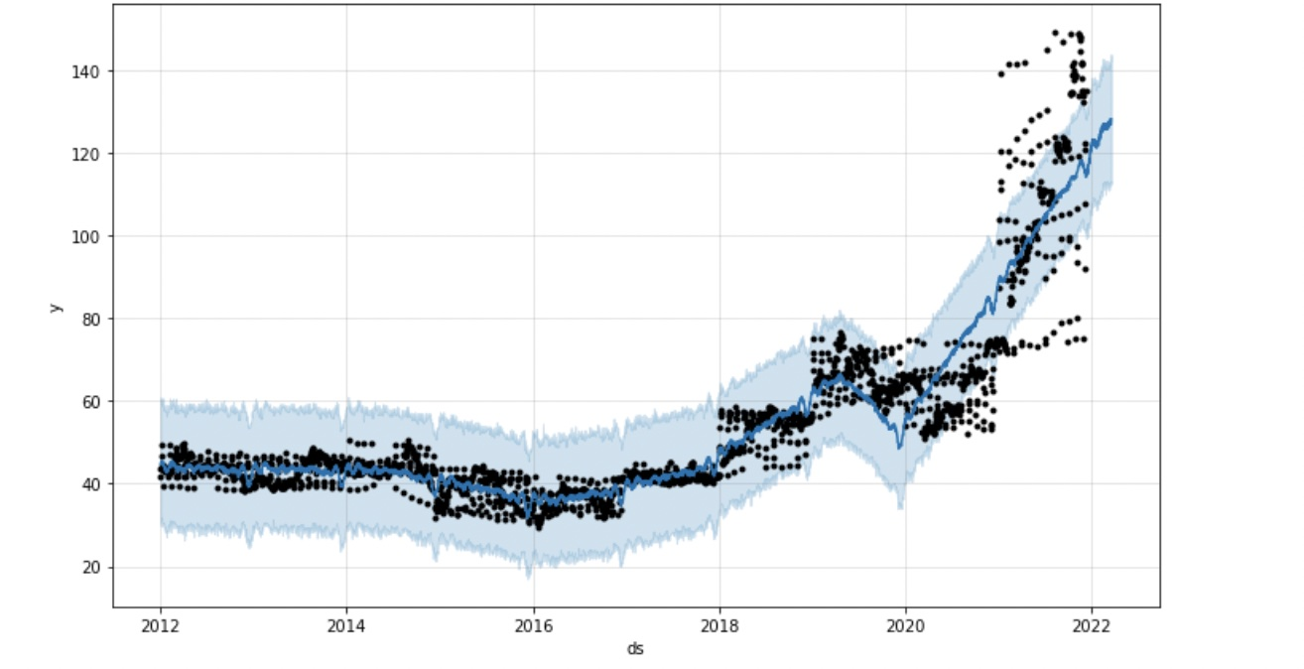
Facebook Prophet Model
using the m model and make future function will get predictions with a frequency of d which is daily

Slide 11
Insight :
“Stocks can’t be predicted ”
If so, Everyone can be a billionaire.

Slide 12
THANKS!
Any questions?
You can find us at:
GitHub
LINKED IN

