Slide 1

Closing the Feedback Loop
Notes:
Welcome to this module on Closing the Feedback Loop, where we talk about instrumentation of your Application with Application Insights and the release process and how to add checks and approvals to this

Slide 2

APPLICATION INSIGHTS

Slide 3

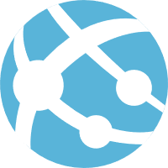


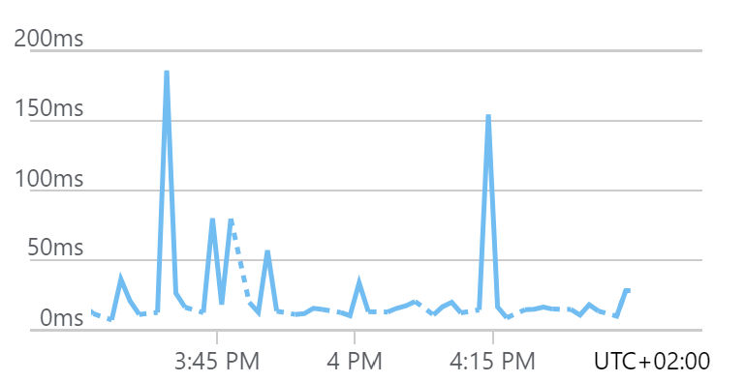
Application Insights
Concept:
Part of Azure Monitor
Application Performance Management service
Insights to application operations and usage
How to use:
Create Application Insights resource
Use the instrumentation key to send telemetry
Runtime
SDK
Monitor your app
Notes:
0 When you are working on an application, you want to know how your application is doing.
1 Users are making requests to your web application, but if any failures occur, we want to know about them before they start to warn us. Besides that, we want to give our users an optimal experience, we want to know what features they use and how, and we need to find any performance related issues that are slowing down our application.
2 To monitor a web application in Azure, you can use Application Insights. Application Insights is part of Azure Monitor, and provides an Application Performance Management service. It uses the data platform from Azure Monitor to give insights into our web application operations and usage, and helps us diagnose errors. It is designed to help us improve your applications performance and usability.
3 When we start using it, we will first need an Application Insights resource in our Azure subscription. This is the place where our data will be displayed. Once the resource is created, we will see that it has an instrumentation key. The instrumentation key is a unique GUID that we can use to connect our application to Application Insights.
4 We need to add the instrumentation key to our web application, to let it know where it has to send its telemetry to.
5 This can be done at runtime by configuring it in the web application settings. It is also possible to build the Application Insights SDK into our application's code. This last method is more flexible, since it allows us to add custom telemetry as well.
6 Once we have instrumented the application, it starts sending telemetry to Application Insights. We then can start monitoring our application.

Slide 4
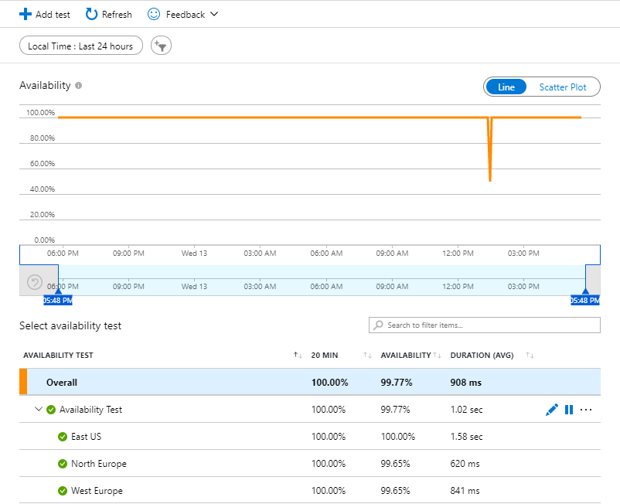
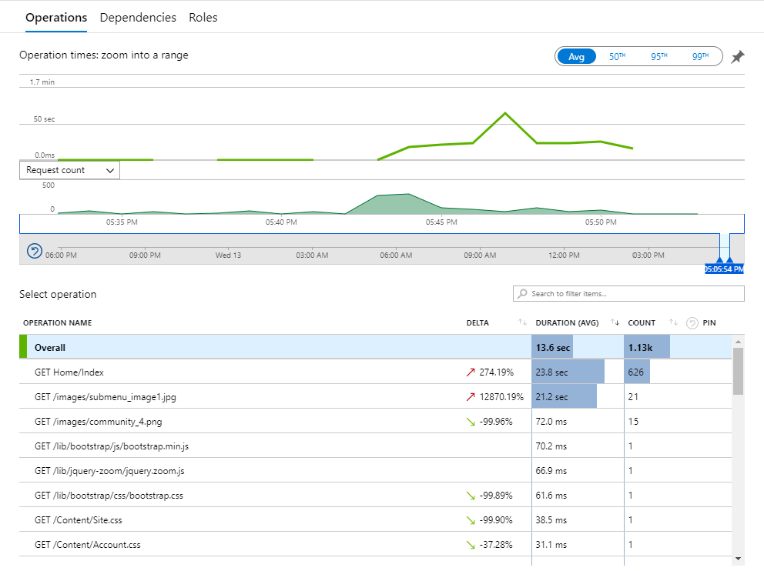
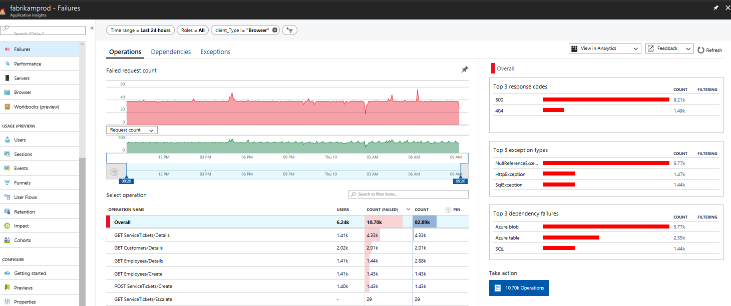
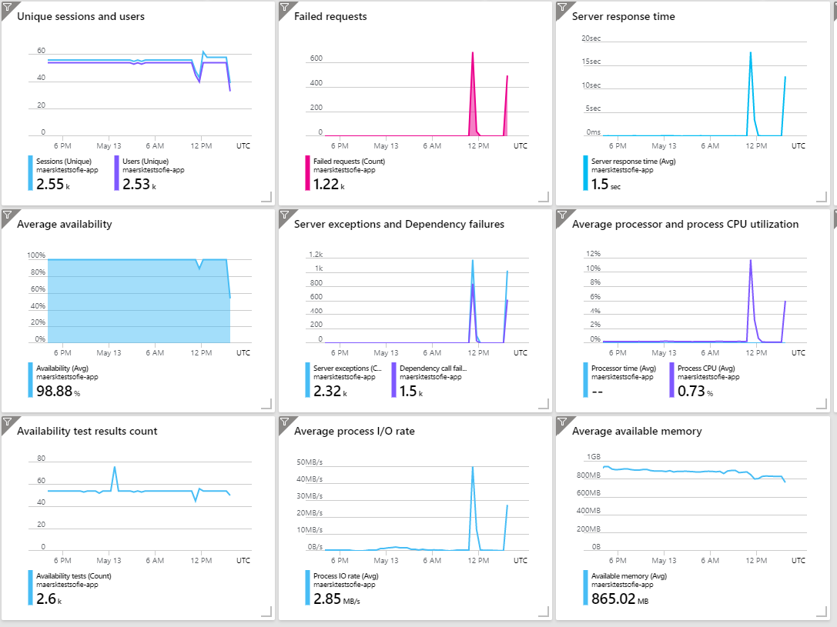
Monitoring your application
Availability
Availability tests
Web request from different regions
Performance
Measure count and duration
Failures
Diagnose failures
Dashboards
Historical data
Notes:
0 Once the application is set up to send its telemetry, we can start monitoring the usage and behavior of the app. Application Insights has a lot of features, that we won't all discuss. To highlight a few of them, these are the type of the questions we want to know about our running application:
1 Is our application available for our users?
2 How is the performance?
3 Are there any failures?
These are all questions we can answer with Application Insights.
4 Availability can be measured with availability tests. When creating an availability test, Application Insights will send web request to our application at regular intervals from different regions around the world. If your website is not responding, it can send an alert.
5 We also want information about the performance of our application. For that we can use the performance panel in Application Insights. It shows the count and duration of each operation within the application. This makes it easier to identify which operations have a relatively high duration and therefor have an impact on our users.
6 Then we strive for a certain quality. We can check for failures in the Failure panel. This view shows the failure rate trend for the requests, how many of them are failing, most common exceptions types, and more.
7 To give a nice visual overview, we can create dashboards. This gives us the possibility to put together different charts and views to get a complete overview of our application health and performance.
8 Be aware that all the data we see on these dashboards is historical data. There is always some time between the actual event and the moment you see it on appearing on dashboard. That is because the data ingestion process, that happens after the application sends its data, can take a few miniutes.

Slide 5

AZURE PIPELINES

Slide 6
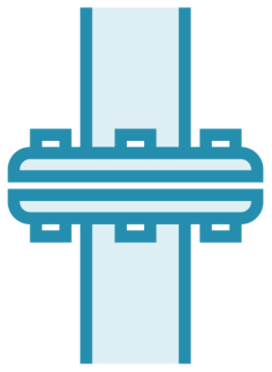


What is a Pipeline in Azure DevOps?
YAML Definition
Automation engine
Continuous Integration (CI)
Continuous Delivery (CD)
Pipeline Definition
Triggers
Stages
Jobs
Agent
Steps
Job
Step
Stage
Step
Step
Job
Step
Step
Stage
Job
Step
Notes:
Lets start with defining what an Azure DevOps pipeline is.
A pipeline is an automation engine that is build to support us in the automation of building and deploying software.
This is better known these days as Continuous Integration(the build) and continuous delivery (the deployment) of software.
The automation engine uses the following concepts to orchestrate the work it has to do:
The automation started by a trigger. A trigger can e.g. be the fact that a change is committed in source control or a pull request is made.
The automation is a composition of stages, jobs and steps.
At the top level we define the stages of the automation. A stage is the top level coordination of what we are automating.
An example of a stage is build, test, deploy. This then defines we are building the software, we are testing the software, we are deploying the software, etc. You can define any stage with any name. it designates the purpose of what we are trying to achieve with the automation.
Each stage has one or more jobs it needs to complete to fulfill what the stage tries to accomplish.
Jobs are the unit of work that can be scheduled on an Agent. An Agent is a process that runs on a machine and listens to incoming requests to run a job.
An agent can run on any type of operating system and you can have one or more jobs running in parallel on different agents.
A job contains one or more steps it needs to execute. The step is the real work that is done. This is e.g. retrieving artifacts from a version control system, the compilation of the source code creating a distributable package.
The definition of how the automation workflow is composed, is defined in a pipeline definition.
The pipeline definition is stored in a YAML file, which is kept in source control.

Slide 7
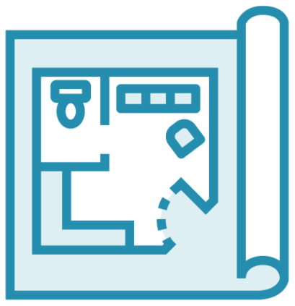
Azure Pipelines for CI/CD
CI stage you can create any other stage
Best practice to decouple build from deployment
Multiple stages before we move to production
Collect artifacts required for deployment
Application binaries
Infrastructure as code
Configuration as code
YAML Definition
Job
Step
Stage
Step
Step
Job
Step
Step
Stage
Job
Step
Notes:
We can create multiple stages, each stage uses jobs, jobs run on agents and a job contains steps. Each step is responsible for doing some form of automation.
After we have completed the continuous integration stage of the pipeline we can add any other stage we feel we need to build the confidence to finally go to the final stage which is the deployment a reveal of the new software in production.
It is a best practice to split up a pipeline into at least two stages. One is the previous discusses continuous integration stage the second is the release stage.
Often, we split this into multiple release stages, because we often first want to gain additional confidence we can run the software in production without causing problems to our end users. E.g we create a stage where we first deploy to a test environment, run a set of tests and then move to e.g. production.
The first step we need to take when we start a new stage, is that we need to pick up the artifacts created in the CI stage. This can be the set of application binaries, your infrastructure definition as code and your configuration as code

Slide 8
Azure DevOps Deployment Job
Deployment History
Deployment Strategy
Enable initialization.
Deploy the update.
Route traffic to the updated version.
Test the updated version after routing traffic.
In case of failure, run steps to restore to the last known good version
RunOnce, Rolling, Canary
Notes:
In a pipeline we specify the use of a Job. Azure DevOps also has a special type of Job called a Deployment job.
A deployment job provides us some additional capabilities. E.g.
It keeps track of the Deployment History and gives us the ability to drill down into the details of the changes between different deployments.
It also provides the notion of a deployment strategy.
A deployment Job defines a set of steps you should go through as a best practice and provides even so called Lifecycle hooks to these steps.
Each of the lifecycle hooks resolves into an agent job or a server job
There are a few standard strategies that can be applied.
We have the RunOnce, Roling and Canary strategy that we can apply. This determines which of the lifecyle hooks get called and in what sequence.
E.g. when we use canary, we will get a call into the Enable Intitialization step once and then for each increment we specify there will be a call to the Deploy, route traffic, post route traffic etc.
Then when we detect a failure in one of the increments we execut the failure path and roll back to the previous version.

Slide 9
Azure DevOps Environments
Collection of resources
Deployment target
Deployment History
Traceability
Resource Health
Permissions
Notes:
Azure DevOps provides us with a concept called Environments.
An environment is a collection of resources that can be targeted by deployments from a pipeline. Environments can include Kubernetes clusters, Azure web apps, virtual machines, databases. Typical examples of environment names are Dev, Test, QA, Staging, and Production.
An environment provides a Deployment history
It shows the pipeline name and run details that are recorded for deployments
The deployment history of an environment is useful to identify the source of changes.
It also provides Traceability of commits and work items -
You can view jobs results of the pipeline that run against that target environment.
You can also view the commits and work items that were newly deployed to the environment. Traceability also allows one to track whether a code change (commit) or feature/bug-fix (work items) reached an environment.
You can also Diagnose resource health -
This enables you to validate whether the application is functioning at its desired state, without the need to jump to another toolset to get this information.
And finally it also provides permissions.
You can Secure environments by specifying which users and pipelines are allowed to target an environment.

Slide 10
Checks and Approvals
Environments
Where do I deploy to
Approval set to an environment
Someone in the team needs to approve
Can force to be different then person committed the code
Approval can be automated
Azure Monitor
Invoke Azure function
Invoke REST API
Required Template
Notes:
One final thing to note is that we have the ability to add Checks and approvals to an environment.
On each environment we can set either a Manual approval so you can comply with your organizations compliance frameworks that state that deployments need to be approved by e.g. a release manager, or some other rol you have in the organization
You can either assign the approval to a group of people and you can enforce the person approving the changes coming in is nit the same person as the person that made the change to the software.
You can also automate these checks by using automation.
There is support for a set of automated checks.
This can be a check if alerts have been tripped by your deployments in azure monitor e.g.
Or you can invoke an Azure function that can do any checks you see fit for your approval
You also have the option ot invoke a Rest API or demand a specific template is used for the deployment.

Slide 11
Summary
Application Insights
Azure Pipelines
Checks & Approvals

