Slide 1
UTK/Utah Progress Report
Ross Whitaker
Joshua Cates

Slide 2
Year 1 Deliverables
Low-level image processing tools
  Filtering (freq. & space)
  Gaussian scale space
    discrete scale space - Lindiberg
  Image geometry
Nonlinear smoothing (pde-based)
Watershed segmentation

Slide 3
Strategy
Opening Game
In-House
Software
Insight
Toolkit
Algorithm development
Parameter setting
Demonstrate results
Learn/study toolkit
Developer feedback
Deliverables

Slide 4
Where We Are
In-House Software
Insight Toolkit
Diffusion
  Curve-based approach
Watersheds
  Improved impl.
  Data structures
Exception handling
FFT
  Variations
  Performance anal.
Gaussian kernels

Slide 5
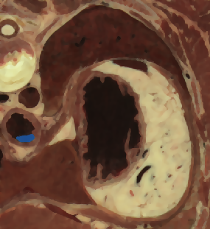
Curve-Based, Color Diffusion
Based on “Self Snakes” - Sapiro ‘98
Robust, accurate num. Impl.
R
M
S
e
r
r
o
r
c
o
m
p
a
r
i
s
o
n
(
n
=
3
0
)
r
3
0
o
c
u
r
v
e
r
2
5
a
n
n
i
s
o
r
s
n
a
k
e
e
2
0
S
1
5
M
R
1
0
5
0
1
2
3
4
k

Slide 6
ItkExceptionObject
Virtual base class
Confers error type, description, and location
Need to identify basic exception types

Slide 7
Fourier Transforms
  Generalized to N-Dimensions
  Specialized for real (T-valued pixels) functions
itkFFT<itkImage<T, N>>
itkFFT<itkImage<complex<T>, N> >
itkImage<complex<T>, N>
itkImage<T, N>
itkImage<complex<T>, N>

Slide 8
Gaussian Filtering
  Convolution generalized to N-Dimensions
  Streamability pending working iterator
  Lindeberg discrete Gaussian, separable
itkConvolve<T, N>
itkImage<T, N>
itkImage<T, N>
ItkGaussianKernel<X>
ItkGaussianKernel<X>
ItkGaussianKernel<...>
itkGaussian<T, N>
ItkGaussianKernel<N>

Slide 9
Differential Geometry
Low-level operators
  Arithmetic, differential, threshold, etc.
API design
  Use case scenarios
Streamable
  Pending working iterator

