Slide 1


Please attribute as SimpleITK Historical Overview
This work is copyrighted by the Insight Software Consortium
It is distributed under a Creative Commons Attribution 4.0 International License: https://creativecommons.org/licenses/by/4.0/

Slide 2


SimpleITK Historical Overview: Standing on the Shoulders of Giants
Ziv Yaniv^{1,2} , Bradley C. Lowekamp^{1,2} , David T. Chen^{1,2}
¹Bioinformatics and Computational Biosciences Branch, NIAID ²Medical Science and Computing LLC

Slide 3
What is SimpleITK?
A simplified multi-language interface to the Insight Toolkit (ITK).
Available in:
C++, Python, R, Java, C#, Lua, Ruby, TCL
github.com/SimpleITK/SimpleITK

Slide 4
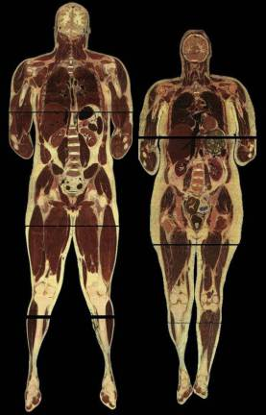
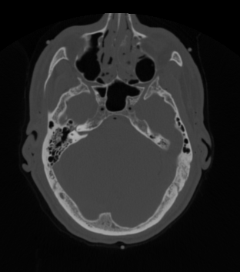
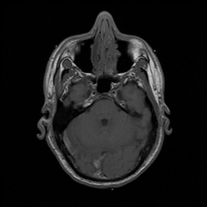
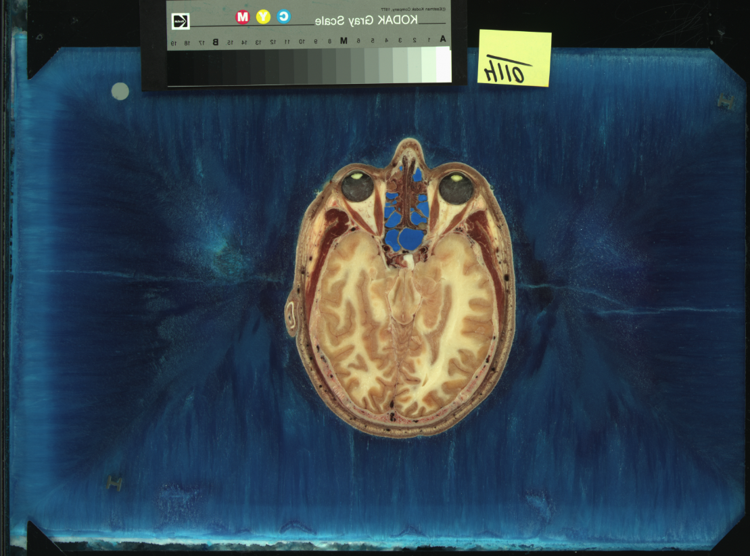

In the Beginning There Was Data
Male ~ 15Gb (21CDs)
Female ~ 40Gb (58CDs)
Dialup ~ 28.8Kbps (51 days to download the male dataset).
“The Visible Human Male: A Technical Report", V. Spitzer et al., J. Am. Med. Inform. Assoc.,3(2), pp. 118-130, 1996.

Slide 5


Need to Analyze the Data
2002
2017/2018
Insight Segmentation and Registration Toolkit
Insight Toolkit
“Engineering and Algorithm Design for an Image Processing API: A Technical Report on ITK - the Insight Toolkit”, T. S. Yoo et al., Stud. Health Technol. Inform., 85, pp. 586-592, 2002.

Slide 6

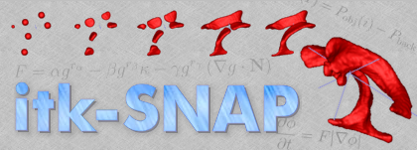
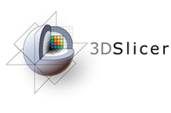




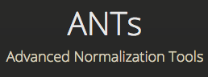




Open Source

Slide 7









Commercial Entities
Based on mailing list – Likely.
But we have no written testimony.

Slide 8
Why SimpleITK
Change in programming expertise:
Python.
Change in expectations:
No need to compile/build software.
Software should be easy to install.
Language Rank | Spectrum Ranking
1. Python | 100.0
2. C++ | 99.7
3. Java | 97.5
4. C | 96.7
5. C# | 89.4
6. PHP | 84.9
7.R | 82.9
8. JavaScript | 82.6
9. Go | 76.4
10. Matlab | 72.8
✓
✓
✓
✓
✓
“The 2018 Top Programming Languages”, IEEE Spectrum, S. Cass.

Slide 9

Simplified Data Analysis
2011-2018
2019 -

Slide 10
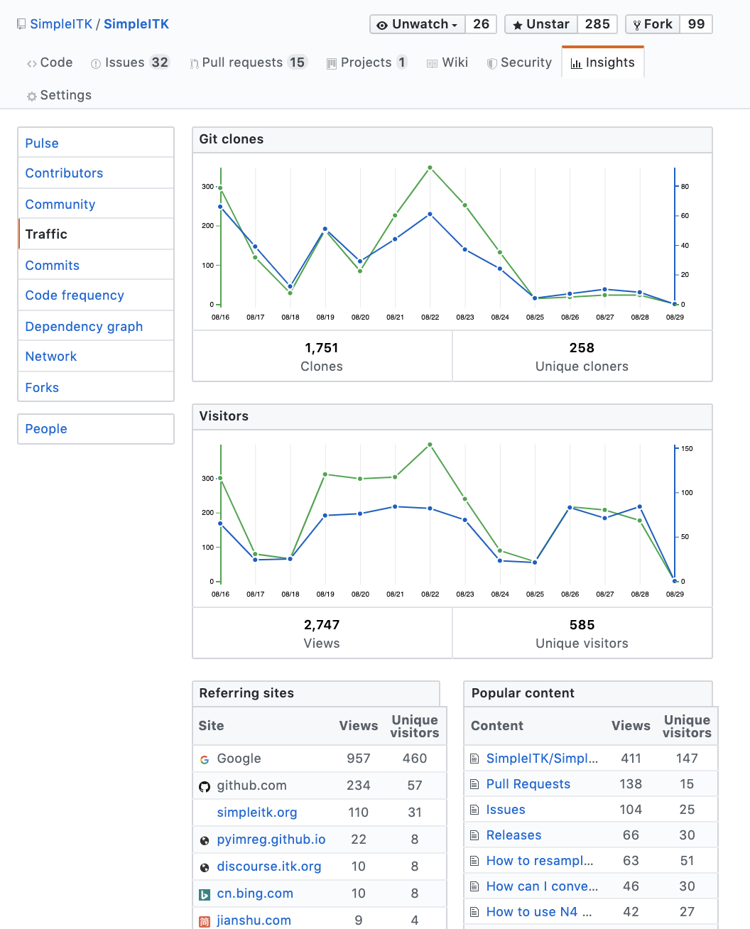
SimpleITK by the Numbers
A week in 8/2019:
19 Minor releases, 1 Major release.
38 Contributors.
9667 Commits.
214,260 lines of code.
Starred on GitHub: main repository > 285, notebook repository >275.
More than 29,776 downloads from pypi in 8/2019.
Notes:
Release tags: git tag
Number of contributors: git log --format='%aN' | sort -u -k2; then count and remove people with multiple appearances (Dave Chen, David T. Chen…)
Number of commits in repo: git rev-list --all --count
Lines in repository: git ls-files | xargs wc -l

Slide 11
How to Support
Cite us:
Beare, B. C. Lowekamp, Z. Yaniv, “Image Segmentation, Registration and Characterization in R with SimpleITK”, J Stat Softw, 86(8), https://doi.org/10.18637/jss.v086.i08, 2018.
Z. Yaniv, B. C. Lowekamp, H. J. Johnson, R. Beare, "SimpleITK Image-Analysis Notebooks: a Collaborative Environment for Education and Reproducible Research", J Digit Imaging., https://doi.org/10.1007/s10278-017-0037-8, 31(3): 290-303, 2018.
B. C. Lowekamp, D. T. Chen, L. Ibáñez, D. Blezek, "The Design of SimpleITK", Front. Neuroinform., 7:45. https://doi.org/10.3389/fninf.2013.00045, 2013.
Star us on GitHub:
Main repository – github.com/SimpleITK/SimpleITK
Notebook repository – github.com/InsightSoftwareConsortium/SimpleITK-Notebooks

Slide 12


