Slide 1

Customer Shopping Behavior Analysis
Uncovering insights from 3,900 purchases to drive strategic decisions

Slide 2
DATASET OVERVIEW
The Foundation
3,900
18
Transactions
Data Points
Key Features
Customer demographics & location
Purchase details & product categories
Shopping behavior & review ratings
Subscription & shipping preferences

Slide 3
PYTHON ANALYSIS
Data Preparation & Cleaning
01
02
Data Loading
Missing Data Handling
Imported dataset using pandas for initial exploration
Imputed Review Rating nulls with category medians
03
04
Feature Engineering
Database Integration
Created age groups and purchase frequency metrics
Connected to PostgreSQL for advanced SQL analysis

Slide 4

Revenue by Gender
Male Customers
Female Customers
$68,313 total revenue generated
$68,071 total revenue generated
Nearly equal revenue contribution across genders

Slide 5
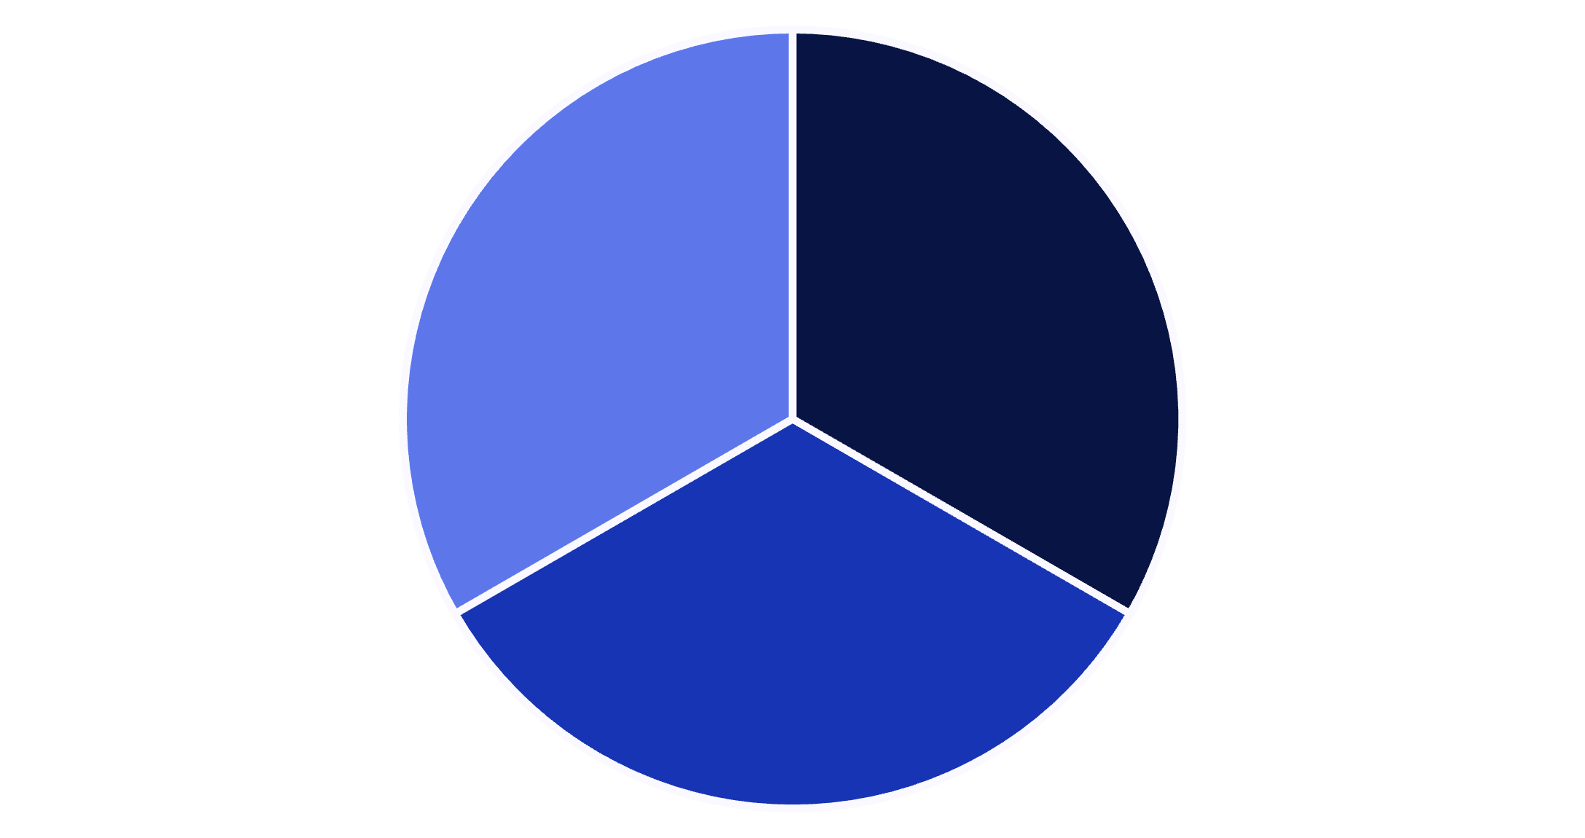
Customer Segmentation Insights
Three Equal Segments
Customers classified by purchase history:
New: First-time buyers
Returning: 2-5 purchases
Loyal: 5+ purchases
New
Returning
Loyal

Slide 6






TOP RATED
Highest-Rated Products
Jewelry
Handbag
Sunglasses
Dress
4.2 average rating
4.0 average rating
3.9 average rating
3.8 average rating
Sneakers
3.7 average rating

Slide 7

Subscription Impact
Subscribers
Non-Subscribers
$59.76 average spend
$59.65 average spend
$116,897 total revenue
$19,487 total revenue
Key Finding: Subscribers drive 6x more total revenue

Slide 8
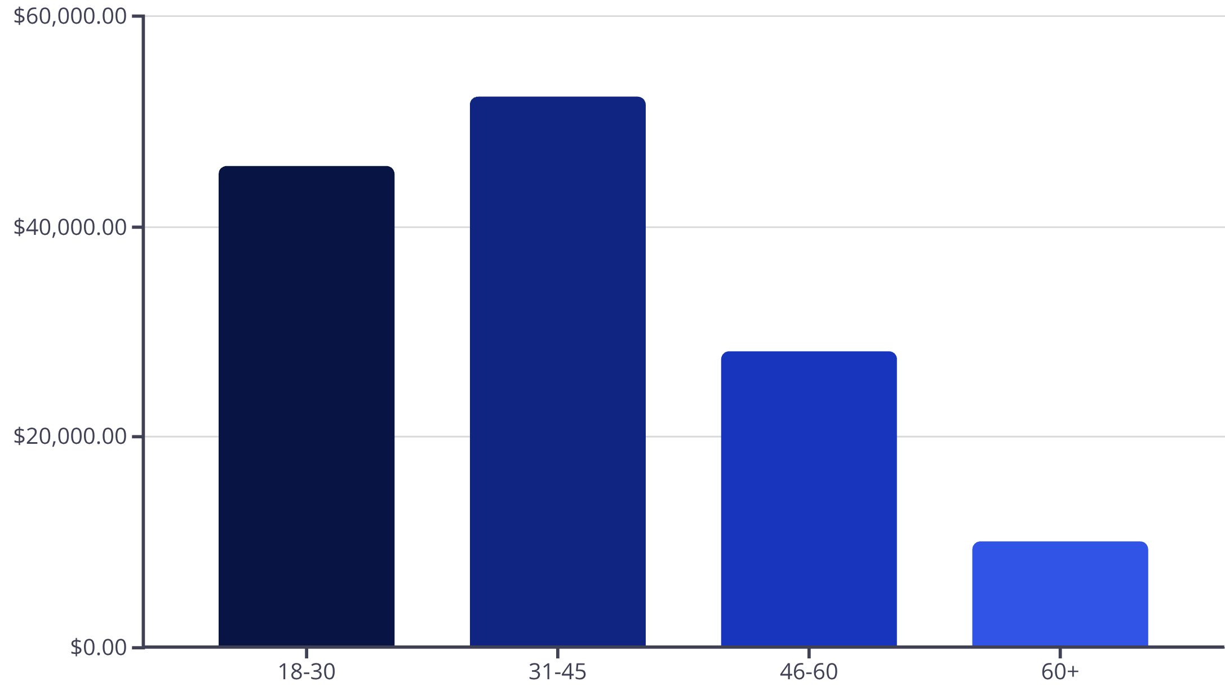
Revenue by Age Group
Age Insights
31-45 age group generates highest revenue at $52,341
Young adults (18-30) contribute $45,820
Opportunity to target mid-age demographics

Slide 9
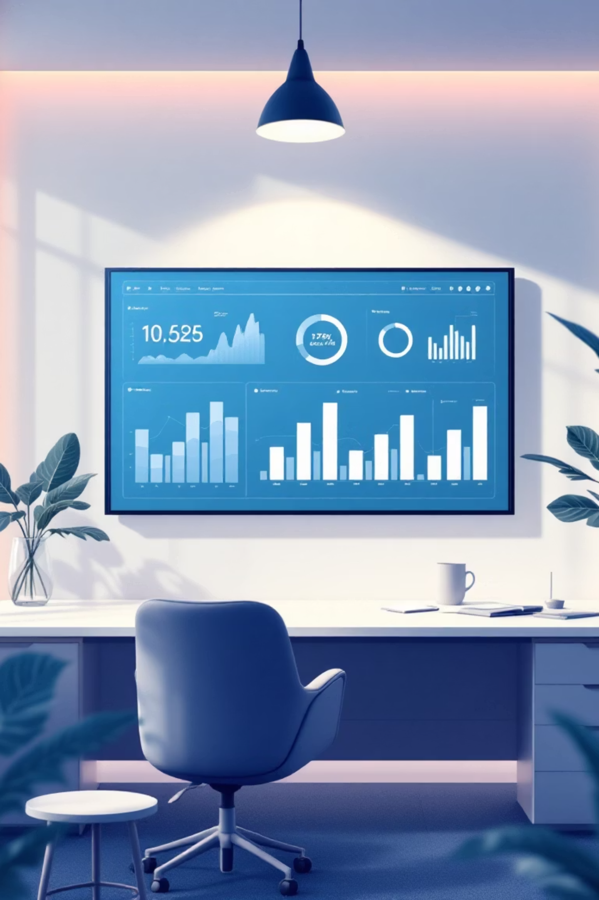
Power BI Dashboard
Interactive visualization bringing all insights together
Real-Time Metrics
Track KPIs and trends dynamically
Custom Filters
Slice data by category, season, location
Actionable Insights
Visual patterns for strategic decisions

Slide 10




RECOMMENDATIONS
Strategic Next Steps
Boost Subscriptions
Loyalty Programs
Promote exclusive benefits to drive loyalty
Reward repeat buyers to increase retention
Optimize Discounts
Target Marketing
Balance promotions with margin control
Focus on high-revenue age groups

