Slide 1
Sales Trend & Segment Analysis for Product Strategy (A Business Analytics Case Study for Lognormal Analytics)
Presented by:
Mansi Sinha Junior Business Analyst

Slide 2
Objective Overview
Main Objective
Trend Detection
Segment Influence Analysis
Competitor Impact Assessment
Additional Strategic Insights

Slide 3
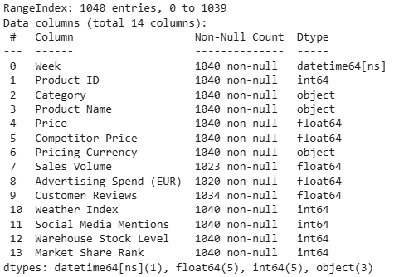
Data Understanding
Dataset Summary
Dataset covers 10 products across 3 categories: Home Goods | Clothing | Electronics
Total 1040 rows (weekly observations)
Time span: May 2023 – May 2025 ( 104 weeks)
Note*:
- Sales Volume had some missing values -> Imputed using median
- Currency is standardized to EUR

Slide 4
Segment Influence Analysis
Goal: Identify how different customer “types” (segments) are driving sales volume across categories.
Segment Creation (Proxy Segments Used): Since direct customer segments weren’t available, proxy segments were derived using:
Price Tier - Budget vs Premium
Buzz Level - Based on Social Media Mentions
Customer Sentiment - Based on Review Ratings
Ad Spend Level - High vs Low Advertising Spend

Slide 5
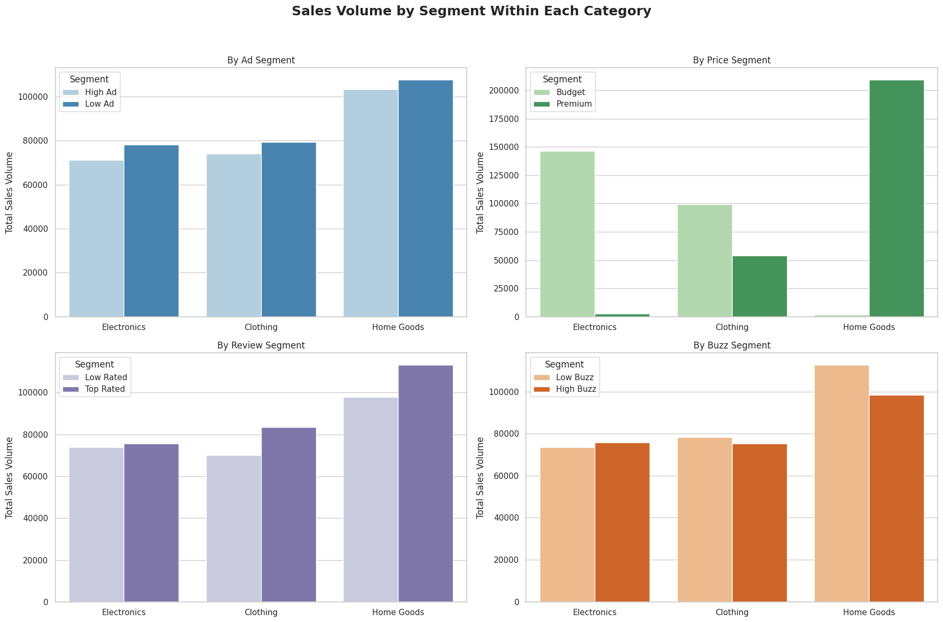

Slide 6
Key Insights
🏠 Home Goods sold the highest quantity, especially in premium tier - Customers perceive value in quality.
👗 Clothing saw better performance in budget segments, indicating price-sensitive behavior.
📣 High-buzz & high-review products consistently sold more across all categories - Trust & awareness matter.
📉 High Ad Spend did not guarantee higher sales - In many cases, low-ad products outperformed, suggesting ad inefficiency or brand-driven pull.

Slide 7
Trend Detection
Goal: Analyze how sales volume evolves over time to identify growth patterns, consistency, or seasonal trends.
Time Series Used
Weekly data over 104 weeks (May 2023 – May 2025)
Used Week column to visualize time-based sales trends

Slide 8
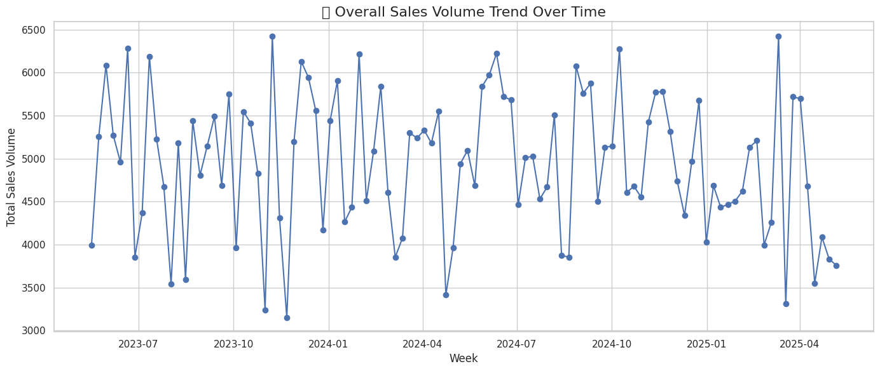
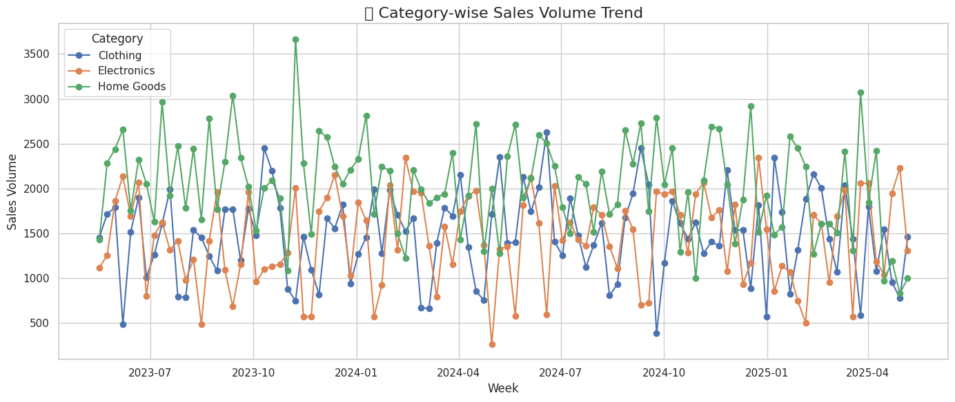

Slide 9
Key Trends Observed
Overall Sales Trend:
Sales remained stable with no strong upward or downward pattern
No visible seasonality or weekly spikes detected
Category-wise Trends:
Home Goods: Consistent performance over 2 years
Electronics: Minor fluctuations but mostly stable
Clothing: Volatile, lacking clear momentum

Slide 10
Competitor Price Impact
Goal: Measure how competitor pricing affects our weekly sales volume and whether undercutting or premium pricing changes buyer behavior.
Approach:
Created a new metric:
- Price Diff = Competitor Price – Our Price
Check Correlation Between Price Diff v/s Sales Volume

Slide 11
Key Findings
Correlation coefficient ≈ -0.005 - Virtually no relationship between price difference and sales volume
Products with lower prices did not necessarily sell more
In several categories, premium-priced products performed equally well

Slide 12
Operational & Environmental Factor Check (Objective 4: Additional Strategic Insights)
Goal: Identify hidden operational or external influencers affecting sales volume.
Variables Analysed
Warehouse Stock Level vs Sales Volume ➤ Correlation: -0.03 → Inventory availability not a limiting factor
Weather Index vs Sales Volume ➤ Correlation: +0.02 → No seasonal/weather-based impact detected
Lag Effect of Advertising ➤ Correlation of ad spend (1-week lag) with sales: insignificant ➤ Implies ad strategy isn’t boosting immediate sales

Slide 13
Recommendations
📦 Segment Influence (Objective 1)
📈 Trend Detection (Objective 2)
Focus on Home Goods Premium Tier- high performance despite price
In Clothing, push budget-friendly SKUs - price-sensitive customers
Boost review generation & social media buzz - stronger sales drivers than price or ads
No major seasonal spikes - Plan steady supply & marketing
Clothing shows volatility - Consider redesign or re-positioning
Use stable trends in Electronics & Home Goods for baseline forecasting

Slide 14
Recommendations
💸 Competitor Pricing (Objective 3)
⚙️ Operational Factors (Objective 4)
Price difference has minimal impact on volume
Avoid aggressive discounting - focus on value, trust & brand
Optimize pricing based on customer segment, not competition
Inventory levels & weather have no meaningful influence
Ads show no short-term lift - Reassess strategy (creative, timing, audience)
Invest in long-term perception-building over reactive tactics

Slide 15
AI Tool Disclosure & Links
Used ChatGPT for:
- Structuring Python code (EDA, plots, correlations)
- Insight framing
- Report and PPT organization
- All final decisions, interpretations, and strategy directions reflect my original thought process and judgment.
Links:
- Google Drive
(This Link Consist Google Collab Python Code & Report of the Case Study)
- Tableau Dashboard

