Slide 1



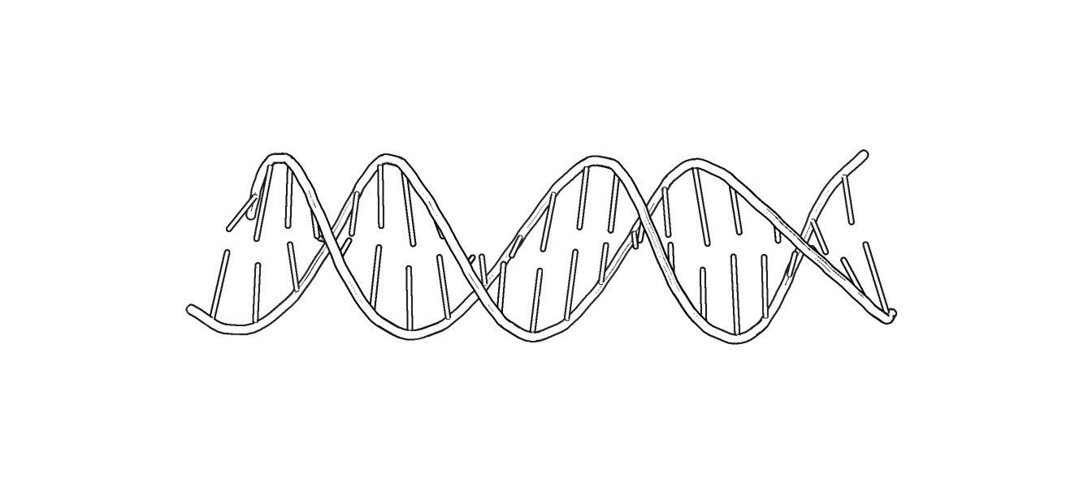

Construção de mapas de Hi-C
Amanda Souza Câmara
Leibniz Institute of Plant Genetics and Crop Plant Research
26 de outubro de 2026

Slide 2
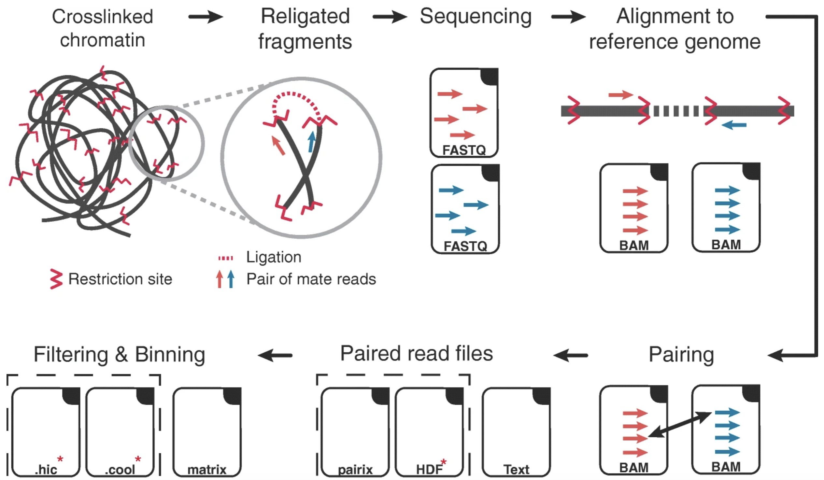
Como construir o mapa de contatos
Experimento Informática
Pal et al, 2018

Slide 3
Como construir o mapa de contatos
Ler os pares de sequências de Hi-C
Alinhar no genoma de referênca
Identificar sítios pares
Popular a matriz de pares sítios com ocorrências de pares observados

Slide 4
Muitos pipelines diferentes
ICE (Imakaev et al. 2012),
TADbit (Serra et al. 2017)
HiCUP (Wingett et al. 2015)
HIPPIE (Hwang et al. 2015)
Juicer (Durand et al. 2016b)
HiC-Pro (Servant et al. 2015)
HiCExplorer (Ramirez et al. 2018)
Ferramentas independentes combinadas (samtools, cutadapt,bwa, minimap,…)

Slide 5
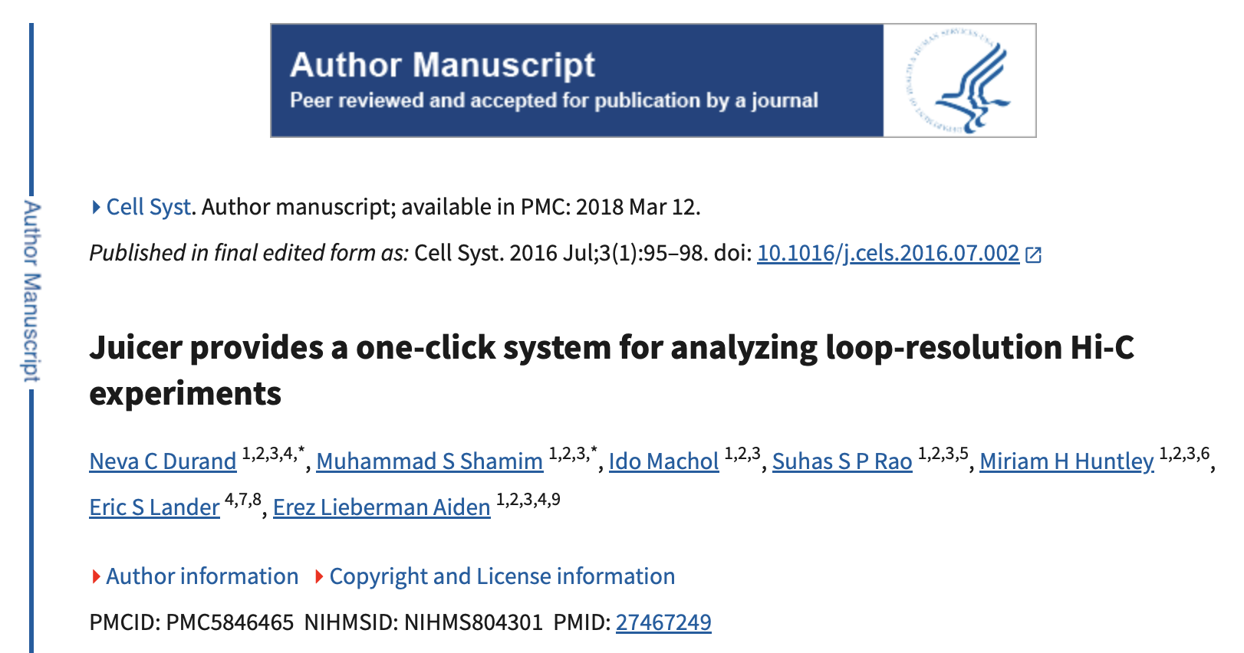
Juicer

Slide 6
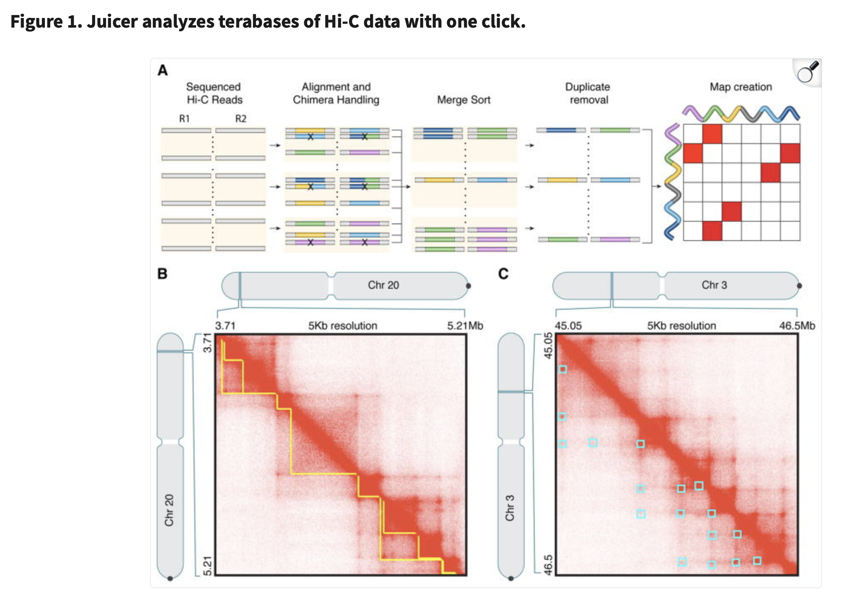
Juicer

Slide 7
Tudo com juicer
Ler os pares de sequências de Hi-C
Alinhar no genoma de referênca
Identificar sítios pares
Popular a matriz de pares sítios com ocorrências de pares observados
Mas é preciso preparar a bancada

Slide 8
Instalando dependências
Python normalmente já está instalado
Bwa, samtools e java no mac:
brew install samtools
brew install bwa
brew install openjdk
No linux:
sudo apt update
sudo apt-get install samtools
sudo apt install bwa
sudo apt install default-jdk

Slide 9
Organizar pastas (diretórios) e arquivos
  Preparar o juicer para encontrar os arquivos nos locais certos
Ler os pares de sequências de Hi-C
  Preparar arquivos fastq R1 e R2
Alinhar no genoma de referênca
  Preparar o genoma para ser lido
  Encontrar os possíveis sítios de digestão
Identificar sítios pareados
Popular a matriz de pares de sítios com ocorrências de pares observados

Slide 10
Preparando o juicer
Crie uma pasta para as análises do curso, dentro dela:
git clone https://github.com/theaidenlab/juicer.git # baixar o juicer do github
mkdir myjuicer
cd myjuicer
ln -s ../juicer/CPU scripts # copia scripts do juicer para sua propria pasta
cd scripts/common
wget https://hicfiles.tc4ga.com/public/juicer/juicer_tools.1.9.9_jcuda.0.8.jar # baixar o pacote de ferramentas do juicer
ln -s juicer_tools.1.9.9_jcuda.0.8.jar juicer_tools.jar
cd ../.. # volta para myjuicer
mkdir references
mkdir restrictions_sites
Só para mac, substituir comando awk por gawk no script principal do juicer
brew install gawk
alias awk=/opt/homebrew/bin/gawk
sed -i '' '545s/awk /gawk /;547s/awk /gawk /;552s/awk /gawk /;554s/awk /gawk /' scripts/juicer.sh
sed -i '' 's/| awk -f \$juiceDir\/scripts\/common\/dups_sam.awk/| gawk -f $juiceDir\/scripts\/common\/dups_sam.awk/g' scripts/juicer.sh

Slide 11
Input
Arquivos de pares de sequências de Hi-C, fastq (x2)
Sequência do genoma de referência, fasta
Informação sobre enzimas de digestão usadas

Slide 12
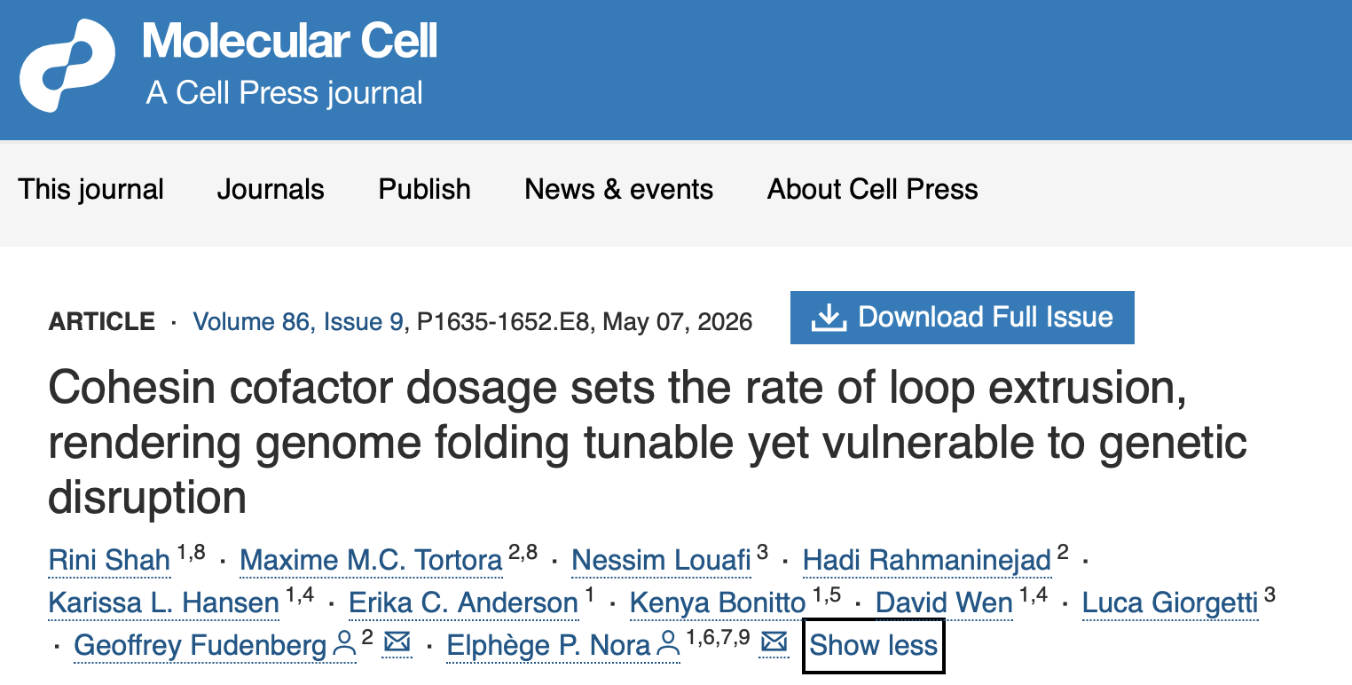
Nosso exemplo
https://www.cell.com/molecular-cell/abstract/S1097-2765(26)00233-9

Slide 13
Encontrar informações de entrada
Onde estão guardados os arquivos de pares de sequências de Hi-C (fastq)
  Normalmente no Sequence Read Archive (SRA da NCBI, criado em 2007, https://en.wikipedia.org/wiki/Sequence_Read_Archive)
Qual foi o genoma de referência e onde encontrá-lo
Qual foi a enzima de digestão usada?

Slide 14
Organizando dados de entrada
Na pasta myjuicer
Baixar o toolkit do sra para baixar arquivos fastq com uma das duas opções
  curl -L -o sratoolkit.tar.gz https://ftp-trace.ncbi.nlm.nih.gov/sra/sdk/current/sratoolkit.current-mac-arm64.tar.gz
  curl -L -o sratoolkit.tar.gz https://ftp-trace.ncbi.nlm.nih.gov/sra/sdk/current/sratoolkit.current-alma_linux64.tar.gztar -xvzf sratoolkit.tar.gz
tar -xvzf sratoolkit.tar.gz
  export PATH="$PWD/sratoolkit.3.4.1-alma_linux64/bin:$PATH”
  export PATH="$PWD/sratoolkit.3.4.1-mac-arm64/bin:$PATH”
Na sua pasta do curso
mkdir cohesin_dosage_example
cd cohesin_dosage_example
mkdir fastq
cd fastq
prefetch SRR30953179
fasterq-dump --split-files SRR30953179
# mudar nome dos arquivos para terminar em _R1.fastq e _R2.fastq

Slide 15
Preparando o genoma
Na pasta myjuicer
cd references
curl -O https://hgdownload.soe.ucsc.edu/goldenPath/mm10/bigZips/mm10.fa.gz (o genoma de mus musculus, mm10)
gunzip mm10.fa.gz
samtools faidx mm10.fa #para recuperar o tamanho dos cromossomos
cut -f1,2 mm10.fa.fai > mm10.chrom.sizes
bwa index mm10.fa
cd ../restrictions_sites
chmod +x ../../juicer/misc/generate_site_positions.py
../../juicer/misc/generate_site_positions.py Arima mm10 ../references/mm10.fa

Slide 16
Esquema de pastas e arquivos para rodar o juicer.sh
Sua pasta do curso
juicer
myjuicer
cohesin_dosage_example
scripts
references
restriction_sites
fastq
common/
juicer.sh
mm10_Arima.txt
_R1.fastq
_R2.fastq
mm10.fa
mm10.chrom.sizes

Slide 17
Rodar o juicer
Na pasta cohesion_dosage_example
../myjuicer/scripts/juicer.sh -t 8 -D ../myjuicer/ -z ../myjuicer/references/mm10.fa -p ../myjuicer/references/mm10.chrom.sizes -y ../myjuicer/restrictions_sites/mm10_Arima.txt -s Arima &

Slide 18
Estatísticas dos reads
Copiar hic_bam_summary.sh do github do curso para sua pasta do curso
Na pasta cohesin_dosage_example
bash ../hic_bam_summary.sh aligned/merged_dedup.bam cohesin_dosage_example

Slide 19
Column | Meaning
sample | Sample name supplied when running the script.
bam_pairs | Number of complete primary read pairs represented in merged_dedup.bam. This is not the original number of raw FASTQ pairs.
duplicate_pairs | Number of read pairs for which at least one mate has the BAM duplicate flag (0x400).
duplicate_fraction | duplicate_pairs / bam_pairs. Fraction of pairs in the BAM marked as duplicates.
both_mapped_pairs | Number of pairs for which both mates mapped to the reference. Includes duplicates and pairs with low MAPQ.
singleton_pairs | Number of pairs for which exactly one mate mapped.
singleton_fraction | singleton_pairs / bam_pairs. Fraction of pairs with only one mapped mate.
non_dup_q10 | Number of pairs passing those filters.
p_non_dup_q10 | non_dup_q10 / bam_pairs. Fraction of BAM pairs retained after these filters.
pairs_ge_1kb | Number of filtered pairs that are either interchromosomal or map at least 1 kb apart on the same chromosome.
p_ge_1kb | pairs_ge_1kb / non_dup_q10. Fraction of filtered pairs meeting the ≥1-kb definition.
pairs_ge_1mb | Number of filtered pairs mapping to the same chromosome at least 1 Mb apart.
p_ge_1mb_among_ge_1kb | pairs_ge_1mb / pairs_ge_1kb. Fraction of the ≥1-kb group that is intrachromosomal and separated by at least 1 Mb.
interchromosomal | Number of filtered pairs whose mates map to different chromosomes.
p_interchromosomal_among_ge_1kb | interchromosomal / pairs_ge_1kb. Fraction of the ≥1-kb group that is interchromosomal.
*Feito com IA

Slide 20
Para visualizar
Instalar o Juicebox
Abrir cohesion_dosage_example/aligned/inter.hic

Slide 21
./juicer.sh -h
1. Reference genome and input parameters
*Feito com IA
Option | Meaning | Example
-g | Genome ID supported by the script | -g hg38
-d | Top-level experiment directory containing fastq/; Juicer creates splits/ and aligned/here | -d /path/to/sample
-z | Reference genome FASTA | -z references/TAIR10.fa
-p | Chromosome sizes file, defining which chromosomes go into the .hic file | -p references/TAIR10.chrom.sizes
-y | Restriction-site positions file for the reference assembly | -y restriction_sites/TAIR10_HindIII.txt
-s | Restriction enzyme/site setting | -s HindIII
-b | Ligation-junction sequence, used when counting ligation junctions | -b GATCGATC
-D | Parent directory of the Juicer installation, containing scripts/, references/ and restriction_sites/ | -D /path/to/myjuicer

Slide 22
./juicer.sh -h
2. Threads and metadata
*Feito com IA
Option | Meaning | When to change it
-t | Number of threads for BWA alignment | Increase when CPU resources are available
-T | Number of threads for .hic file creation | Increase if the file-creation stage is slow and resources allow
-a | Experiment description stored in the output metadata/statistics | Useful for recording treatment, tissue or experimental condition
-i | Sample name in the BAM read-group metadata | Set to the biological sample name
-k | Library name in the read-group metadata | Set to the library identifier

Slide 23
./juicer.sh -h
3. Duplicate handling and output options
*Feito com IA
Option | Meaning | Practical advice
-w | Wobble distance used in duplicate detection; the CPU script's default is 4 | Keep the default unless you have a reason to change it
-j | Use exact duplicate matching instead of wobble-based matching | Changes duplicate-detection behavior; do not change casually
-f | Include fragment-delimited maps in .hic creation | Use if you need restriction-fragment-resolution maps
-u | Treat the data as single-end rather than paired-end | Ordinary paired-end Hi-C generally does not use this
-m | Methylation-library mode | Only for the relevant specialized workflow
-e | Exit early before final .hic creation | Useful in specialized workflows, but not for producing the normal final output

Slide 24
./juicer.sh -h
*Feito com IA
4. Restarting a failed run with -S
-S value | Intended restart point
chimeric | Alignment has completed; resume chimeric-read handling
merge | Chimeric handling has completed; resume merging
dedup | Merged alignments exist; resume duplicate handling
final | Deduplication is complete; create final statistics and .hic files
postproc | .hic files exist; resume feature-annotation post-processing
early | Stop before normal final .hic creation

Slide 25
./juicer.sh -h
5. Other options
*Feito com IA
Option | Purpose
--assembly | Early-exit workflow that creates the older merged_nodups output for downstream assembly workflows
--cleanup | Automatically clean up intermediate files after successful completion
--qc | QC-oriented run mode with a reduced resolution range, according to the script help
--qc_apa | Run QC Aggregate Peak Analysis
--in-situ | Specialized mode for in-situ Hi-C processing
-h or --help | Display help

Slide 26

Nosso exemplo
https://academic.oup.com/plcell/article/34/7/2638/6571821?login=false#365062977

Slide 27
Organizando dados de entrada
Na pasta myjuicer
Baixar o toolkit do sra para baixar arquivos fastq com uma das duas opções
  curl -L -o sratoolkit.tar.gz https://ftp-trace.ncbi.nlm.nih.gov/sra/sdk/current/sratoolkit.current-mac-arm64.tar.gz
  curl -L -o sratoolkit.tar.gz https://ftp-trace.ncbi.nlm.nih.gov/sra/sdk/current/sratoolkit.current-alma_linux64.tar.gztar -xvzf sratoolkit.tar.gz
tar -xvzf sratoolkit.tar.gz
  export PATH="$PWD/sratoolkit.3.4.1-alma_linux64/bin:$PATH”
  export PATH="$PWD/sratoolkit.3.4.1-mac-arm64/bin:$PATH”
Na sua pasta do curso
mkdir yang_arabidopsis_example
cd yang_arabidopsis_example
mkdir fastq
cd fastq
prefetch PRJNA780072
fasterq-dump --split-files PRJNA780072
# mudar nome dos arquivos para terminar em _R1.fastq e _R2.fastq

Slide 28
Preparando o genoma
Na pasta myjuicer
cd references
wget https://ftp.ensemblgenomes.ebi.ac.uk/pub/plants/release-63/fasta/arabidopsis_thaliana/dna/Arabidopsis_thaliana.TAIR10.dna.toplevel.fa.gz
gunzip Arabidopsis_thaliana.TAIR10.dna.toplevel.fa.gz
samtools faidx Arabidopsis_thaliana.TAIR10.dna.toplevel.fa #para recuperar o tamanho dos cromossomos
cut -f1,2 Arabidopsis_thaliana.TAIR10.dna.toplevel.fa.fai > Arabidopsis_thaliana.TAIR10.dna.toplevel.chrom.sizes
bwa index Arabidopsis_thaliana.TAIR10.dna.toplevel.fa
cd ../restrictions_sites
chmod +x ../../juicer/misc/generate_site_positions.py
../../juicer/misc/generate_site_positions.py Arabidopsis_thaliana.TAIR10.dna.toplevel Arabidopsis_thaliana.TAIR10.dna.toplevel.fa

Slide 29
Esquema de pastas e arquivos para rodar o juicer.sh
Sua pasta do curso
juicer
myjuicer
cohesin_dosage_example
scripts
references
restriction_sites
fastq
common/
juicer.sh
Arabidopsis_thaliana.TAIR10.dna.toplevel_Arima.txt
Arabidopsis_thaliana.TAIR10.dna.toplevel.fa
Arabidopsis_thaliana.TAIR10.dna.toplevel.chrom.sizes
SRR16937571_R1.fastq
SRR16937571_R2.fastq

