Slide 1

Mortality from Chronic Diseases in the United States, 2010-2020
Group project 3
Contributors: Tracy Tachick, Michaela Johnson, Jessica Pilon

Slide 2
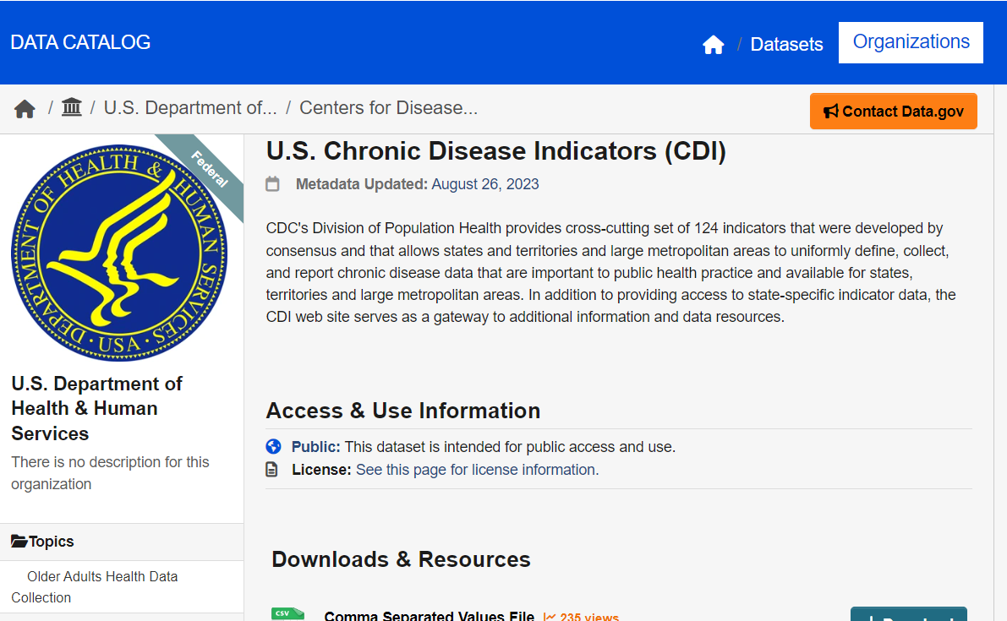
Our Data Source:
Our initial goal was to find a light-hearted, feel-good topic!
Naturally, we concluded our search with Chronic Disease Indicators, and narrowed the large (1 million+ entries) dataset to just the mortalities.
We wanted to see how Chronic Diseases affected different areas and demographics across the US.
https://catalog.data.gov/dataset/u-s-chronic-disease-indicators-cdi

Slide 3
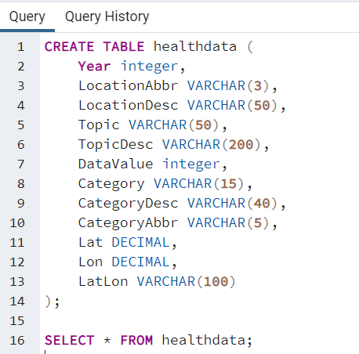
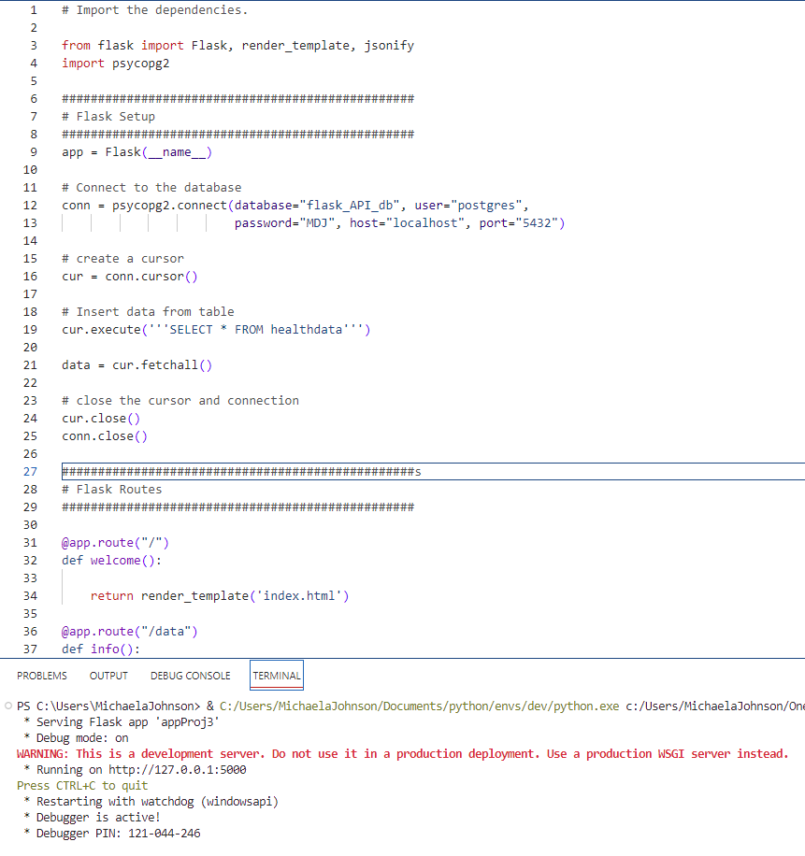
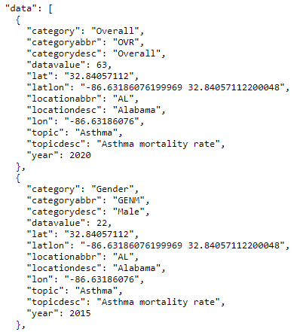
The Process: from CSV to PostgreSQL to Flask.py to API
PostgreSQL
Flask & psycopg
Live JSON API

Slide 4

1. What are the Chronic Diseases causing the most mortalities?
2.How have those causes changed over time?
3. Do Chronic Disease mortalities change per state?
4. Which demographics are most affected?
But most importantly: How do I work with this Dataset???
The Questions we asked:

Slide 5
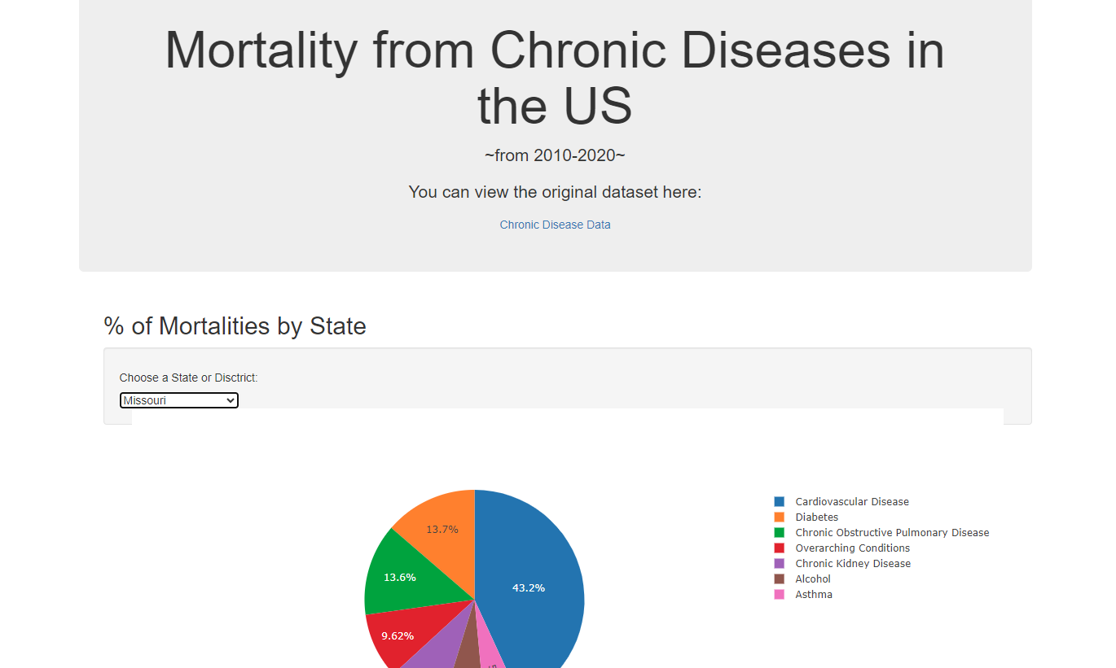
Drop-down box & Pie Chart

Slide 6
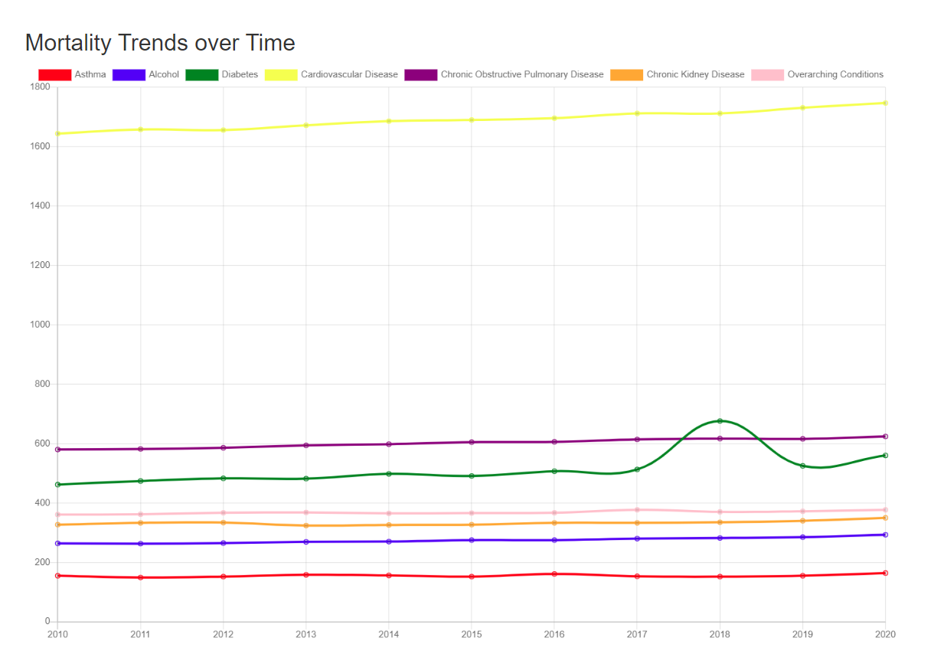
Line Graph

Slide 7
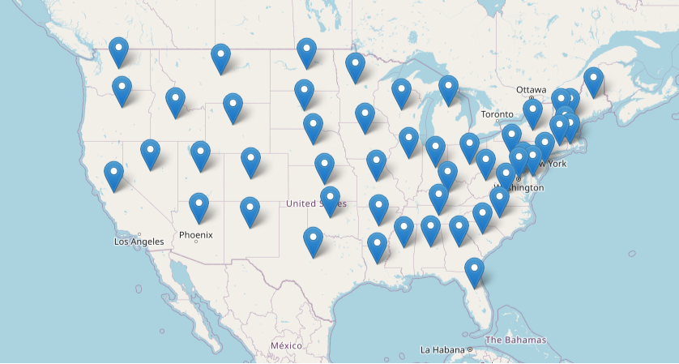
US Map

