Slide 1



SHAKTI HACKATHON 2026 · ROUND 1 IDEA SUBMISSION
साक्षी · সাক্ষী · the witness
An SOS gets help to her. Saakshi gets justice to her.
Saakshi silently records harassment, seals the evidence so no one can claim it was edited, and explains her rights in her own language.
TRACK
TEAM
BUILT WITH
Women Safety / Blockchain
Appvengers
AI agents · Polygon · PWA
Notes:
Saakshi means 'the witness'. Most safety apps get help to a woman. Saakshi is built for what comes after: proof that can't be lost or doubted, and a clear path to justice, in her own language.

Slide 2
Ashtami night, North Kolkata
i. Her story
Ria is 20. She has waited all year for this night.
“Where is your
proof?”
10:40 pm
The pandal queue is packed. The dhak drowns out her friend Payel.
10:41 pm
A hand grabs her from behind. Nobody saw, or everyone looked away.
Ria goes home. She never files the complaint. Like three in four women who face violence, she tells no one.
10:55 pm
He follows her to the metro. All she has is a shaky 9-second video.
Next day
At the station: “Are you sure it was him? Your video shows nothing.”
RIA IS A COMPOSITE. HER NIGHT IS NOT.
Notes:
Ria is a composite character, but every part of her night happens to real women, during Pujo and every other day. The harassment lasts seconds. What follows decides everything: evidence that doesn't hold up, a question she can't answer, and silence.

Slide 3
Ria is far from alone
i. Her story
77
4,48,211
crimes against women registered in 2023, over 1,200 a day.
1 in 5
of every 100 women who face violence never tell anyone or seek help.
cases of crime against women ended in a conviction, 2017–2023.
3.7%
NFHS-5 (2019–21), as reported
conviction rate for crimes against women in West Bengal, 2023.
Ask any woman you know. She has a story she never reported.
Sources: NCRB, Crime in India 2023 (via PTI, Sep 2025). NFHS-5 help-seeking data as reported. The Wire analysis of NCRB data, 2017–2023.
Notes:
Seventy-seven of every hundred women who face violence never tell anyone. Over 1,200 cases are registered every day, and those are only the reported ones. In Bengal, fewer than four in a hundred end in conviction. The thread running through all of it is proof.

Slide 4
Help arrives. Belief doesn’t
i. Her story
01
02
03
04
THE MOMENT
THE EVIDENCE
THE REPORT
THE COURT
SOS apps alert her family and the police. That part works.
Phone snatched, files lost, and the video dismissed as edited.
Which law applies? Which office? What if he finds the app?
Courts need a certificate with the file’s hash. Few have it.
WHERE TODAY’S APPS STOP
WHERE RIA WAS LEFT ALONE, AND WHERE SAAKSHI BEGINS
SUPREME COURT · 2026
Electronic evidence must be certified with its hash value.
Section 63(4), Bharatiya Sakshya Adhiniyam, upheld in Pune Bar Association v. Union of India. Saakshi records that hash the second evidence is captured.
Notes:
Every safety app helps with the first ten seconds. Ria's case collapsed in the days after: no usable evidence, no idea which law applied, and a court system that now expects hash-certified records. The Supreme Court upheld that requirement in 2026.

Slide 5
Three women, three kinds of harm
i. Her story
Ria, 20
Mitali, 34
Ananya, 19
STUDENT · NORTH KOLKATA
HOMEMAKER · HOWRAH
FIRST-YEAR STUDENT · DURGAPUR
Groped in an Ashtami crowd, then followed to the metro. Her only proof is a shaky 9-second video.
Her husband checks her phone every night. Cruelty at home is India’s most-reported crime against women.
Morphed photos of her are spreading on Instagram. Her college group chat has already seen them.
“No one will believe me.”
“If he finds out, it gets worse.”
“By morning, everyone will have seen it.”
SAAKSHI GIVES HER
SAAKSHI GIVES HER
SAAKSHI GIVES HER
Silent capture, sealed evidence and a ready Zero FIR.
A journal hidden inside a calculator, and a duress PIN.
A sealed screenshot vault and a takedown request the same night.
Composite characters. Cruelty by husband or relatives: 1,33,676 cases in 2023 (NCRB, Crime in India 2023).
Notes:
Harassment looks different for every woman. Ria faces it in public, Mitali at home, Ananya online. Each has a different fear, and Saakshi answers each one directly.

Slide 6
ii. The witness
At dawn on Mahalaya, Kumartuli’s artisans paint the goddess’s eyes. They call it chokkhu daan (চক্ষুদান), the gift of sight.
Saakshi gives every woman a witness that never looks away.
01
02
03
Capture.
Prove.
Act.
Three taps start a silent SOS. Audio, video and location stream out, encrypted.
Fingerprinted on her phone, sealed on Polygon. No one can claim it was edited.
An AI agent explains which laws apply and drafts the complaint, in Bengali, Hindi or English.
Notes:
On Mahalaya, Kumartuli's artisans paint the goddess's eyes, a ritual called chokkhu daan, the gift of sight. Saakshi gives every woman that gift: a witness that never looks away. It does three things. Capture, so nothing is lost. Prove, so no one can claim it was edited. Act, so she is never left wondering what to do next.

Slide 7
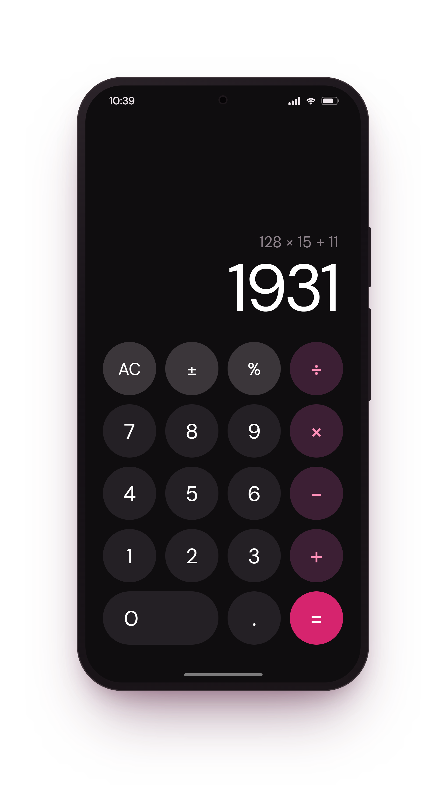
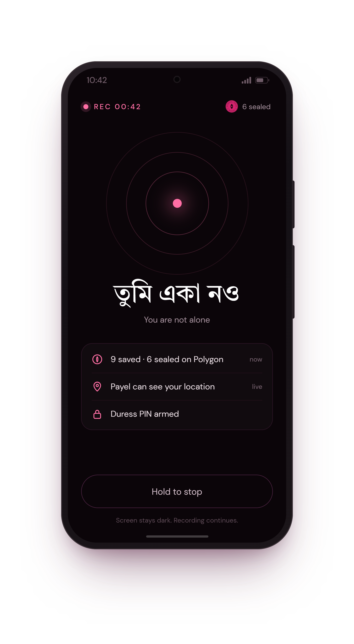
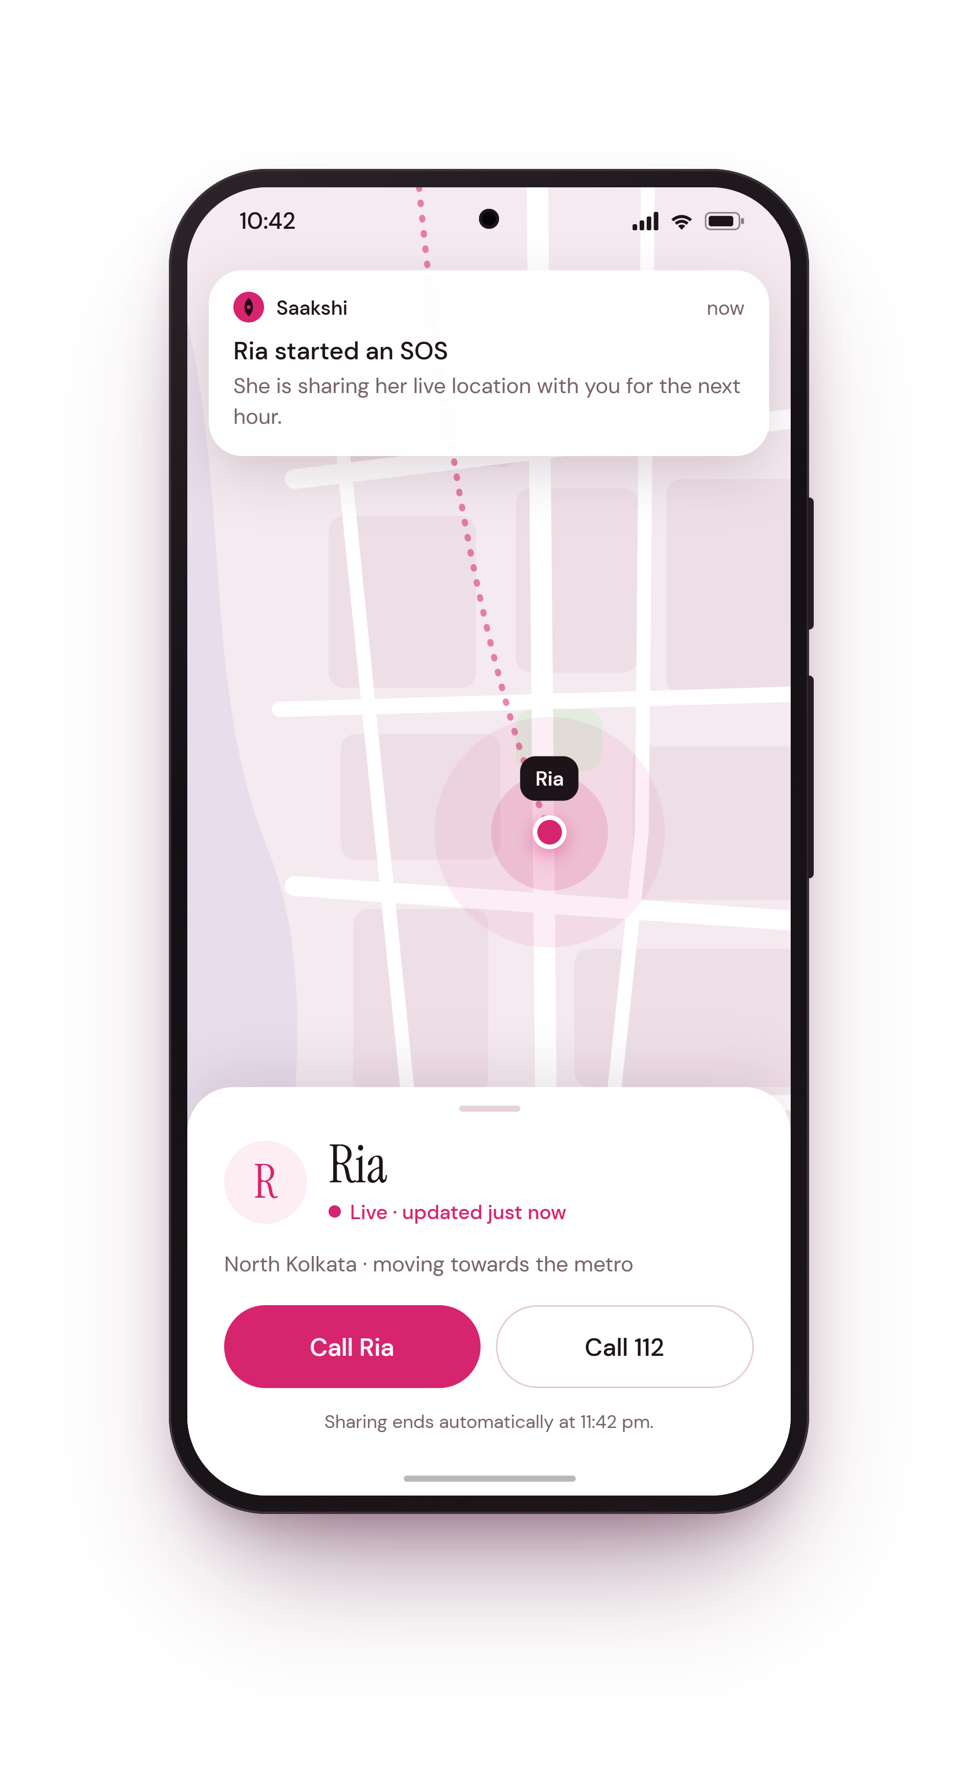
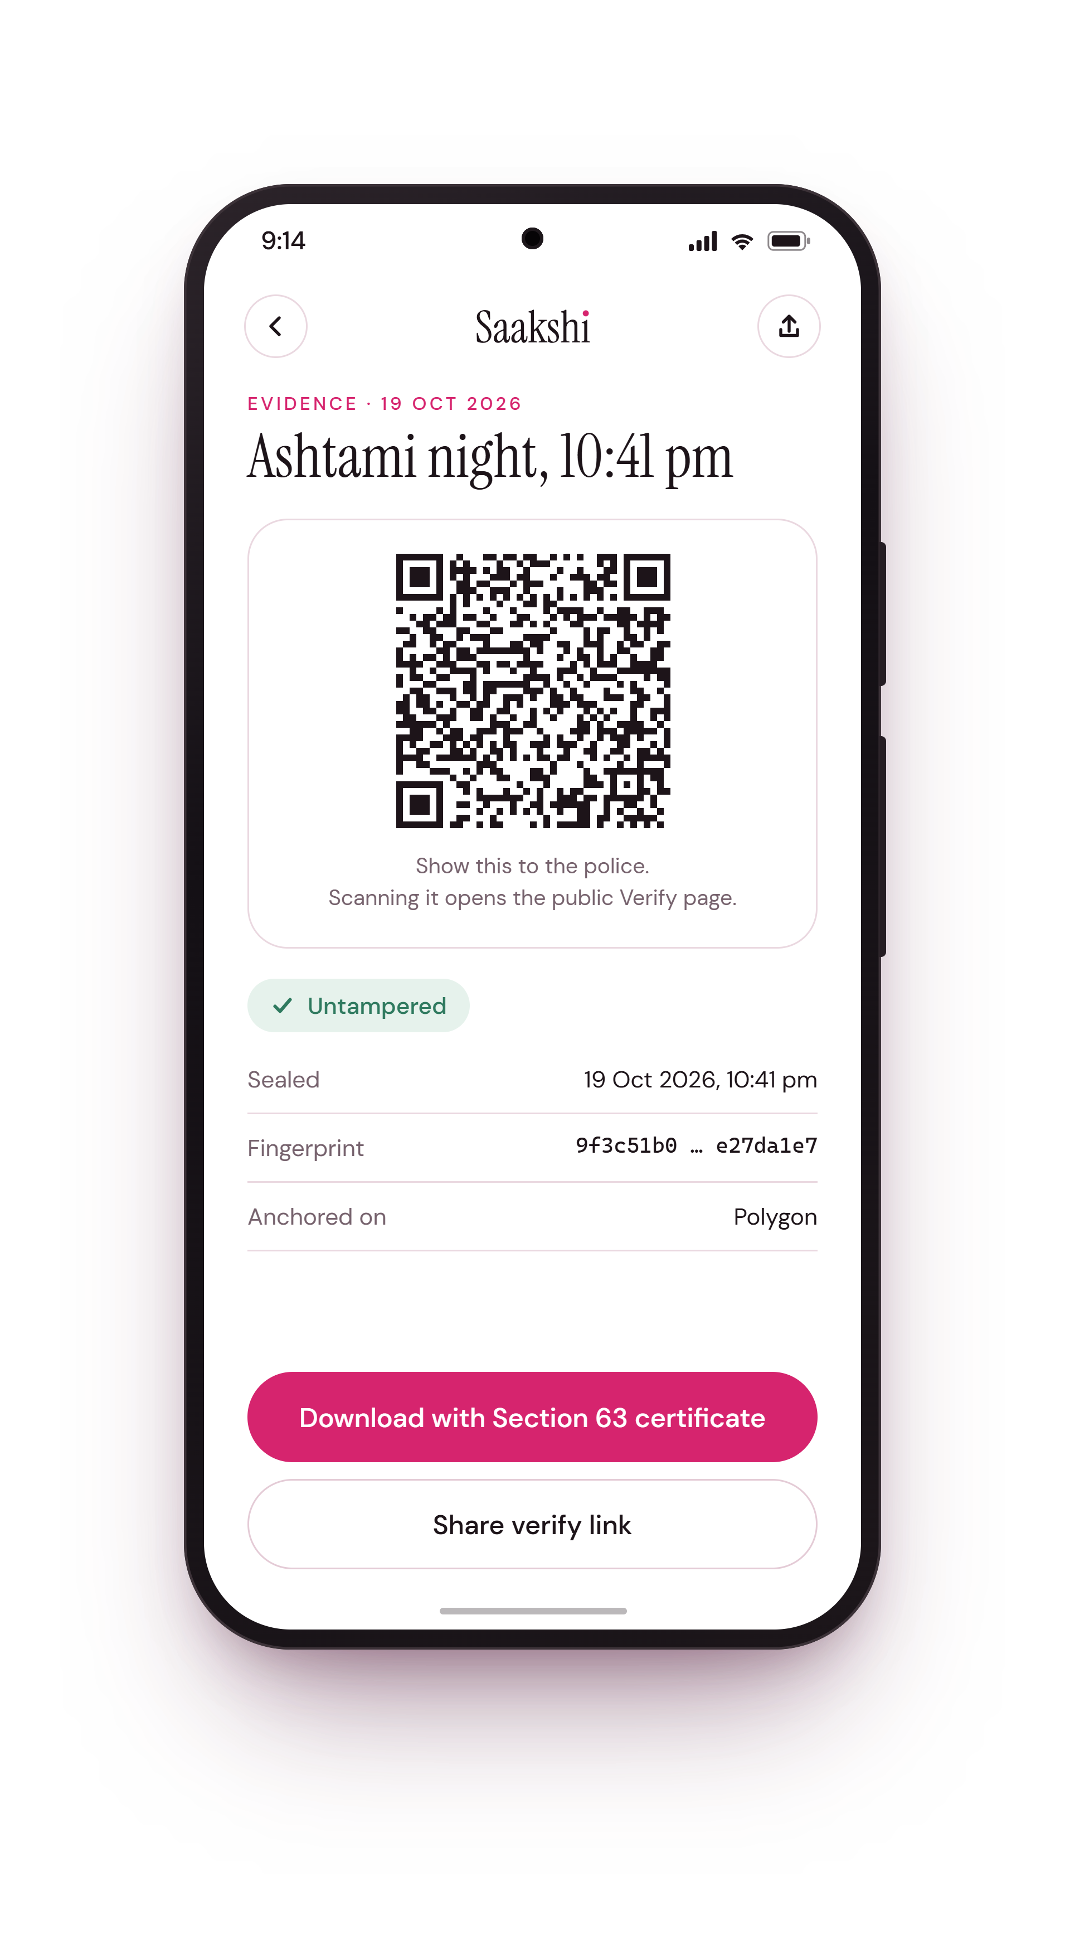
Invisible until she needs it
ii. The witness
01 · DISGUISE
02 · SILENT SOS
03 · NOT ALONE
04 · PROOF
A working calculator. Her PIN and = opens Saakshi.
Three taps. The screen goes dark.
Payel gets an alert and Ria’s live location for an hour.
One QR code any officer can scan to verify it.
Notes:
Four screens tell the story. To anyone looking at her phone, Saakshi is just a calculator. Three taps start a silent SOS: the screen goes dark and simply tells her, in Bengali, that she is not alone. Her friend gets her live location for one hour. The next day, one QR code is all an officer needs to verify her evidence. These are the real screens we will build.

Slide 8
Ashtami night, again
ii. The witness
10:41 pm
10:41 pm
10:42 pm
11:30 pm
Next day
TRIGGER
CAPTURE AND SEAL
NOT ALONE
UNDERSTAND
BELIEVED
Three taps on her calculator. The screen goes dark.
Recording starts. The first piece is sealed on Polygon.
Payel sees Ria’s live location. They find each other.
Saakshi explains her rights in Bengali and drafts a Zero FIR.
The officer scans her QR code. Untampered, sealed at 10:41 pm.
তুমি একা নও
“Where is your proof?”
“Here it is.”
You are not alone. The first thing her screen says.
Notes:
Same night, same crowd, same man. The difference is that Ria now has a witness. Within seconds her first piece of evidence is off the phone and sealed. Her friend knows where she is. That night she understands her rights in her own language, and the next morning the question that silenced her has an answer.

Slide 9
The ten arms of Saakshi
ii. The witness
As the SHAKTI brief puts it: “Devi Durga wields ten arms, each channelling a Shakti.”
01
Duress PIN
06
Public Verify page
Looks like cancel, silently escalates
Anyone can check a file in one click
02
Disguise mode
07
AI legal agent
Hides behind a working calculator
Explains the law kindly, and cites it
03
Chunked streaming
08
Her language
Evidence leaves her phone every five seconds
Speak or type in Bengali, Hindi or English
04
Tamper-proof seal
09
Consent first
SHA-256 fingerprint, timestamped on Polygon
Location sharing is time-limited and visible
05
Gasless by design
10
Works offline
No wallet, no crypto, no fees for her
Queues evidence and syncs when back online
Notes:
The organisers describe Durga's ten arms; these are Saakshi's. The first two protect her from the person hurting her. The middle ones protect the evidence. The last ones protect her choices and her dignity. Every one of them is in the build, not just on a roadmap.

Slide 10
How a recording becomes proof
iii. Under the hood
CIPHERTEXT ONLY
FINGERPRINTS ONLY
PUBLIC PROOF
ON HER PHONE
SAAKSHI CLOUD
POLYGON
ANYONE, ANYWHERE
Fingerprinted first
Stored, encrypted
Sealed in public
Verified by anyone
In 5-second pieces
SHA-256, then AES-GCM
Queued when offline
Row-level security
Ciphertext only
Fingerprints batched
EvidenceAnchor contract
One root, many files
No personal data, ever
Verify page and QR code
Section 63 certificate
File never uploaded
ALONGSIDE: THE AI AGENT
Claude API with tool-calling, answering only from a curated corpus of Indian law, always with citations. Bengali and Hindi voice through the Web Speech API. It drafts the complaint and the Section 63 certificate for her to review.
NEXT.JS · TYPESCRIPT · TAILWIND · SUPABASE · SOLIDITY · HARDHAT · ETHERS.JS · POLYGON AMOY · CLAUDE API · WEB PUSH · VERCEL
Notes:
Privacy is the architecture, not a feature. Files are encrypted on her phone before upload, so the cloud only ever holds scrambled data. Only fingerprints reach the blockchain, and a relayer pays network fees so she never touches crypto. Anyone can verify a file in a browser without uploading it.

Slide 11
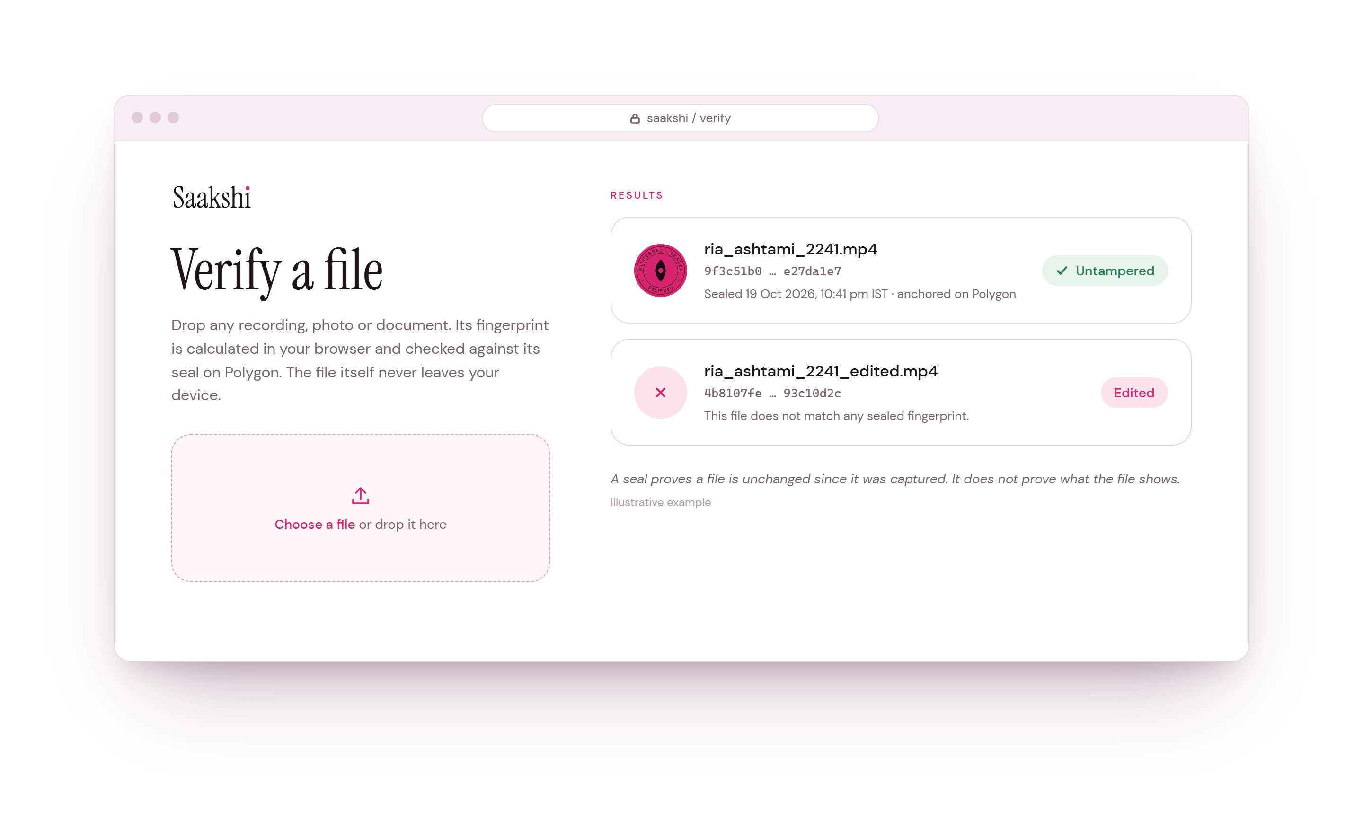
Only a fingerprint goes on-chain
iii. Under the hood
ON-CHAIN
One salted fingerprint per batch, and the moment it was sealed.
NEVER ON-CHAIN
Her video, voice, location and name.
Merkle batching. Thousands of files per transaction, a fraction of a rupee each.
Gasless. Saakshi pays the network fee. She never needs a wallet.
Erasure built in. Delete the encrypted file and its key, and nothing personal remains.
Notes:
Putting Ria's video on a blockchain would be slow, expensive and a privacy disaster, because a blockchain never forgets. Saakshi seals only a fingerprint. On the Verify page, the file is fingerprinted in the browser and never uploaded. Change a single byte of her video and it shows as edited.

Slide 12
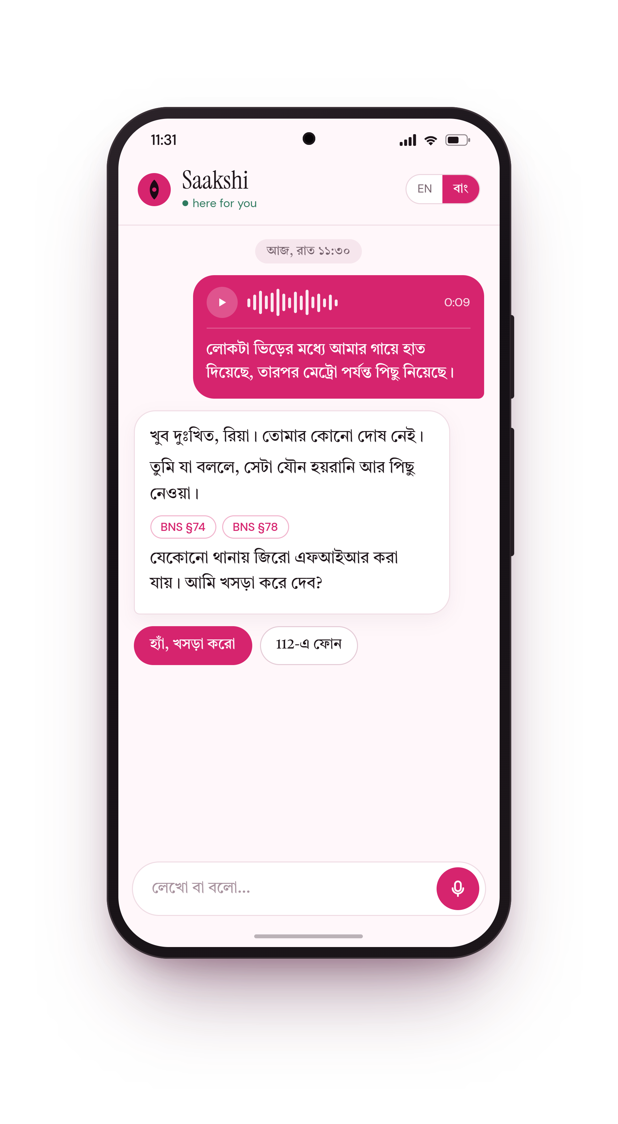
It answers like an elder sister would
iii. Under the hood
WHAT SHE HEARS, IN ENGLISH
“I’m so sorry, Ria. It’s not your fault. What you describe is sexual harassment and stalking (BNS §74, §78). A Zero FIR can be filed at any police station. Shall I draft it?”
01
Triage
02
Legal
Hears her voice or text in Bengali, Hindi or English.
Answers only from curated Indian law, always cited.
03
Drafting
04
Routing
Writes the complaint, Zero FIR request and certificate.
Points her to 112, 181, the NCW or free legal aid.
NEVER FILES WITHOUT CONSENT · EVERY CLAIM CITED · LEGAL AID: NALSA 15100
Notes:
When Ria speaks to Saakshi at 11:30 at night, she needs kindness first and law second. The reply on screen is in Bengali; its English meaning is on the right. Four narrow agents work behind one gentle voice, and the legal agent only answers from verified legal text, refusing rather than guessing. Stretch goal: a Banglish and Hinglish triage model trained with Adaption, the hackathon's technology partner.

Slide 13
The questions she would ask
iii. Under the hood
“What if he snatches my phone?”
“What if he forces me to cancel?”
The evidence has already left it, five seconds at a time.
The duress PIN looks like a cancel and silently escalates.
“What if he goes through my phone?”
“What if they say my video is edited?”
He sees a calculator. No notifications, instant quick-exit.
The blockchain seal from capture time proves it isn’t.
“What if I press it by mistake?”
“What if I don’t want the police?”
Ten seconds to undo. Calling 112 is always her choice.
Evidence stays sealed for later. NGOs and counsellors too.
“What if the app gets the law wrong?”
“What if someone uses this to track me?”
It answers only from cited legal text, and she reviews first.
Sharing is consent-based, time-limited and always visible.
“What if Saakshi itself is hacked?”
“What if I’m under 18?”
Files are encrypted on her phone before they leave it.
Routes to POCSO-specific help and Childline 1098.
Notes:
These are the edge cases, written as her questions, because that is how they feel to the person living them. The one judges rarely see: a safety app with location sharing can itself become a stalking tool, so sharing in Saakshi is always consensual, time-limited and visible.

Slide 14
A working product in four days
iv. Build and impact
21
22
23
24
OCTOBER
OCTOBER
OCTOBER
OCTOBER
Calculator disguise, duress PIN, encrypted 5-second capture, live on Vercel
Polygon Amoy contract, Merkle batching, Verify page, QR, guardian alerts
AI agent with a cited legal corpus, complaint and Section 63 PDF, journal, vault
Offline queue, tests on real Android phones, demo video recorded
PROJECT OWNERSHIP
AFTER THE HACKATHON
Written from scratch during SHAKTI. The public GitHub history shows every step.
Co-design with women students and a Kolkata NGO
Native Android: power-button trigger, SMS fallback
Integration with ERSS 112 and e-FIR portals
Notes:
A realistic build plan where every day ends with something deployable, so the Round 2 demo shows Ria's night working end to end on real phones. After the hackathon, the first step is to design it with the women who will use it, not just for them.

Slide 15
From “Where is your proof?” to “Here it is”
iv. Build and impact
For Ria
For Mitali
For Ananya
Walks into any police station with sealed evidence and a ready Zero FIR, and is taken seriously.
Builds a dated record of abuse he can’t find or erase: the pattern protection-order cases rest on.
Sends her takedown request the same night, with proof of exactly when she acted.
WHAT A PILOT WILL MEASURE
SUSTAINABLE BY DESIGN
Incidents with sealed, verifiable evidence
Time from incident to a filed complaint
Integrity checks passed at verification
Women who felt able to act (follow-up survey)
Free forever for every woman who needs it
Paid POSH dashboards for colleges and companies
Integrations for state police and NGOs
UN SDG 5 · GENDER EQUALITY
UN SDG 16 · PEACE, JUSTICE AND STRONG INSTITUTIONS
Notes:
Impact, measured in people: Ria is believed, Mitali is protected, Ananya acts before the damage spreads. A pilot will measure these outcomes honestly. Women never pay; institutions that already have legal duties under the POSH Act fund it.

Slide 16
THANK YOU
For five days, we worship Shakti in every pandal.
Saakshi is for the other 360.
DURGA PUJA · 17–21 OCT
J
F
M
A
M
J
J
A
S
O
N
D
Every woman deserves a witness.
ধন্যবাদ · धन्यवाद · Team Appvengers
Notes:
For five days a year we celebrate Shakti in every pandal. Every dot here is a day of 2026: the five white ones are Durga Puja. Women live the other three hundred and sixty. Saakshi is built for those days, so that every woman, everywhere, has a witness. Thank you.

