Slide 1

AutoPerf: Software Performance Anomaly Detection using Autoencoder
Mohammad Mejbah ul Alam, Abdullah Muzahid
University of Texas at San Antonio

Slide 2
Performance Anomaly in Software
Deviation from expected behavior
Leads to performance degradation
Changes result in performance anomaly:
Source code : new features, bug fixes
Configuration
Environment/system

Slide 3
MySQL
struct srv_stats{
...
n_rows_read;
...
};
Bug : Concurrent access by multiple threads leads to high contention
mutex_lock(&stats_lock);
...
srv_stats.n_rows_read++;
...
mutex_unlock(&stats_lock);

Slide 4
MySQL – Original
MySQL – Bug fixed
struct srv_stats{
...
n_rows_read;
...
};
struct srv_stats{
...
n_rows_read[64];
...
};
mutex_lock(&stats_lock);
...
srv_stats.n_rows_read++;
...
mutex_unlock(&stats_lock);
mutex_lock(&stats_lock);
...
srv_stats.n_rows_read[tx_id%64]++;
...
mutex_unlock(&stats_lock);
Change in code leads to performance anomaly
(cache contention)

Slide 5
Cache Contention
Core 1
Core 2
Cache line
X[0]
X[1]
X[2]
X[3]
X[0]
X[1]
X[2]
X[3]
False Sharing
write
T1
T2
Core 1
Core 2
Cache line
X
X
True Sharing
write
T1
T2
Cache invalidations lead to slower performance

Slide 6
Performance Anomaly Detection Methods
Static Analysis : Cannot detect runtime performance issues
Dynamic Analysis : Finding out root cause is difficult
Profiling Performance Counters
Efficient in detecting root cause
Challenges:
Large number of performance counters
Requirement of multiple tests and domain expertise

Slide 7
Machine Learning for Detection
Dataset built from Performance Counters
Machine Learning Algorithm
Anomaly
No Anomaly
Supervised Learning is not practical
Lack of a priori knowledge of performance issues
Unsupervised learning algorithm : Autoencoders

Slide 8
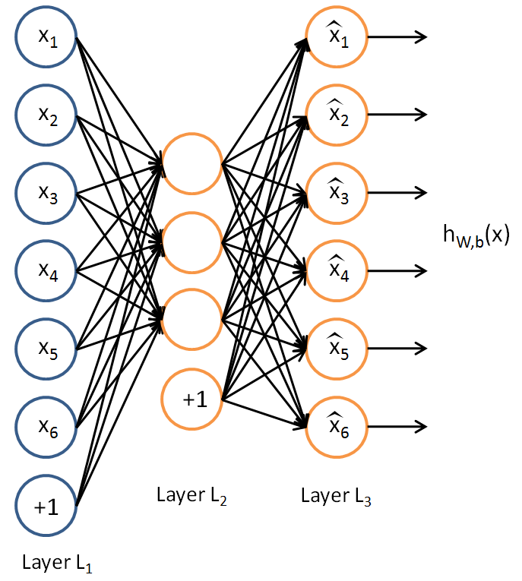
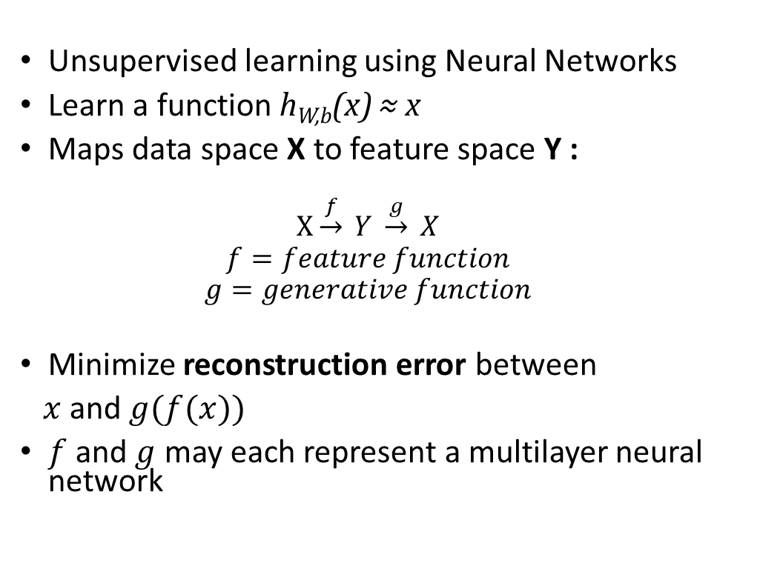
Autoencoder Learning Algorithm
Unsupervised learning using Neural Networks
Learn a function h_{W,b}(x) ≈ x
Maps data space X to feature space Y :
$$X\underset{→}{f} Y \underset{→}{g} X$$
$$f=feature function$$
$$g=generative function$$
Minimize reconstruction error between
$x$and $g(f(x))$
$f$and $g$ may each represent a multilayer neural network

Slide 9
Autoencoder Learning Algorithm
Encode
Decode
Encode : Hidden dimension is smaller than input dimension
Capture the most salient features of the training data [1]
Decode: Trained autoencoder “reconstructs” input “x” as output
[1] Reducing the Dimensionality of Data with Neural Networks

Slide 10
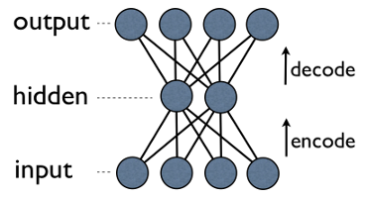
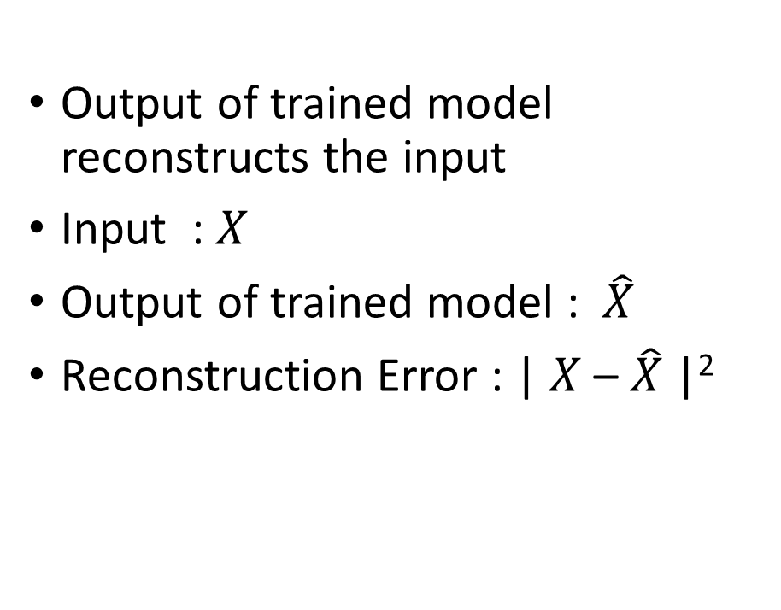


Anomaly Detection with Autoencoders
Output of trained model reconstructs the input
Input : $X$
Output of trained model : $\hat{X}$
Reconstruction Error : | $X$ – $\hat{X}$ |²
$$\hat{X}$$
$$X$$

Slide 11
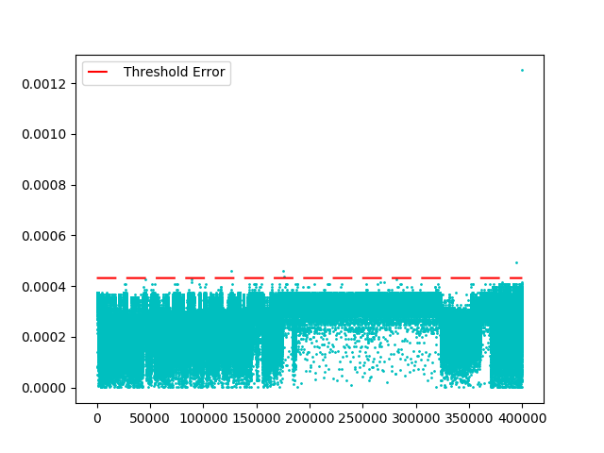
Anomaly Detection with Autoencoders
Program: Dedup from PARSEC benchmark
Reconstruction Error
Threshold Error, Err_{th} = µ + 2σ
µ = Mean reconstruction error
σ = Standard deviation
Training Samples ( Not anomalous )

Slide 12
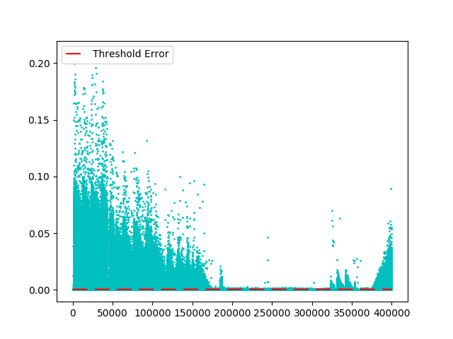
Anomaly Detection with Autoencoders
Program: Dedup from PARSEC benchmark
Program: Dedup from PARSEC benchmark (anomalous)
Reconstruction Error
Training Samples ( Not anomalous )
Test Samples ( Anomalous )

Slide 13
Anomaly Detection Workflow
Annotate Modified Functions
Collect Performance Counters
Preprocess
Performance Counters
Construct Inputs for Autoencoder
Program
Reconstruction Error for each sample
Trained Autoencoder
Run Diff
Modified
Program
Yes
> Threshold
No
Ranking of Root Cause
Anomalous Sample
Non-anomalous Sample

Slide 14
Profiling Performance Counters
Hardware Performance Counters (HPC) : Counters provided by CPU Performance Monitoring Unit (PMU).
Profile annotated function or code block
Run program with different inputs size and thread numbers
Performance API (PAPI) interface for performance counter
Collect perf counters for each dynamic execution of the code block/function

Slide 15
Preprocess Performance Counters
Normalize the each counter with number of tatal instructions and number of threads
normalized_counter_{i} = counter_{i} / (total_instructions_retired * number of active threads)

Slide 16
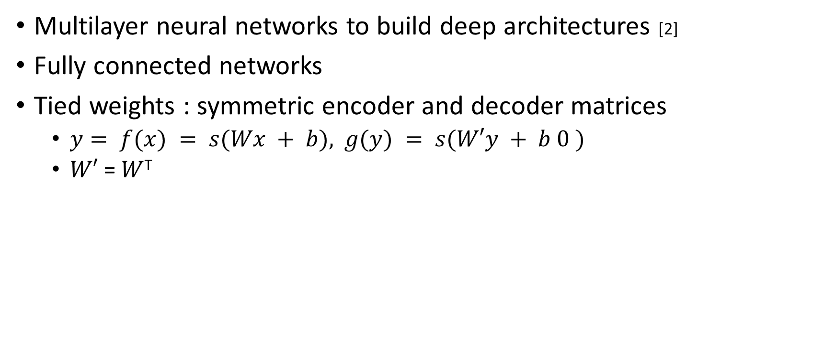
Training Autoencoder
Multilayer neural networks to build deep architectures [2]
Fully connected networks
Tied weights : symmetric encoder and decoder matrices
$y= f(x) = s(Wx + b),$ $g(y) = s(W′y + b 0 )$
$W′$= $W$^{T}
[2]Extracting and Composing Robust Features with Denoising Autoencoders
Notes:
The reasons I'm aware of for using tied weights: 1. In the linear case the optimal solution is PCA, which can be obtained with tied weights. 2. It has a regularization effect: 2a. Less parameters to be optimized 2b. It can prevent degenerate solutions, in particular those with very small weights in encoder, compensated by very large weights in decoder (something that would allow for instance a near-linear solution to be found with tanh nonlineraities) 3. Less parameters to be stored (=> lower memory footprint)

Slide 17
Hyperparameter Selection
Loss function : sigmoid
Learning rate : 0.01
Batch size : 100
Epochs : 100 (with early stopping)

Slide 18
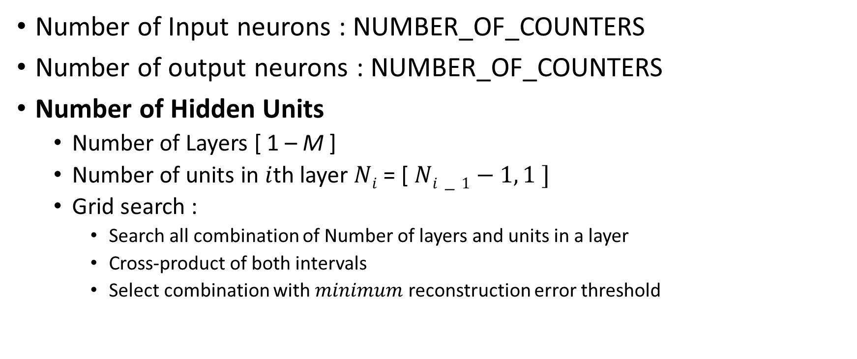
Hyperparameter Space Exploration
Number of Input neurons : NUMBER_OF_COUNTERS
Number of output neurons : NUMBER_OF_COUNTERS
Number of Hidden Units
Number of Layers [ 1 – M ]
Number of units in $i$th layer $Ni$ = [ $Ni−1−1, 1 ]$
Grid search :
Search all combination of Number of layers and units in a layer
Cross-product of both intervals
Select combination with $minimum$ reconstruction error threshold

Slide 19




Ranking of Root Cause
Step-1 : Rank counters in samples detected as anomalous
a₁ , a₂ , a₃ , … a_{N}
$\hat{a}1$
$\hat{a}2$
$\hat{a}3$
$\hat{a}N$
,
,
,
, … ,
Original Sample
Reconstructed sample by Autoencoder
(Detected as anomalous)
d₁ , d₂ , d₃ , … d_{N}
Euclidian Distance
rank
1
2
3
…
….
d_{x}
d_{x+1}
d_{x+2}
…
….
d_{x} , d_{x+1} , d_{x+2} , … d_{x+n-1}
Sorted in descending order
Step-2 : Majority vote of all samples detected as anomalous

Slide 20
Case Study : Performance Anomaly in MySQL

Slide 21
MySQL – Original
MySQL – Bug fixed
struct srv_stats{
...
n_rows_read;
...
};
struct srv_stats{
...
n_rows_read[64];
...
};
mutex_lock(&stats_lock);
...
srv_stats.n_rows_read++;
...
mutex_unlock(&stats_lock);
mutex_lock(&stats_lock);
...
srv_stats.n_rows_read[tx_id%64]++;
...
mutex_unlock(&stats_lock);
Change in code leads to performance anomaly
(cache contention)

Slide 22
MySQL – Original
Annotate
Candidate
function
struct srv_stats{
...
n_rows_read;
...
};
int index_read(..){
annotation_START(id);
…
mutex_lock(&stats_lock);
...
srv_stats.n_rows_read++;
...
mutex_unlock(&stats_lock);
…
annotation_END();
}
mutex_lock(&stats_lock);
...
srv_stats.n_rows_read++;
...
mutex_unlock(&stats_lock);

Slide 23
MySQL – Original
Run performance benchmark program for mysql : sysbench
Run with different input sizes and different number of threads as input
Profile 33 hardware performance counters
100 different execution profiles of the program for training
int index_read(..){
annotation_START(id);
…
mutex_lock(&stats_lock);
...
srv_stats.n_rows_read++;
...
mutex_unlock(&stats_lock);
…
annotation_END();
}

Slide 24
Input Layer
Output Layer
x₁
All combination of
Number of hidden layer [1 , 5]
Number of hidden units
N-1 to 1
x₁
x₁
x₁
Select network with minimum
reconstruction error:
32->16->12->8->4->8->12->16->32
x₁
x₁
…
…
…
…
…
…
x₃₂
x₃₂
One of 33 counters INSTRUCTIONS_RETIRED is used to normalize 32 performance counters

Slide 25
Anomaly detection in MySQL
MySQL – Anomalous
int index_read(..){
annotation_START(id);
…
mutex_lock(&stats_lock);
...
srv_stats.n_rows_read[tx_id%64]++;
...
mutex_unlock(&stats_lock);
…
annotation_END();
}
Profile anomalous code and construct test inputs
Use the trained autoencoder to reconstruct the inputs
Ranking of performance counters:
OFFCORE_RESPONSE_0:ANY_REQUEST:HITM’
L1_STM
….

Slide 26
Anomaly detection in MySQL
MySQL – Anomalous
Anomaly in function with id marker
int index_read(..){
annotation_START(id);
…
mutex_lock(&stats_lock);
...
srv_stats.n_rows_read[tx_id%64]+ +;
...
mutex_unlock(&stats_lock);
…
annotation_END();
}
Profile anomalous code and construct test inputs
Use the trained autoencoder to reconstruct the inputs
Ranking of performance counters:
OFFCORE_RESPONSE_0:ANY_REQUEST:HITM’
L1_STM
….
Cache contention

Slide 27
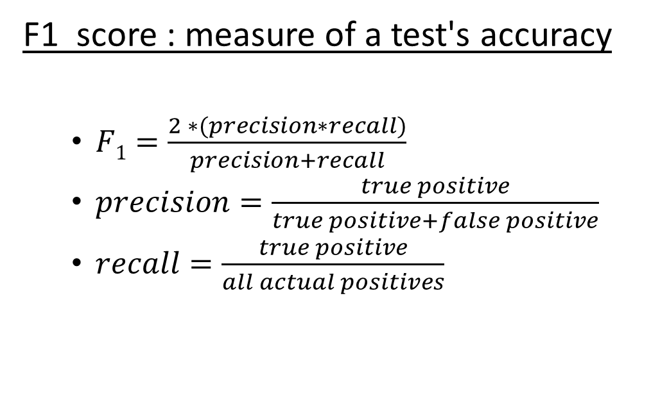
Accuracy of Selected Autoencoder Model
Test program executions
F1 score : measure of a test's accuracy
$F1=\frac{2 ∗(precision∗recall)}{precision+recall}$
$precision=\frac{true positive}{true positive+false positive}$
$recall=\frac{true positive}{all actual positives}$
Non-anomalous executions
Anomalous executions
4 true negatives, 1 false positive
3 true positives, 2 false negative

Slide 28
Accuracy of Selected Autoencoder Model
Train with 100 different executions data
Test with 10 anomalous and 10 not anomalous executions data

Slide 29
Experiments & Results
Expermental Setup:
32 core 2 socket Intel(R) Xeon(R) CPU
33 hardware performance counters
Evaluated Programs:
5 kernel programs with injected anomalies:
parallel vector_sum, scalar_sum, vector_dot_product, matrix_multiplication, matrix_compare
5 benchmark programs from PARSEC and PHOENIX
Bodytrack, dedup, histogram, reverse_index, linear_regression
3 real world applications:
MySQL, Memcached, Boost libraries

Slide 30
Anomaly Detection Results
Program
parallel_scalar_sum
parallel_vector_sum
parallel_dot_product
parallel_matrix_mult
parallel_matrix_comp
Autoencoder Network
32->10->6->10->32
32->11->5->10->32
32->10->6->10->32
32->10->8->10->32
32->10->8->10->32
F1 score
1
1
1
1
1
Anomaly type
False sharing
False sharing
False sharing
False sharing
False sharing

Slide 31
Anomaly Detection Results
Program
bodytrack
dedup
histogram
linear_regression
reverse_index
Autoencoder Network
32->11->7->5->7->11->32
32->12->10->9->10->12->32
32->11->9->4->9->11->32
32->12->9->7->9->12->32
32->12->8->12->32
F1 score
1
1
1
1
1
Anomaly type
True sharing
True sharing
False sharing
False sharing
False sharing

Slide 32
Anomaly Detection Results
Program
MySQL
Memcached
Boost
Autoencoder Network
32->16->12->8->4->8->12->16->32
32->12->9->12->32
32->16->8->4->8->16->32
F1 score
0.8
1
0.8
Anomaly type
True sharing
True sharing
False sharing

Slide 33
One Autoencoder Per Function
F_1 : histogram
F_2 : dot product of two vectors
F_3 : sum of scalar/array
F_4 : linear regression
F_5 : matrix compare
F_6 : matrix multiplication
F_7 : sum of vectors

Slide 34
One Autoencoder for All Functions

Slide 35
Can We Do Better?
Clustering of functions
K-means algorithm
Assign one of K cluster to each N dimensional points for each function
K = ?

Slide 36
Kmeans with K=2
F_1
F_4
F_7
Cluster 1
F_2
F_3
F_5
F_6
Cluster 2

Slide 37
Kmeans with K=3
F_1
F_4
F_7
Cluster 1
F_2
F_5
F_6
Cluster 2
F_3
Cluster 3

Slide 38
Kmeans with K=4
F_1
F_4
F_7
Cluster 1
F_2
F_6
Cluster 2
F_3
Cluster 3
F_5
Cluster 5

Slide 39
SQLite: Embedded SQL database
Versions: 3.10.0, 3.11.0
Total functions changed : 13

Slide 40
Injected anomaly in sqlite3Step(..) function in SQLite executed by multiple threads
int sqlite3Step(…) {
…
sqlite3_mutex_enter(db->mutex);
for(int i=0; i<100; i++){
int val = v->doingRerun;
v->doingRerun += val;
}
v->doingRerun = 0;
…
…
sqlite3_mutex_leave(db->mutex);
Injected contention

Slide 41
Summary
AutoPerf uses unsupervised learning for anomaly detection
Effective tool for performance regression testing
Detects cache contention related performance anomaly in 13 programs including 3 in real world applications
Email: mejbah.alam@gmail.com

