Slide 1

Blender
António Fonseca e Jorás Oliveira

Slide 2
Intro
Blender Foundation facilitates a public project on blender.org with the mission to get the world’s best 3D CG technology in the hands of artists as free/open source software.
The vision is that everyone should be free to create 3D CG content, with free technical and creative production means and free access to markets.
The Foundation’s goals are:
Manage the facilities on blender.org for users and developers who want to contribute to Blender.
Maintain and improve the current Blender product via a public accessible source code system under the GNU General Public License.
Establish funding or revenue mechanisms that serve the foundation’s goals and cover the foundation’s expenses.
Provide individual artists and small teams with a complete, free and open source 3D creation pipeline
Code: https://github.com/blender, https://developer.blender.org/
Python, C, GO, Typescript

Slide 3
License & Docs
GPL
CopyRight vs CopyLeft
The GPL employs a "copyleft" mechanism, requiring that any modifications or distributions of the licensed software be made available under the same GPL terms.
https://www.blender.org/about/license/
blender.org/get-involved/ vs developer.blender.org vs github.com/blender

Slide 4
Corporate
Blender HQ – Amsterdam
A team of passionate developers, artists and designer works full time on the Blender project.
This is possible thanks to the Blender Development Fund, the Blender Studio projects and countless community initiatives.
Online Team
Blender releases are possible thanks to the contributions of hundreds of individuals worldwide.
From fixing a bug to improving the documentation of a feature, this community of actively involved contributors is key to Blender’s success.

Slide 5
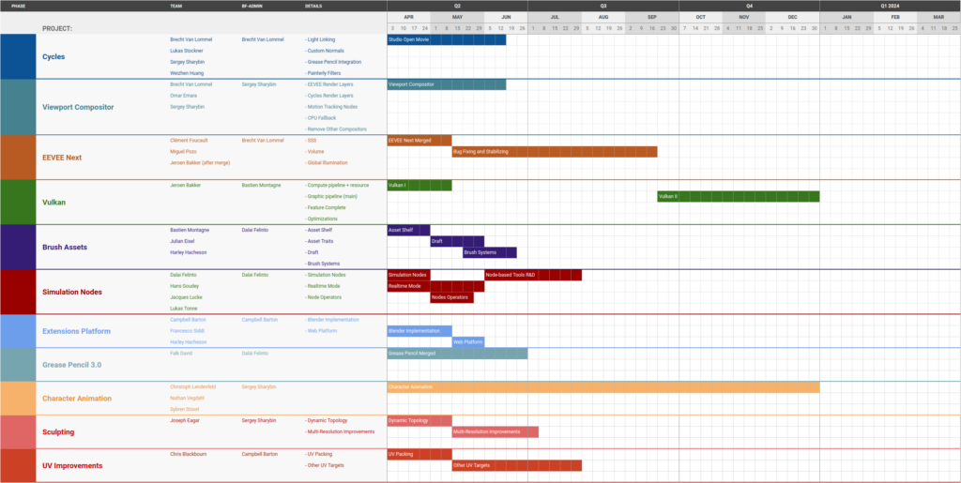
RoadMap
https://code.blender.org/2023/05/development-fund-supported-projects-q2/

Slide 6
Contributions
Are external contributions accepted? How can one contribute?
Easy instructions on how to contribute
https://developer.blender.org
https://docs.blender.org/manual/en/latest/contribute/index.html
Who makes the decisions?
Blender Institute
Chairman: Ton Roosendaal

Slide 7
Community
https://www.blender.org/about/people/
List of ‘main’ developers
https://devtalk.blender.org/
Devblog to ask for help
https://twitter.com/BlenderDev
Last tweet - 2022
https://github.com/blender/blender
gitHub with no pull requests and no actions.
https://www.reddit.com/r/blender
Lots of sub

Slide 8
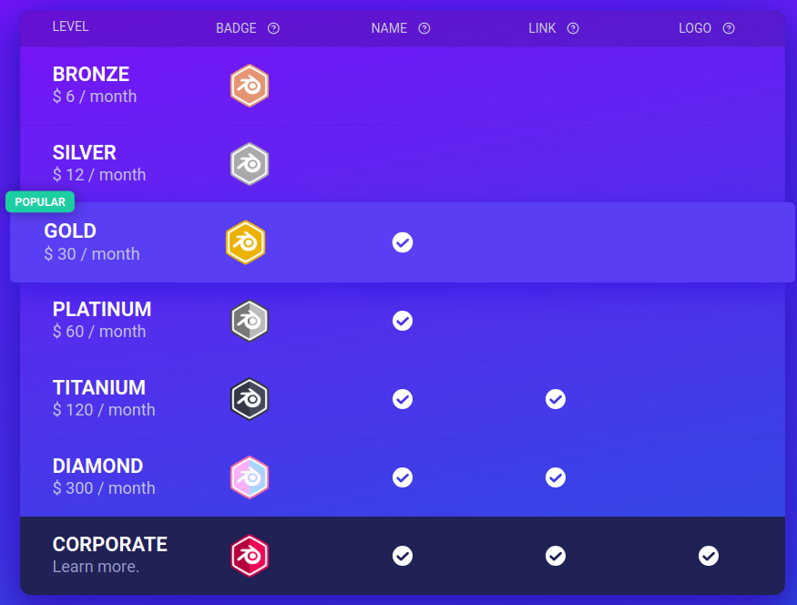
Funds
https://fund.blender.org/
Corporate and private funders
About 100M funded in total according to crunchBase
Blender-Foundation-Annual-Report
Early foundation report, with detailed funds raising and spending information

Slide 9
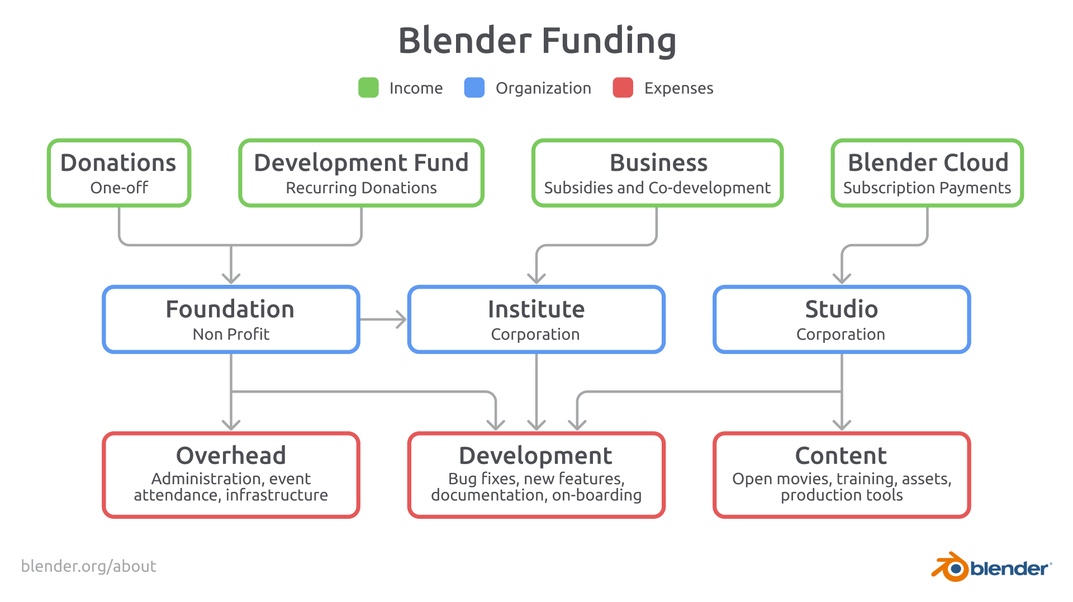

Slide 11
What is the purpose of the project?
Where is the source code located? Which technologies are used?
What is the license? Are there public guidelines or any kind of bureaucracy for contributions?
Is there developer documentation?
Does it seem easy to compile/run?
Does it seem easy to modify?
How is the project governed?
Who are the key figures (developers, evangelists, etc.) in the project? If the project is large, mention two different areas in this item.
Is there a public roadmap?
Are external contributions accepted? How can one contribute?
Who makes the decisions?
Where can project members be found? Where can one seek help?
Does the project raise funds?
Are there companies sponsoring developers?
How much has been raised? And spent? For what purposes?
Who decides how the funds are spent?

Slide 12
https://github.com/blender/blender
Clear and concise instructions on how to build/compile/run
https://docs.blender.org/manual/en/latest/contribute/index.html
Clear and concise documentation detailing how to contribute, and the expected guidelines for contributors
https://fund.blender.org/
Corporate and private funders
About 100M funded in total according to crunchBase
Blender-Foundation-Annual-Report-2022
Early foundation report, with detailed funds raising and spending information, on a per year basis, starts on page 94

