Slide 1
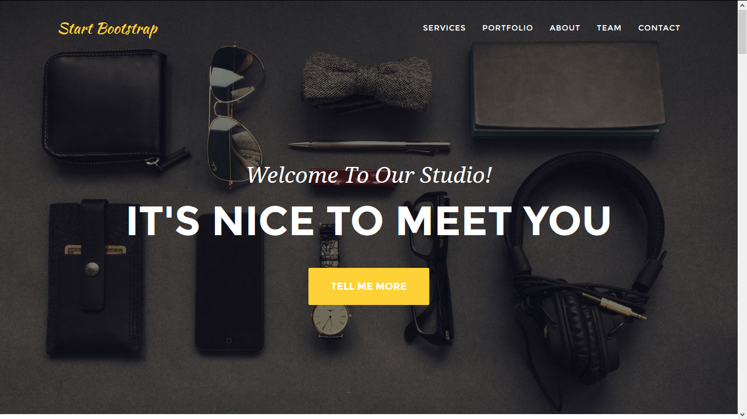
LOGO page
Inspire4edu
When Inspiration Become an Aspiration

Slide 2
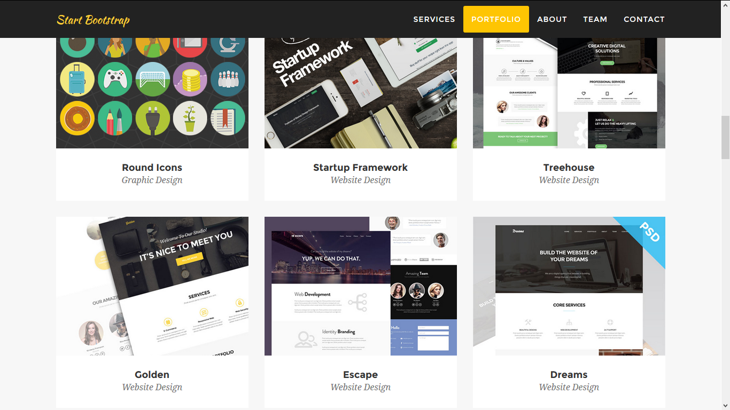



1.Portfolio will be changed to Courses 2.Service will be deleted
Courses
Technician Rehabilitation Diploma
Smart Courses
English Fluency
Business Excellence

Slide 3
Project name (Technician Rehabilitation Diploma (T.R.D)
1.Computer Technology:
دبلومة تخصصية في علوم الحاسب الالي
2.Petroleum Technology:
دبلومة تخصصية في علوم البترول
in this Department after first year of the scholarship, each student should specialize in one of these three specialties:
A. Network Engineering and Computer Maintenance.
B. Programming and web design.
C. Graphic design and advertising and production technology journalist.
تقوم فكرة هذه الدبلومة على نفس البرامج التى يتم تدريسها في برنامج ITI المدعم من قبل وزارة الاتصالات وبنفس مستوى محاضريها الاكفاء .
in this Department after first year of the scholarship, each student will be specializing in these three specialties:
A. Department of refining.
B. Department of Geology.
C. Drilling and production department
تقوم فكرة هذه الدبلومة على توفير أفراد متخصصين ( أخصائي بترول ) بما يتناسب مع احتياجات سوق العمل الفعلي في شركات البترول بمحاضرين أكفاء ذوى خبرة سابقة في شركات بترول ومناهج تتلائم مع سوق العمل بالأضافة إلي الإستعانة بهيئة تدريس جامعات في تدريس بعض المواد .

Slide 4
Smart Courses:
Graphics Design Course
Web development Courses
Photoshop
Illustrator
In Design
AutoCAD 2D
ASP.net
Java Course
PHP
Web Design Course
ICDL Preparation Courses
Mobile Application Course
(IT) information technology
Windows
Word
Excel
Access
Power point
Internet & outlook
Introduction to Android OS
Introduction to Scripting languages
Java Programming for Android
Android SDK Application Development
Publishing Applications to Android Market
Android Final Project

Slide 5
English Fluency:
Course Contents:
The course level | Hours
Beginner Level 1 | 18
Beginner Level 2 | 18
Intermediate Level 1 | 18
Intermediate Level 2 | 18
Upper intermediate Level 1 | 18
Upper intermediate Level 2 | 18
Advanced Level 1 | 18
Advanced Level 2 | 25
ILETS Preparation | 50
Ask for placement test time and dates

Slide 6
Business Excellence Courses
Lean Six Sigma
Secretarial Preparation Course
One of the most powerful tool leading to reduce the waste in both process and production operation supported with one of the most dedicated instructors certified with black belt level .
The course is to develop and train calibers whom interested in secretarial work
Course Contents
Orange Belt
Green Belt
•Windows
•Word
•Excel
•Power point
•Internet , outlook
•C.V writing and interviewing skills
•Business Etiquette
•Business Language

Slide 7
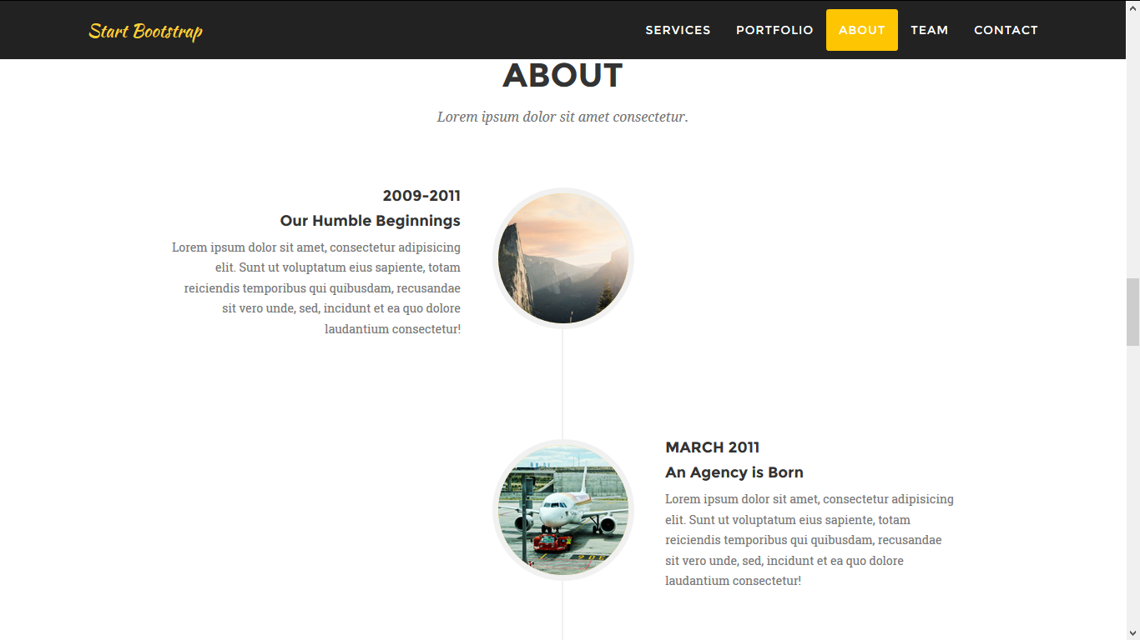
Our vision
Educating and Developing youth in a scientific way to be a corner stone in developing and building the whole community and civilization.
رؤیتنا
تأھیل الشباب بطریقة علمیة أكادیمیة على الإنتاج والمساھمة فى بناء حضارة المجتمع ورفاھیته بما یتناسب مع التطورات العالمیة.

Slide 8
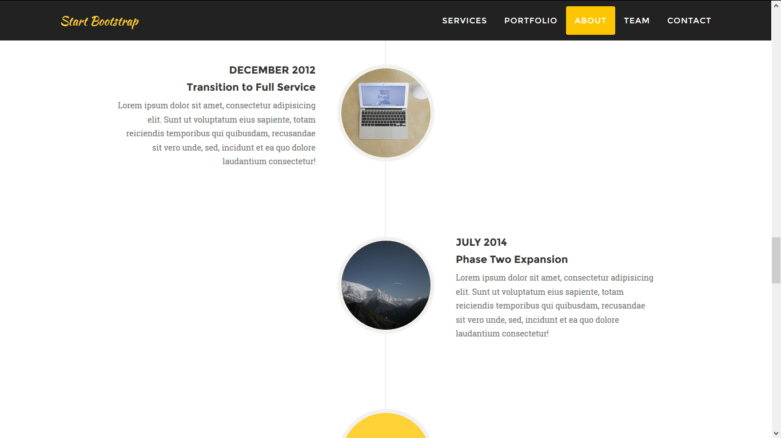
Our Goals
To find Inspire4edu as a modern academy training youth with different capabilities and educational back ground by supporting them with the following:
Developing Professional and Personal Skills.
Computer skills.
Developing the Market and Business awareness.
Train the trainers and teachers through leveraging their professional and personal capabilities.
اھدافنا
إیجاد مركزأكادیمي متطور یقوم بتدریب الشباب على اختلاف مستویاتھم العلمیة والثقافیة و تنمیة
مواردھم البشریة،ومھارات الكمبیوتروإدارةالأعمال والتسویق.
تدریب المدرسین والمتدربين على رفع كفائتھم من الناحیة الثقافیة و المھنیة كلا فى تخصصه.

Slide 9
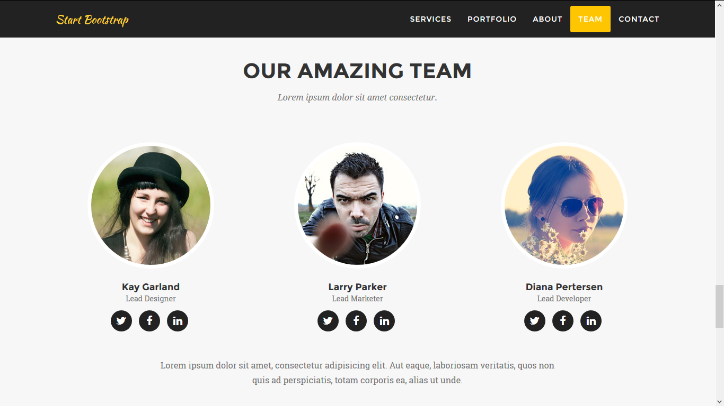

Slide 10
