Slide 1
Investing101: pathway to wealth
BY: MABEL NUNEZ, MBA
gIRL$ ON THE MONEY.

Slide 2
INTRODUCTIONS
Intro
Birth & Mission of Girl$ on The Money
Educational Resources
My Background

Slide 3
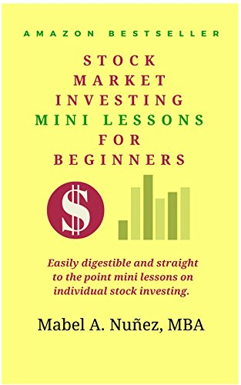
the book

Slide 4
Why investing matters
Inflation is REAL
Difficult to accumulate wealth through savings alone
Women live longer (*we are also better investors!)

Slide 5
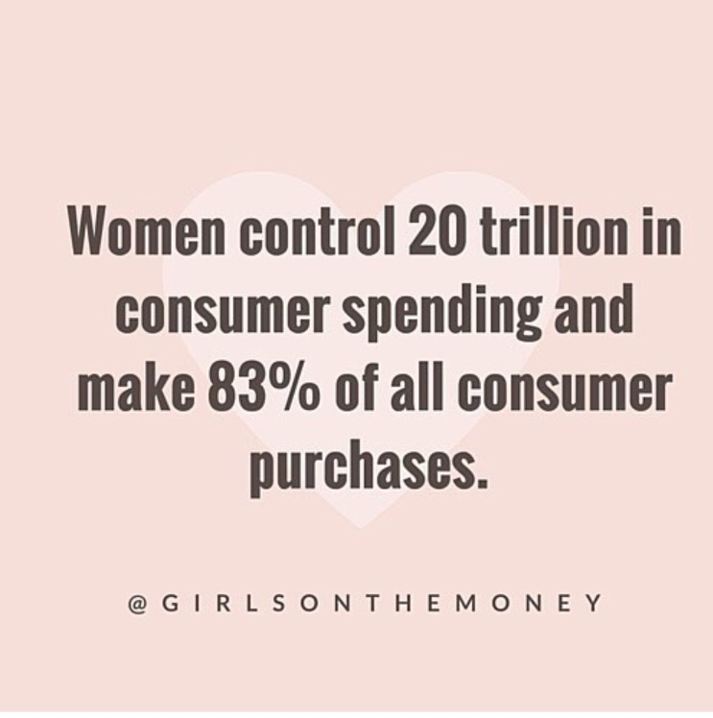
Did you know…

Slide 6
Consumer Vs. Investor Mentality:
DARE to be Different.

Slide 7
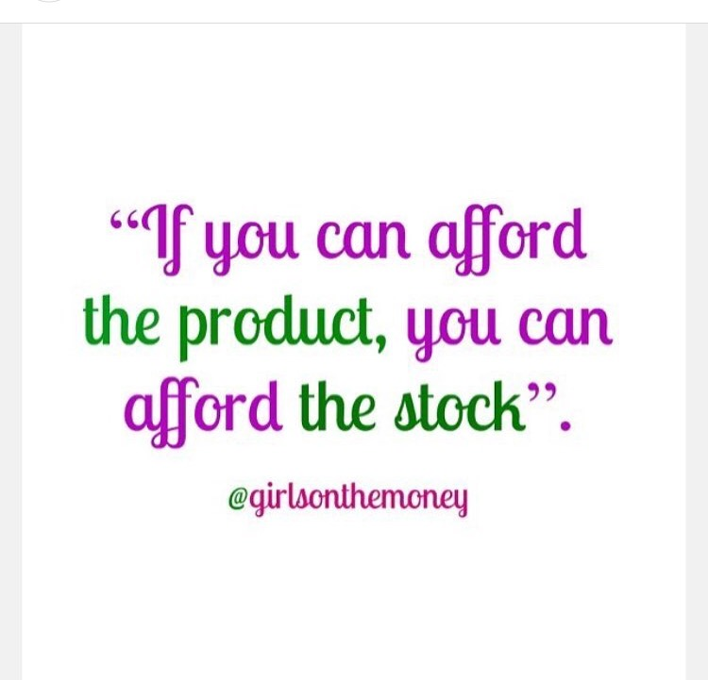

Slide 8
What it means to invest
"Calling someone who trades actively an investor is like calling someone who repeatedly engages in
one-night stands a romantic."
–Warren Buffet

Slide 9

Preparing to invest

Slide 10
Consider the following…
High interest consumer debt – specifically credit card debt – should be out of the picture.
Employer retirement accounts – are you taking full advantage?
A word on student loan debt…

Slide 11
Taking action: EDUCATION IS KEY
Know you DO NOT need a lot of money to get started.
Make a conscious decision to start an INVESTING FUND (choose a platform you feel comfortable with).
Don’t forget about your emergency fund.
IMPORTANT: An emergency fund and an investing fund are two separate things.

Slide 12
Taking action: EDUCATION IS KEY
Understand the different platforms available for investing – Choose what YOU feel comfortable with.
Understand the TYPES of investing accounts available – Taxable & Non-Taxable accounts (IRAs, Roths, Regular).
Understand the different Asset Classes or OPTIONS of where to invest your money (Index Funds, ETFs, High Quality Stocks).
A word on fees.

Slide 13
Taking control: Actionable steps
Take 20-25 minutes of your time and open an investing account (*review your options).
If you don’t have “tons” of money just “sitting around” waiting to get invested – start with $500-$1,000
(Or whatever you can afford right now).
Add as you go, build a habit – (I.e.: biweekly contributions).

Slide 14
Taking control: Actionable steps
Make it AUTOMATIC.
Consume QUALITY content. KEEP LEARNING.
My Favorite resources include…

Slide 15
NEXT INVESTING COURSEs:
Next Stock Market Investing Bootcamp for Beginners begins on Monday June 4th, 2018!
Mention LOLA Retreat for 20% off enrollment.

Slide 16
Follow me on…
Instagram: @Girlsonthemoney
Watch me every Tuesday evening 8:30 PM EST: Instagram & Facebook Live!
www.Girlsonthemoney.com

Slide 17
QUESTIONS?
Thank you!

