Slide 1
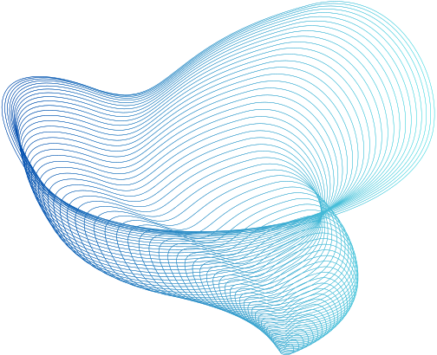
SPEECH DENOISER
WITH UNETS
SAMMAN SHRESTHA
RHISHAV PAUDEL

Slide 2
TABLE OF CONTENT
Introduction
Objective
Dataset
Methodology
Training Challenges
Results
Conclusion

Slide 3
INTRODUCTION
The Speech Denoiser project aims to address the challenge of enhancing the quality of speech signals in noisy environments.
Utilizing a U-Net architecture, the model is trained on a dataset of 1700 samples, combining clean and noisy audio pairs.

Slide 4
OBJECTIVE
To enhance the quality of speech signals in noisy environments through the development and implementation of a U-Net-based speech denoising model.

Slide 5
DATASET
The dataset consists of 1700 samples obtained from Microsoft Scalable Noisy Speech Dataset (MS-SNSD), each comprising a clean audio recording and its corresponding noised version.
The data was carefully selected to cover a variety of scenarios, ensuring the model's robustness in denoising different types of audio signals.

Slide 6




DATA PREPROCESSING
Loading audio
The clean and noise audio files are loaded with a sample rate of 22,050 Hz. The silence at the beginning and end is trimmed. Finally noisy dataset is generated by overlapping clean audio with random noise audio.
The preprocessing steps include loading clean and noise audio files, trimming unnecessary segments, mixing clean audio with random noise audio, and generating log spectrograms of the noisy speech as well as clean audio speech.
Spectrogram Generation
Computing short-time Fourier transform (STFT) on both noisy and clean audio using a frame size of 512 samples and a hop length of 256 samples.
Normalization
The spectogram values are then normalized for consistent input to the denoising model.

Slide 7
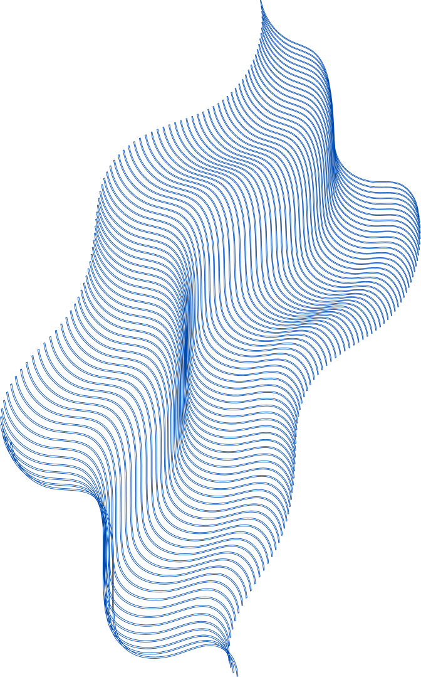
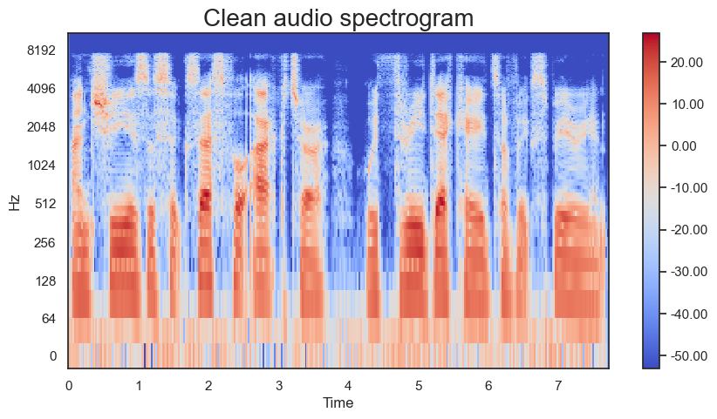
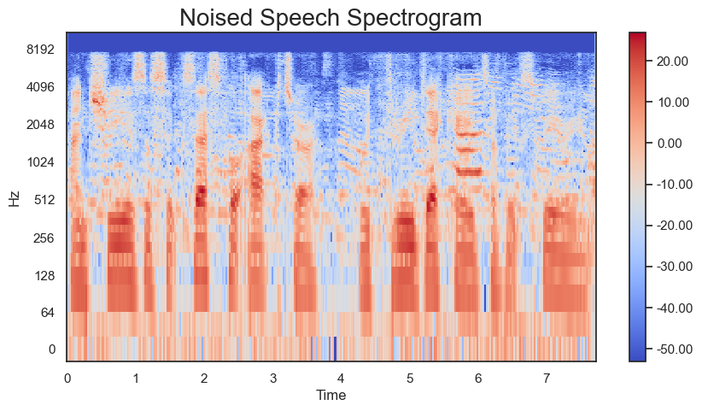
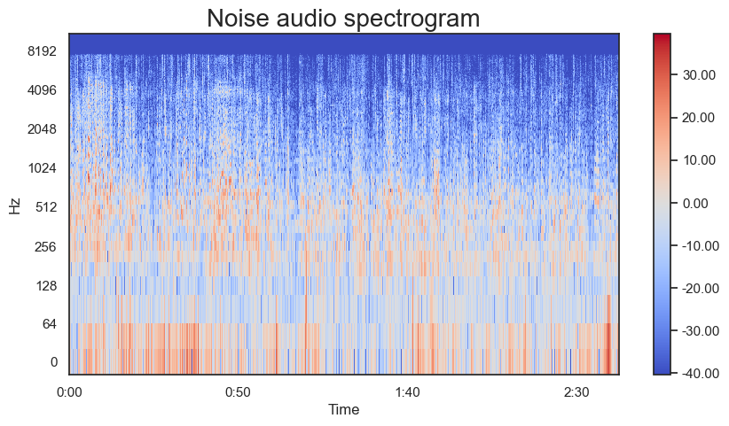
SPECTROGRAM
A spectrogram is a visual representation of the spectrum of frequencies in a sound signal as they vary with time.
The noisy speech spectrogram is used as input and clean audio speech is used as desired output for the model.

Slide 8
TRAINING
Utilize the U-Net architecture, a convolutional neural network (CNN) with an encoder-decoder structure and skip connections.
The encoder downsamples the input, capturing hierarchical features, while the decoder upsamples to reconstruct the original resolution.
Skip connections connect corresponding encoder and decoder layers, aiding in the preservation of spatial information.
Binary cross-entropy is used as the loss function, considering the denoising objective.
Intersection over Union (IoU) is used to measure the similarity between predicted and ground truth masks as a evaluation metric.

Slide 9
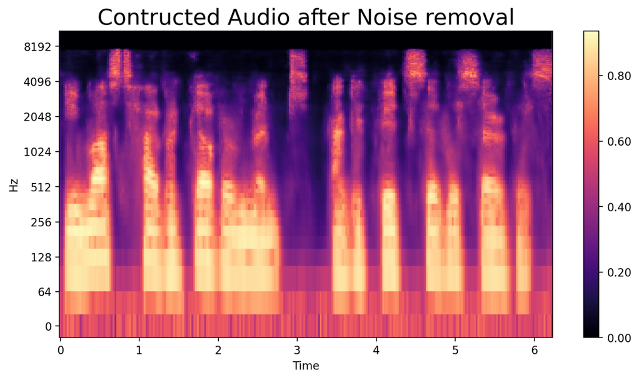
AUDIO SIGNAL RECONSTRUCTION
Denormalization
During post-processing, the min-max values of original noised audio are used to de-normalize the denoised log spectrogram.
The trained UNet model is used to generate the log spectrogram representing the clean version of noised speech spectrogram. Different post processing steps is the applied to obtain the clean audio from the spectrogram.
Log Spectrogram to Audio Signal
The inverse STFT is then performed to convert the spectrogram back to a time-domain audio signal.

Slide 10
TRAINING CHALLENGES
Memory and GPU Constraints: The U-Net architecture is memory and GPU-intensive. Training on a available dataset of 23000 samples was constrained by limited computational resources. As a result model was trained on 1700 samples.
Overfitting: Due to the relatively small dataset, the model was prone to overfitting, capturing noise-specific patterns rather than learning general denoising features. This limited the model's performance when applied to unseen data.
Post-Processing Challenges: The spectrogram is only captures the magnitude of the audio not the phase. As a result during the reconstruction process of spectrogram to audio phase was randomly introduced resulting a robotic voice.
Longer training times: A single spectrogram is represented with the size of 256*512 which resulted in longer processing and training time.

Slide 11
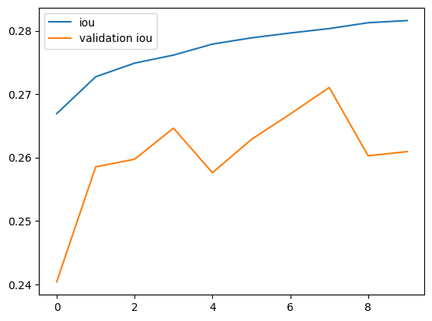
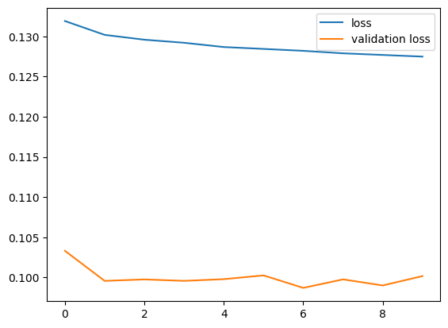
RESULTS
Epochs trained: 20
Loss: 0.1275
IOU score: 0.2816
Model achieved a moderate IOU score, indicating a reasonable degree of success in denoising.

Slide 12
CONCLUSION
Leveraging a dataset of noisy and clean audio spectrograms, the U-Net model was trained to learn the intricate patterns and features essential for effective denoising.
The project faced challenges, including overfitting due to the dataset's size and computational limitations.
Future work may involve expanding the dataset and optimizing the model for improved generalization.
Overall, this project provides valuable insights into the application of deep learning techniques for speech denoising, laying the groundwork for potential advancements in audio signal processing.

