Slide 1
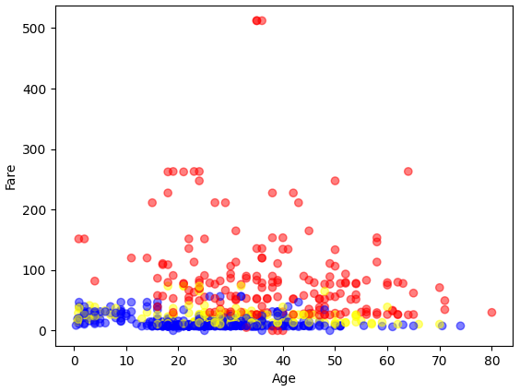
Practice 5
Read data from 'Titanic.csv' and generate a scatter plot
where the x-axis represents 'Age' and the y-axis represents 'Fare', with passengers of different 'Pclass' corresponding to different colors.

