Slide 1
CS112 : Introduction to Python Programming
Week 12: lab practice

Slide 2
Practice 1
Create two Panda Series for the following gene expression in two conditions.
ctrl = [120, 52, 100, 90, 20]
treated = [120, 20, 90, 120, 25]
Use genes as index
genes = ['ERAP1', ‘IL10', ‘JAK2', 'TP53', ‘EST1']
Print the genes with absolute differences > 20 between the two conditions

Slide 3
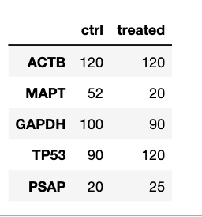
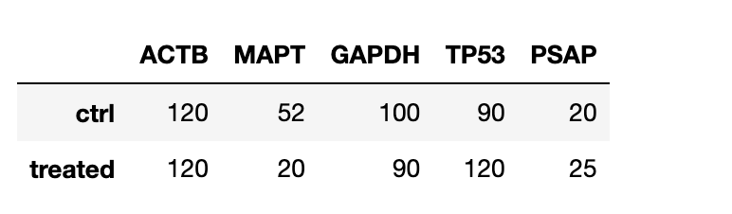
Practice 2
Generate 2 panda DataFrames for the following data.
genes = ['ERAP1', ‘IL10', ‘JAK2', 'TP53', ‘EST1’]
ctrl = [120, 52, 100, 90, 20]
treated = [120, 20, 90, 120, 25]

Slide 4
Practice 3
Print the names of male students who failed the exam (score <60) by filtering the scores using Pandas, the data has been organized into a dictionary:
records = { 'Name': ['Mary', 'Maria', 'Anna', 'John', 'Jake', 'Joe' ],
'Gender': ['Female', 'Female', 'Female', 'Male', 'Male', 'Male'],
'Score': [88, 92, 56, 70, 55, 48] }

Slide 5
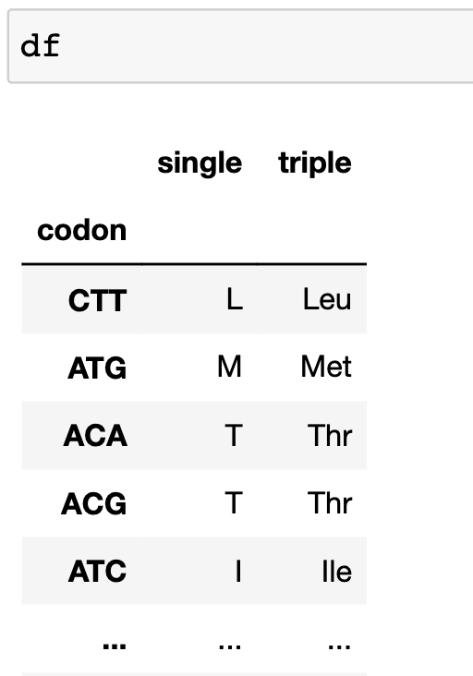
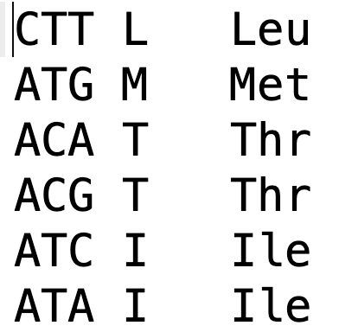
Practice 4
Read the codon_table.txt file as a DataFrame, using [‘codon’,’single’ ,’triple’] as column names and the ‘codon’ column as index.
Save the DataFrame as a csv file with/without header/index.
codon_table.txt

Slide 6


Practice 5
1. From the codon table DataFrame,
1) Print the single and triple letters for the following codons:
ATT, ATG, TGC, GTT
2) print the codons for the following amino acids:
L, M, T, I

Slide 7
Practice 6
Given a CSV file named Titanic.csv that contains data on passengers of the Titanic.
Read the file as a dataframe and
Print out the Survival rates for male and female passengers.
Create a new column tmp, where the value for each passenger is their fare (Fare) divided by the mean of all fares.
Sort the DataFrame in ascending order based on the Age column and print out the sorted DataFrame.

