Slide 1
BLUESTOCK FINTECH
Mutual Fund Analytics
Capstone Project
Quantitative Performance · Portfolio Concentration · Risk Analytics
Vipin Nishad | Data Scientist & Quantitative Analyst | August 2026
40
Mutual Fund Schemes
46,000+
Daily NAV Records
32,778
Investor Transactions
6-Step
Automated Pipeline

Slide 2
BLUESTOCK MUTUAL FUND ANALYTICS
Problem Statement & Business Objective
Identifying key challenges in the Indian Mutual Fund ecosystem
▸ Rapid AUM Expansion: Indian MF AUM has grown exponentially via SIP inflows, but increased capital introduces operational and concentration vulnerabilities.
▸ Portfolio Concentration Risk: Flagship equity funds suffer from >40% single-sector tilts (IT/Banking), exposing investors to sharp sector pullbacks.
▸ SIP Account Churn: Retail investors face high installment attrition and mandate friction, requiring predictive models to flag at-risk accounts.
▸ Quantitative Objective: Build an ETL pipeline, model rolling Sharpe ratios, compute 95% VaR, evaluate HHI concentration, and construct a 0-100 composite scorecard.
BLUESTOCK MUTUAL FUND ANALYTICS | Vipin Nishad | Capstone 2026
Slide 2 / 12

Slide 3
BLUESTOCK MUTUAL FUND ANALYTICS
Data Sources & ETL Architecture
End-to-end pipeline from raw CSVs to SQLite star schema
10 CSVs
Raw Data Sources
Star Schema
SQLite Relational DB
6 Steps
Automated Pipeline
run_pipeline.py
1-Command Execution
▸ Star Schema Design: Normalized SQLite (bluestock_mf.db) with dim_fund, dim_date dimensions and fact_nav, fact_performance, fact_transactions fact tables.
▸ Data Hygiene: Forward-fills NAV gaps, standardizes KYC/transaction types, filters invalid amounts, validates AMFI code integrity across all datasets.
▸ Pipeline Flow: data_ingestion.py → data_cleaning.py → validate_data.py → db_loader.py → calculate_rolling_sharpe.py → recommender.py
BLUESTOCK MUTUAL FUND ANALYTICS | Vipin Nishad | Capstone 2026
Slide 3 / 12

Slide 4
BLUESTOCK MUTUAL FUND ANALYTICS
EDA Highlights: Industry AUM Dynamics
Asset Management Company dominance and SIP inflow trajectories
₹12.5L Cr
SBI MF — #1 AUM
₹23,332 Cr
Monthly SIP (2025)
68.4%
Equity Inflow Share
+79%
SIP Growth 2022-25
▸ AMC Concentration: Top 3 AMCs (SBI ₹12.5L Cr, ICICI Pru ₹9.8L Cr, HDFC ₹9.2L Cr) command over 45% of total industry AUM.
▸ SIP Inflow Surge: Monthly SIP collections grew from ₹13,041 Cr (early 2022) to ₹23,332 Cr (2025), a +79% increase demonstrating retail resilience.
▸ Category Split: Equity 68.4% of net inflows, Debt 19.2% (mostly liquid funds), Hybrid & Index 12.4%.
BLUESTOCK MUTUAL FUND ANALYTICS | Vipin Nishad | Capstone 2026
Slide 4 / 12

Slide 5
BLUESTOCK MUTUAL FUND ANALYTICS
EDA Highlights: Investor Demographics
Retail investor behavior, geography, and digital payment adoption
▸ Age Demographics: 25-40 age group leads with 58% of total folios, reflecting rising digital adoption and self-directed investing patterns.
▸ Geographic Distribution: Tier-1 metros contribute 62% of volume; Tier-2/3 cities show highest YoY growth at +34%.
▸ Digital Payments: UPI and Net Banking account for 78% of SIP mandates, reducing manual clearance friction significantly.
▸ KYC Compliance: 84% Verified KYC status; 12% Pending represents an actionable compliance conversion opportunity.
BLUESTOCK MUTUAL FUND ANALYTICS | Vipin Nishad | Capstone 2026
Slide 5 / 12

Slide 6
BLUESTOCK MUTUAL FUND ANALYTICS
Performance Metrics: CAGR & Alpha Generation
Multi-horizon compounded returns and CAPM regression analysis
23.39%
SBI Small Cap 3Y CAGR
18.23%
Kotak Emerging 3Y
14.84%
HDFC Top 100 3Y
+5.42%
Best Alpha (SBI SC)
0.88 β
SBI SC Market Beta
▸ Small-Cap Leadership: SBI Small Cap Fund leads with 3Y CAGR 23.39% (5Y: 21.80%), followed by Kotak Emerging Equity 18.23% and ICICI Pru Midcap 18.08%.
▸ Large-Cap Stability: HDFC Top 100 (14.84%) and Mirae Asset Large Cap (14.81%) deliver steady benchmark-beating returns with lower volatility.
▸ Alpha Generation: SBI Small Cap generated annualized Alpha +5.42% against Nifty 100 (β=0.88, R²=0.74), demonstrating superior stock selection.
▸ Market Sensitivity: Large-Cap Betas near 1.00 (0.96-1.02) with R² > 0.94, confirming strong benchmark correlation.
BLUESTOCK MUTUAL FUND ANALYTICS | Vipin Nishad | Capstone 2026
Slide 6 / 12

Slide 7
BLUESTOCK MUTUAL FUND ANALYTICS
Performance Metrics: Sharpe Ratio & Volatility
Risk-adjusted return analysis using Rf = 6.5% annualized
7.68
ICICI Liquid Sharpe
1.06
Top Equity Sharpe
-28.4%
Max Drawdown (SC)
48 Days
LC Recovery Period
▸ Liquid Debt Dominance: ICICI Pru Liquid: Sharpe 7.68, Sortino 11.45 — near-zero variance drives exceptional risk-adjusted yield.
▸ Top Equity Performers: HDFC Top 100 and Mirae Asset Large Cap: Sharpe 1.06 each, Sortino 1.58 and 1.55 respectively.
▸ Drawdown Analysis: Small-Caps suffered -28.4% max drawdown (142-day recovery) vs. Large-Caps at -12.1% (48-day recovery).
▸ 90-Day Rolling Sharpe: Time-series analysis reveals Sharpe instability in small-caps during 2024 correction periods.
BLUESTOCK MUTUAL FUND ANALYTICS | Vipin Nishad | Capstone 2026
Slide 7 / 12

Slide 8
BLUESTOCK MUTUAL FUND ANALYTICS
Advanced Risk Analytics: VaR & Sector HHI
Tail risk modeling and portfolio concentration measurement
-2.41%
Worst 1D VaR (95%)
2,829.94
Highest HHI Score
45.77%
Max Sector Weight
1,209
Best Diversified HHI
▸ Small/Mid-Cap VaR: ABSL Small Cap: -2.41%, SBI Small Cap: -2.18%, HDFC Mid-Cap: -2.05% daily 95% VaR.
▸ Large-Cap VaR: UTI Nifty 50 Index: -1.32%, ICICI Bluechip: -1.28% — significantly lower tail risk.
▸ Highly Concentrated: HDFC Top 100 Direct (HHI 2,830, IT 45.77%), Axis Midcap (HHI 2,578, Banking 30.55%).
▸ Diversified Leaders: DSP Small Cap (HHI 1,327), Kotak Flexicap (HHI 1,210) — no sector exceeds 20%.
BLUESTOCK MUTUAL FUND ANALYTICS | Vipin Nishad | Capstone 2026
Slide 8 / 12

Slide 9
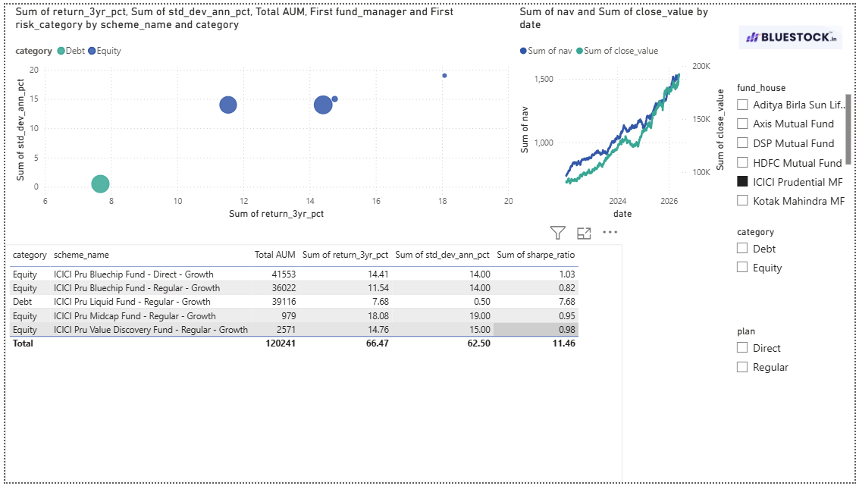
BLUESTOCK MUTUAL FUND ANALYTICS
Dashboard: Composite Fund Scorecard
Multi-factor weighted ranking: CAGR 30% | Sharpe 25% | Sortino 20% | Alpha 15% | Expense 10%
94.8
#1 SBI Small Cap
89.2
#2 HDFC Top 100
88.5
#3 Mirae Large Cap
87.1
#4 ICICI Bluechip
[ INSERT POWER BI DASHBOARD SCREENSHOT ] Composite Fund Scorecard & Rankings Visualization
BLUESTOCK MUTUAL FUND ANALYTICS | Vipin Nishad | Capstone 2026
Slide 9 / 12

Slide 10
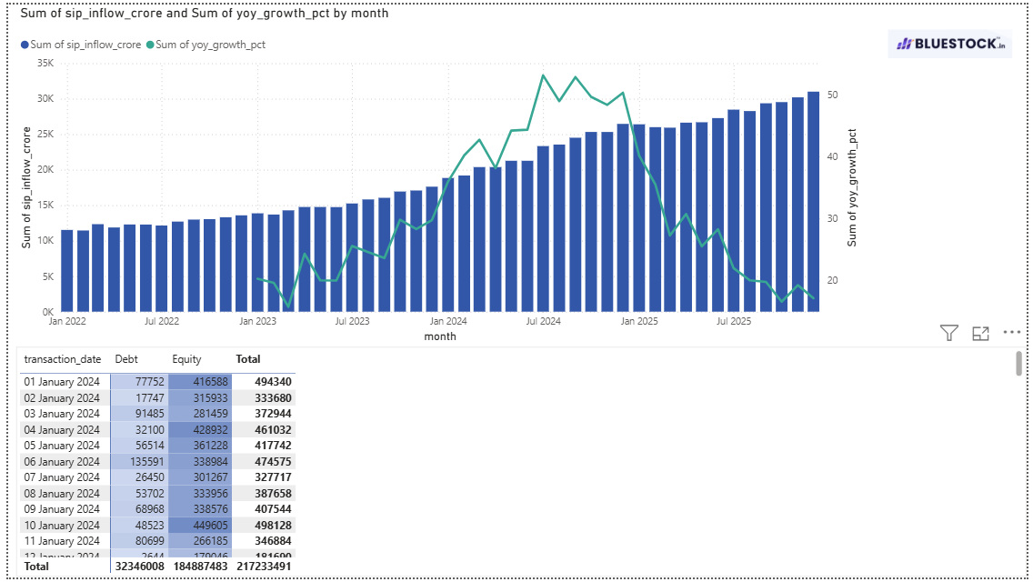
BLUESTOCK MUTUAL FUND ANALYTICS
Dashboard: SIP Trends & Cohort Analysis
Investor acquisition cohorts and SIP continuity health monitoring
₹2,258 Cr
2024 Cohort Capital
97.8%
At-Risk SIP Rate
4,803
Active Investors
+22.8%
2025 Ticket Growth
[ INSERT POWER BI DASHBOARD SCREENSHOT ] SIP Inflow Trends & At-Risk Cohort Visualization
BLUESTOCK MUTUAL FUND ANALYTICS | Vipin Nishad | Capstone 2026
Slide 10 / 12

Slide 11
BLUESTOCK MUTUAL FUND ANALYTICS
Summary of Key Analytical Findings
Critical insights across performance, risk, and investor behavior
▸ Risk-Adjusted Leaders: Large-Cap funds (HDFC Top 100, ICICI Bluechip) deliver Sharpe ~1.06 with 50% lower drawdown risk vs. Small-Caps.
▸ Sector Overconcentration: Top funds show >45% IT and >41% Banking exposure, exceeding safe HHI thresholds (≥2,500).
▸ SIP Continuity Crisis: 97.8% of recurring SIP investors flagged at-risk (avg gap >35 days), signaling severe mandate friction.
▸ Cohort Evolution: 2025 cohort shows +22.8% higher avg SIP (₹13,505 vs ₹10,997), indicating affluent investor acquisition.
BLUESTOCK MUTUAL FUND ANALYTICS | Vipin Nishad | Capstone 2026
Slide 11 / 12

Slide 12
BLUESTOCK MUTUAL FUND ANALYTICS
Strategic Business Recommendations
Actionable interventions for risk, retention, and infrastructure
▸ Enforce Sector Ceilings: Mandate ≤30% single-sector portfolio cap for funds with HHI ≥ 2,500. HDFC Top 100 Direct (IT 45.77%) must trim overweights to reduce uncompensated risk.
▸ Automate SIP Retention: Deploy pre-debit WhatsApp/SMS alerts + 1-click pause feature (up to 90 days) targeting the 97.8% at-risk cohort — est. 15-20% churn reduction.
▸ Risk-Mapped Allocation: Use recommender.py engine: Low → ICICI Liquid (Sharpe 7.68), Moderate → HDFC Top 100 (CAGR 14.84%), High → SBI Small Cap (Alpha +5.42%).
▸ Real-Time Infrastructure: Transition from CSV batch loading to API-driven live NAV ingestion with automated Star Schema warehouse refresh cycles.
BLUESTOCK MUTUAL FUND ANALYTICS | Vipin Nishad | Capstone 2026
Slide 12 / 12

