Slide 1
Multi-Agent
Programming Contest
Artur Daudrich, Sergey Dedukh, Manuel Mittler,
Michael Ruster, Michael Sewell, Yuan Sun.
Research lab – Summer term 2014
University Koblenz-Landau

Slide 2
Outline
The contest
Scenario
Our Strategies
  Zoning strategy
  Agent specific strategies
Implementation details
Competition outcome
Lessons learned

Slide 3
The Contest – Aims and Scope
International online competition since 2005
Attempt to stimulate research in the area of multi-agent system development and programming
Focus: Agent cooperation and coordination. Implementation technology left to participants

Slide 4
Scenario
  Two teams send 28 agents each onto Mars
  There are water wells with varying amounts of water
  The teams try to find the most valuable spots and defend them
  Teams may attack each other
  Goal: Maximise points given by achievements and occupied wells.

Slide 5
Scenario - Environment
Weighted graph
  Weighted edge: costs of traversing this edge
  Labeled node: value of this water well
Graph is unknown at the beginning
  Neither the costs of traversing an edge nor the value of a node are known
  Agents must explore the graph

Slide 6
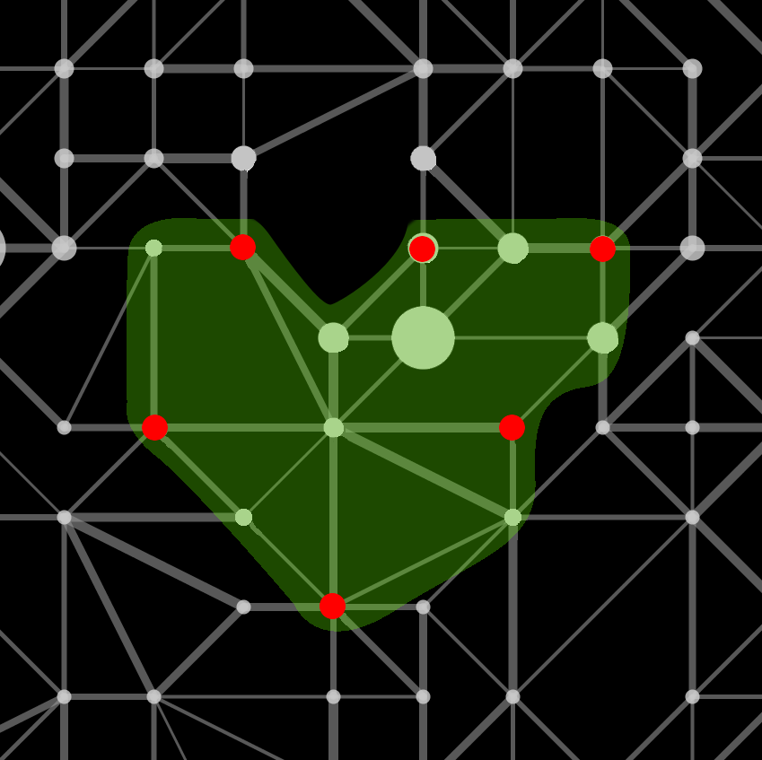
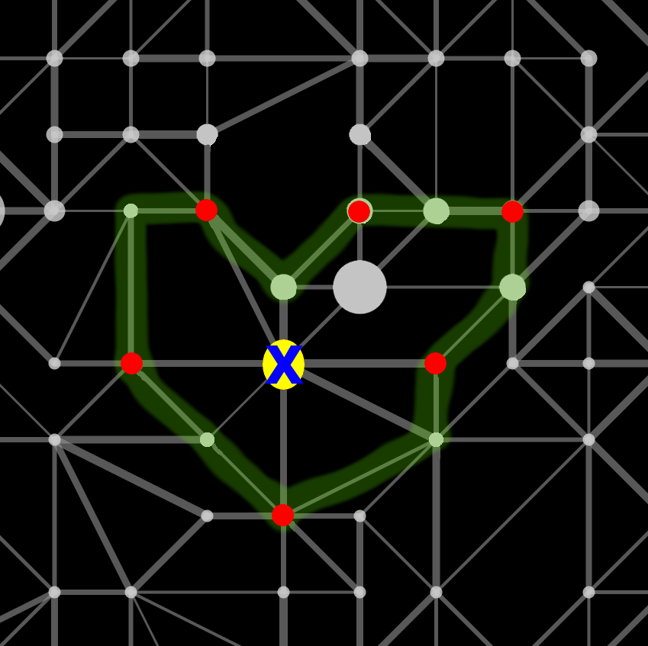
Scenario – Occupying Zones/ Graph colouring algorithm

Slide 7
Scenario - Agents
Attributes
  Energy, health, strength, visibility range
Five different roles:
  Explorer, saboteur, sentinel, repairer and inspector
  All can skip, goto, survey, buy and recharge
  May perform various role-specific actions
  Have different attributes

Slide 8
Scenario - Agents
Role | Special actions | Energy | Health | Strength | Visibility range
Explorer | Probe | 35 | 4 | 0 | 2
Repairer | Repair, parry | 25 | 6 | 0 | 1
Saboteur | Attack, parry | 20 | 3 | 3 | 1
Sentinel | Parry | 30 | 1 | 0 | 3
Inspector | Inspect | 25 | 6 | 0 | 1

Slide 9
Scenario - Agents
Agents run on participant's infrastructure
Simulated environment runs on a remote server
Agents communicate with the server by exchanging XML messages
After each simulation step the server delivers new percepts on which the agents then can reason

Slide 10
Our Strategies
Two overall phases: exploration and zone mode
We start with exploring the graph
After that all agents but saboteurs switch to zone mode
Saboteurs focus on attacking.

Slide 11
Our Strategies - Exploration
Before we start with building zones, the graph needs to be explored (DFS)
Inspector, repairer and sentinel agents perform survey action to retrieve the edge weights of the nodes
Explorers perform probe action before surveying
Processed nodes are stored in order to not survey/probe a node twice

Slide 12
Our Strategies – Zone Mode
Once there are no unsurveyed nodes anymore, agents switch to zone mode
Agents register for zoning (called “zoners”)
Each zoner calculates his best zone in a given range
Best means highest zone value with minimal number of agents

Slide 13
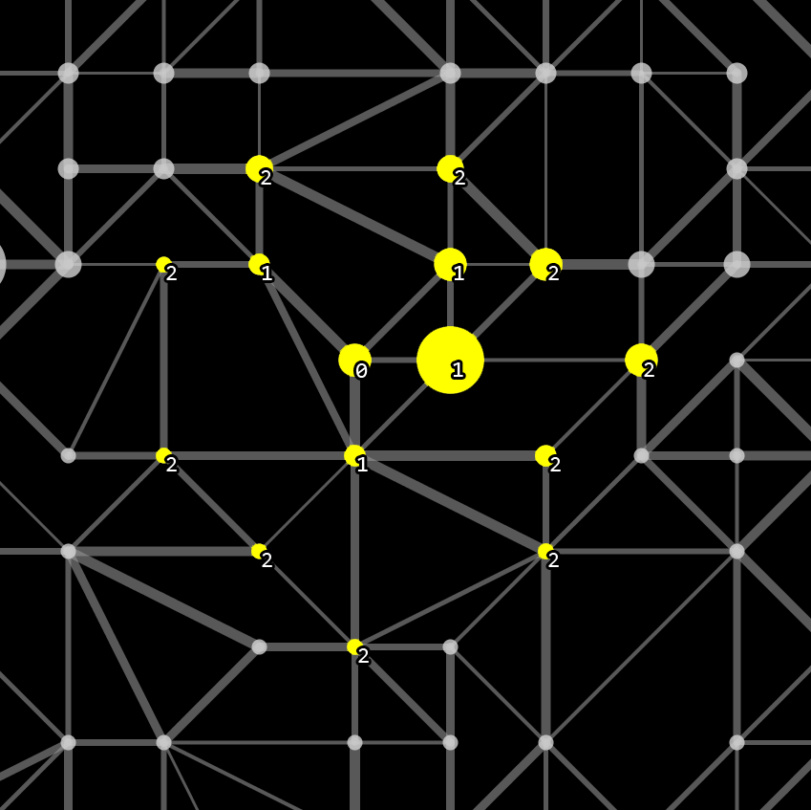
Our Strategies – Zone Calculation
All vertices in maximum 2-hop-distance marked yellow
Numbers indicate distance to centre
Yellow: vertices to consider
Green: an agent must be placed there
Red: no agent should be placed there

Slide 14
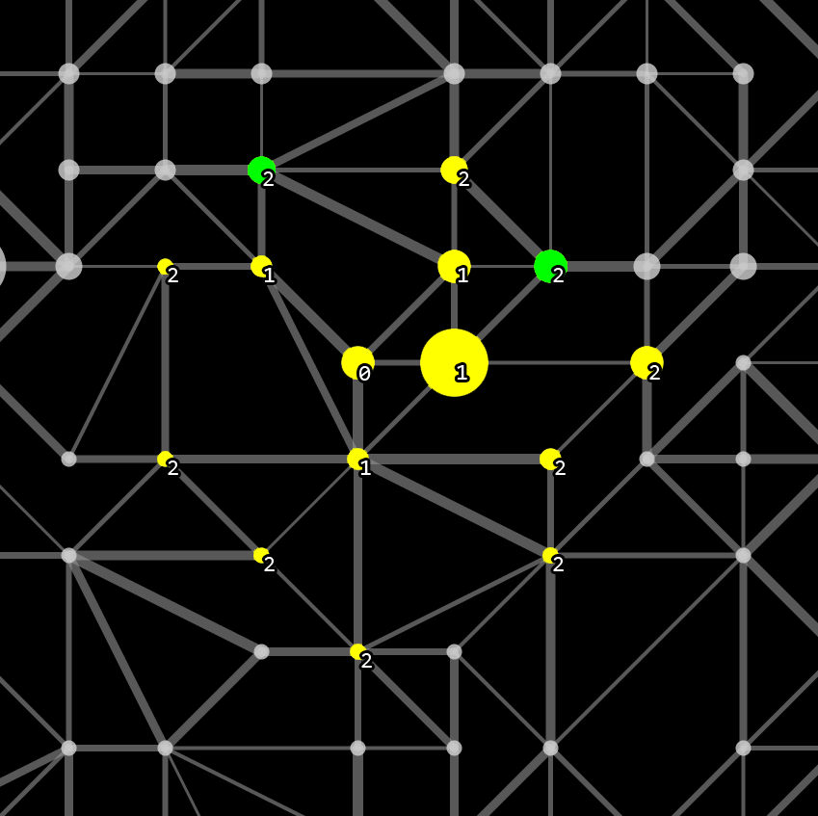
Our Strategies – Zone Calculation
All 2-hop-vertices connected to 2 or more 1-hop-vertices are marked green
Yellow: vertices to consider
Green: an agent must be placed there
Red: no agent should be placed there

Slide 15
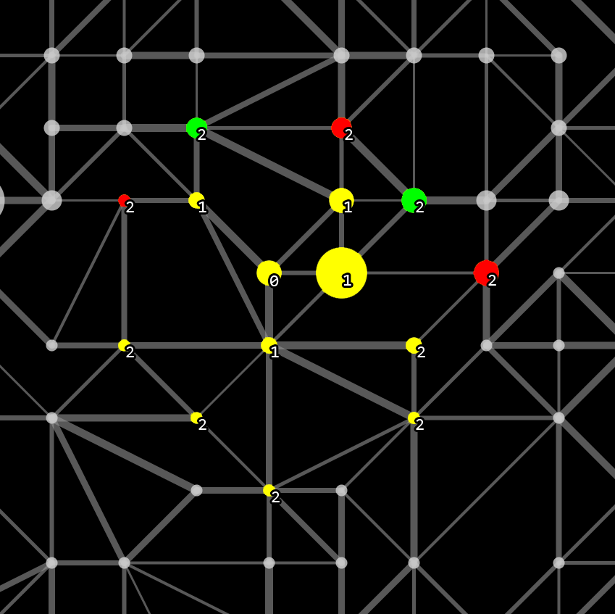
Our Strategies – Zone Calculation
All 2-hop-vertices connected to a green 2-hop-vertex by maximum 1 hop are red
Yellow: vertices to consider
Green: an agent must be placed there
Red: no agent should be placed there

Slide 16
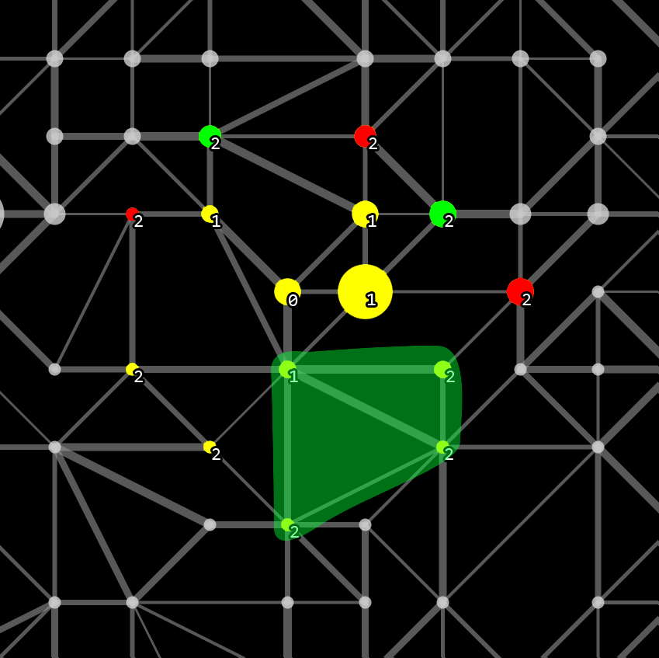
Our Strategies – Zone Calculation
“bridges”:
  three 2-hop-vertices
  all connected to a
  1-hop-vertex and
  maximum two hops away from each other
Yellow: vertices to consider
Green: an agent must be placed there
Red: no agent should be placed there

Slide 17
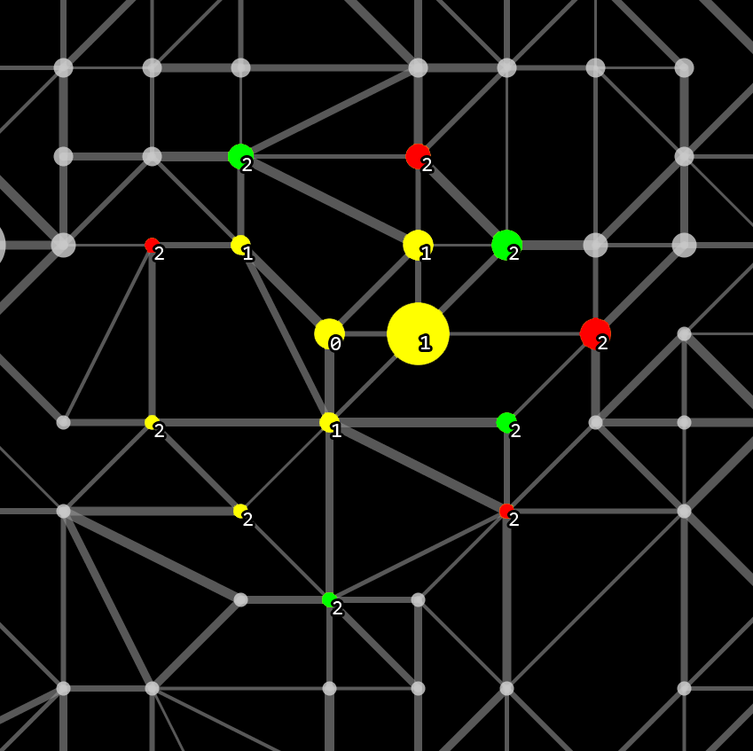
Our Strategies – Zone Calculation
Found “bridges” have their ends marked green and their connecting vertex red.
Yellow: vertices to consider
Green: an agent must be placed there
Red: no agent should be placed there

Slide 18
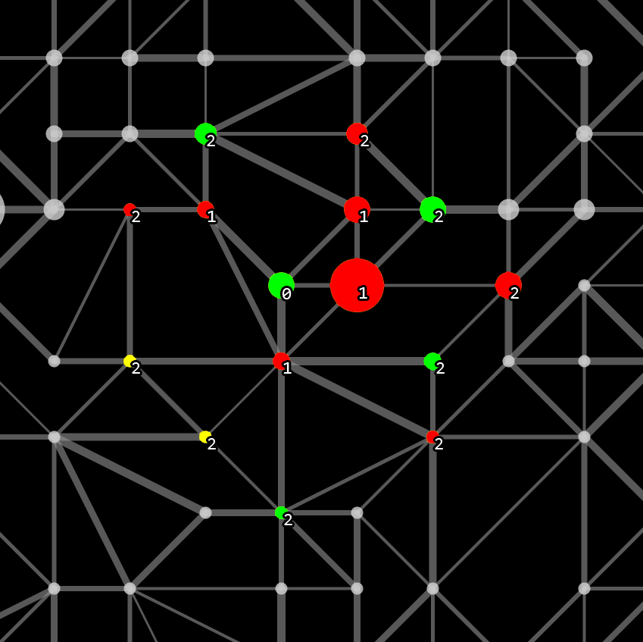
Our Strategies – Zone Calculation
The centre is marked green as well.
All 1-hop-vertices are marked red.
Yellow: vertices to consider
Green: an agent must be placed there
Red: no agent should be placed there

Slide 19
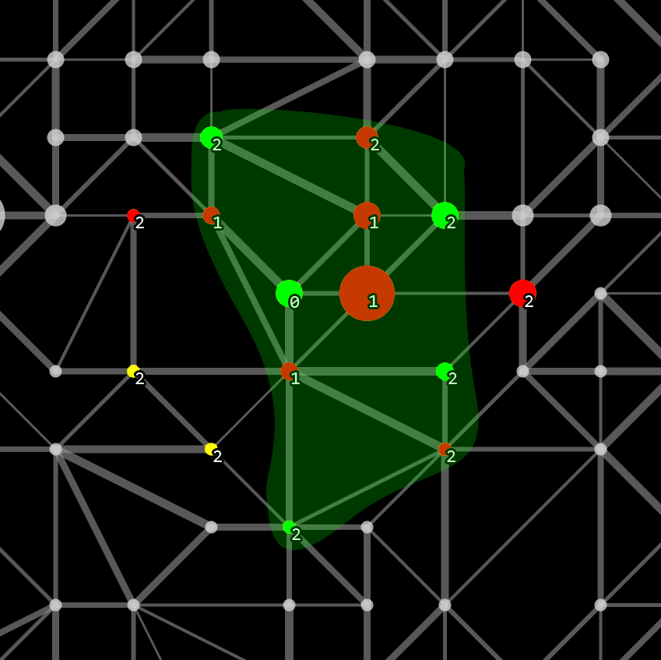
Our Strategies – Zone Calculation
Five agents cover a zone of eleven vertices.
Yellow: vertices to consider
Green: an agent must be placed there
Red: no agent should be placed there

Slide 20
Our Strategies – Zone Mode
If there are enough agents (zoners) available for zoning do the following:
  communicate every zone to every zoner
  best zone is picked
  use closest zoners to build best zone
  all participants of the zone are removed from available zoners
If not: agent goes to highest value node in certain range

Slide 21
Our Strategies – Explorer Strategy
Explorers stay longer in zone mode as they keep probing
Probe in clusters/circles
  Closest vertex with most already probed neighbours
  Should help find highly valuable zones.

Slide 22
Our Strategies – Saboteur Strategy
Defend established zones
Attack closest enemy agent
We had one “artillery agent” which upgraded his visibility range every time it did not see an enemy agent

Slide 23
Our Strategies – Repairer Strategy
If an agent gets disabled he calls the closest repairer
Respond to calls for help and repair disabled agents
Disabled agents move to the repairer
Hence, active zones are not broken up

Slide 24
Implementation details – AgentSpeak(L) example
role(saboteur).
+!attack(Enemy):
  energy(X) & X >= 2
  ← attack(Enemy).
+!attack(_)
  ← recharge.

Slide 25
Implementation details
Programming language: Jason, a combination of Java and AgentSpeak(L)
Plans (reasoning and execution of actions) were implemented in AgentSpeak(L)
Computationally intense tasks and storing of graph related percepts was done in Java objects
Interaction between Java and AgentSpeak(L) via Jason's internal actions

Slide 26
Competition outcome
Team MaKo scored 2nd
The team from the USFC won three times in a row
Position | Team | Score difference | Matches won
1. | SMADAS-UFSC | 526038 | 11
2. | MAKo | -159782 | 6
3. | TUB | 32475 | 5
4. | TheWonderbolts | -303668 | 5
5. | GOAL-DTU | -95063 | 3

Slide 27
Lessons Learned
Communication between agents in Jason was an extreme bottleneck
Recursion is very expensive in AgentSpeak(L)
When a dash appears in a Literal it is interpreted as an arithmetic expression
Aggressive strategy was quite effective

Slide 28
End Of Presentation
Thanks for your attention!
MAPC

