Slide 1
LHT=15
5
People: 15
Vectors: 50
LHM: 0.5
10
People: 10
Vectors: 50
LHM: 0.5
15
People: 5
Vectors: 100
20
People: 10
Vectors: 100
25
People: 1
Vectors: 100
In this scenario, I changed Nodes 5, 7, 23 to have LHT=15
4
People: 5
Vectors: 50
LHM: 0.5
9
People: 10
Vectors: 100
14
People: 0
Vectors: 100
19
People: 10
Vectors: 100
24
People: 10
Vectors: 100
3
People: 1
Vectors: 100
8
People: 10
Vectors: 100
13
People: 10
Vectors: 100
18
People: 10
Vectors: 100
23
People: 15
Vectors: 200
LHM: 5.0
2
People: 10
Vectors: 100
7
People: 0
Vectors: 100
12
People: 15
Vectors: 100
17
People: 5
Vectors: 200
LHM: 5.0
22
People: 0
Vectors: 400
LHM: 10.0
1
People: 5
Vectors: 100
6
People: 10
Vectors: 100
11
People: 10
Vectors: 200
LHM: 5.0
16
People: 0
Vectors: 400
LHM: 10.0
21
People: 0
Vectors: 400
LHM: 10.0

Slide 2
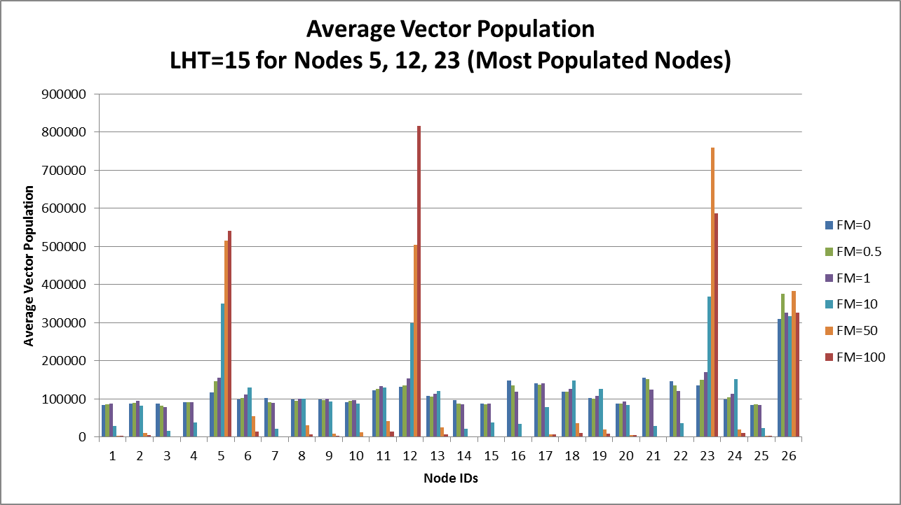
Still can’t complete overcome the crowding.

Slide 3
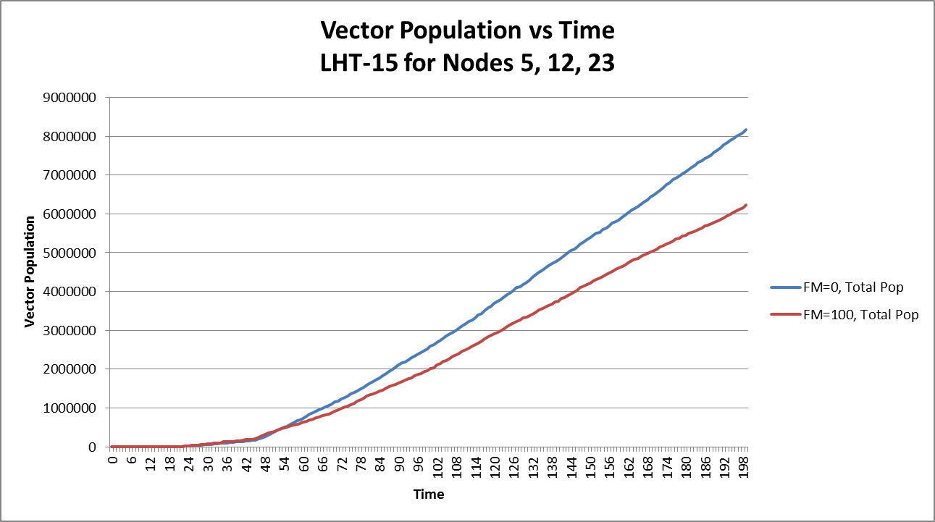
Overcrowding is still keeping the overall vector population down.

Slide 4
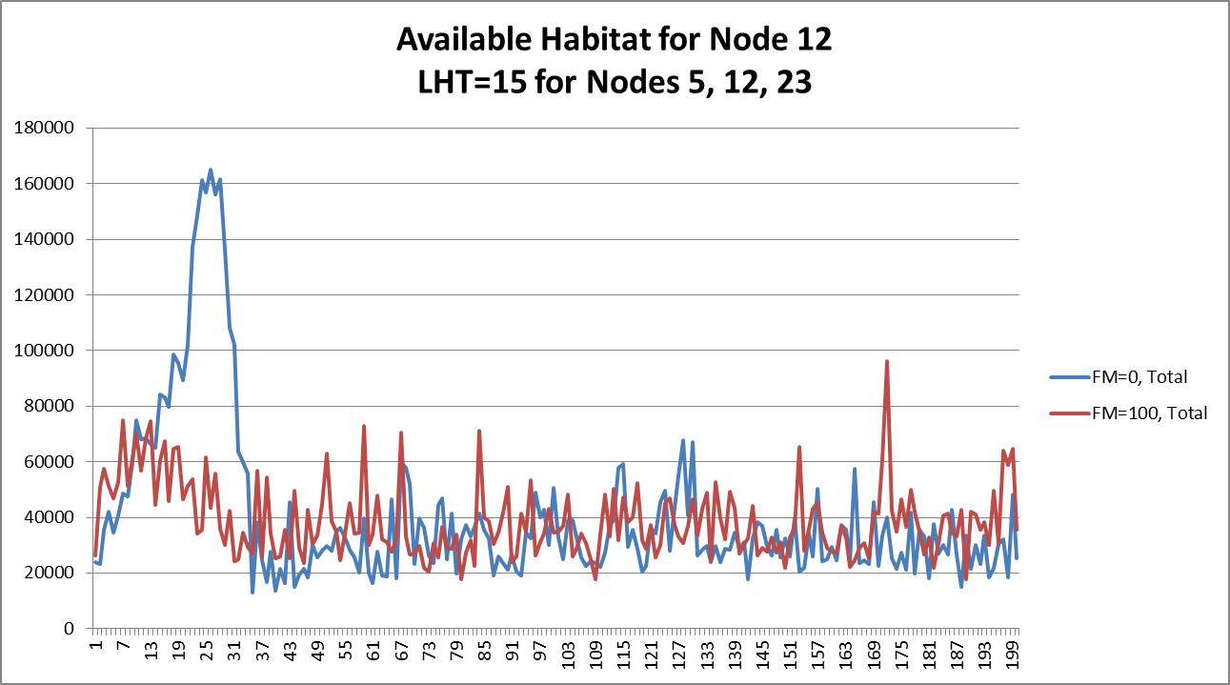
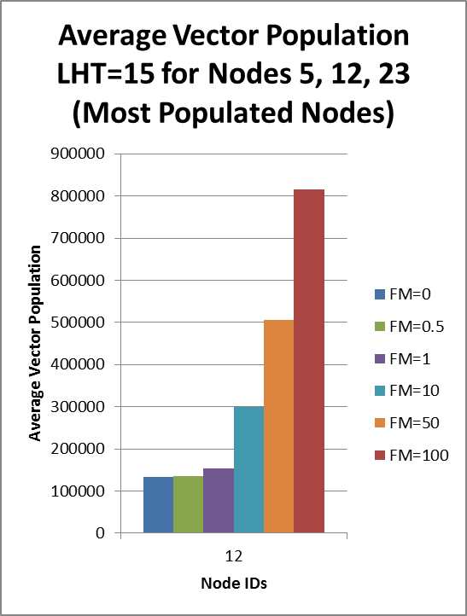
The Available Habitat seems to be about the same, but there are way more vectors in FM=100

Slide 5
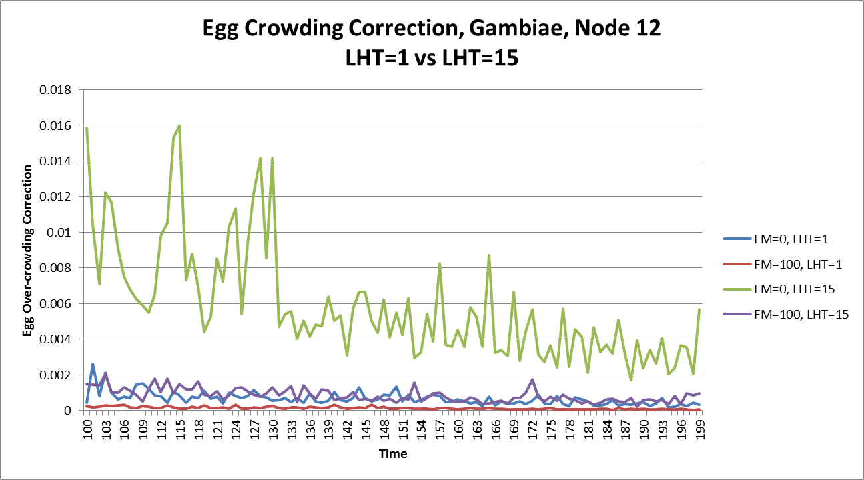
Egg Crowding is based on available habitat and the number of eggs laid.
When LHT=1 and FM=100, the correction greatly reduces the number of eggs that hatch.

