Slide 1

Cognizant Community Event Google Glass App

Slide 2
Google Glass App
Enacted by | Environment | Context | Scenarios
Persona A: Claims Adjustor | 1 - Roof Section | You are a claims adjustor and have been asked to evaluate damage to solar panels on the roof of a commercial building, allegedly sustained during foul weather the previous week. You also suffered a minor stroke six months ago and are making an excellent recovery. | Claims Adjustor Arrives at roof section and uses Google Glass app to open web-based documentation “form” that takes speech commands. Views claim, then dictates comments while taking video, takes photos Requests and receives report form home office about weather in that area at presumed time of damage: notes weather activity doesn’t seem to correspond to damage. Records voice memo on whether this claim should be paid. At the conclusion of the claim, (maybe when hitting “Submit”?) reminder pops up for next appointment, which will be in another state.

Slide 3
GoogleGlass App Scenario Simulation

Slide 4
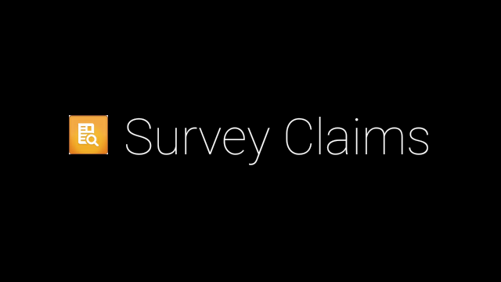
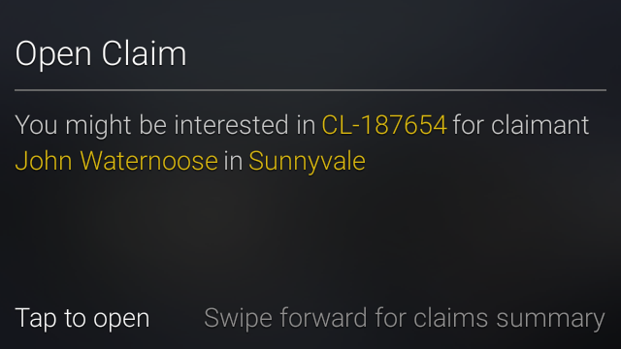
Google Glass App
[Context: The field adjuster arrives on the insured location (claimant’s home) wearing the Google Glass in order to carry out survey process by inspecting the damaged roof]
Install and Open Survey Claims app
Tap to open app
By sensing the insured location, the app contextually opens the claim suggesting the adjuster that he might be interested in CL-187654 for claimant John Waternoose in Sunnyvale
Two options are provided -
Tap to open claims
Swipe forward to view claims summary
If the adjuster is pointed out the claim of his interest, he taps to open claims

Slide 5
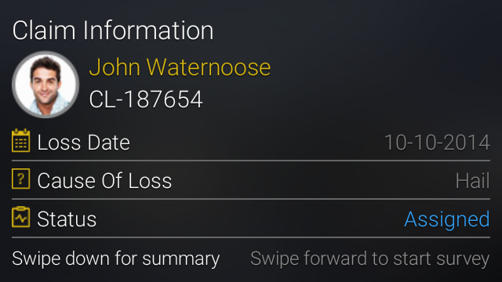
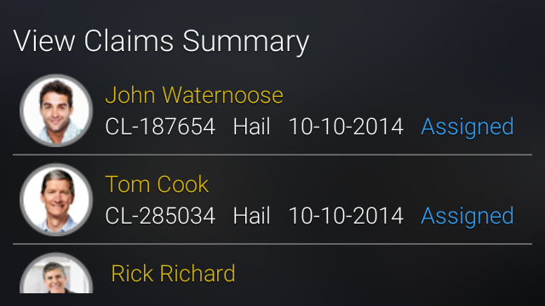
Google Glass App
The claimant photo, claimant name, claim number, loss date, cause of loss and claim status is displayed
The adjuster swipes forward (once) to start the survey
Referring previous slide, alternately the adjuster can choose a different claim by viewing the summary information
In Open claims screen, the adjuster swipes forward (once) to view the claims summary
View claims summary is displayed
The adjuster taps on the claim of interest
The claimant photo, claimant name, claim number, loss date, cause of loss and claim status is displayed
The adjuster swipes forward (once) to start the survey

Slide 6
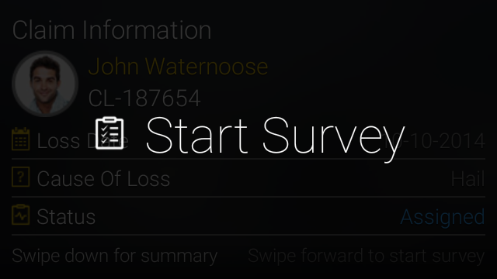
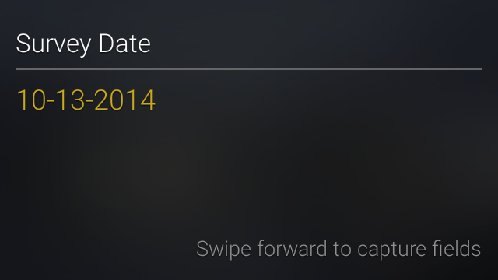
Google Glass App
Start Survey menu is displayed
The adjuster taps to start survey
As part of the survey, the adjuster captures 4 text fields namely
Survey date (pre-populated – view-only)
Extent of damage (voice trigger input)
Roof Type (voice trigger input)
Cause of loss (voice trigger input)
Survey date is pre-populated with the current date
The adjuster swipes forward to capture the other field inputs

Slide 7
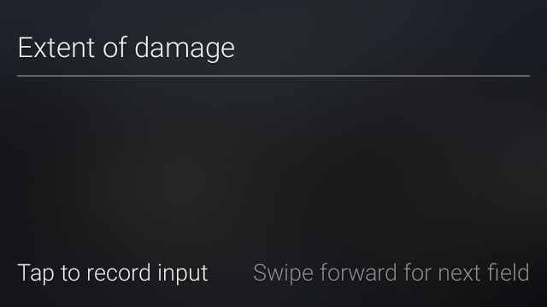
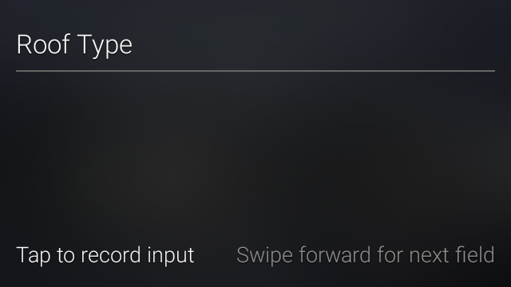
Google Glass App
The first field Extent of damage is displayed
The adjuster taps to record input
The adjuster uses voice trigger to speak ‘Large sections of roof structure removed’ and the speech is converted to text and displayed on screen and auto saved
The adjuster swipes forward (once) for the next input
The next field Roof Type is displayed
The adjuster taps to record input
The adjuster uses voice trigger to speak ‘Asphalt’ and the speech is converted to text and displayed on screen and auto saved
The adjuster swipes forward (once) for the next input

Slide 8

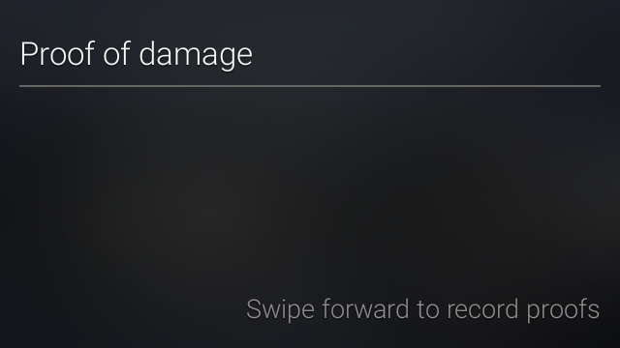
Google Glass App
The next field Cause of damage is displayed
The adjuster taps to record input
The adjuster uses voice trigger to speak ‘Suspected to be Hail’ and the speech is converted to text and displayed on screen and auto saved
The adjuster swipes forward (once) for the next input
The next context screen Proof of damage is displayed
There are multiple menu options available while swiping forward
Record video
Take photo
(Request) Weather Report
Record Memo (Audio notes)
Submit Survey
The adjuster swipes forward (once) to record proofs

Slide 9
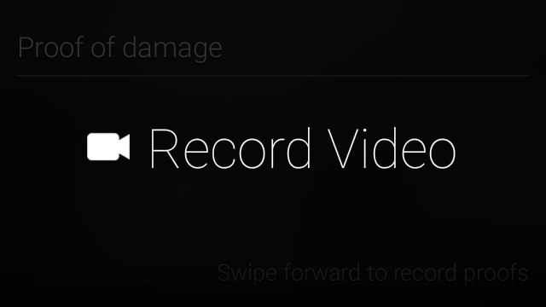
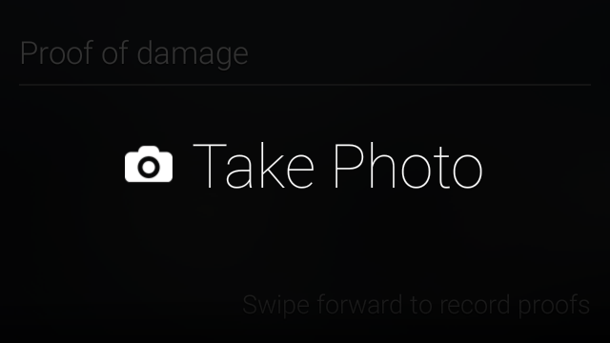
Google Glass App
Record Video menu is displayed
The adjuster taps to video record the damages at the insured location
Videos are recorded 10 seconds by default.
To continue recording, tap and select Extend Video.
To stop recording, tap to Stop recording and tap to accept.[The video file is automatically uploaded to server]
The adjuster swipes down to go back to Proof of damages context screen
The adjuster swipes forward (twice) to take photo of the damages
Take Photo menu is displayed
The adjuster taps to take photo of the damages at the insured location
The adjuster swipes forward (once) for options
Save menu is displayed
The adjuster taps to save the captured image

Slide 10
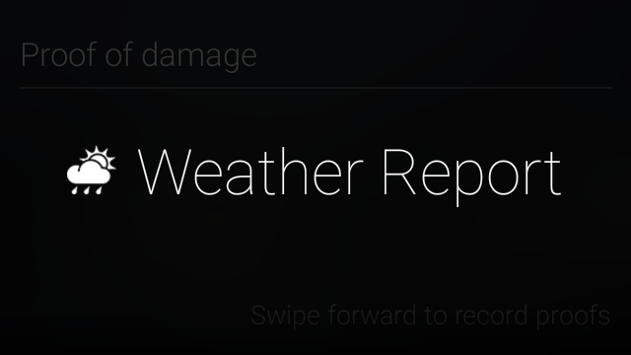
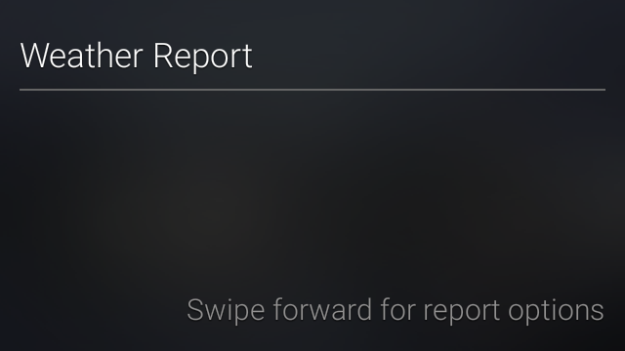
Google Glass App
Based on the survey fields captured until now, the adjuster suspects if the cause of loss is hail and wants to request weather report for verification
The adjuster swipes down to go back to Proof of damages context screen
The adjuster swipes forward (thrice) to request weather report
Weather Report menu is displayed
The adjuster taps on the menu and it enters the weather report context screen
There are 2 options available while swiping forward
Obtain weather report on the loss date at the insured location
Obtain historical report at the insured location when a prior damage occurred
The adjuster swipes forward (once) to obtain the report at the date of loss

Slide 11
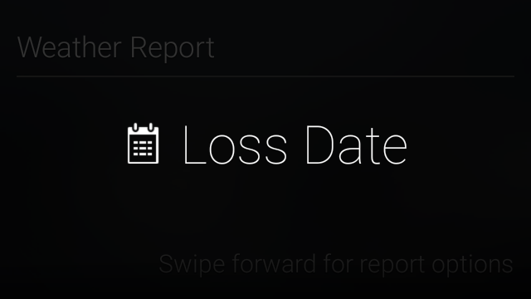
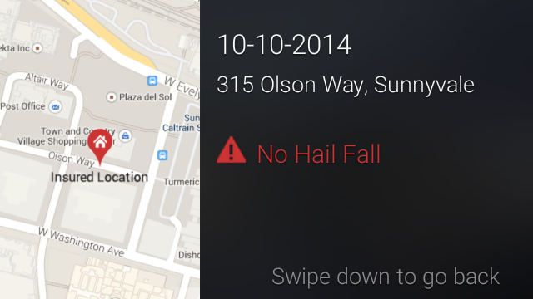
Google Glass App
Loss Date menu is displayed
The adjuster taps to obtain the report
The weather report indicates No Hail has fallen at insured location on the date of loss reported
It looks like a mild storm / heavy rainfall on that day.
The adjuster swipes down to go back to the weather report context screen
The adjuster swipes forward (twice) to obtain the historical report

Slide 12
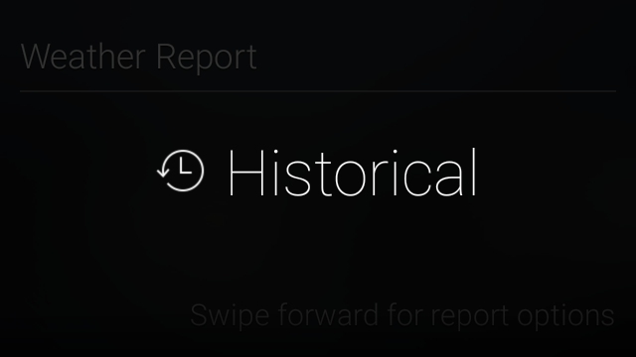
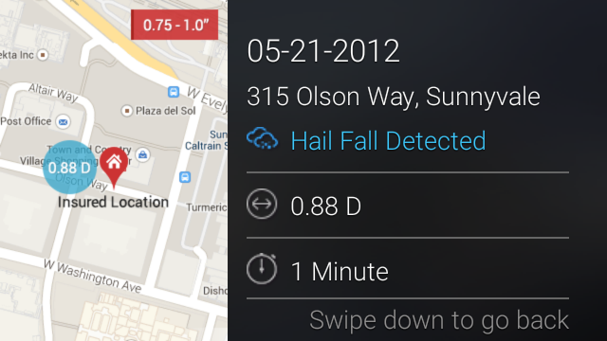
Google Glass App
Historical menu is displayed
The adjuster requests historical weather report to check if hail damage has occurred at the insured location in the past and has affected the roof
The adjuster taps to obtain the report
The adjuster infers that 0.88 diameter hail fall is detected few years back and has persisted for a minute affecting the roof
The adjuster swipes down to go back to the weather report context screen
The adjuster swipes down again to go back to Proof of damages context screen
Proof of damages context screen is displayed
The adjuster swipes forward (4 times) to obtain record memo

Slide 13
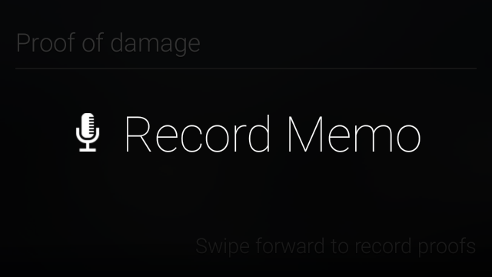
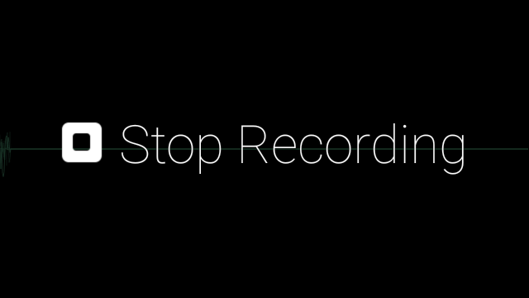
Google Glass App
Record Memo menu is displayed
The adjuster taps to audio record his survey findings
[Adjuster’s inference
On the loss date, there is no hail that is severe to have got recorded. It might be a mild storm / heavy rainfall. Prior to that, 2 years back, there was a hail and it had affected the roof. The insured / claimant has not attended to it and that has eroded over a period of time notwithstanding the weather now. It is the neglect on part of the claimant and this claim will not be paid.]
The adjuster speaks out ‘Claim cannot be paid due to neglect’
The adjuster taps and Stop Recording menu is displayed
The adjuster taps again to stop recording [This also uploads the recorded file to server]
The adjuster swipes down to go back to Proof of damages context screen
The adjuster swipes forward (5 times) to submit the survey findings

Slide 14
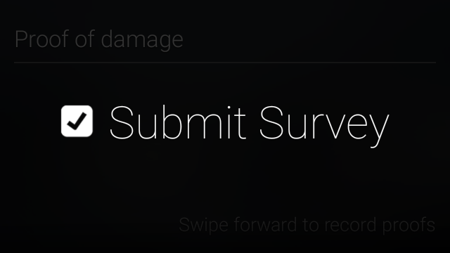
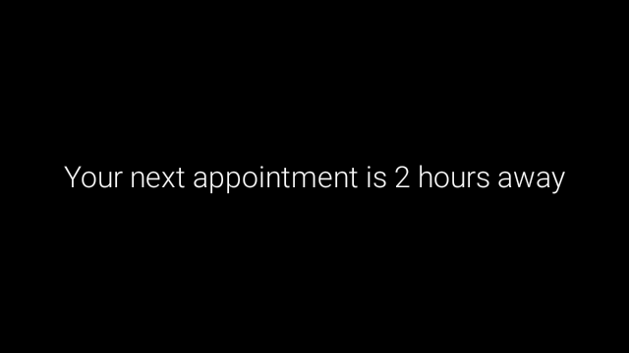
Google Glass App
Submit Survey menu is displayed
The adjuster taps to submit survey findings
[All the fields, both text and media are auto-saved and synchronized to backend server and can be viewed later in the Google Glass Companion app]
The adjuster is reminded that his next appointment is 2 hours away

Slide 15
FAQ

Slide 16
Google Glass App - FAQ
Q. How many clients have we already delivered these to?
A. This is a proof of concept.
Q. Any other use cases we see this working in?
Other use cases for Google Glass app wrt insurance industry is documented here http://www.cognizant.com/insightswhitepapers/Google-Glass-Insurances-Next-Killer-App.pdf

Slide 17
Thank You

