Slide 1

Cognizant Community Event GoogleGlass Companion App

Slide 2
GoogleGlass Companion App
Enacted by | Environment | Context | Scenarios
Persona A: Claims Adjustor | 1 - Roof Section | You are a claims adjustor and have been asked to evaluate damage to solar panels on the roof of a commercial building, allegedly sustained during foul weather the previous week. You also suffered a minor stroke six months ago and are making an excellent recovery. | Claims Adjustor Arrives at roof section and uses Google Glass app to open web-based documentation “form” that takes speech commands. Views claim, then dictates comments while taking video, takes photos Requests and receives report form home office about weather in that area at presumed time of damage: notes weather activity doesn’t seem to correspond to damage. Records voice memo on whether this claim should be paid. At the conclusion of the claim, (maybe when hitting “Submit”?) reminder pops up for next appointment, which will be in another state.

Slide 3
GoogleGlass Companion App Scenario Simulation
Note that this app is a companion app to Google Glass which can be used by the event coordinator. The survey details captured by the field adjuster (text, images, videos, audio etc.) through the Google Glass is stored in backend and reflected in this companion app.

Slide 4

GoogleGlass Companion App
Download and Install the “GlassAdjusterCC” app through Truhub

Slide 5
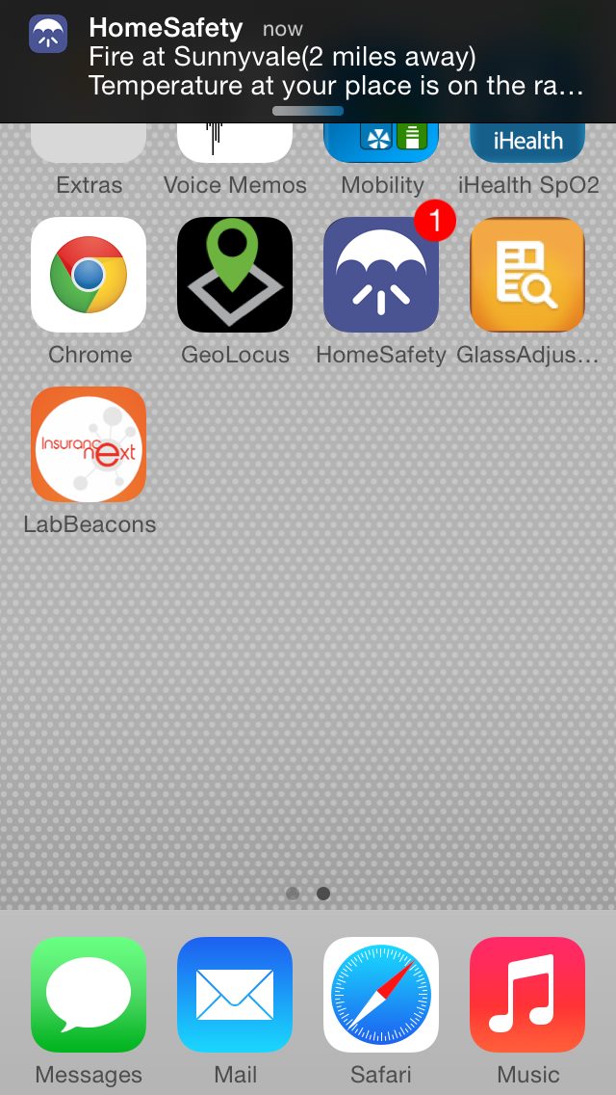
GoogleGlass Companion App
Scenario 1
Opens the GlassAdjusterCC app.

Slide 6
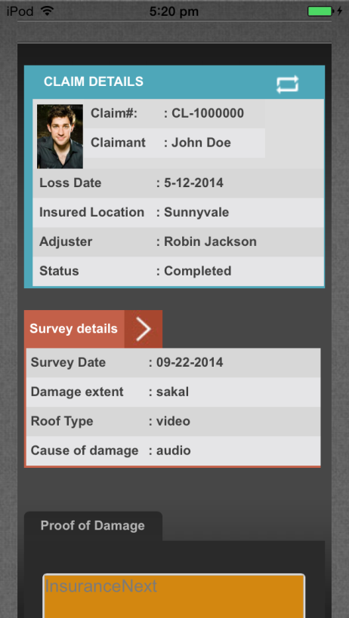
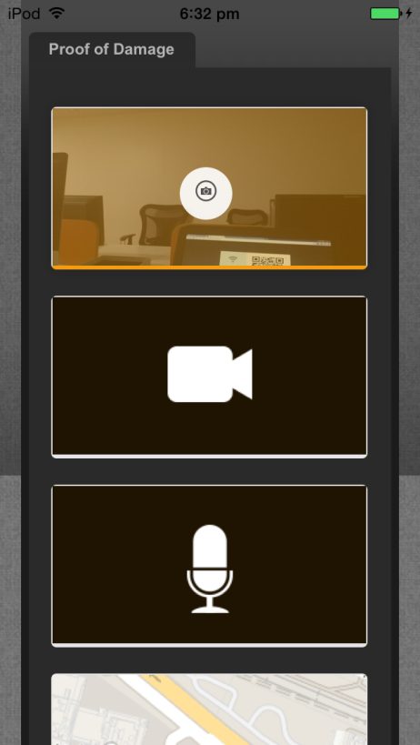
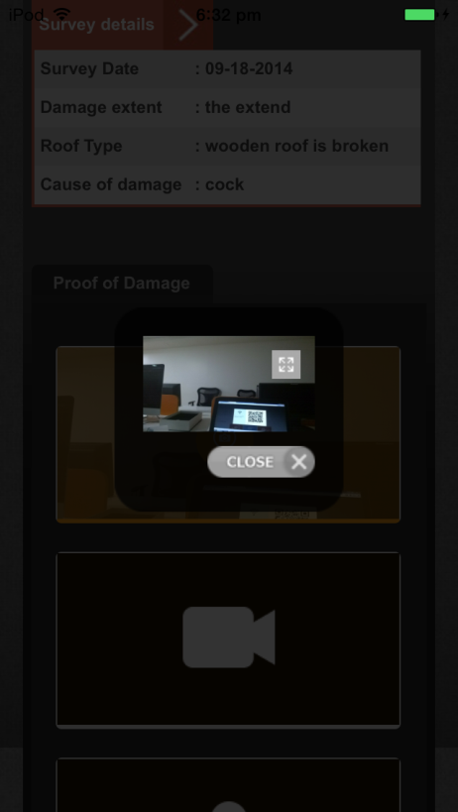
GoogleGlass Companion App
Scenario 1 (Extension)
The app shows him the most recent claim information and survey details captured by the claims adjuster through the Glass app. All these details get populated from the latest claim survey that is done on the Glass app.
He can click and view the images, videos, audio recordings and weather reports
If you perform another survey on the Glass app, you can click on the Sync icon shown in the first image highlighted with an yellow border to view those details.

Slide 7
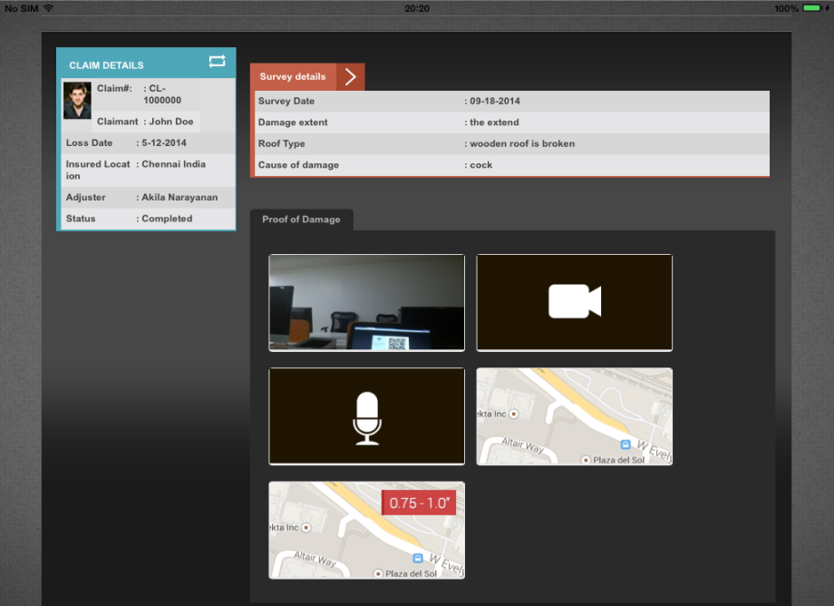
GoogleGlass Companion App
Scenario 1 (iPad View)
The app shows him the most recent claim information and survey details captured by the claims adjuster through the Glass app. All these details get populated from the latest claim survey that is done on the Glass app.
He can click and view the images, videos, audio recordings and weather reports
If you perform another survey on the Glass app, you can click on the Sync icon shown in the first image highlighted with an yellow border to view those details.

Slide 8
FAQ

Slide 9
Google Glass Companion App - FAQ
Q. How many clients have we already delivered these to?
A. This is a proof of concept.
Q. Any other use cases we see this working in?
Other use cases for Google Glass app wrt insurance industry is documented here http://www.cognizant.com/insightswhitepapers/Google-Glass-Insurances-Next-Killer-App.pdf

Slide 10
Thank You

