Slide 1

Bank Fraud Risks and Mitigation
Champlin Smith
DSC6820

Slide 2
Risks
Problem Statement
Rising levels of credit card fraud and suspicious account activity across global operations.
Existing fraud systems lack real-time processing and cannot respond fast enough.
Customer, vendor, and location data spread across multiple platforms prevents accurate risk evaluation.
High false positives and limited contextual enrichment reduce fraud detection accuracy.
Increasing Anti-Money Laundering (AML) regulations require full transparency and long-term record retention.
Key Risks
Financial Loss: Unauthorized transactions quickly accumulate without real-time blocking.
Regulatory Exposure: Failure to meet AML and fraud compliance standards.
Customer Impact: Slow detection damages trust and increases dissatisfaction.
Operational Inefficiency: Manual reviews and disconnected data systems slow response times.
Reputational Damage: Publicized fraud events undermine confidence in the bank’s security.

Slide 3
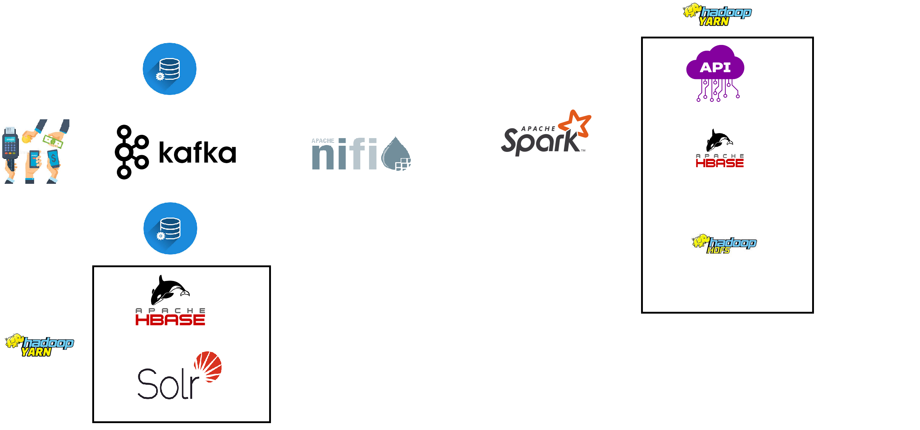
Architecture
RDBMS
RDBMS

Slide 4
Benefits and Conclusion
Regulatory & Compliance
Real-time detection of illegal or suspicious activity
Long-term, fault-tolerant storage for audits and regulatory reporting
Full traceability reduces compliance risk
Operational & Financial
Reduces manual investigation and operational costs
Failure-tolerant storage ensures reliable analytics and minimal downtime
Saves money by stopping actual losses
Customer & Business
Improves customer experience by blocking fraud in real time
Reduces false positives, protecting legitimate transactions
Strengthens trust, loyalty, and retention

