Slide 1

DomCoin
Dominic Whyte

Slide 2

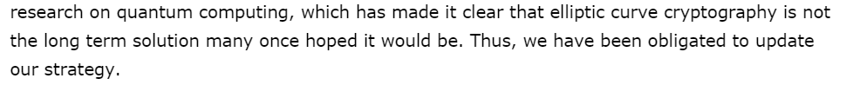
First: News and Technological Advances
RSA vs. Elliptic Curve Cryptography
NSA statement published in August 2015 regarding Elliptic Curve Cryptography (ECC)

Slide 3

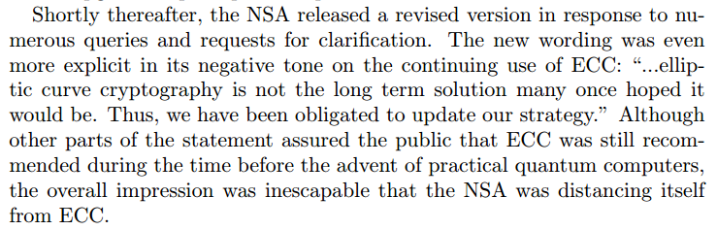
Koblitz, Neal (Co-creator of ECC) and Alfred Menezes. "A Riddle Wrapped in an Enigma."

Slide 4

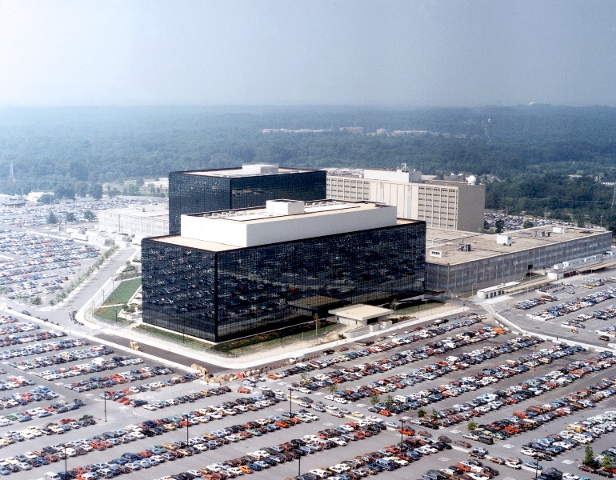
NSA Statement from august 2015
Bitcoin signature system based on ECC
In scenario that NSA has discovered fault in ECC that does not apply to RSA, important to have a cryptocurrency running that is not reliant on ECC
NSA Headquarters in Maryland

Slide 5
Demo – A full transaction using domcoin
DomCoin and Bitcoin similarity
Satoshi Nakamoto’s 2008 paper “Bitcoin: A Peer-to-Peer Electronic Cash System”
Follow transaction to understand DomCoin

Slide 6
Step 1: download necessary files and blockchain/ledger
www.domcoins.ezzycorporation.com
Download/compile programs and necessary software
Download longest blockchain and corresponding ledger
What are these?
Example: Alice, a user with 5010 DomCoins, wishes to send 5005 DomCoins to another new account Bob also under her control

Slide 7
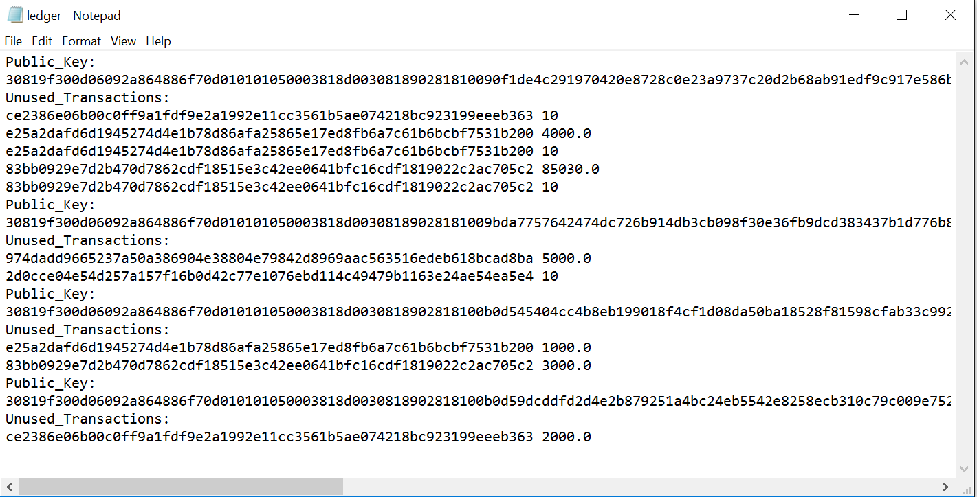
Another user,
Total: 89,060 DomCoins
Alice
Total: 5010
DomCoins

Slide 8
Step 2: Generating Public and Private Key Pairs
Program you wish to run
Generate account for Bob (public/private key pair)
Use GenerateKeys.java
java-introcs GenerateKeys bob_private_key bob_public_key
Demo: generate keys and observe output, look at .key files
Key: generating a key with the same filename as one that already exists overwrites the previous key pair!
File names of private/public keys

Slide 9
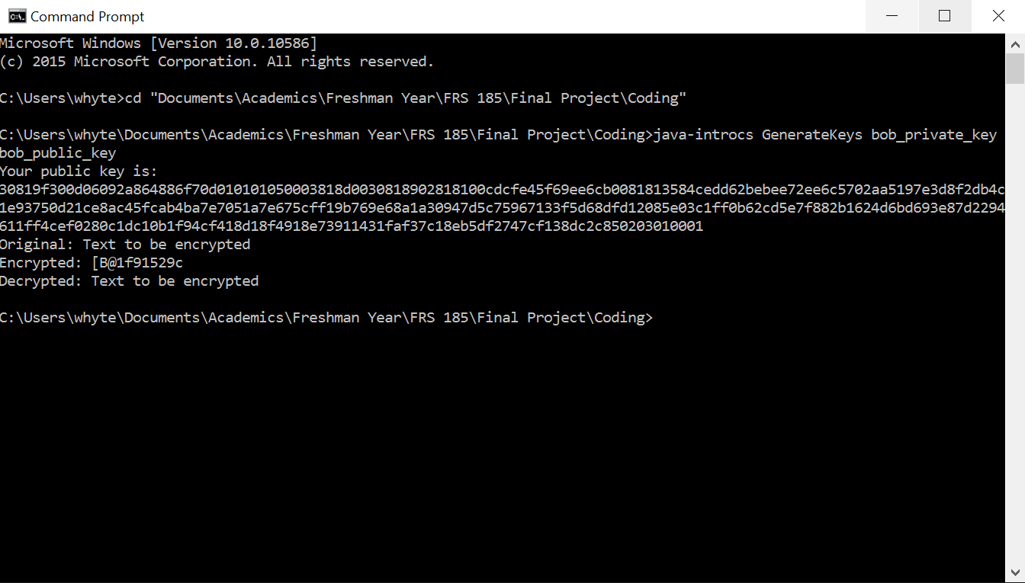
Step 2: Generating Public and Private Key Pairs
Provides Bob public key in hexadecimal
Test encryption and decryption method (RSA key pair)

Slide 10
Step 3: Preparing a Transaction
Run PrepareTransaction.java
java-introcs PrepareTransaction [insert receiver (Bob) public key in hexadecimal] aliceprivatekey alicepublickey 5005
File name containing private key of sender
File name containing public key of sender
Amount the transaction is for

Slide 11
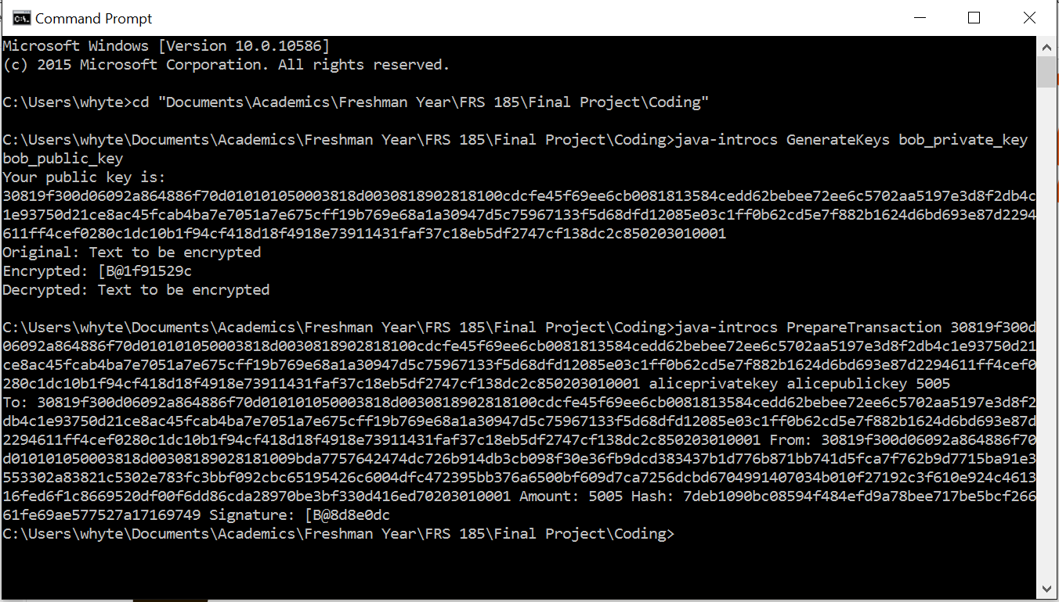
Step 3: Preparing a Transaction
To/From public keys and amount
Hash of above info is found using Sha256.java (Secure Hash Algorithm)
Hash printed as plaintext and with Alice private key applied to it (signature)
Others can verify this

Slide 12
Sha256.java
Secure Hash Algorithm of 256 bits (SHA-256) (also in Bitcoin)
Cryptographic hash function designed by the National Security Agency
Changing even one character changes hash
Prevents other’s from editing transaction
Test different inputs to Sha256.java

Slide 13
Now: post to DomCoin website!

Slide 14
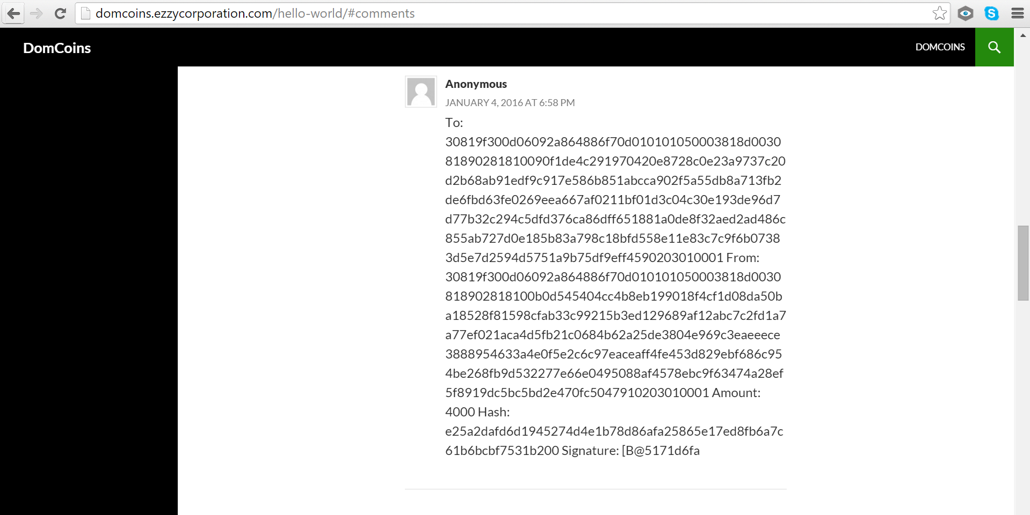
Now: post to DomCoin website!
An Example of a Transaction Post

Slide 15
Step 4: New block creation
Exchange not yet finalized (entered pool of unconfirmed transactions)
10 DomCoin reward for completing a block
Eve’s Task: take the oldest unconfirmed transaction and attempt to add it to the longest existing blockchain

Slide 16
Another user,
Total: 89,060 DomCoins
Eve!
Alice
Total: 5010
DomCoins

Slide 17
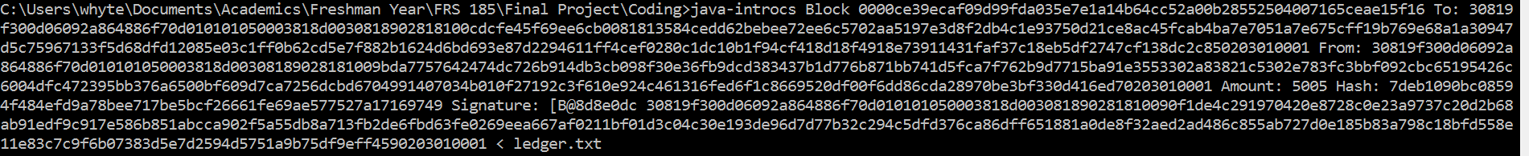
Step 4: new block creation
Before all else: validate blockchain/ledger
Then: Manually add a new account for Bob in the Ledger
java-introcs Block [insert previous block hash here] [insert PrepareTransaction.java transaction description output here] [insert miner public key here] < ledger.txt
Why are these four items entered into the block?
Previous block hash
Textual transaction description
Miner public key
Ledger.txt

Slide 18
Step 4: new block creation
Major Points relating to output:
Authentication Success confirms transaction hash matches hash of transaction
New block to be added to blockchain
Includes all details of transaction
Inputs/Outputs! Have identifier to know from which transaction they came
“Spending” unused Transactions
“Change Transactions”
Updated Ledger
Inputs/Outputs removed/added
Mining reward

Slide 19
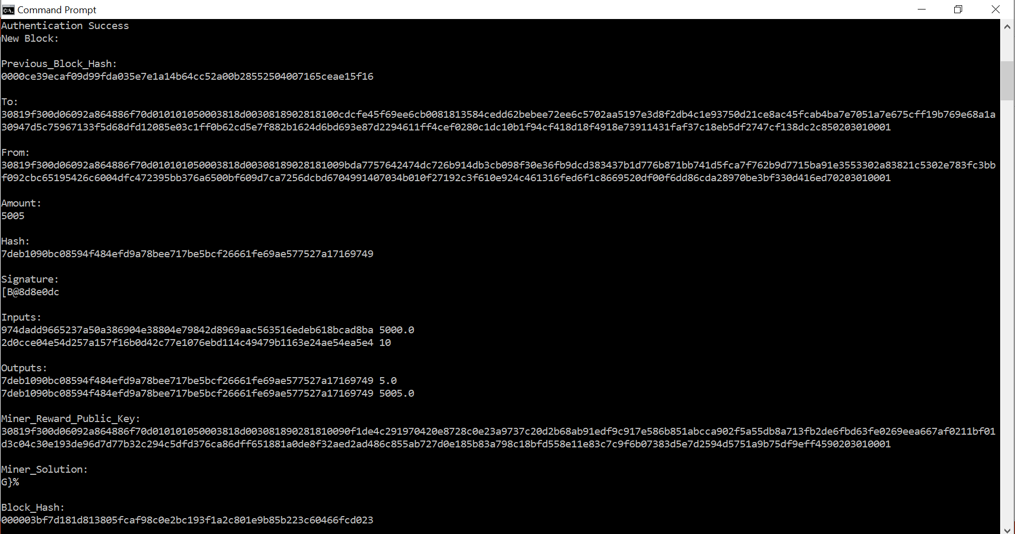
Mining: discuss if enough time at the end. Just a proof-of-work system

Slide 20
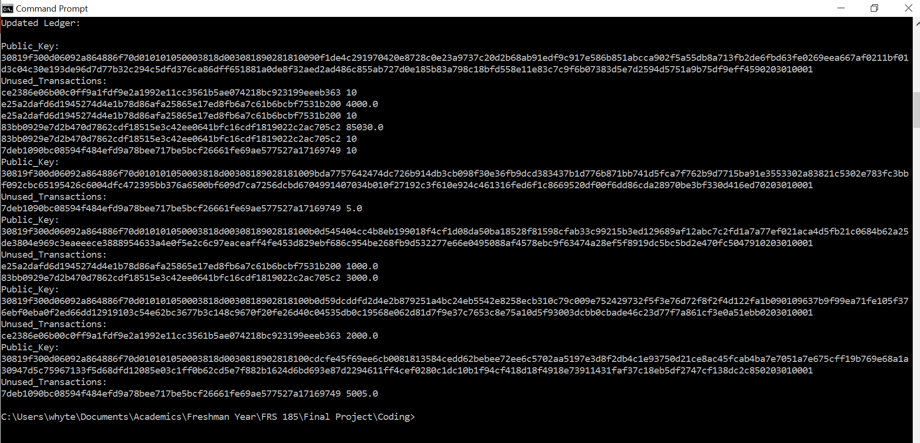

Slide 21
Now: update the ledger and blockchain

Slide 22
Next: post the updated files to DomCoin website!

Slide 23

Vs.
How to compare the two? Need to look at societal needs…

Slide 24
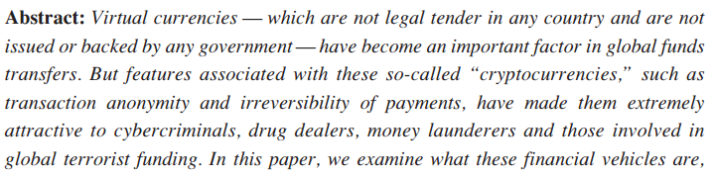
Cryptocurrencies and terrorism
Role of cryptocurrencies in crime and terrorism
Defence Against Terrorism Review:
Pull factors: virtual anonymity, global reach, ease-of-use, speed, non-repudiation

Slide 25

Cryptocurrencies and terrorism
Should we ban cryptocurrencies?
Example: Internet
Jonathan Chester startup: Bitwage
“minimize the threat of terrorist financing by implementing a thorough risk-based anti-money laundering policy that includes customer due diligence and transaction monitoring”
“in-house compliance officer” ➔ Against Nakamoto’s principles?
Include in DomCoin?
Limits growth rate
Potential risks ➔ linking public keys to identities

Slide 26
Cryptocurrencies and the environment
Mining is computationally heavy
Use of calculations
Long Future Foundation:
Given increase to $1 million per BTC, 6570 terawatt hours per annum ($0.05 per kilowatt hour and 50% profit margin)
Profitability incentivizes increased energy spending ➔ no security return (increase difficulty)

Slide 27
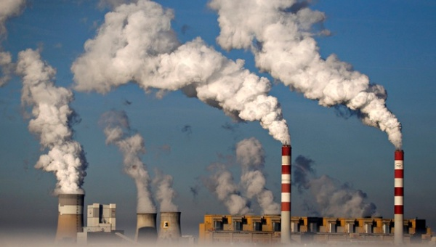

Cryptocurrencies and the environment
The solution? A different miner reward mechanism in DomCoin
DomCoin vs. Bitcoin incentives
DomCoin inflation ensures low miner reward ➔ less incentive for large companies
No need for huge computational power
Inherent benefits of electronic currencies

Slide 28
What next for DomCoin?

Slide 29
References
[1] | "1971 Termination of Gold/Dollar Convertibility." UC Berkeley Library. Berkeley, n.d. Web. 03 Jan. 2016. <http://vm136.lib.berkeley.edu/BANC/ROHO/projects/debt/terminationgolddollar.html>.
[2] | "Who Is Satoshi Nakamoto?" The Economist. The Economist Newspaper, 02 Nov. 2015. Web. 03 Jan. 2016.
[3] | Nakamoto, Satoshi. "Bitcoin: A Peer-to-Peer Electronic Cash System." The Cryptographic Mailing List (2008): n. pag. https://bitcoin.org/bitcoin.pdf. Bitcoin. Web. 26 Dec. 2015. <www.bitcoin.org>.
[4] | "Secure Hashing." National Institute of Standards and Technology. N.p., n.d. Web. 03 Jan. 2016. <http://csrc.nist.gov/groups/ST/toolkit/secure_hashing.html>.
[5] | "Bitcoin: Proof of Work." Khan Academy. N.p., n.d. Web. 03 Jan. 2016. <https://www.khanacademy.org/economics-finance-domain/core-finance/money-and-banking/bitcoin/v/bitcoin-proof-of-work>.
[6] | "Cryptography Today." www.nsa.gov/. National Security Agency, 19 Aug. 2015. Web. 04 Jan. 2016. <https://www.nsa.gov/ia/programs/suiteb_cryptography/>.
[7] | Koblitz, Neal, and Alfred Menezes. "A Riddle Wrapped in an Enigma." (n.d.): n. pag. Web. 1 Jan. 2016. <https://eprint.iacr.org/2015/1018.pdf>.
[8] | "Elliptic Curve Digital Signature Algorithm." Bitcoin Wiki. N.p., 10 Feb. 2015. Web. 04 Jan. 2016. <https://en.bitcoin.it/wiki/Elliptic_Curve_Digital_Signature_Algorithm>.

Slide 30
References
[9] | "RSA Encryption." Wolfram MathWorld. N.p., n.d. Web. 04 Jan. 2016. <http://mathworld.wolfram.com/RSAEncryption.html>.
[10] | Driscoll, Scott. "How Bitcoin Works under the Hood." How Bitcoin Works Under the Hood. N.p., 14 July 2013. Web. 05 Jan. 2016. <http://www.imponderablethings.com/2013/07/how-bitcoin-works-under-hood.html>. <https://www.youtube.com/watch?v=Lx9zgZCMqXE>.
[11] | Narayanan, Arvind. "Princeton Bitcoin and Cryptocurrency Technologies Online Course." Princeton Course Website. N.p., n.d. Web. 06 Jan. 2016. <https://piazza.com/princeton/spring2015/btctech/resources>.
[12] | Khan, Salman. "Bitcoin: Transaction Records." Khan Academy. N.p., n.d. Web. 06 Jan. 2016. <https://www.khanacademy.org/economics-finance-domain/core-finance/money-and-banking/bitcoin/v/bitcoin-transaction-records>.
[13] | Chester, Jonathan. "How Questions about Terrorism Challenge Bitcoin Startups." Forbes. Forbes Magazine, n.d. Web. 06 Jan. 2016. <http://www.forbes.com/sites/jonathanchester/2015/12/14/is-bitcoin-the-currency-of-terrorism/>.
[14] | "Defense Against Terrorism Review." (n.d.): n. pag. Centre of Excellence - Defence Against Terrorism, Fall 2014. Web. 6 Jan. 2016. <http://insct.syr.edu/wp-content/uploads/2015/05/Brill_Cryptocurrencies.pdf>.
[15] | Perez, Yessi. "Think Tank Reignites Debate Over Bitcoin Mining's Environmental Effects." CoinDesk. CoinDesk, 27 May 2015. Web. 06 Jan. 2016. <http://www.coindesk.com/think-tank-debate-bitcoin-mining-environment/>.
[16] | "Crypto-Currency Market Capitalizations." Crypto-Currency Market Capitalizations. N.p., n.d. Web. 06 Jan. 2016. <http://coinmarketcap.com/>.

Slide 31
Step 4.5: Mining
Done automatically when creating a block
Avoid double spending (need to have a fixed transaction order generated by the majority of nodes ➔ assured through mining)
Proof-of-work
Coin flipping example
Hash(Block text + special key) ➔ N leading zeros
Hard to find key, easy to check
RandomString.java

Slide 32
Step 4.5: Mining
java-introcs Miner 1 asdfasfd ➔ Trials: 11 Time taken: 0.015 seconds
java-introcs Miner 2 asdfasfd ➔ Trials: 453 Time taken: 0.047 seconds
java-introcs Miner 3 asdfasfd ➔ Trials: 1050 Time taken: 0.084 seconds
java-introcs Miner 4 asdfasfd ➔ Trials: 9296 Time taken: 0.285 seconds
java-introcs Miner 5 asdfasfd ➔ Trials: 234335 Time taken: 1.169 seconds
java-introcs Miner 6 asdfasfd ➔ Trials: 38795347 Time taken: about 2 minutes
java-introcs Miner 7 asdfasfd ➔ Trials: 425918263 Time taken: about 47 minutes (Solution: “: 53l”)
SHA-256 hash(asdfasfd“: 53l)
➔000000084a0b8684de135161e04274b2fb223540461097ef450c9ba6d6759dfa
Test this in command prompt!

Slide 33
Step 4.5: Mining
Blockchain order not decided by one user, instead by community
Attacker would need computing power comparable to network
Mining difficulty changed by system

Slide 34
Blockchain and ledger verification
Omitted until now
Done before adding a block to blockchain
Must check:
Longest blockchain (Why?)
Check mining solutions
Blocks are in order (value under Previous_Block_Hash)
SHA-256 of transaction text yields hash
Applying public key of sender to signature yields hash
Inputs and outputs agree with current state of ledger
Block text + Mining solution yields block hash

Slide 35
Security
Why can’t an attacker:
Change the ledger and repost it to the website?
Post a transaction to the website using another person’s public key?

