Slide 1
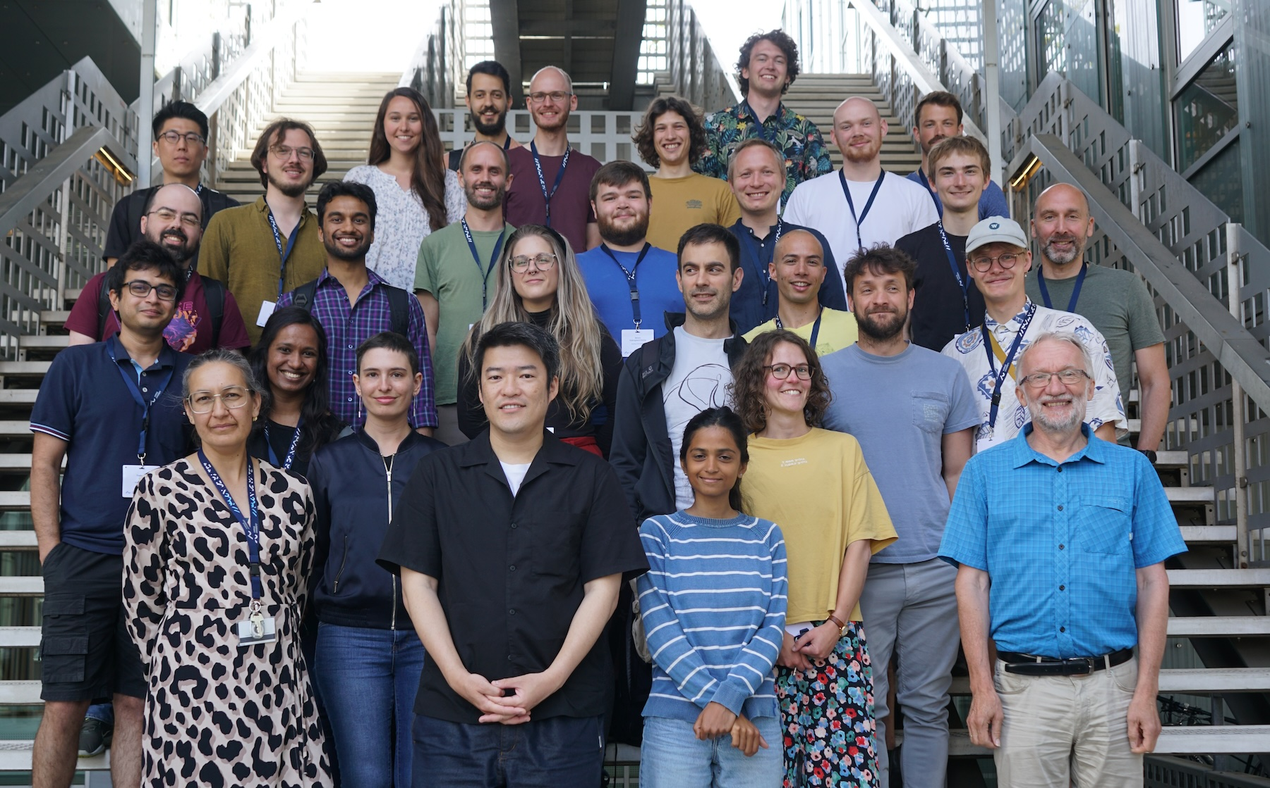
Projects from the Cryptography and Security Group

Slide 2
Types of project
Privacy enhancing tech. Given some practical goal. Example: do an electronic election.
Naïve, non-private/non-secure solution easy. Example: send all votes to one server, tallies and broadcasts result.
In project, design and implement a better solution, with better protection of privacy and correctness.
Will often proceed in steps: start simple and extend to protect against more and more attacks.
Attacks on systems: understand the attack, verify it works by implementing, put in perspective (was the attack a significant problem? what was done about it in real life?)
Theoretical projects (no coding) are also possible, expect to use lots of time on reading.
Your own ideas welcome! Contact us early if you have an idea.
For a complete list of project ideas, see the document on-line.

Slide 3
What happens now?
If you want a project in cryptography, please sign up as soon as possible!
When we have most/all slots filled, Ivan will contact you and ask about your preferences.
Once we know your wishes/ideas, you will be assigned a supervisor.

