Slide 1
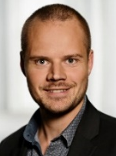
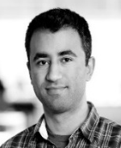
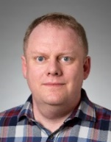

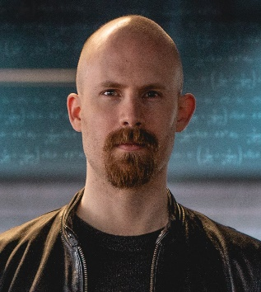
Bachelor projects in Algorithms
A typical BSc project (and MSc thesis) consists of
reading and understanding in depth one or more research papers
getting an overview of related results in the literature
implementing one or more algorithms / data structures
experimental evaluation of the implementation
writing a report summarizing all the above, incl. rephrasing central theory
Depending on ambition of the project group and the progress during semester
technical complexity of algorithms considered
balance between theory / implementation / experimental evaluation
confirm known experiments / first implementation / novel research
project description adjusted based on progress
Kasper
Peyman
Gerth
Courses | BSc | Algorithms and Data Structures (CS, 1st semester, Brodal) Computer Architecture, Networks and Operating Systems (CS & IT 4th semester, Afshani) Machine Learning (CS, 5th semester, Larsen) Introduction to Programming with Scientific Applications (non-CS, Brodal)
 | MSc | Computational Geometry: Theory and Experimentation (CS, 1st semester, Afshani) Randomized Algorithms (CS, 2nd semester, Larsen) Cluster Analysis (CS, 2nd semester, Schwiegelshohn)
Andrea
Chris

Slide 2
, Peyman Afshani associate professor Computational geometry External memory algorithms
Gerth Stølting Brodal professor Data structures External memory algorithms
Geometric Algorithms
Data set corresponds to points in Euclidean space.
Design algorithms and data structures exploiting geometry.
Problems offered:
Closest Points
Recreate and implement optimal algorithms for 2D and 3D
Coresets for Minimum Enclosing Ball.
Find a sphere with minimum radius covering points
Crossover with scalable algorithms: be fast when number of points or dimension are large
Shortest Paths on Open Street Map
Do a better job than Google Maps

Slide 3
Kasper Green Larsen associate professor Data structures Lower bounds
Chris Schwiegelshohn assistant professor Machine learning Dimension reduction
Scalable Algorithms
Streaming model:
Data points are submitted one after another.
Answer questions about the data, but do not store the entire data set.
Different degrees of difficulty depending on problem, type of data, type of updates, etc.
Problems offered:
Connectivity:
receive edge updates
decide whether a graph is connected
Distinct Elements:
receive updates to a vector
decide how many non-zero entries the vector has
Min-Cut
receive edge updates
find a good 2-clustering

