Slide 1
Bachelor Projects 2025
Computational Complexity and Game Theory

Slide 2
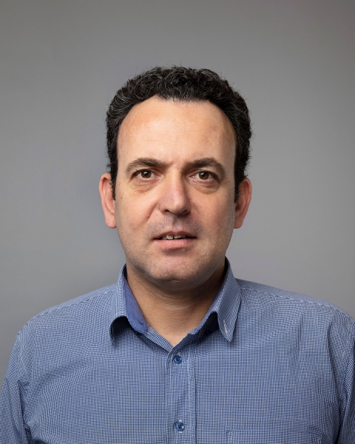
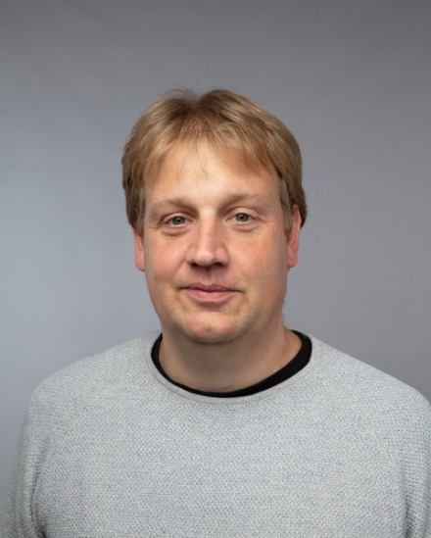
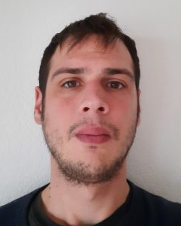
People
Ioannis Caragiannis
Kristoffer Arnsfelt Hansen
Stratis Skoulakis

Slide 3
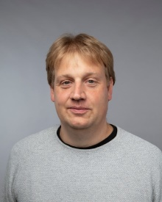
Courses
Randomized Algorithms (spring, graduate)
Algorithms, Incentives, and Data (fall, graduate)
Ioannis
Optimization (spring, bachelor)
Theory of Algorithms and Computational Complexity (fall, graduate)
Kristoffer
Just Hired ☺
Stratis

Slide 4
Projects
Fair division algorithms, Participatory Budgeting, Financial Networks
Ioannis
Gradient descent, Linear Complementarity Problems
Kristoffer
Reinforcement Learning, Online Learning and Assembly of Calculus
Stratis

Slide 5
Final remarks
Projects can be tailored to suit your interests!
We are on Nygaard 3rd floor (387, 389 & 398). Come by and say Hi!
You are welcome to bring your own ideas for projects or just your thoughts about what you are interested in.

