Slide 1
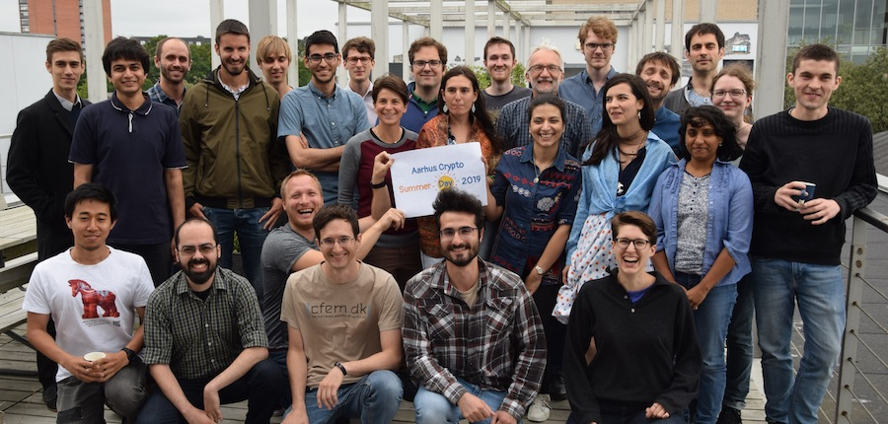
Projects from the Cryptography and Security Group

Slide 2
Example project idea
Build an electronic voting system
Start by implementing a very simple solution concept you will be given, to get a not very secure system.
Extend the system in various ways to get security against more types of attacks.
If time and ambition permits, study literature to extend you system even more, compare to other solutions.
We also have a couple of project ideas that are about attacks on systems: understand the attack, verify it works by implementing, put in perspective (was the attack a significant problem? what was done about it in real life?)
Theoretical projects (no coding) are also possible, expect to use lots of time on reading.
Your own ideas welcome! Contact us early if you have an idea.
For a complete list of project ideas, see the document on-line.

Slide 3
What happens now?
If you want a project in Crypto, please sign up as soon as possible.
When we have most/all slots filled, Ivan will contact you and ask about your preferences.
Once we know your wishes/ideas, you will be assigned a supervisor.

