Slide 1
Human-Centered Computing
Bachelor Projects

Slide 2

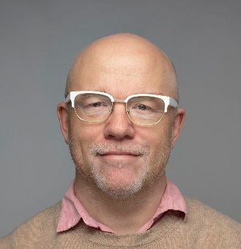
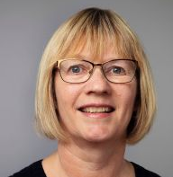
Overview: HCC @ CS
Research Area: Human aspects of computing
Faculty: 5x Professors
          6x Associate Professors
          2x Assistant Professors
Postdocs: 10 postdocs
Students: 16 Ph.D. students
Niklas Elmqvist
Professor and Head of Section
✉️ elm@cs.au.dk
📞 +45 21 77 79 00
Marianne Dammand Iversen
Section Manager
✉️ dammand@cs.au.dk
📞 +45 24 47 11 17
https://cs.au.dk/research/section-on-human-centered-computing

Slide 3

Society
DEVICES & SPACE
💻Devices
🌡️ Sensors & Actuators
🥽 XR & Spatial Computing
🏠 Physical Context
Devices
People
PEOPLE
👀 Perception
🧠 Cognition
🏃‍♂️ Behavior
❤️ Needs
DATA & SOCIETY
🤝 Teams
💬 Communication
📈 Data & Models
🤖 Human-Centered AI
☁️ Infrastructure
🏛️ Society & Institutions

Slide 4
Society
DEVICES & SPACE
💻Devices
🌡️ Sensors & Actuators
🥽 XR & Spatial Computing
🏠 Physical Context
Devices
People
PEOPLE
👀 Perception
🧠 Cognition
🏃‍♂️ Behavior
❤️ Needs
DATA & SOCIETY
🤝 Teams
💬 Communication
📈 Data & Models
🤖 Human-Centered AI
☁️ Infrastructure
🏛️ Society & Institutions

Slide 5
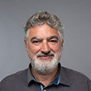
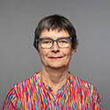



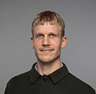
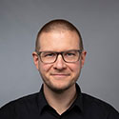



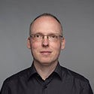

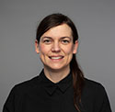
Olav W. Bertelsen
(Associate Professor)
Participatory Design, Computer Supported Collaborative Work
Susanne Bødker (Professor)
Participatory Design, Computer Supported Collaborative Work, Interaction Design
Niklas Elmqvist (Professor)
Data Visualization, Visual Analytics, Human-Centered AI
Hans Gellersen (Professor)
Ubiquitous Computing, Gaze Interaction
Marianne Graves Pedersen (Professor)
Shape-Changing Interfaces, Tangible Interaction, Child-Computer Interaction
Jens Emil Grønbæk
(Assistant Professor)
Proxemics, Mixed Reality Collaboration
Clemens Nylandsted Klokmose (Associate Professor)
HCI, Interactive Systems
Tobias Langlotz (Professor)
Augmented Reality, Visual Computing, Vision Augmentation
Ken Pfeuffer (Associate Professor)
Eye Tracking, Ubiquitous Computing, Gaze Interaction
Eve Hoggan (Associate Professor)
Multimodal Interaction, Mobile Interaction, CSCW
Hans-Jörg Schulz
(Associate Professor)
: Visual Analytics, Data Visualization, Human-Data Interaction
Michael Wessely
(Assistant Professor)
Fabrication, Engineering,
Interactive Systems
Stefanie Zollmann
(Associate Professor)
Visual Computing, Visualization, Augmented Reality, XR, Computer Graphics

Slide 6
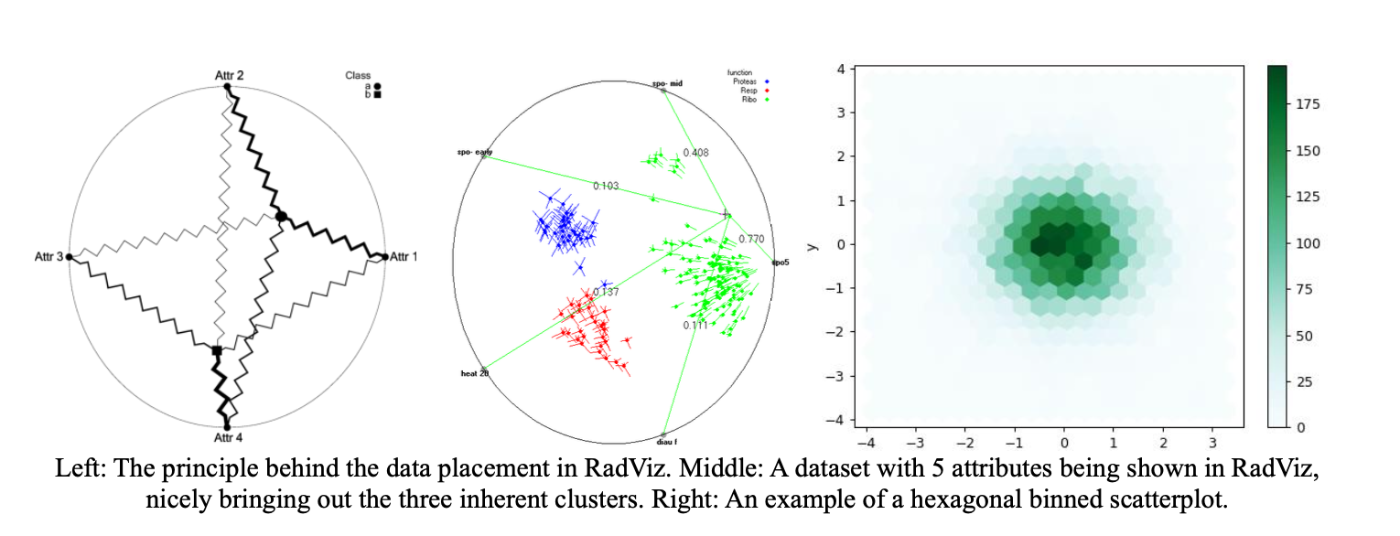
Human-Data Interaction
Hans-Jörg Schulz
Binned RadViz Visualisation
Interaction Techniques for the Triangulation Model

Slide 7
VR and AR
Stefanie Zollmann
Perceptually-Aware Foveated Rendering in VR
Stable VR360 Outpainting
Comparing Plane-Based 3D Selection Techniques in Augmented Reality
Exploration Of Interaction Techniques In XR
Virtual Tourism
Niklas Elmqvist
Ken Pfeuffer
Tobias Langlotz

Slide 8
fabrication
Michael Wessely
Generative Parametric Design: Bridging LLMs and 3D Manufacturing
Flexible, Soft, Skin-Mounted E-Ink Displays
Smart Sunglasses
Tobias Langlotz

Slide 9
Hybrid/remote collaboration
Clemens Klokmose
Generative Interfaces for AI-Augmented Meeting Histories
How can Mixed Reality blend different spaces for collaboration?
Mixed Reality Whiteboard Collaboration
Multimodal Physical Computing Interfaces for Mobile Hybrid Meetings
Jens Emil Grønbæk
Eve Hoggan

Slide 10
education
Marianne Graves Pedersen
Designing Tools for Cryptography Education
Tools, Activities and Resources for Education about Generative AI
Building Playful Educational Tools to Introduce Young People to Computer Science
Multimodal Declarative NetLogo Simulations
Clemens Klokmose

Slide 11
Critical design
Olav Bertelsen
Practical experiments with a Design Satire Card Deck

Slide 12
Information visualisation
Niklas Elmqvist
Accessibility in Dashboards
Monitoring Agency in Data Visualization Process

