Slide 1
Data-Intensive Systems
Bachelor project proposals 2025
Akhil Arora, Davide Mottin, and Ira Assent
Notes:
Hello Everyone and Good morning
My name is Akhil, and today, I will give you a brief overview of the Bachelor projects offered by the Data-Intensive Systems Group, highlighting why you should work with us ☺.

Slide 2
Our research group
Our interests
Data management, data science, natural language processing, machine learning, computational social science, and artificial intelligence
Models and algorithms
Efficiency, scalability, and interpretability
Our methods
Formalize real-world problems
Devise concepts and algorithmic solutions
Evaluate empirically
Our tools and results
Theoretical analysis, meaningful insights, and prototype implementations
Notes:
Interests:
Our group is highly interdisciplinary: among the three of us, we have expertise in data management and data science, NLP, AI/ML, and CSS.
What ties us together? we design models and algorithms with a special focus on efficiency, scalability, and interpretability.
[Click] Methods: Our approach to problem solving involves the following three-step process:
Start in the wild, and map real-world problems to abstract CS problems
Devise models and algorithms to solve the problem, and
then evaluate their effectiveness empirically.
[Click] Usual artefacts generated from our research include, but are not limited to, theoretical analysis, meaningful insights from raw data, and prototype implementations/tools.

Slide 3



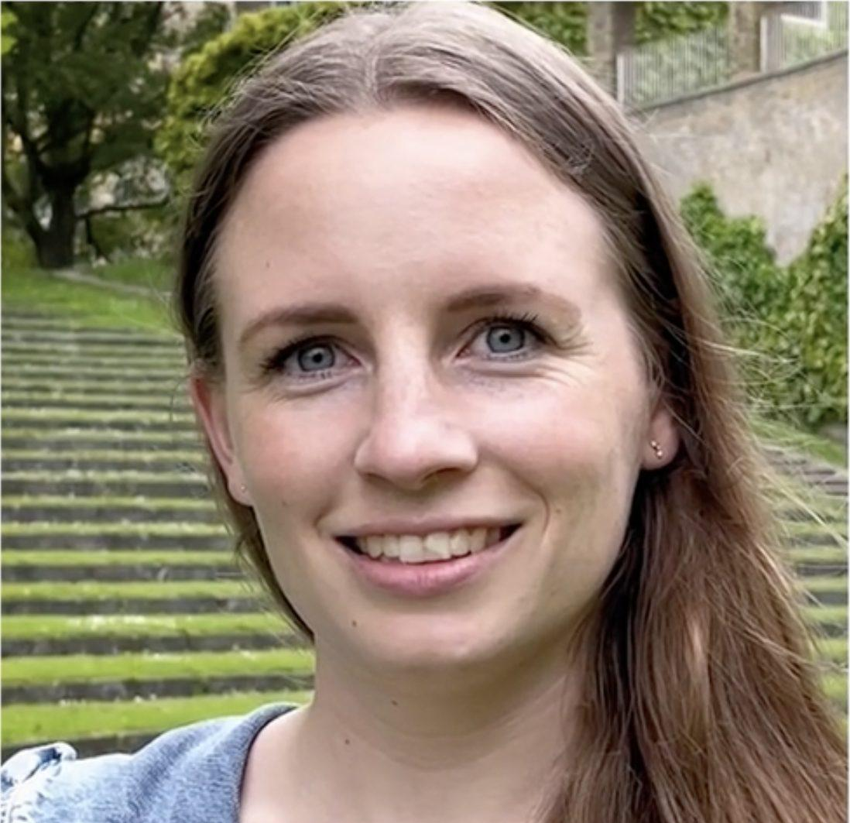



Our great supervisory team
Zhiqiang Zhong
Postdoc
Anders Sandholm
Google Prod. Man.
Kasper Overgaard Mortensen
PhD student
Amalie Brogaard Pauli
PhD student
Cheng Huang
PhD student
Konstantinos Skitsas
PhD student
Nearchos Potamitis
Research Asssistant
Notes:
In addition to the professors in the group, here is our amazing team of co-supervisors with whom you will get a chance to work with should you choose a project from our group.

Slide 4
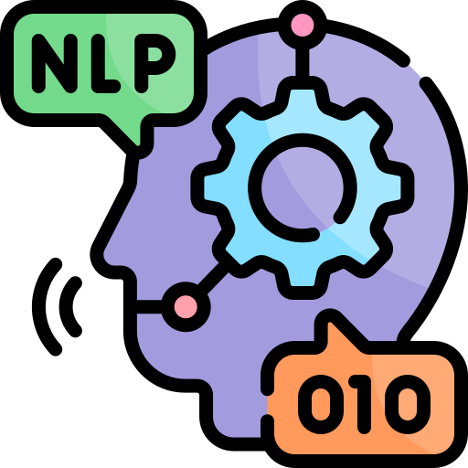

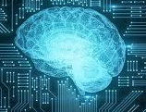

Projects in a Nutshell
Generative Quote Extraction from Online News using LLMs
EnSud: Entity Summarization Goes South
Reflective Fleet of Agents
Heterogeneous Fleet of Agents
Entity-insertion recommender for Wikipedia
Graph correspondences
Natural Language
Processing
Analysis of Generalized Zero-Shot Learning for Graph Machine Learning
CacheSaver: Efficient, Cost-effective Experimentation with LLMs
Cardinality Estimation with Multi-arm Bandits
Graph Mining Techniques for Large-Scale Datasets
Explainable AI
OANa: Old algorithms, new hardware
Artificial Intelligence
Graph Intelligence
Data Mining
Notes:
Enough publicity, now let’s get down to business!
I am sure most (and ideally all) of you have already read the detailed project descriptions, but here’s a zoomed-out bird’s eye view of the different projects offered and their role in the grand scheme of things, which should give you some perspective. The projects lie broadly in:
[Click] Graph Intelligence
[Click] AI
[Click] NLP and Data Mining

Slide 5



Graph Intelligence
Can we learn to describe an entity?
EnSud: Entity Summarization Goes South
Can we find correspondences between nodes of two different graphs?
Graph correspondences
Analysis of Generalized Zero-Shot Learning for Graph Machine Learning
How to design Generalized Zero-shot Graph ML methods?
Can graph-based clustering improve large-scale model training?
Graph Mining Techniques for Large-Scale Datasets
Notes:
Graphs are one of the most powerful ways of representing most real-world data, in fact, I am not exaggerating if I say graphs are ubiquitous: from the Web, to public transport systems, and from Genes to Chemical Compounds, we are surround by graph-shaped data.
Our group offers you the opportunity to work on real-world problems on graph-shaped data:
[Click] ranging from devising models to summarize entity descriptions and identify correspondences between entities in knowledge graphs on the Web, to
[Click] developing methods to improve zero-shot graph ML and scaling-up graph ML models to massive Web-scale data.

Slide 6
Artificial Intelligence
How can we enhance the explainability of AI-powered models?
Explainable AI
Reflective Fleet of Agents
How can we design agent-based AI-reasoning frameworks for generalized problem solving?
Heterogeneous Fleet of Agents
CacheSaver: Efficient, Cost-effective Experimentation with LLMs
Can we design a generalized framework for efficient experimentation with LLMs?
Notes:
If you want to build an attractive profile for jobs in the IT industry today, you can’t shy away from AI (and most importantly LLMs).
Work with us on exciting directions, such as:
[Click] Improving the explainability of AI models,
[Click] Devising Agentic AI-powered reasoning frameworks, and
[Click] Developing methods/tools for improving LLM decoding and inference.

Slide 7
Data Mining
Can Bandits Estimate Cardinality?
Cardinality Estimation with Multi-arm Bandits
OANa: Old algorithms, new hardware
Can we devise extremely fast algorithms on futuristic hardware?
Notes:
AI and graphs don’t interest you, not to worry:
[Click] How about improving database optimizers, which are “still” the work horse behind most real-world systems in a variety of sectors such as banking, hospitals, public transport, and more. Or
[Click] Working on adapting classical algorithms to modern hardware (e.g. GPUs or TPUs)

Slide 8
Natural Language Processing
How to design effective knowledge maintenance tools for Wikipedia editors?
Entity-insertion recommender for Wikipedia
Can LLMs extract speaker-quotation pairs from online news articles?
Generative Quote Extraction from Online News using LLMs
Notes:
Not interested in data mining either, NLP comes to the rescue ☺. Come work with us on:
[Click] Desining tools for assisting humans maintain the largest source of open and free knowledge, i.e., Wikipedia, and get a chance to work with researchers from Wikipedia. OR
[Click] Develop a framework relying on LLMs to see what your favourite politician/actor/sportsperson is saying in online news articles and how’s the media portraying their quotations?

