Slide 1
Late submission:0
Total score: 98/100

Slide 2
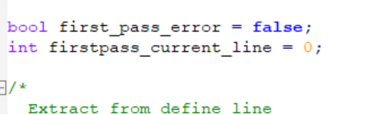

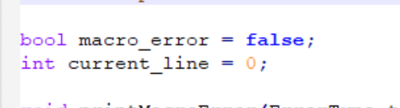
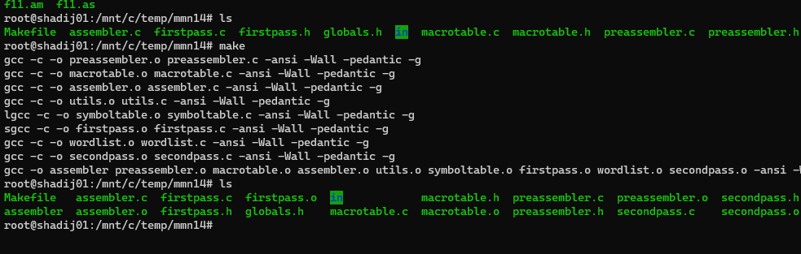
→ -2
Compilation and makeFile issues : passed
Code divided into files : passed
Code complexity/unclear : passed
Missing test files , readme file : passed
missing screen shots : -1
should compile with ansic and not c90 !!!
Use of global variables: -1

Slide 3
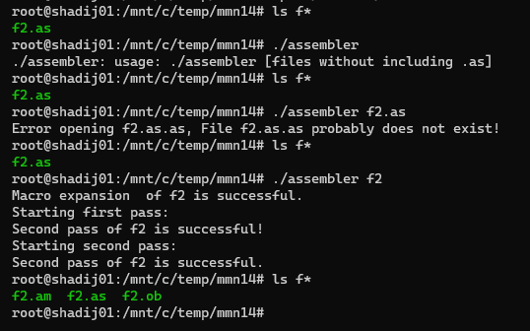
passed
program should run with input files like “*.as” by sending the file name only without the extension!: passed
e.g. correct run : ./assembler f1 f2 … : only if file extension is “as” the program should run
For ./assembler f2.as … program should generate an error. :
legal run : ./assembler f2 (without file extension)
Wrong names of output files: passed

Slide 4
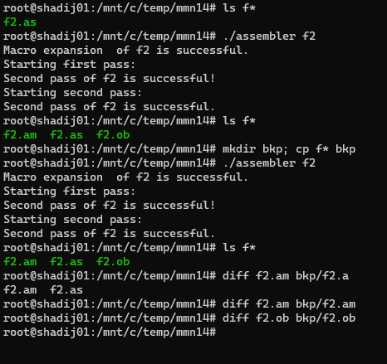
passed
Running same input file multiple times
Output should be similar for multiple runs of same input file.
Input: f2.as
Run below twice
./assembler f2
./assembler f2
f2.as:
MAIN: mov X, W
mov r2, r3
END: hlt
W: .data 22
X: .data -1

Slide 5
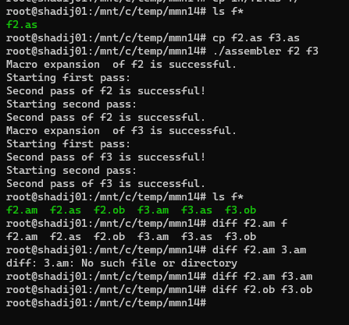
passed
running a program with multiple input files: passed
output should be similar for both output files..
Input: f2.as and f3.as are identical
Infit loop : passed

Slide 6
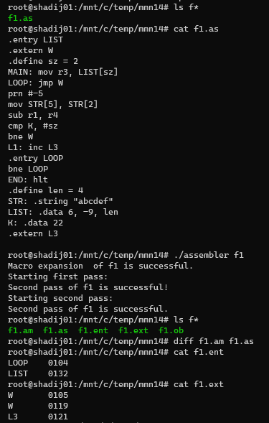
f1.ob (expected):
25 11
0100 ****!%*
0101 ***#%**
0102 **%*#*%
0103 *****%*
0104 **%#*#*
0105 ******#
0106 **!****
0107 !!!!%!*
0108 ****%%*
0109 **#!!#%
0110 ****##*
0111 **#!!#%
0112 *****%*
0113 ***!!!*
0114 ****!**
0115 ***##**
0116 **%*#!%
0117 *****%*
0118 **%%*#*
0119 ******#
0120 **#!*#*
0121 ******#
0122 **%%*#*
0123 **#%%*%
0124 **!!***
0125 ***#%*#
0126 ***#%*%
0127 ***#%*!
0128 ***#%#*
0129 ***#%##
0130 ***#%#%
0131 *******
0132 *****#%
0133 !!!!!#!
0134 *****#*
0135 ****##%
passed
output ob/ent/ext/am files : passed
XX.am file should be identical to origin XX.as file: passed
→ Input: f1.as
Expected
output
f1.ent (expected):
LOOP 0104
LIST 0132
f1.ob (student output):
25 11
0100 ****!%*
0101 ***#%**
0102 **%*#*%
0103 *****%*
0104 **%#*#*
0105 ******#
0106 **!****
0107 !!!!%!*
0108 ****%%*
0109 **#!!#%
0110 ****##*
0111 **#!!#%
0112 *****%*
0113 ***!!!*
0114 ****!**
0115 ***##**
0116 **%*#!%
0117 *****%*
0118 **%%*#*
0119 ******#
0120 **#!*#*
0121 ******#
0122 **%%*#*
0123 **#%%*%
0124 **!!***
0125 ***#%*#
0126 ***#%*%
0127 ***#%*!
0128 ***#%#*
0129 ***#%##
0130 ***#%#%
0131 *******
0132 *****#%
0133 !!!!!#!
0134 *****#*
0135 ****##%
f1.ext (expected):
W 0105
W 0119
L3 0121
f1.as:
.entry LIST
.extern W
.define sz = 2
MAIN: mov r3, LIST[sz]
LOOP: jmp W
prn #-5
mov STR[5], STR[2]
sub r1, r4
cmp K, #sz
bne W
L1: inc L3
.entry LOOP
bne LOOP
END: hlt
.define len = 4
STR: .string "abcdef"
LIST: .data 6, -9, len
K: .data 22
.extern L3
f1.am
.entry LIST
.extern W
.define sz = 2
MAIN: mov r3, LIST[sz]
LOOP: jmp W
prn #-5
mov STR[5], STR[2]
sub r1, r4
cmp K, #sz
bne W
L1: inc L3
.entry LOOP
bne LOOP
END: hlt
.define len = 4
STR: .string "abcdef"
LIST: .data 6, -9, len
K: .data 22
.extern L3
f1.am (expected)
.entry LIST
.extern W
.define sz = 2
MAIN: mov r3, LIST[sz]
LOOP: jmp W
prn #-5
mov STR[5], STR[2]
sub r1, r4
cmp K, #sz
bne W
L1: inc L3
.entry LOOP
bne LOOP
END: hlt
.define len = 4
STR: .string "abcdef"
LIST: .data 6, -9, len
K: .data 22
.extern L3

Slide 7
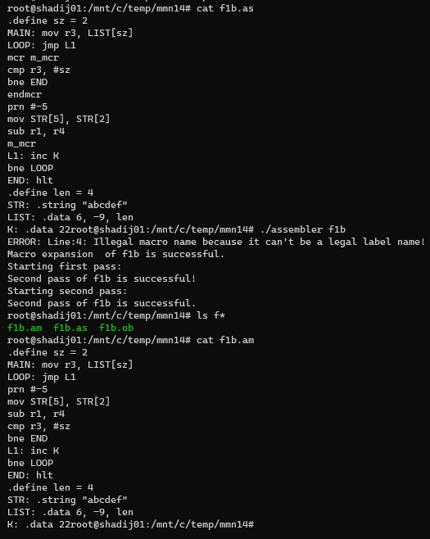
passed
Output: passed
ext/ent files should not be created: passed
Input: f1b.as
f1b.ob (student output):
25 11
0100 ****!%*
0101 ***#%**
0102 **%*#*%
0103 *****%*
0104 **%#*#*
0105 **#!%*%
0106 **!****
0107 !!!!%!*
0108 ****%%*
0109 **#!!#%
0110 ****##*
0111 **#!!#%
0112 *****%*
0113 ***!!!*
0114 ****!**
0115 ***#!**
0116 ***#%**
0117 *****%*
0118 **%%*#*
0119 **#!!*%
0120 **#!*#*
0121 **%*#!%
0122 **%%*#*
0123 **#%%*%
0124 **!!***
0125 ***#%*#
0126 ***#%*%
0127 ***#%*!
0128 ***#%#*
0129 ***#%##
0130 ***#%#%
0131 *******
0132 *****#%
0133 !!!!!#!
0134 *****#*
0135 ****##%
Expected output
f1b.ob (expected):
25 11
0100 ****!%*
0101 ***#%**
0102 **%*#*%
0103 *****%*
0104 **%#*#*
0105 **#!%*%
0106 **!****
0107 !!!!%!*
0108 ****%%*
0109 **#!!#%
0110 ****##*
0111 **#!!#%
0112 *****%*
0113 ***!!!*
0114 ****!**
0115 ***#!**
0116 ***#%**
0117 *****%*
0118 **%%*#*
0119 **#!!*%
0120 **#!*#*
0121 **%*#!%
0122 **%%*#*
0123 **#%%*%
0124 **!!***
0125 ***#%*#
0126 ***#%*%
0127 ***#%*!
0128 ***#%#*
0129 ***#%##
0130 ***#%#%
0131 *******
0132 *****#%
0133 !!!!!#!
0134 *****#*
0135 ****##%
f1b.ent (expected):
Should not be created
f1b.as:
.define sz = 2
MAIN: mov r3, LIST[sz]
LOOP: jmp L1
mcr m_mcr
cmp r3, #sz
bne END
endmcr
prn #-5
mov STR[5], STR[2]
sub r1, r4
m_mcr
L1: inc K
bne LOOP
END: hlt
.define len = 4
STR: .string "abcdef"
LIST: .data 6, -9, len
K: .data 22
f1b.ext (expected):
Should not be created
f1b.am .define sz = 2
MAIN: mov r3, LIST[sz]
LOOP: jmp L1
prn #-5
mov STR[5], STR[2]
sub r1, r4
cmp r3, #sz
bne END
L1: inc K
bne LOOP
END: hlt
.define len = 4
STR: .string "abcdef"
LIST: .data 6, -9, len
f1b.am: (expected)
.define sz = 2
MAIN: mov r3, LIST[sz]
LOOP: jmp L1
prn #-5
mov STR[5], STR[2]
sub r1, r4
cmp r3, #sz
bne END
L1: inc K
bne LOOP
END: hlt
.define len = 4
STR: .string "abcdef"
LIST: .data 6, -9, len
K: .data 22

Slide 8
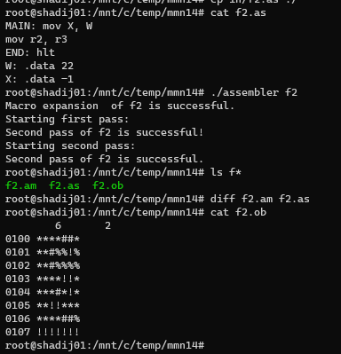
passed
Output: passed
Input : f2.as
Expected output
f2.ent (expected):
Should not be created
f2.ob (expected):
6 2
0100 ****##*
0101 **#%%!%
0102 **#%%%%
0103 ****!!*
0104 ***#*!*
0105 **!!***
0106 ****##%
0107 !!!!!!!
f2.ext (expected):
Should not be created
f2.as:
MAIN: mov X, W
mov r2, r3
END: hlt
W: .data 22
X: .data -1
f2.ob (student output):
6 2
0100 ****##*
0101 **#%%!%
0102 **#%%%%
0103 ****!!*
0104 ***#*!*
0105 **!!***
0106 ****##%
0107 !!!!!!!

Slide 9
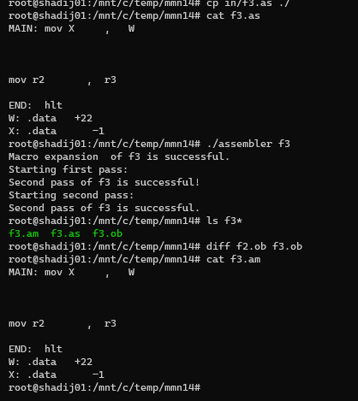
passed
Check spaces (empty lines) : passed
Output should be similar to f2.ob
→ Input: f3.as
f3.ob (expected):
6 2
0100 ****##*
0101 **#%%!%
0102 **#%%%%
0103 ****!!*
0104 ***#*!*
0105 **!!***
0106 ****##%
0107 !!!!!!!
f3.ent (expected):
Should not be created
Expected output
f3.ext (expected):
Should not be created
f3.as:
MAIN: mov X , W
mov r2 , r3
END: hlt
W: .data +22
X: .data -1
f3.ob (student output)
6 2
0100 ****##*
0101 **#%%!%
0102 **#%%%%
0103 ****!!*
0104 ***#*!*
0105 **!!***
0106 ****##%
0107 !!!!!!!

Slide 10
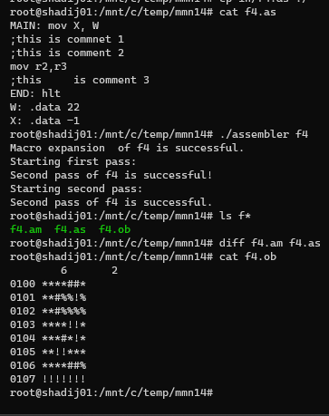
passed
Check comments : passed
XX.am file should be identical to origin XX.as file: passed
Output should be similar to f2.ob
→ Input: f4.as
Expected output
f4.ob (expected):
6 2
0100 ****##*
0101 **#%%!%
0102 **#%%%%
0103 ****!!*
0104 ***#*!*
0105 **!!***
0106 ****##%
0107 !!!!!!!
f4.ent (expected):
Should not be created
f4.ext (expected):
Should not be created
f4.as:
MAIN: mov X, W
;this is commnet 1
;this is comment 2
mov r2,r3
;this is comment 3
END: hlt
W: .data 22
X: .data -1
f4.ob (student output):
6 2
0100 ****##*
0101 **#%%!%
0102 **#%%%%
0103 ****!!*
0104 ***#*!*
0105 **!!***
0106 ****##%
0107 !!!!!!!

Slide 11
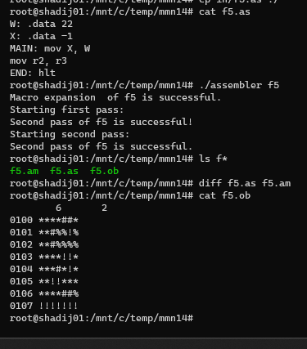
passed
Check when data appears in the beginning of the program: passed
Output should be similar to f2.ob
→ Input: f5.as
Expected output
f5.ent (expected):
Should not be created
f5.ob (expected):
6 2
0100 ****##*
0101 **#%%!%
0102 **#%%%%
0103 ****!!*
0104 ***#*!*
0105 **!!***
0106 ****##%
0107 !!!!!!!
f5.ext (expected):
Should not be created
f5.ob (student output):
6 2
0100 ****##*
0101 **#%%!%
0102 **#%%%%
0103 ****!!*
0104 ***#*!*
0105 **!!***
0106 ****##%
0107 !!!!!!!
f5.as:
W: .data 22
X: .data -1
MAIN: mov X, W
mov @r2, @r3
END: stop

Slide 12
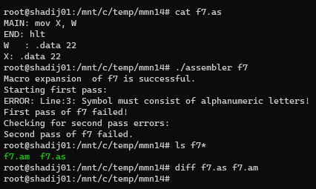
→ passed
Check illegal space after label e.g. ‘W :’ → passed
Expected output → Error message: passed
output files should not be created while error is detected → passed
→ Input: f7.as
f7.as:
MAIN: mov X, W
END: hlt
W : .data 22
X: .data 22

Slide 13
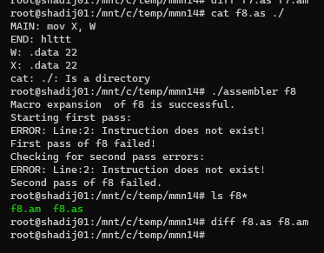
→ passed
handling unexpected command “hlttt” → passed
output files should not be created while error is detected: passed
Input: f8.as
Expected output : error message
f8.as:
MAIN: mov X, W
END: hlttt
W: .data 22
X: .data 22

Slide 14
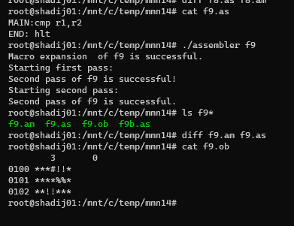
passed
check if no space after “:” - MAIN:cmp is legal instruction → passed
Expected output: no error . Instruction is legal: passed
→ Input: f9.as
f9.ob (expected):
3 0
0100 ***#!!*
0101 ****%%*
0102 **!!***
f9.ent (expected):
Should not be created
f9.ext (expected):
Should not be created
f9.as:
MAIN:cmp r1,r2
END: hlt
f9.obj (student output):
3 0
0100 ***#!!*
0101 ****%%*
0102 **!!***
Expected output

Slide 15
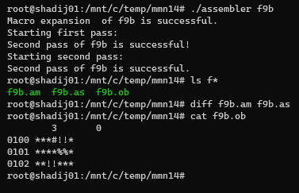
passed
check if space after “:”: passed
Check if no space between operands: passed
Expected output: no error . Input is legal
output: failed
→ Input: f9b.as
f9b.ent (expected):
Should not be created
f9b.ob (expected):
3 0
0100 ***#!!*
0101 ****%%*
0102 **!!***
f9b.ext (expected):
Should not be created
f9b.as:
MAIN: cmp r1,r2
END: hlt
Expected output
f9b.obj (student output):
3 0
0100 ***#!!*
0101 ****%%*
0102 **!!***

Slide 16
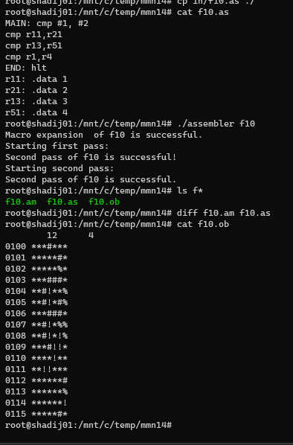
passed
Check legal label name r11,r21,r13,r51 → passed
Expected output : input is legal and output file should be created
→ Input: f10.as
f10.ob (expected):
12 4
0100 ***#***
0101 *****#*
0102 *****%*
0103 ***###*
0104 **#!**%
0105 **#!*#%
0106 ***###*
0107 **#!*%%
0108 **#!*!%
0109 ***#!!*
0110 ****!**
0111 **!!***
0112 ******#
0113 ******%
0114 ******!
0115 *****#*
f10.ent (expected):
Should not be created
Expected output
f10.ext (expected):
Should not be created
f10.obj (student output):
12 4
0100 ***#***
0101 *****#*
0102 *****%*
0103 ***###*
0104 **#!**%
0105 **#!*#%
0106 ***###*
0107 **#!*%%
0108 **#!*!%
0109 ***#!!*
0110 ****!**
0111 **!!***
0112 ******#
0113 ******%
0114 ******!
0115 *****#*
f10.as:
MAIN: cmp #1, #2
cmp r11,r21
cmp r13,r51
cmp r1,r4
END: hlt
r11: .data 1
r21: .data 2
r13: .data 3
r51: .data 4

Slide 17
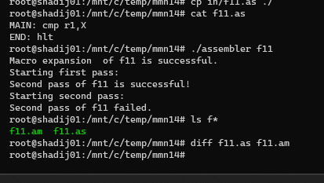
passed
check if missing label : passed
Expected output : error message
output file should not be created : passed
→ Input: f11.as
f11.ob (expected):
Shold not be creatd
Expected output
f11.ent (expected):
Should not be created
f11.as:
MAIN: cmp r1,X
END: hlt
f11.ext (expected):
Should not be created

