Slide 1


Slide 2
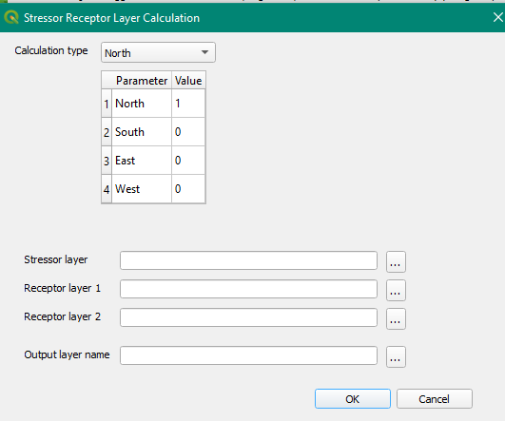
Example selector
Layer Selection

