Slide 1
Install
Install the latest version of the plugin as a zip file from \\pfs1w\C1300-C1399\C1308_MREA_Sandia\Working_Files\QGIS Plugin\stressor_receptor_calc.zip.
In QGIS go to Plugins – Manage and Install Plugins – Install from ZIP. Select the zip file referenced above in the path box and select Install. Select OK for any security warnings
The NetCDF Python library will need to be installed for QGIS. To install, navigate to C:\Program Files\QGIS 3.16\. Run OSGeo4W.bat as an Administrator
At the prompt enter py3_env and hit Enter. Then enter pip install netcdf4 and hit Enter

Slide 2
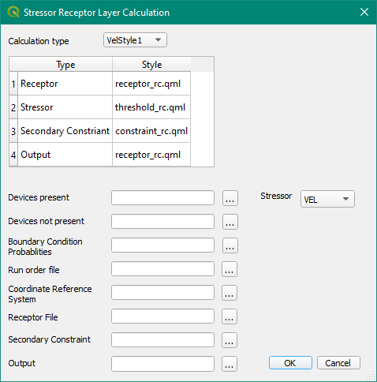
Image of Plugin Interface

Slide 3

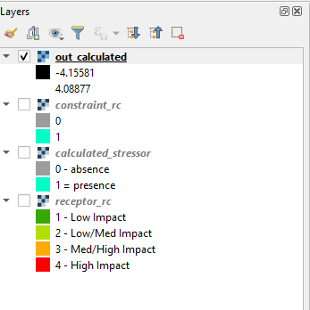
Velocity variable Oregon WEC trial map

Slide 4
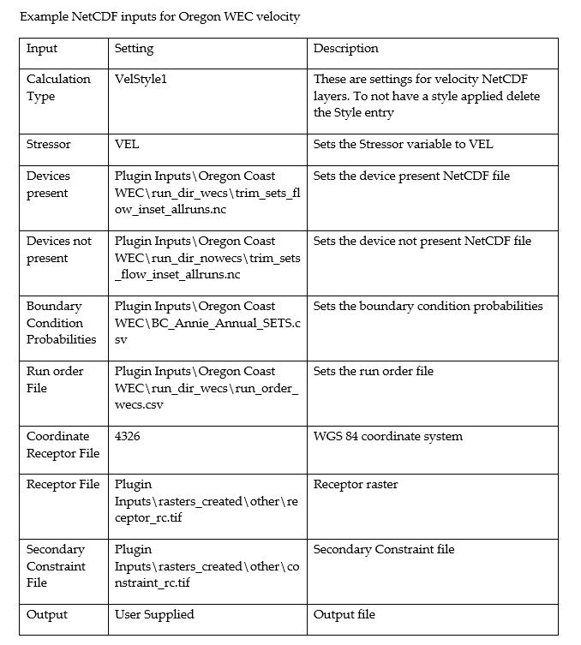
Velocity variable Oregon WEC table of inputs

Slide 5
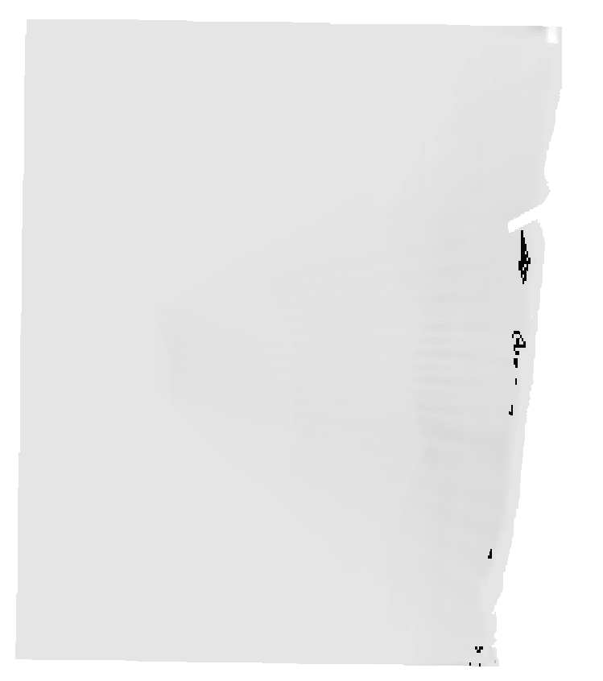
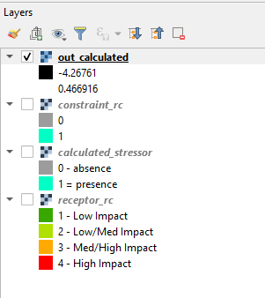
Taumax variable Oregon WEC trial map

Slide 6
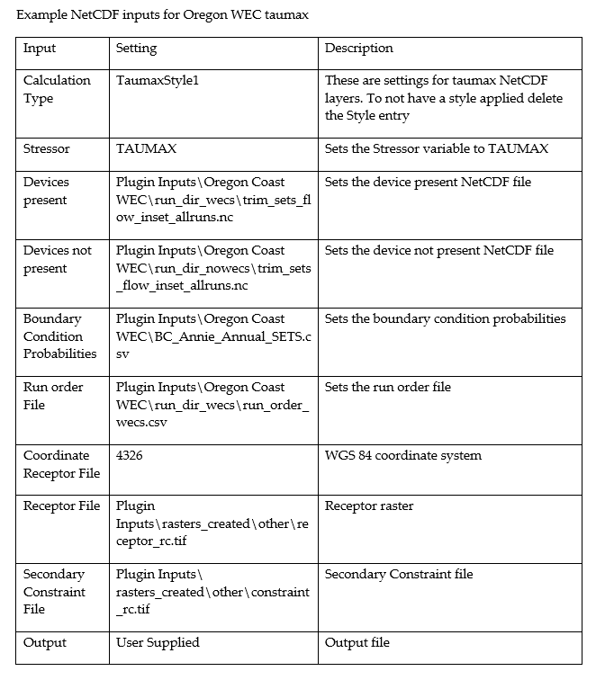
Taumax variable Oregon WEC table of inputs

Slide 7
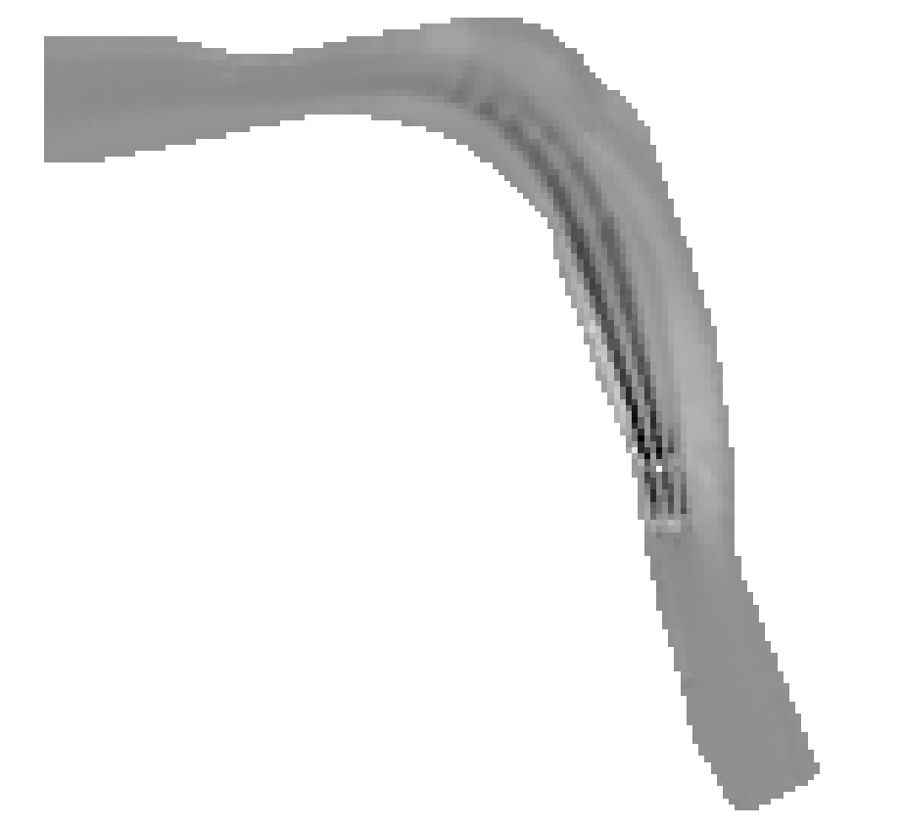
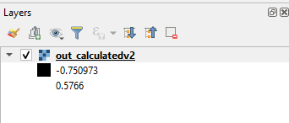
Difference map of one set of Tanana WEC runs (100 year with-without)

Slide 8
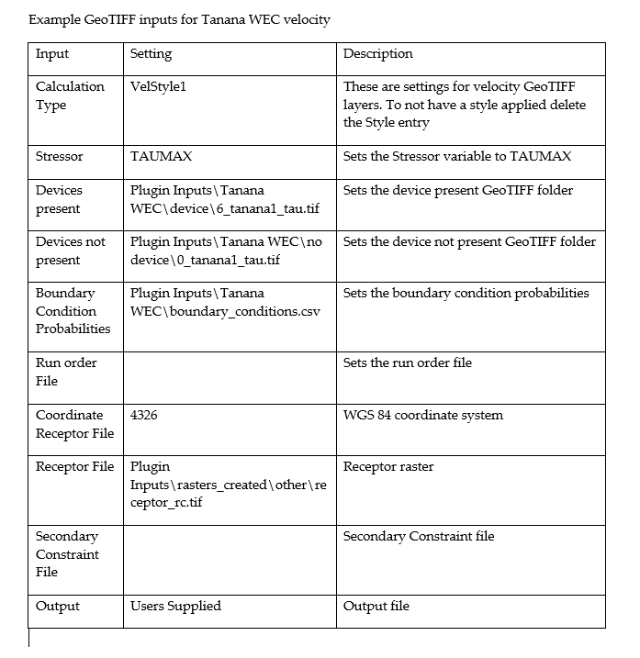
Difference map of one set of Tanana WEC runs (100 year with-without) table of inputs

