Slide 1
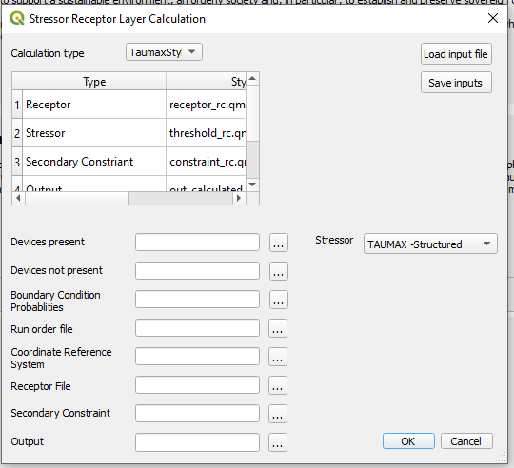
Please resize or allow for dynamic sizing (drag larger) so that boxes display complete menu options
Change Name to “Spatial Environmental Assessment Tool”
Load GUI inputs
Save GUI inputs
Add Style to “Receptor, Stressor, etc.”
Device Model Results
Can we flip these?
Baseline Model Results
Model Probabilities File
Run Order Reference File
Coordinate Reference System
Receptor Layer
Secondary Constraint (Optional)
Output Layer

Slide 2
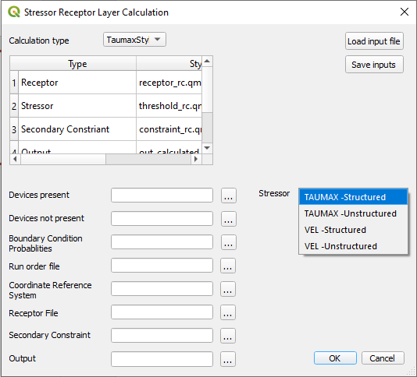
Please resize or allow for dynamic sizing (drag larger) so that boxes display complete menu options
Shear Stress-Delft3D-Flow
Shear Stress-Dflow-FM
Velocity-Delft3D-Flow
Velocity-Dflow-FM

Slide 3
Metadata
Style files for data display
“Model results with marine energy devices present”- netcdf file or folder of files
Stressor type and model type. Delft3D-Flow is structured model results
Dflow-FM is unstructured model results.
“Model results with marine energy devices present”- netcdf file or folder of files
Excel file of model runs and associated probabilities.
Run Order Reference File
Spatial Coordinate Reference System
Raster Layer of receptors
Secondary Constraint (Optional)
Output Layer

