Slide 1
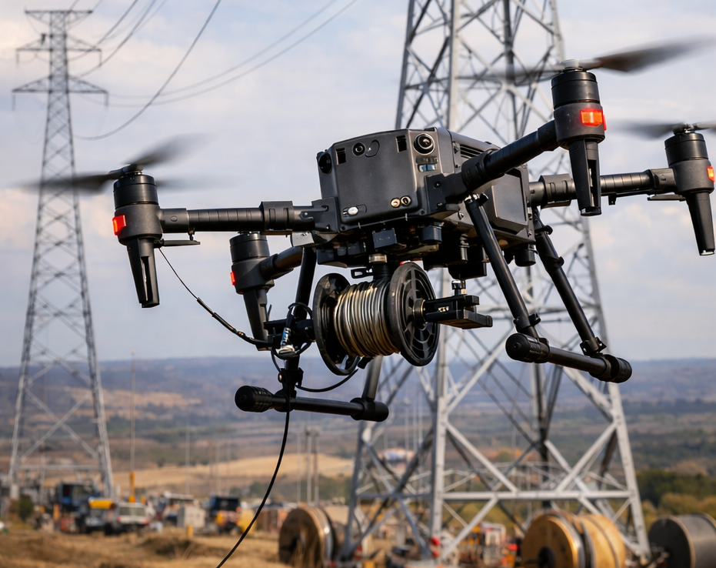
Milestone 0: Presentation
Oriol Bonet, Martí Alsina, Xavier Vilalta and Jan Font
Integrated Project II
Universitat de Vic

Slide 2
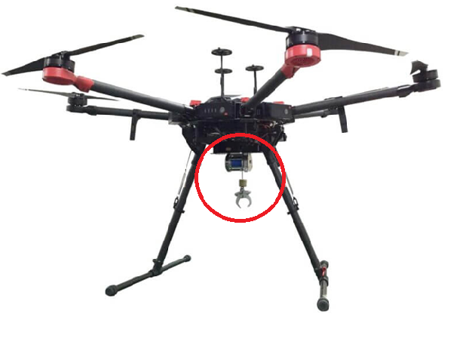
PROJECT PROPOSAL
Attachable hook for a drone
Cable Routing
Remote controlled

Slide 3
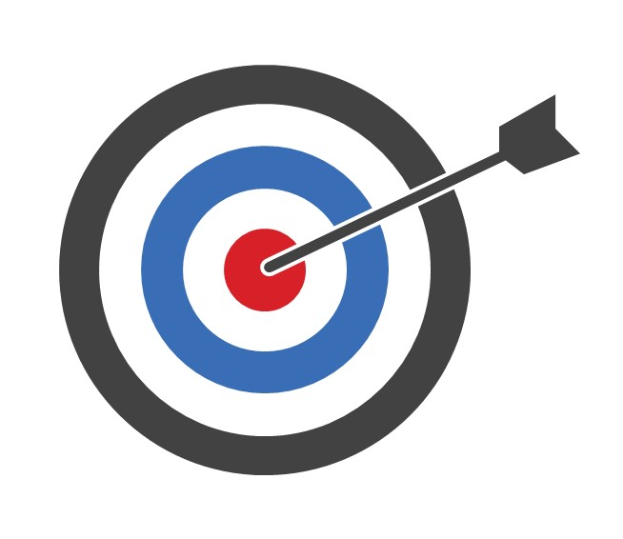
OBJECTIVES
Main objective
Assembly of a remote-controlled hook attachment
Specific objectives
Pulley system
Safety features

Slide 4




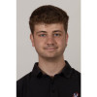
TEAM ORGANITZATION
Project leader ➔ Jan Font
Mechanical manager ➔ Martí Alsina
Electrical manager ➔ Oriol Bonet
Software manager ➔ Xavier Vilalta

Slide 5
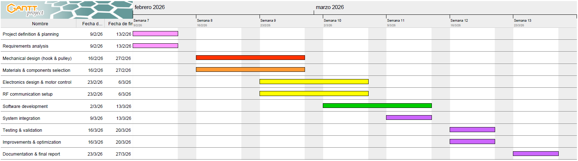
MANAGEMENT PLANNING
Project leader
Mechanical manager
Electrical manager
Software Manager
All members
Weekly review
Sprint Planning / Sprint Review

Slide 6

WEBSITE
https://github.com/Integrated-Project-2-2026-UVic-UCC/Team6

Slide 7
REFERENCES
Madsen, M. (2018). DJI Phantom 3 – Payload Dropper v2. https://www.thingiverse.com/thing:2913421
Drone Sky Hook. (n.d.). Dual Release and Drop PLUS for DJI Phantom 3. https://www.droneskyhook.com/product-page/Dual-Release-and-Drop-PLUS-for-DJI-Phantom-3
3Deddy. (2019). DJI Phantom 3 – Payload Dropper. https://www.thingiverse.com/thing:3953342

Slide 8
Thank you for your attention!

