Slide 1
Integrated Alarm System for the ALMA Observatory
Achitecture
Alessandro Caproni
ESO Software Development Division

Slide 2
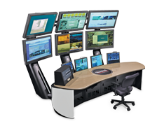


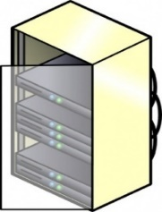
ALMA alarm systems
Operator panels
Integrated Alarm System
Alarms and monitor points
Software systems

Slide 3
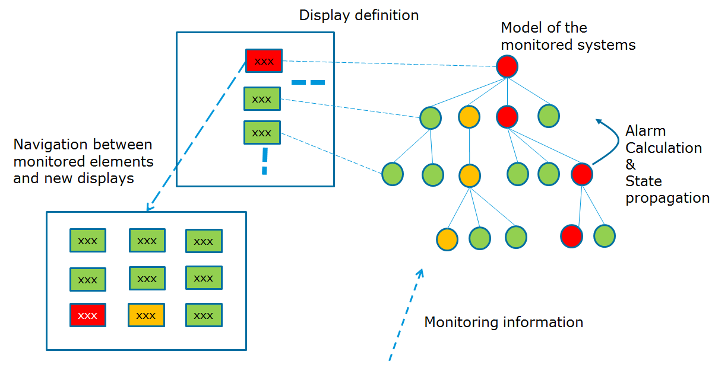
Development study

Slide 4
Current status
Vague and confused ideas
A growing prototype

Slide 5

IAS core – Distributed Alarm System Units
Outputs
DASUs
Inputs

Slide 6
IAS core – Alarm System Computing Elements
ASCE7
DASU
ASCE6
ASCE5
ASCE4
ASCE3
ASCE2
ASCE1
CONVERSION LAYER

Slide 7
IAS Core – Alarm System Computing Element
out
∑∑
out =∑_{1..n}(….)
Inputs sent on changes
out refreshed at a given time interval
Validity
Inputs and output share the same type
1
n

Slide 8
∑ (AKA Transfer Function)
∑ brief calculation on the inputs
∑ no remote access or I/O
∑ Dynamically load from CDB
Implementation
Java/scala
Python?
DSL?

Slide 9
ASCE state machine
INIT
Load TF
Init TF
initialized
HEALTHY
Run TF
shutdown
TF BROKEN
Idle
broken
slow
shutdown
TF SLOW
Run TF
normal
shutdown
SHUTDOWN
Shut down TF
shutdown
close
CLOSED

Slide 10
Putting all together
Server 2
Server 1
JVM1
JVM1
JVM2

Slide 11
Identifiers
DASU
ASCE7
ARRAY01@
LOCKED@ASC5@ARRAY01
ASCE6
ASC4@ARRAY01
ASCE5
ASCE4
TEMP@DBCONVERTER@ARRAY01
ASCE3
ASCE2
ASCE1
DBCONVERTER@ARRAY01
CURRENT@POWERP@PWDASU
CONVERSION PLUGIN

Slide 12
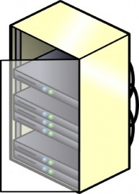

Communication with subsystems
Online
IAS server(s)
Weather
BSDB
Power plant

Slide 13
Communications
HIOs passing between ASCEs and DASUs
Commands (to DASUs, from GUIs..)
GUIs
(RTI)DDS?
Message passing (ZMQ, ActiveMQ..)?
Actors (Akka)?
…

Slide 14
Back stage DB
HIOs produced at run time
High load (reading/writing HIOs, logs, commands)
GUIs read HIOs from there
Cassandra already in use for monitoring seems a good candidate

Slide 15
Configuration DB
Stores HIOs, ASCE, DASUs configuration
Deployment configuration
A RDB suffices here (Oracle? Mysql?)
On files (JSON, XML..)?
Cassandra could be evaluated if we want to use only one technology

Slide 16
GUIs
Roles
Web server (JS, angular?)
Java FX for local (command line) GUIs
Google/apple notifications for mobile
Nice to have: support for mobile applications

Slide 17
Prototype
Infrastructure (ant, jenkins, git…)
scala, java, python, shell
Implementation
Logging
HIO types
ASCE with ∑ (scala/java)
DASU (on going)

Slide 18

That’s all!

Slide 19
∑ example: multiplicity
def eval(compInputs: Map[String, HeteroInOut], actualOutput: HeteroInOut): HeteroInOut = {
if (compInputs.size<threshold) throw new UnexpectedNumberOfInputsException(compInputs.size,threshold)
if (actualOutput.iasType!=ALARM) throw new TypeMismatchException(actualOutput.id.runningID,actualOutput.iasType,ALARM)
for (hio <- compInputs.values
if hio.iasType!=ALARM) throw new TypeMismatchException(actualOutput.id.runningID,hio.iasType,ALARM)
// Get the number of active alarms in input
var activeAlarms=0
val numOfActiveAlarms = for {
hio <- compInputs.values
alarmValue = hio.actualValue.get.value.asInstanceOf[AlarmValue]
if (alarmValue.alarmState==AlarmState.Active)} activeAlarms=activeAlarms+1
// Update the output
if (activeAlarms>=threshold) {
actualOutput.updateValue(AlarmValue.transition(actualOutput.actualValue.get.value.asInstanceOf[AlarmValue], new Set()))
} else {
actualOutput.updateValue(AlarmValue.transition(actualOutput.actualValue.get.value.asInstanceOf[AlarmValue], new Clear()))
}
}

