Slide 1
Mathematical Foundations
Machine learning – From Mathematical Foundations
Priya Lakshmi Narayanan PhD
Integrated Pathology Unit
Department of Cancer Biology
To Advanced Optimisation
A comprehensive overview of the key mathematical concepts and its association in image and data analytics
06 Nov 2025

Slide 2

Presentation Agenda
Mathematical foundation and applications
Interactive colab by examples
Linear algebra in histology
Use case

Slide 3
Overview: Core Mathematical Pillars
Linear Algebra - Vectors, matrices, and transformations
Calculus - Derivatives, gradients, and optimization
Probability Theory - Uncertainty and distributions
Statistics - Estimation and inference
Optimization - Finding optimal solutions
Information Theory - Measuring information and uncertainty
Processing for robust AI models
Machine Learning
Domain Adaptation
Computer Vision
Sparse coding
Optimization
Multi-center data harmonization
Data Science
Scalar is a single number (25°C), mass (5 kg), time (10 seconds), price (£50)
Vector is an array of numbers Notation: v = [v₁, v₂, v₃]
Matrix is a 2D array[[1 0 0] [0 0 -1] [0 1 0]]
Tensor is an n-dimensional array with n>2
[[[1, 2], [3, 2]], [[1, 7], [5, 4]]]
https://colab.research.google.com/github/IntegratedPathologyUnit-ICR/bioml_datascience

Slide 4
Learning lifecycle
The Learning Process
Forward pass: Input features x pass through our linear model
Prediction: Model outputs y
Loss calculation: We compute the error between predictions y and ground truth ŷ
Backward pass: The error signal propagates back to update model weights via gradient descent
Iteration: This cycle repeats until convergence
.
X
y
Ground truth (GT)
Learning function
ý
Prediction (PR)
Loss function
https://en.wikipedia.org/wiki/Precision_and_recall
Verma R,et al. MoNuSAC2020: A Multi-Organ Nuclei Segmentation and Classification Challenge. IEEE Transactions on Medical Imaging. 2021 Dec 1;40(12):3413-23.
Joseph J, Roudier MP, Narayanan PL, Augulis R, Ros VR, Pritchard A, Gerrard J, Laurinavicius A, Harrington EA, Barrett JC, Howat WJ. Proliferation Tumour Marker Network (PTM-NET) for the identification of tumour region in Ki67 stained breast cancer whole slide images. Scientific reports. 2019 Sep 6;9(1):12845.

Slide 5
Linear regression by example
The Task
How to predict linear relationship between x and y
x=[-1.0, 0.0, 1.0, 2.0, 3.0, 4.0] y = [-1.5, 0.0, 1.5, 3.0, 4.5, 6.0]
Using 6 training data points
Learn a linear relationship: y = 1.5x
Same random seed for different optimizers
Same initialized weights and bias for different optimizers
Convergence

Slide 6

Foundation examples from github
https://github.com/IntegratedPathologyUnit-ICR/bioml_datascience/blob/main/bioml_notebook_linear_algebra_example_pca.ipynb

Slide 7
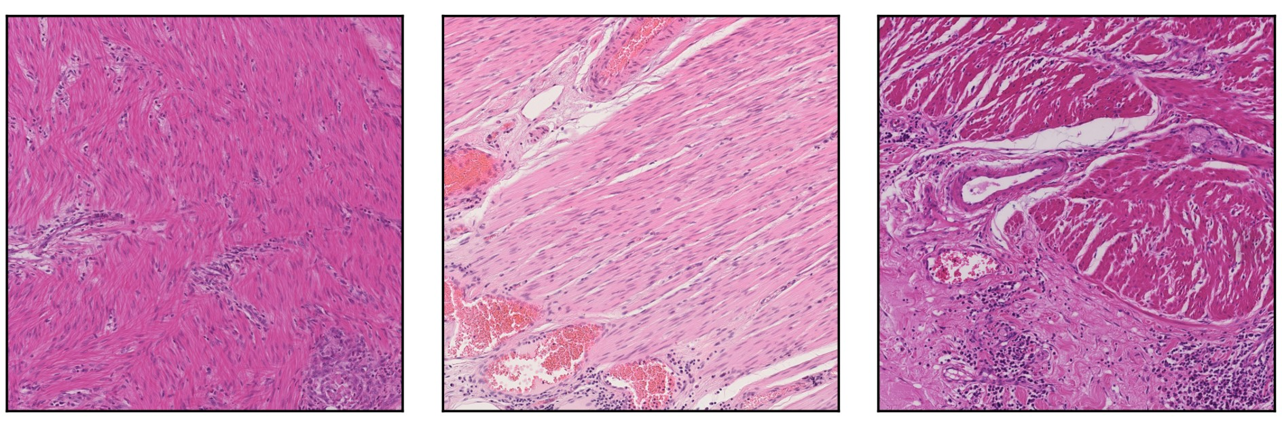
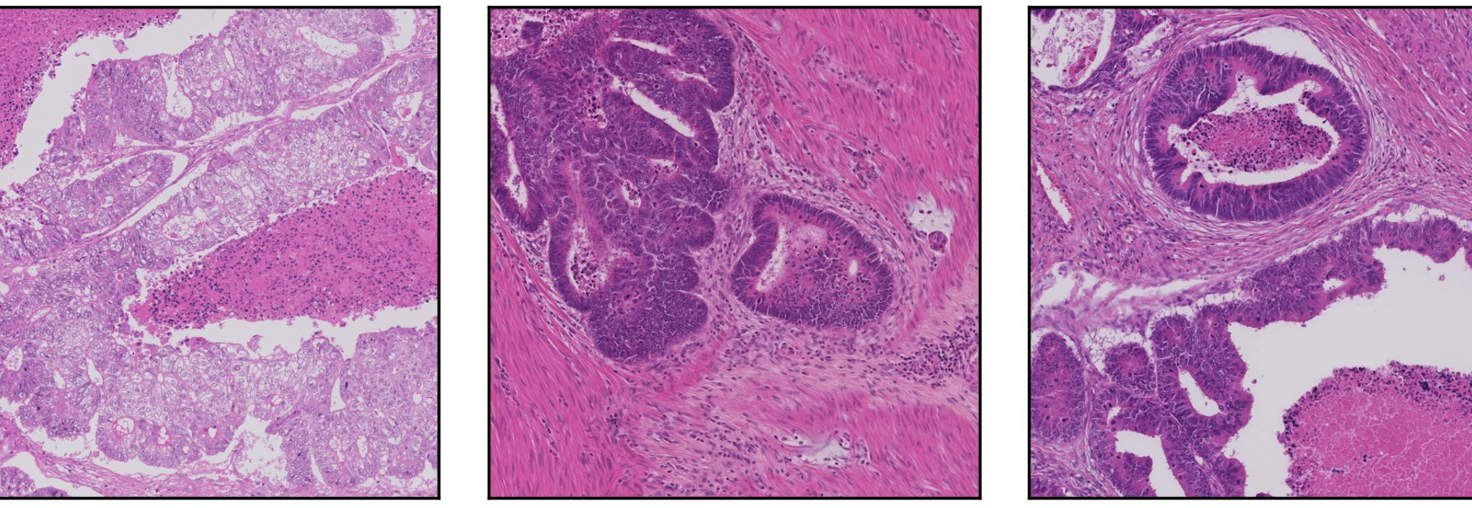
Understanding linear algebra behind histopathology
Medical Imaging Challenge
Tissue samples are stained with dyes and imaged for tissue based diagnosis
Hematoxylin Purple/Blue (stains cell nuclei -> DNA)
Eosin Pink/red (stains cytoplasm)
Key Insight: These are separate optical components that can be mathematically separated using linear algebra
Macenko, Marc et al. "A method for normalizing histology slides for quantitative analysis." 2009 IEEE International Symposium on Biomedical Imaging: From Nano to Macro. IEEE, 2009.

Slide 8
Mathematical Foundation: From RGB to OD
Beer-Lambert Law
Transform RGB to Optical Density: OD = -log(I / 255)
Covariance Matrix
Compute Σ = cov(OD) to capture how R, G, B channels co-vary
Eigenvectors reveal principal stain directions!

Slide 9
Eigendecomposition: Finding Stain Vectors
What the Code Does
Eigenvalue Equation
# Compute eigenvectors
Σ · v = λ · v
_, V = np.linalg.eigh(cov_matrix)
Σ: Covariance matrix
v: Eigenvector (stain direction)
λ: Eigenvalue (variance)
# Take top 2
V = V[:, [2, 1]]
Top 2 eigenvectors = H and E stain directions!

Slide 10





Stain Normalization Connects Multiple Disciplines
Machine/Deep Learning
Computer Vision
Preprocessing for robust AI models
Investigate Color constancy and domain adaptation
Analytics Engine
Stain Normalization bridges mathematics and medicine using eigendecomposition to separate biological signals
Data Science
Optimization
Multi-center data harmonization
Concentration estimation via sparse coding

Slide 11



Optimization techniques
Adam shows fastest initial drop
All reach similar final loss
Different convergence patterns
SGD shows steady progress
Gradient Descent
Iteratively move in direction of steepest descent to minimize loss function
Momentum-Based
Accelerate convergence by accumulating gradients (Adam, RMSprop)
Stochastic Methods
Use random subsets of data for faster convergence (SGD, Mini-batch)

Slide 12
Why Mathematical Foundations Matter
Clinical Impact
Research Benefits
Consistent AI-based biomarker evaluation
Multi-site comparisons
Reliable metric
Better patient outcomes
Reproducible studies
Data harmonization
Multi-center trials
Algorithm robustness
Deep Understanding: Build intuition beyond black-box models
Better Debugging: Diagnose and fix model issues
Innovation: Create novel architectures and algorithms
Theoretical Guarantees: Prove convergence and bounds
Without eigendecomposition and PCA, dimensionality reduction would be impossible!

Slide 13


Thank you everyone !!!

