Slide 1




AEGISHER
App for Women Safety
Sakhi is your personal safety companion, empowering women with smart technology for a safer tomorrow. Stay protected, stay connected.
Empowering Women, Everywhere
Version 1.0

Slide 2
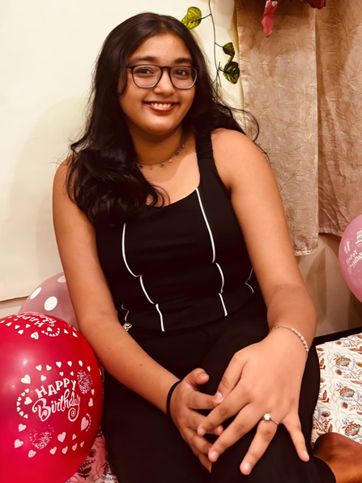
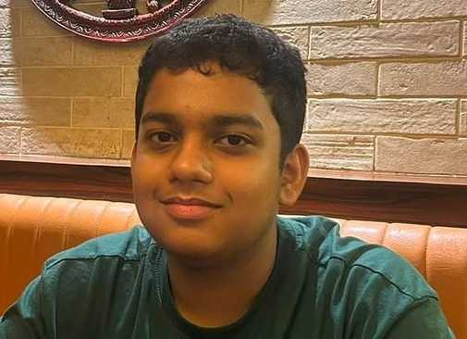
MEET THE TEAM
Krishnika Chanda (Class 11)
Design and aesthetic lead
Came up with the user interface of the app.
Ensured that app is user-friendly while being impactful.
Curated the presentation on screen.
Atreya Chakraborty (Class 10)
Ideation and development lead
Brought the core idea of the app to life.
Focused on incorporation modern solutions to modern problems.
Co-ordinated the technical implementation and real-time linkage.

Slide 3


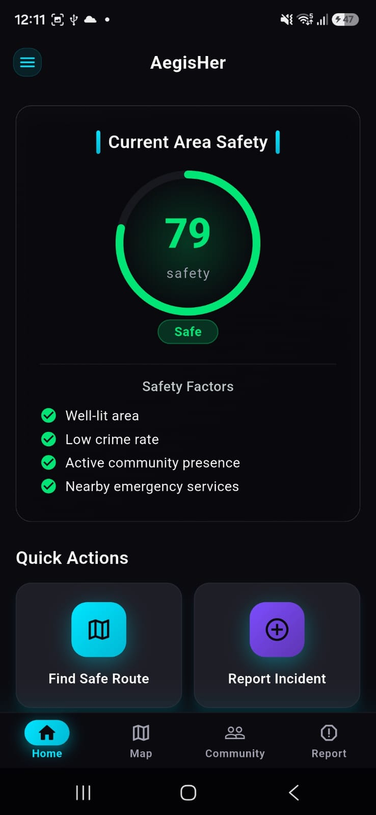
1
SOS Emergency Alert
KEY
FEATURES
Instantly send an emergency SOS alert with your location to our certified volunteers and local authorities with just one tap.
2
Live Location Sharing
Share your real-time location with family and friends so your loved ones can always track your journey and ensure your safety.
3
Trusted Contacts
A personal safety network of trusted contacts who are notified immediately in case of any emergency or distress situation.
Safety Pulse
4
Safety Pulse checks on users traveling alone. If there's no response after multiple attempts, the nearest police station is alerted.The app requires speaker permission so alerts can be heard even if the phone is on silent, preventing unnecessary emergency notifications. .

Slide 4
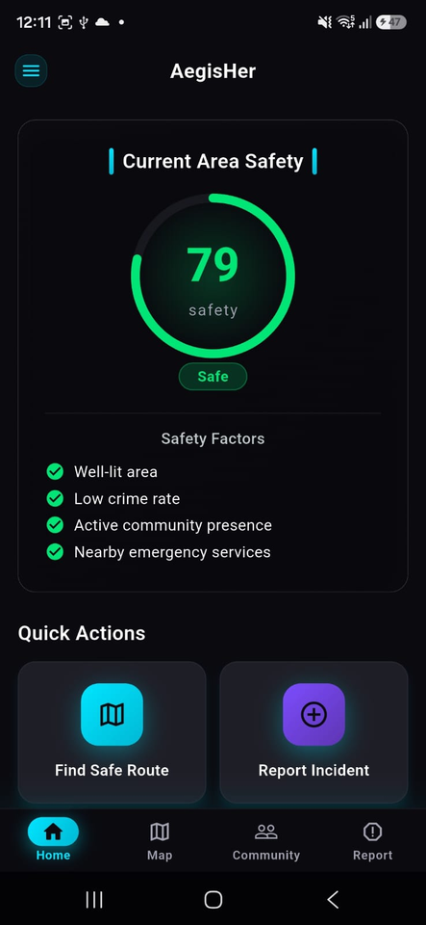
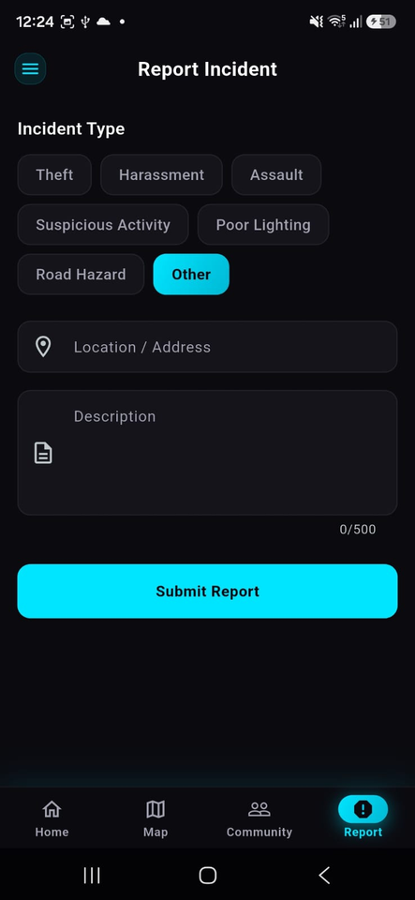
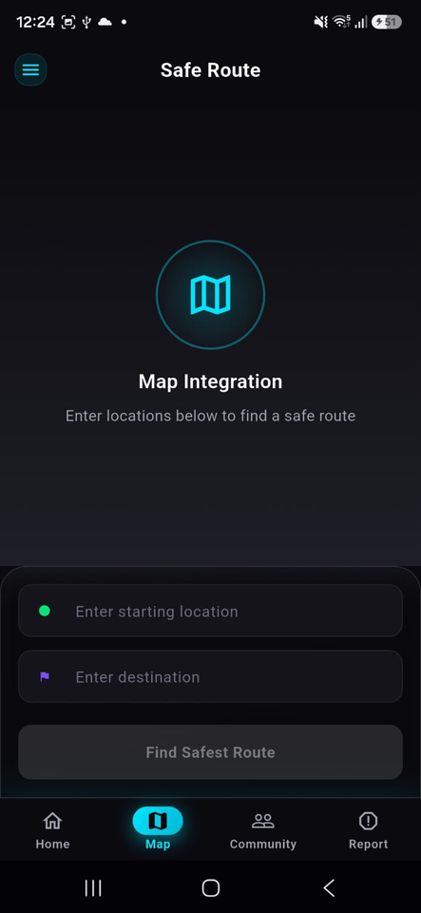
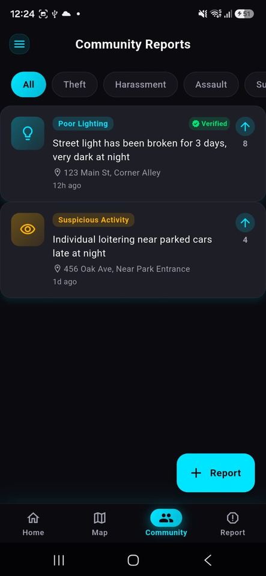
UI SNIPPETS

Slide 5
FUNCTIONALITY DETAILS
The app will constantly keep track of your location and will share it with trusted contacts in case of emergency.
The SOS alert will be present for impromptu crisis which will intimate the nearby police station and the volunteers present in that area.
The app will seek permissions for speaker access so as to implement the Safety Pulse.
In case multiple pulses are responded to, the app will alert authorities as well as your contacts.

Slide 6
IMPLEMENTATION DETAILS
A partnership with Google Maps will be made underway to improve location tracking and sharing.
Volunteers will be paid wages equal to government standards, depending on the regions which they are from.
Volunteers will be selected based on efficient usage of their skills like CPR, basic self defense and tacticality.
A minimum of 2 volunteers will be recruited within a 2 km radius from any point.
Police and other emergency services will be given data packets that contain all necessary files to recieve alerts from the app.
Permissions will be taken from the user to access contacts, location and notifications. In case of an emergency, the app will place emergency calls, that bypass all phone locks.

Slide 7
FUTURE SCOPE
High frequency sound emitter will be improved upon so as to not damage phone speakers.
A phone case with an equipped physical button will be planned to make the alerting process more efficient.
Volunteer outreach programmes will be conducted to recruit people and training sessions will be organised to educate them of basic protective and resuscitation skills.
A web of sensors and processors will be incorporated on to existing mobile towers to make the process of location tracking and sharing seamless and inclusive within the application itself.
A move to go global will be implemented to help women all arounf the globe.
A simplified version of the app will be develepoed for those who cannot afford high-end smart phones

Slide 8
DETAILS OF SOFTWARE & TOOLS
Canva → for designing
Flutter_riverpod → for app state management
Dio → for http client
Drift →for local sql db
Gemini API used for a chatbot for unaccounted situations

Slide 9
Thank you
We will be pleased to answer any of your queries & questions.

